Slide 1
MIS2502: Data Analytics Semi-structured Data Analytics
Zhe (Joe) Deng
deng@temple.edu
http://community.mis.temple.edu/zdeng

Slide 2
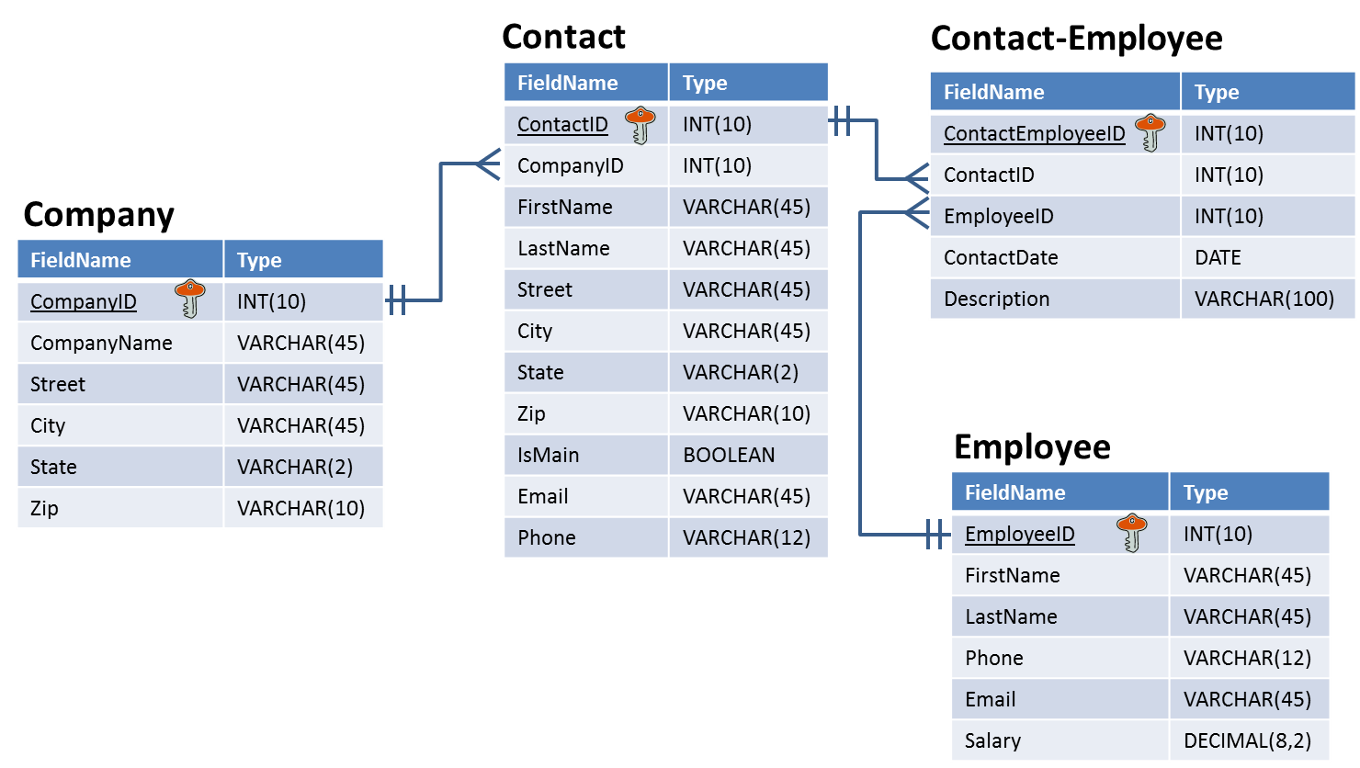
Relational databases are highly structured
Tables have the same number of fields for every record
Each field has a specified data type
Data types have a specified length and precision

Slide 3
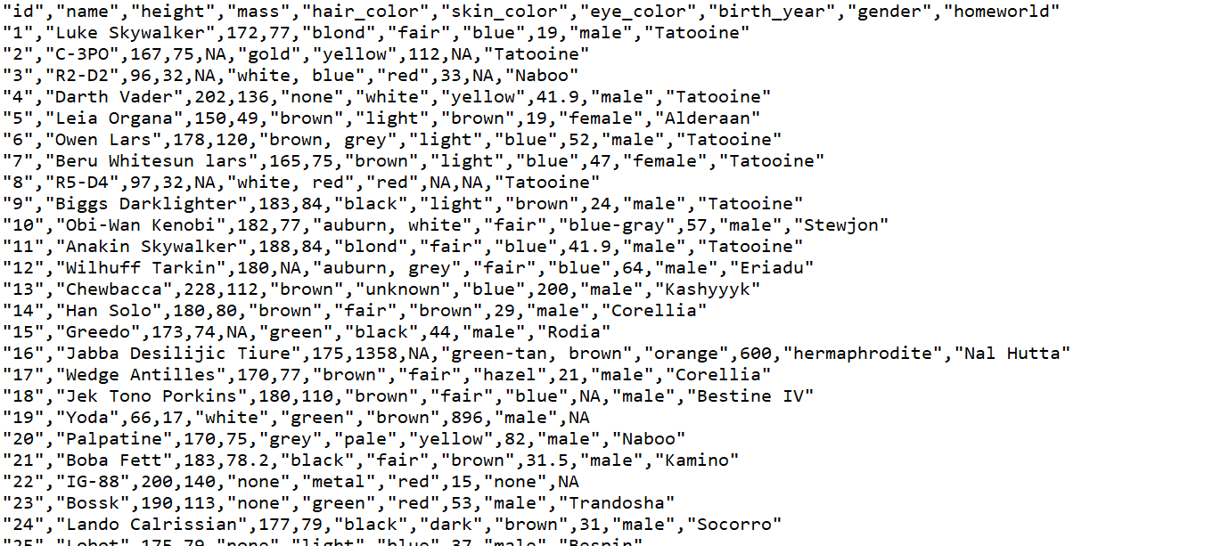
Not all data is stored like that

Slide 4
Comma-separated value (CSV) file.
Each value is separated by a comma. Other than that it is plain text.
No specified field lengths.
The first row is often the field/column names.
Recall the UCI Machine Learning Repository: http://mlr.cs.umass.edu/ml/machine-learning-databases/adult/adult.data

Slide 5
Role of quotation marks
The quotes don’t imply a data type.
Notice that the ID is in quotes but the height and mass are not.
The quotes just allow commas to be considered part of the value, not a separator.
The CSV file format is not fully standardized. The only standardized rule is the basic idea of separating fields with a comma.
This is also a valid CSV file…

Slide 6
Semi-Structured Data
Structured data
Organized according to a formal data model (i.e., relational schema)
Semi-structured data
No formal data model, but contains symbols to separate and label data elements
Unstructured data
No data model and no pre-defined organization

Slide 7
Data Examples
Structured
Semi-Structured
Unstructured
Relational databases
CSV
XML & JSON
Text documents
Images
Would you consider an Excel spreadsheet structured, semi-structured, or unstructured?

Slide 8
Why care about semi-structured and unstructured data?
Semi-structured data
Common way to transfer data between software applications
Because plain-text is universal, datasets are often posted using semi-structured formats
Unstructured data
It’s everywhere
Up to 70% to 80% of an organization’s data may be in unstructured forms (Wikipedia)

Slide 9
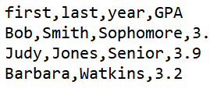
The CSV format is still quite structured
You can’t skip values in a row
You have to be careful when using commas as part of your data
…but there’s no way to create data hierarchies
Can’t make “first” and “last” part of “name”
This means the year for Watkins is 3.2…
…and she doesn’t have a GPA

Slide 10
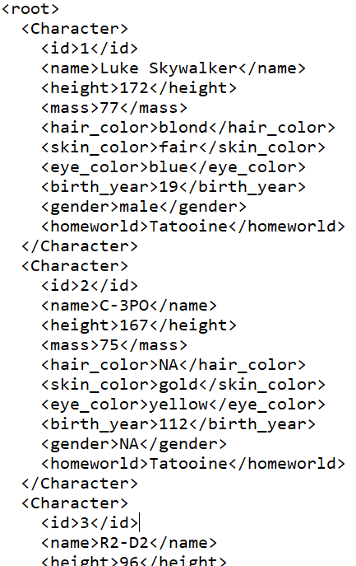
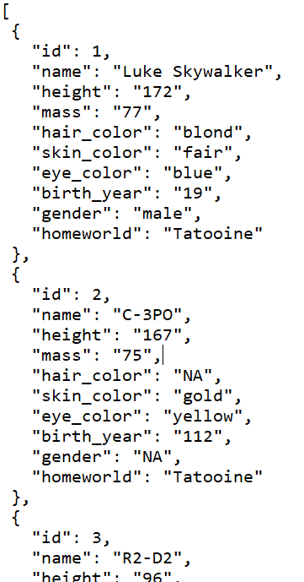
Alternatives to CSV for semi-structured data
XML
Extensible Markup Language
JSON
JavaScript Object Notation

Slide 11
Extensible Markup Language
Plain text file
Uses text for values between tags for labels <opening tag>data</closing tag> <height>172</height>
Values can be of any length
Commas and quotes are valid
Fields can be skipped… Remove <mass>75</mass> from C-3PO and skin color is still gold
Starts and ends with a tag (often <root> or <document>)

Slide 12
Hierarchies in XML
<Character>
<id>1</id>
<name>
<first>Luke</first> <last>Skywalker</last>
</name>
<height>172</height>
<mass>77</mass>
<hair_color>blond</hair_color>
<skin_color>fair</skin_color>
<eye_color>blue</eye_color>
<birth_year>19</birth_year>
<gender>male</gender>
<homeworld>Tatooine</homeworld>
</Character>
We know we can break up name into first and last
But we are also nesting it under name
So first and last are now attributes of name
Easier to find what you’re looking for and organize your data
And id, name, height, mass, etc., are all nested under Character

Slide 13
Bottom line for XML
XML is better than CSVs for semi-structured data
Allow for hierarchies
More flexible
Easier to read
But XML takes up a lot more space with all of those tags
Starwars.csv → 6,251 bytes
Starwars.xml → 28,521 bytes

Slide 14
JavaScript Object Notation
Plain text file
Organized as objects within braces { }
Uses key-value pairs
key: value or “name”: “C-3PO”
keys are field names; strings in quotes
values are the data; strings, numbers, Boolean (quotes around strings required)
a comma separates the key-value pairs
Values can be any length
Fields can be skipped
Remove “mass”: “75” from C-3PO and skin color is still gold
JSON object
JSON object

Slide 15
Hierarchies in JSON
{
"Character": {
"id": "1",
"name": {
"first": "Luke",
"last": "Skywalker"
},
"height": "172",
"mass": "77",
"hair_color": "blond",
"skin_color": "fair",
"eye_color": "blue",
"birth_year": "19",
"gender": "male",
"homeworld": "Tatooine"
}
}
We can have first and last nested as attributes of name, just like XML
And all the fields (id, name, height) are attributes of Character

Slide 16
Bottom line for JSON
Best aspects of XML and CSV
More lightweight than XML
Starwars.csv → 6,251 bytes
Starwars.xml → 28,521 bytes
Starwars.json → 21,074 bytes
Supports hierarchies like XML
JSON becoming the standard for transferring data across the web

Slide 17
Same data, four different ways…
Relational database table
XML file
JSON file
first | last | year | GPA
Bob | Smith | Sophomore | 3.4
Judy | Jones | Senior | 3.9
Barbara | Watkins | Junior | 3.2
<root>
<Person>
<first>Bob</first>
<last>Smith</last>
<year>Sophomore</year>
<GPA>3.4</GPA>
</Person>
<Person>
<first>Judy</first>
<last>Jones</last>
<year>Senior</year>
<GPA>3.9</GPA>
</Person>
<Person>
<first>Barbara</first>
<last>Watkins</last>
<year>Junior</year>
<GPA>3.2</GPA>
</Person>
</root>
[
{
"first": "Bob",
"last": "Smith",
"year": "Sophomore",
"GPA": 3.4
},
{
"first": "Judy",
"last": "Jones",
"year": "Senior",
"GPA": 3.9
},
{
"first": "Barbara",
"last": "Watkins",
"year": "Junior",
"GPA": 3.2
}
]
CSV file
first,last,year,GPA
Bob,Smith,Sophomore,3.4
Judy,Jones,Senior,3.9
Barbara,Watkins,Junior,3.2

Slide 18
JSON and Web APIs
Web Application Program Interface (API)
Software that exposes functionality through a web interface
Use the language of web software to send and receive messages (and exchange data)
Some examples

Slide 19
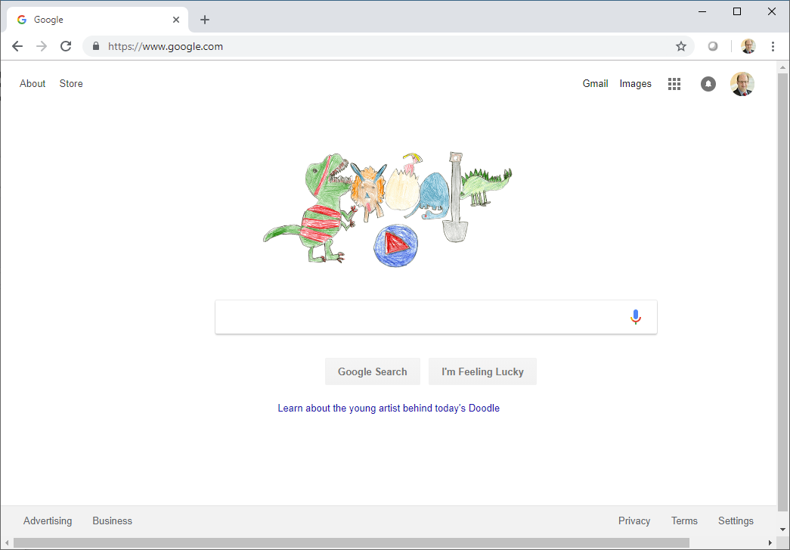
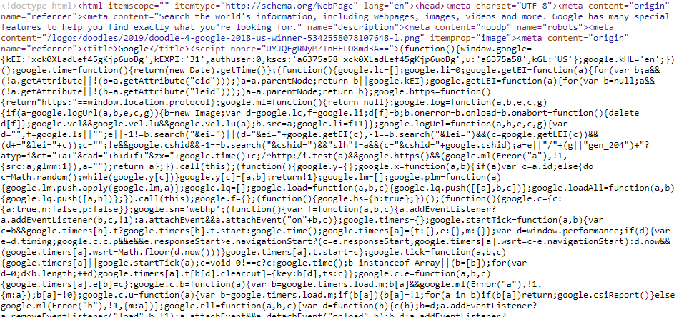
Requesting a web page
Google’s Web Server
REQUEST: http://www.google.com
RESPONSE:
which is really…
This is HTML and JavaScript and CSS. All you need to know is that the web server is sending back a lot of text that tells your web browser what to do.

Slide 20
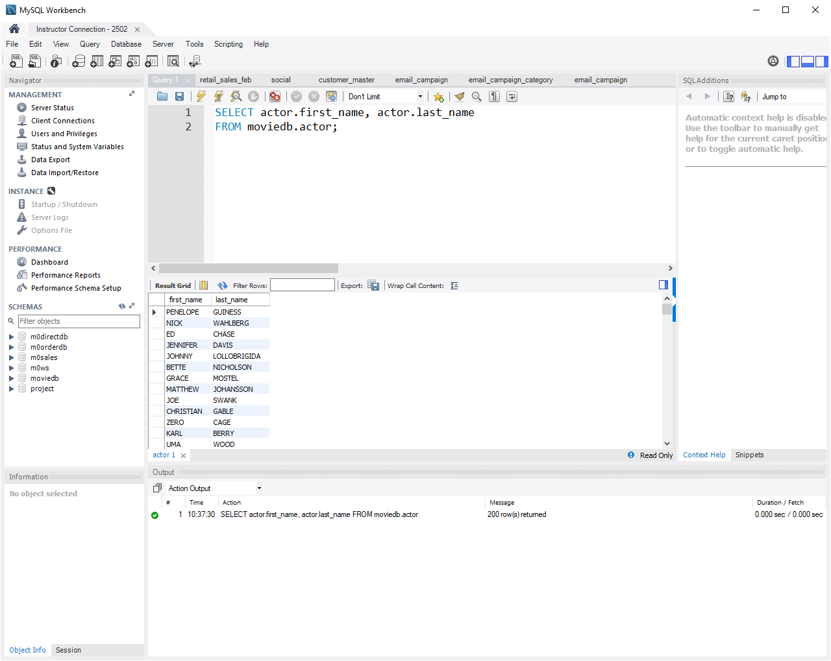
JSON and web APIs
For us, Web APIs are just a way of getting data
JSON is a popular format to package the data
MySQL Database Server
SELECT actor.first_name, actor.last_name FROM moviedb.actor;
PENELOPE GUINESS, NICK WAHLBERG, ED CHASE, JENNIFER DAVIS….
Database Server with Web API
https://swapi.co/api/people/1/?format=json
{"name":"Luke Skywalker","height":"172","mass":"77", "hair_color":"blond","skin_color":"fair“…
This works…try it!

Slide 21
Applications use APIs to communicate with each other by exchanging data
Note there is no web browser involved here!
http://api.paypal.com/payments/...
APPROVED!
Your web browser
on your phone, laptop, desktop computer
Amazon.com web server
serves the familiar web interface you know
Amazon.com application server processes orders, maintains your cart, and makes recommendations
Amazon.com database server
stores customer, product, and order data

Slide 22
JSON and data analytics
JSON is just another data format
JSON files can be read by analytics software, including R
So can CSV files
And XML files
And Excel files

