Slide 1
Assignment #2 SQL Part 1
Solution Key

Slide 2
Details You May Miss in SQL
Items to be SELECT
SELECT [TableName.]Attribute FROM <one table>
SELECT TableName.Attribute FROM <jointed multiple tables> WHERE …=…
Semicolon after SQL Statements!!!
Single quotation marks for character string: AND rating='PG’;
Use primary key-foreign key to join tables, all always use TableNames.Attribute
Query the top/bottom: Q5~Q8
Subquery!!! Tactic for complex queries (e.g. what if the MAX returns multiple rows – do have ties)Q9,Q10
Use Block and Indentation to make life easier!!!!

Slide 3
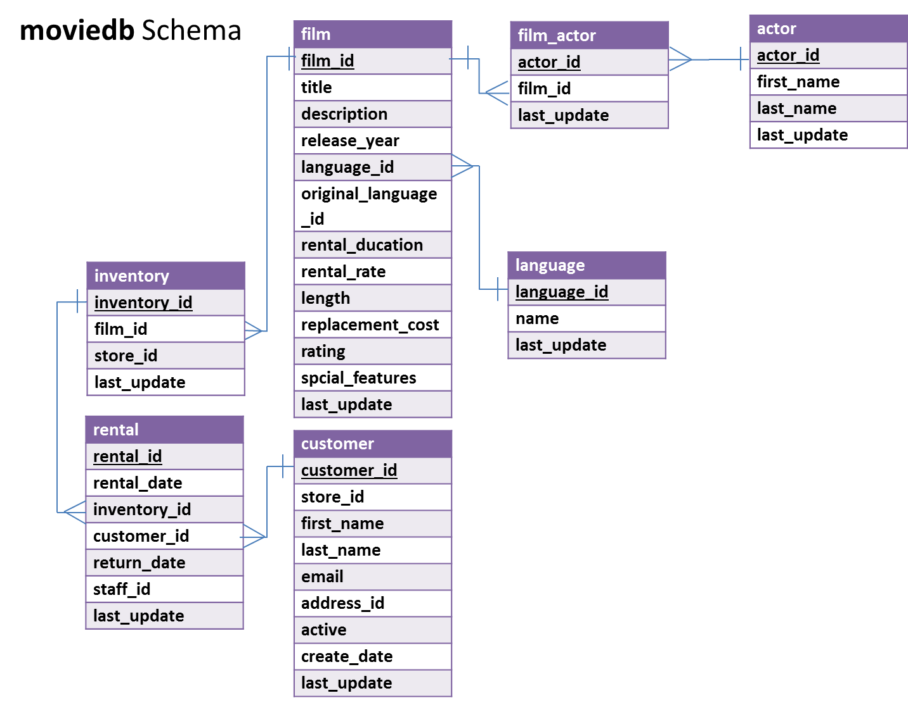

Slide 4
Q1: What are the title and length for films rated PG and longer than 180 minutes?
Query:
SELECT title, length
FROM moviedb.film
WHERE length > 180
AND rating='PG';
Answer:
MONSOON CAUSE 182
RECORDS ZORRO 182
STAR OPERATION 181
WORST BANGER 185

Slide 5
Q2: What is the average rental rate for each movie rating?
Query:
SELECT rating, AVG(rental_rate)
FROM moviedb.film
GROUP BY rating;
Answer:
G 2.888876
PG 3.051856
PG-13 3.034843
R 2.938718
NC-17 2.970952
(may be in different order)

Slide 6
Q3: How many PG movies mention ‘documentary’ in their description?
Query:
SELECT COUNT(*)
FROM moviedb.film
WHERE rating = ‘PG'
AND description LIKE ‘%documentary%';
Answer:
23

Slide 7
Q4: Who were the stars of the movie “Operation Operation”?
Query:
SELECT actor.first_name, actor.last_name
FROM moviedb.actor, moviedb.film, moviedb.film_actor
WHERE actor.actor_id = film_actor.actor_id
AND film.film_id = film_actor.film_id
AND film.title = 'Operation Operation';
Answer:
CHRISTIAN | AKROYD
ADAM | GRANT
GREGORY | GOODING

Slide 8
Q5: What are the three most popular last names among the actors in the database?
Query:(Assume no ties)
SELECT last_name, COUNT(last_name)
FROM moviedb.actor
GROUP BY last_name
ORDER BY COUNT(last_name) DESC LIMIT 3;
Note: it is also fine to use COUNT(*) or COUNT(actor_id) instead of COUNT(last_name).
Answer:
(first names my be in different orders)
KILMER | 5
TEMPLE | 4
NOLTE | 4

Slide 9
Q6: For different film ratings (i.e., G, PG, R, NC-17), which rating has the lowest average rental rate?
Query:(Assume no ties)
SELECT rating, AVG(rental_rate)
FROM moviedb.film
GROUP BY rating
ORDER BY AVG(rental_rate) LIMIT 1;
Answer:
G ($2.889)

Slide 10
Q7: Who has starred in movies in the French language? Return only the first five distinct results in alphabetical order by last name.
Query:
SELECT DISTINCT actor.first_name, actor.last_name
FROM moviedb.actor, moviedb.film, moviedb.film_actor, moviedb.`language`
WHERE actor.actor_id = film_actor.actor_id
AND film.film_id = film_actor.film_id
AND film.language_id=`language`.language_id
AND `language`.`name` = 'French'
ORDER BY actor.last_name ASC LIMIT 5;
Answer:
(first names may be in different order)
KIM | ALLEN
CUBA | ALLEN
MERYL | ALLEN
ANGELINA | ASTAIRE
RUSSELL | BACALL

Slide 11
Q8: Who has rented the fewest movies? How many movies did they rent?
Query:
SELECT customer.first_name, customer.last_name, COUNT(*) FROM moviedb.customer, moviedb.rental
WHERE rental.customer_id = customer.customer_id
GROUP BY customer.customer_id
ORDER BY COUNT(customer.customer_id)
LIMIT 1;
Answer:
BRIAN WYMAN 12

Slide 12
Q9: What is (are) the shortest G-rated movie(s) in English? And how long is it (are they)?
Query:
SELECT film.title, film.length
FROM moviedb.film, moviedb.`language`
WHERE film.language_id = `language`.language_id
AND `language`.`name`='English'
AND rating='G'
AND film.length=(
SELECT MIN(film.length)
FROM moviedb.film, moviedb.`language`
WHERE film.language_id = `language`.language_id
AND `language`.`name`='English’
AND rating='G’
);
Answer:
DIVORCE SHINING | 47
DOWNHILL ENOUGH | 47

Slide 13
Q10: What movies starring Humphrey Willis have the highest rental rate? Return both the movie titles and the rental rate.
Query:
SELECT film.title, film.rental_rate
FROM moviedb.actor, moviedb.film, moviedb.film_actor
WHERE actor.actor_id = film_actor.actor_id
AND film.film_id = film_actor.film_id
AND actor.first_name='Humphrey’
AND actor.last_name='Willis’
AND film. rental_rate =(
SELECT MAX(film. rental_rate)
FROM moviedb.actor, moviedb.film, moviedb.film_actor
WHERE actor.actor_id = film_actor.actor_id
AND film.film_id = film_actor.film_id
AND actor.first_name='Humphrey’
AND actor.last_name='Willis'
);
Answer:
FLINTSTONES HAPPINESS | 4.99
GAMES BOWFINGER | 4.99
IRON MOON | 4.99
SISTER FREDDY | 4.99
TERMINATOR CLUB | 4.99
TRAP GUYS | 4.99
WAR NOTTING | 4.99

