Slide 1



MIS2502:
Data Analytics
Advanced Analytics Using R
Zhe (Joe) Deng
deng@temple.edu
http://community.mis.temple.edu/zdeng

Slide 2


The Information Architecture of an Organization
Now we’re here…
Data entry
Transactional Database
Data extraction
Analytical Data Store
Data analysis
Stores real-time transactional data
Stores historical transactional and summary data

Slide 3
What is Advanced Data Analytics/Mining?
The examination of data or content using sophisticated techniques and tools, to
  discover deeper insights,
  make predictions, or
  generate recommendations.
Goals:
Extraction of implicit, previously unknown, and potentially useful information from data
Exploration and analysis of large data sets to discover meaningful patterns
Prediction of future events based on historical data

Slide 4
What data analytics/mining is not…
Sales analysis
How do sales compare in two different stores in the same state?
Profitability analysis
Which product lines are the highest revenue producers this year?
Sales force analysis
Did salesperson X meet this quarter’s target?
If these aren’t data mining examples, then what are they
?

Slide 5
Advanced data analytics/mining is about…
Sales analysis
Why do sales differ in two stores in the state?
Profitability analysis
Which product lines will be the highest revenue producers next year?
Sales force analysis
How much likely would the salesperson X meet next quarter’s target?

Slide 6

Example: Smarter Customer Retention
Consider a marketing manager for a brokerage
company
Problem: High churn (customers leave)
  Customers get an average reward of $160 to open an account
  40% of customers leave after the 6 month introductory period
  Giving incentives to everyone who might leave is expensive
  Getting a customer back after they leave is expensive

Slide 7


Answer: Not all customers have the same value
One month before the end of the introductory period, predict which customers will leave
Offer those customers something based on their future value
Ignore the ones that are not predicted to churn

Slide 8

Three Analytics Tasks
We Will Be Doing in this Class
Classification
(Decision Tree Approach)
Clustering Analysis
Association Rule Learning

Slide 9
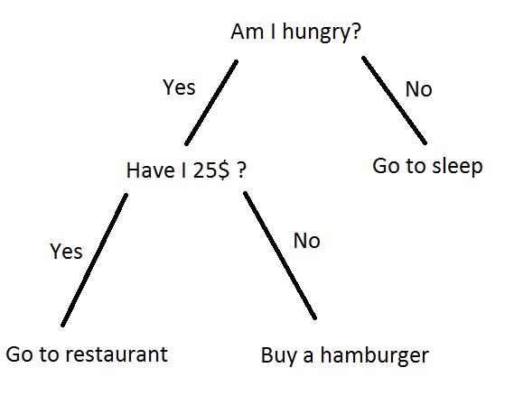
Decision Trees(To Realize Classification)
Used to classify data
according to a
pre-defined outcome
Based on characteristics
of that data
Uses
Predict whether a customer should receive a loan
Flag a credit card charge as legitimate
Determine whether an investment will pay off

Slide 10
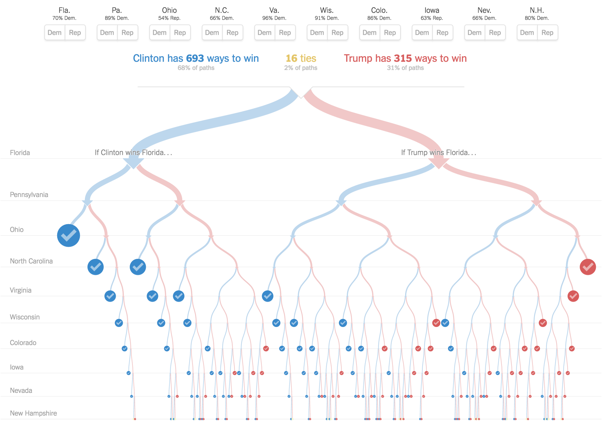

Slide 11
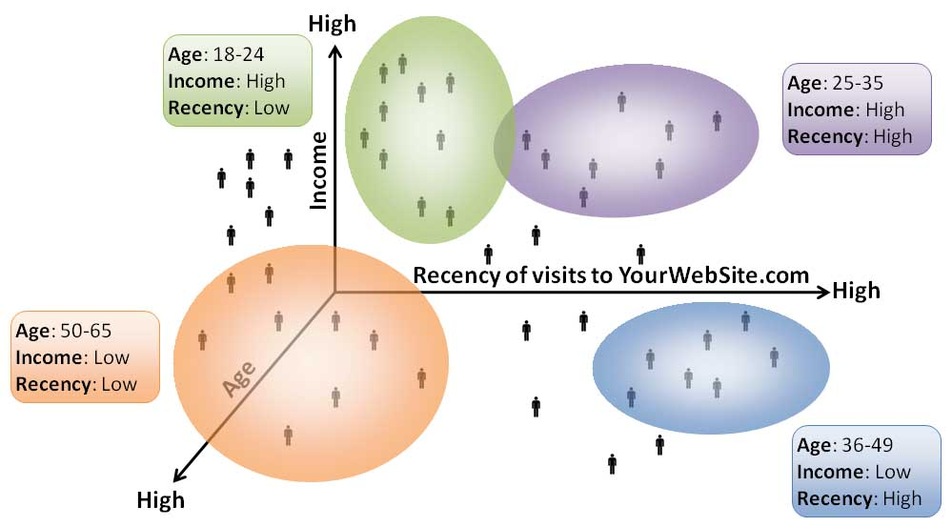
Cluster Analysis
Used to determine distinct groups of data
Based on data across multiple dimensions
Uses
Customer segmentation
Identifying patient care groups
Performance of business sectors

Slide 12
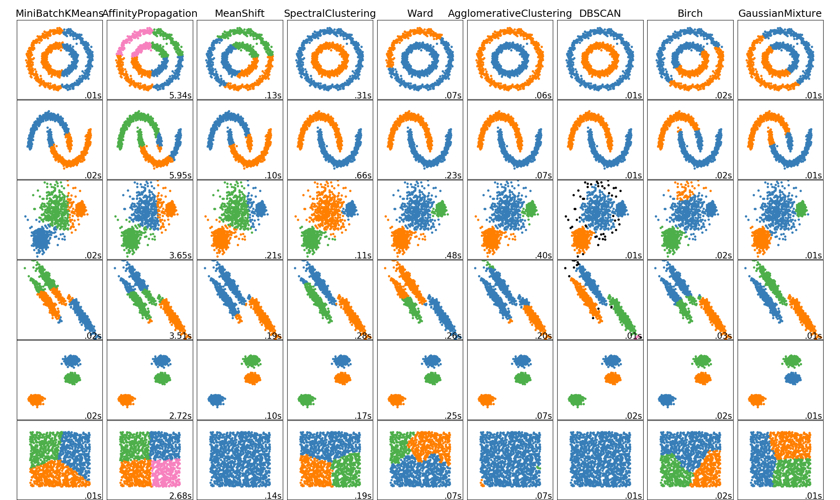

Slide 13
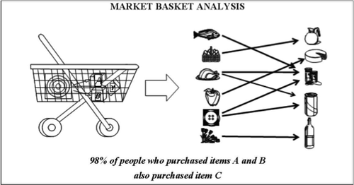
Association Rule Learning
Find out which events predict the occurrence of other events
Often used to see which products are bought together
Uses
What products are bought together?
Amazon’s recommendation engine
Telephone calling patterns

Slide 14
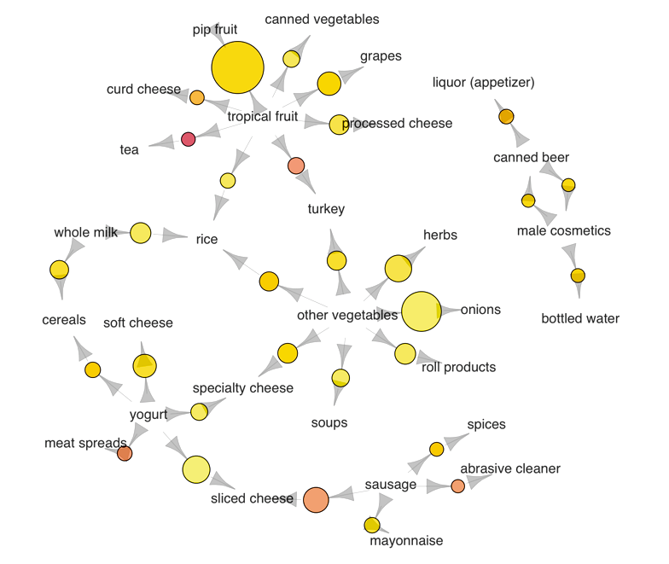

Slide 15


Introduction to R and RStudio
R has become one of the dominant language for data analysis
A large user community
Thousands of third-party packages that contribute functionality
Install R with R studio both on your computer according to the installation instruction on our website.

Slide 16
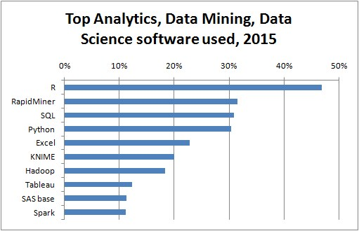
http://www.kdnuggets.com/2015/05/poll-r-rapidminer-python-big-data-spark.html

Slide 17
Software development platform and language
Open source, free
Many, many, many statistical add-on “packages” that perform data analysis
Integrated Development Environment(IDE) for R
Nicer interface that makes R easier to use
Requires R to run
After install both, you only need to interact with Rstudio
Mostly, you do not need to touch R directly

Slide 18
Environment Panel
Script Panel
Utility Panel
Console Panel

Slide 19
RStudio Interface
Script Panel
This is where the R code is shown and edited
When you open a R code file, its content shows up here
Console Panel
This is where R code is executed. Results will show up here
If there is error with your code, the error message will also show up here
Environment Panel
This is where the variables and data are displayed
It helps to keep track of the variables and data you have
Utility Panel
This window includes several tabs
Files: shows the path to your current file, not often used
Plots: if you use R to plot a graph, it will show up here
Packages: install/import packages, more on this later
Help: manuals and documentations to every R functions, very useful

Slide 20
Creating and opening a .R file
The R script is where you keep a record of your work in R/RStudio.
To create a .R file
  Click “File|New File|R Script” in the menu
To save the .R file
  click “File|Save”
To open an existing .R file
  click “File|Open File” to browse for the .R file

Slide 21
The Basics:
Calculation
Variable & Value
Function & Argument(Parameter)
Basic Data Types: Numeric, Character, Logical
Advanced Data Types: Vector, Frame
Packages
Loading data to R
  Working Directory

Slide 22
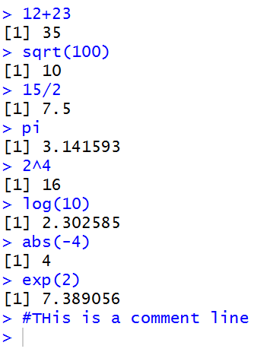
The Basics: Calculations
In its simplest form, R can be used as a calculator:
Type commands into the console and it will give you an answer

Slide 23
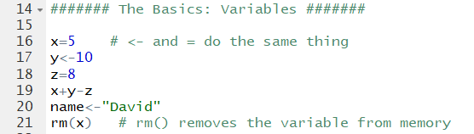
The Basics: Variable & Value
Variable & Value
Read from the right to left as “Assign [value] 5 to [variable] x”.
IDE first requires OS to allocate a segment of machine memory to store
a empty variable template called “x”, then requires OS to allocate another segment
of memory to fill a copy of the template with a value, 5.

Slide 24
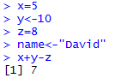
The Basics: Variable & Value
  Variables are named containers for data
  The assignment operator in R is:
  <- or =
  Variable names can start with a letter or digits.
    Just not a number by itself.
    Examples: result, x1, 2b (not 2)
  R is case-sensitive (i.e. Result is a different variable than result)
<- and = do the same thing
x, y, and z are variables that can be manipulated

Slide 25
The Basics: Function & Argument (Parameter)
Function & Argument
Function: rm(ARGUMENT). rm() here is a build-in function. You can also define your own function.
Some function are used to return a value, such as AVG() in SQL. The others are used to complete
an operation, such as this. A function can take no argument, a single argument, or multiple arguments.

Slide 26
The Basics: Function & Argument(Parameter)
sqrt(), log(), abs(), and exp() are functions.
Functions accept parameters (in parentheses) and return a value

Slide 27
Simple statistics with R
You can get descriptive statistics from a vector
> scores
[1] 65 75 80 88 82 99 100 100 50
> length(scores)
[1] 9
> min(scores)
[1] 50
> max(scores)
[1] 100
> mean(scores)
[1] 82.11111
> median(scores)
[1] 82
> sd(scores)
[1] 17.09857
> var(scores)
[1] 292.3611
> summary(scores)
Min. 1st Qu. Median Mean 3rd Qu. Max.
50.00 75.00 82.00 82.11 99.00 100.00
Again, length(), min(), max(), mean(), median(), sd(), var() and summary() are all functions.
These functions accept vectors as parameter.

Slide 28
The Basics: Basic Data Types
Type | Range | Assign a Value
Numeric | Numbers | X <-1 Y <- -2.5
Character | Text strings | name<-"Mark" color<-"red"
Logical (Boolean) | TRUE or FALSE | female<-TRUE

Slide 29
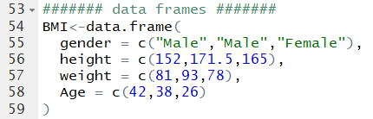
The Basics: Advanced Data Types – Vector & Data Frame
Vectors
  Vector: a combination of elements (i.e. numbers, words) of the same basic type, usually created using c(), seq(), or rep()
Data frames
  Data frame: a table consist of one or more vectors

Slide 30
Vector Examples
> scores<-c(65,75,80,88,82,99,100,100,50)
> scores
[1] 65 75 80 88 82 99 100 100 50
> studentnum<-1:9
> studentnum
[1] 1 2 3 4 5 6 7 8 9
> ones<-rep(1,4)
> ones
[1] 1 1 1 1
> names<-c("Nikita","Dexter","Sherlock")
> names
[1] "Nikita" "Dexter" "Sherlock"
c() and rep() are functions

Slide 31
Indexing Vectors
We use brackets [ ] to pick specific elements in the vector.
In R, the index of the first element is 1
> scores
[1] 65 75 80 88 82 99 100 100 50
> scores[1]
[1] 65
> scores[2:3]
[1] 75 80
> scores[c(1,4)]
[1] 65 88

Slide 32
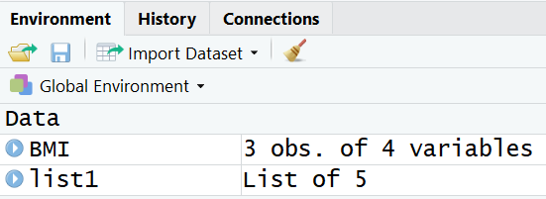
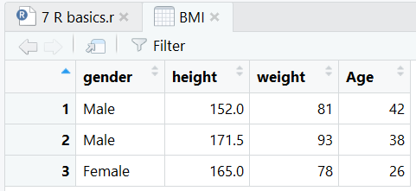
Data Frames
A data frame is a type of variable used for storing data tables
  is a special type of list where every element of the list has same length (i.e. data frame is a “rectangular” list or table)
> BMI<-data.frame(
+ gender = c("Male","Male","Female"),
+ height = c(152,171.5,165),
+ weight = c(81,93,78),
+ Age = c(42,38,26)
+ )
> BMI
gender height weight Age
1 Male 152.0 81 42
2 Male 171.5 93 38
3 Female 165.0 78 26
> nrow(BMI)
[1] 3
> ncol(BMI)
[1] 4

Slide 33
Identify elements of a data frame
To retrieving cell values
> BMI[1,3]
[1] 81
> BMI[1,]
gender height weight Age
1 Male 152 81 42
> BMI[,3]
[1] 81 93 78
More ways to retrieve columns as vectors
> BMI[[2]]
[1] 152.0 171.5 165.0
> BMI$height
[1] 152.0 171.5 165.0
> BMI[["height“]]
[1] 152.0 171.5 165.0

Slide 34
The Basics: Packages
Packages (add-ons) are collections of R functions and code in a well-defined format.
To install a package:
  install.packages("pysch")
For every new R session (i.e., every time you re-open Rstudio), you must load the package before it can be used
    library(psych)
  or
    require(psych)
Each package only needs to be installed once
Must load for every new R session

Slide 35
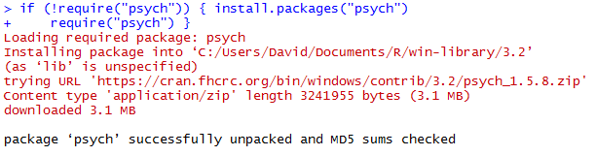
Packages
Downloads and installs the package
(once per R installation)

Slide 36
The Basics: Loading Data into R
R can handle all kinds of data files. We will mostly deal with csv files
Use read.csv() function to import csv data
  You need to specify path to the data file
  By default, comma is used as field delimiter
  First row is used as variable names
  You can simply do this by
  Download source file and csv file into the same folder (i.e., C:\RFiles).
  Set that folder as working directory by assigning source file location as working directory
Very Important!!!

Slide 37
Working directory
The working directory is where Rstudio will look first for scripts and files
Keeping everything in a self contained directory helps organize code and analyses
Check you current working directory with
  getwd()

Slide 38
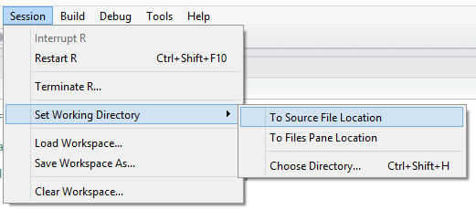
To change working directory
Use the Session | Set Working Directory Menu
  If you already have an .R file open, you can select “Set Working Directory>To Source File Location”.

Slide 39
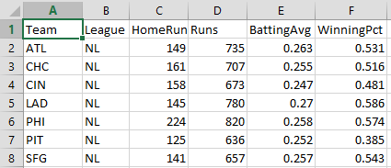
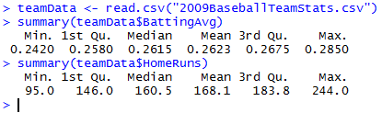
Loading data from a file
Usually you won’t type in data manually, you’ll get it from a file
Example: 2009 Baseball Statistics
(http://www2.stetson.edu/~jrasp/data.htm)
reads data from a CSV file and creates a data frame called teamData that store the data table.
reference the HomeRuns column in the data frame using TeamData$HomeRuns

Slide 40
More On Loading Datasets
Suppose you want to load a dataset called “MIS2502”.
If the dataset is in
an existing R package, load the package and type data(MIS2502)
.RData format, type load(MIS2502)
.txt or other text formats, type read.table("MIS2502.txt")
.csv format, type read.csv("MIS2502.txt")
.dta (Stata) format, load the foreign library and type read.dta(“MIS2502.dta")
Remember “function & argument” in the first part
To save objects into these formats, use the equivalent
write.table(), write.csv(), etc. commands.

Slide 41
The Basics: Summary
Calculation
Variable & Value
Function & Argument(Parameter)
Basic Data Types: Numeric, Character, Logical
Advanced Data Types: Vector, Frame
Packages
Loading data to R
  Working Directory

Slide 42
Analysis Examples
Student t-Test: Compare means
Histogram
Plotting data

Slide 43
Analysis Example: [Student] t-Test
Compare differences across groups:
We want to know if National League (NL) teams scored more runs than American League (AL) Teams
  And if that difference is statistically significant
To do this, we need a package that will do this analysis
  In this case, it’s the “psych” package
Downloads and installs the package
(once per R installation)

Slide 44
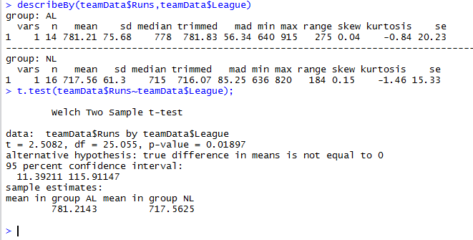
t-Test: Compare Differences Across Groups
describeby(teamData$Runs, teamData$League)
Variable of interest (Runs)
Broken up by group (League)
Results of t-test for differences in Runs by League

Slide 45
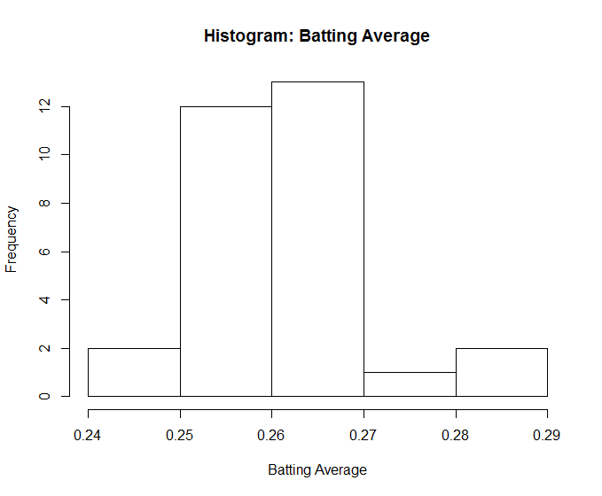
Analysis Example: Histogram
hist(teamData$BattingAvg,
xlab="Batting Average",
main="Histogram: Batting Average")
hist()
first parameter – data values
xlab parameter – label for x axis
main parameter - sets title for chart

Slide 46
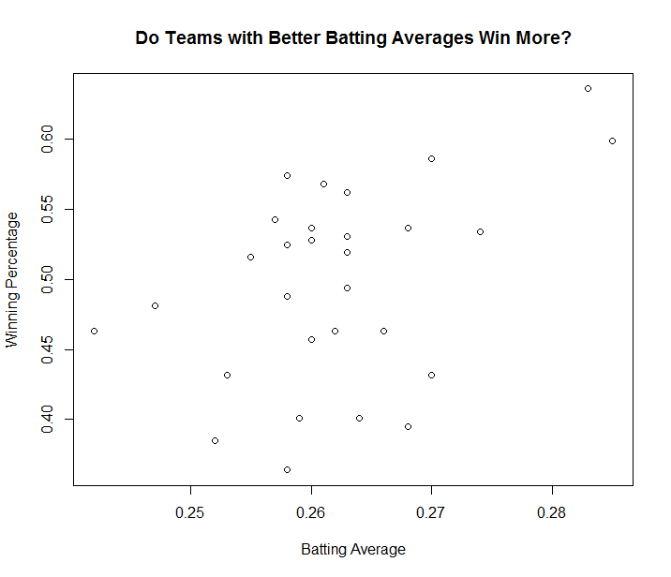
Analysis Example: Plotting data
plot(teamData$BattingAvg,teamData$WinningPct,
xlab="Batting Average",
ylab="Winning Percentage",
main="Do Teams With Better Batting Averages Win More?")
plot()
first parameter – x data values
second parameter – y data values
xlab parameter – label for x axis
ylab parameter – label for y axis
main parameter - sets title for chart

Slide 47
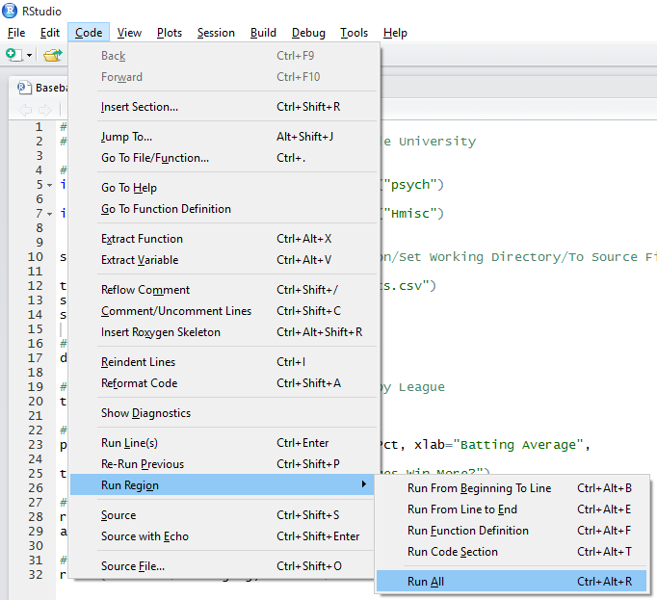
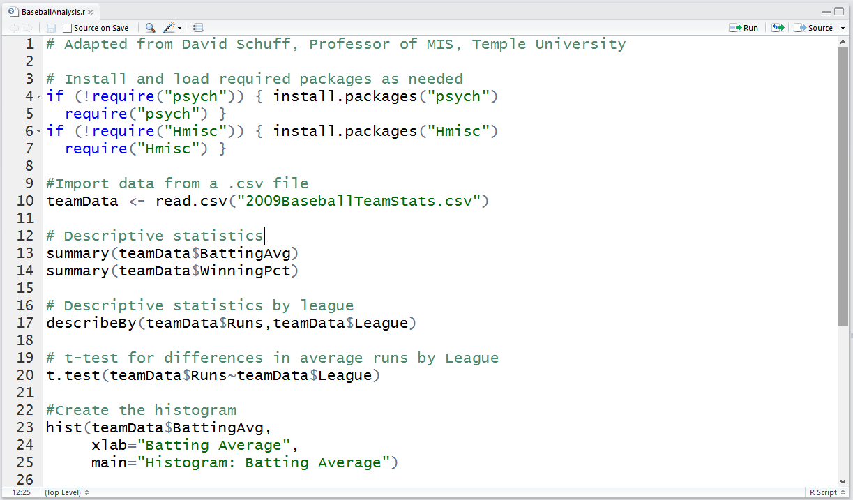
Execute the script
Use the Code | Run Region | Run All Menu
Commands can be entered one at a time, but usually they are all put into a single file that can be saved and run over and over again.

Slide 48
Getting help
help.start() | general help
help(mean) | help about function mean()
?mean | same. Help about function mean()
example(mean) | show an example of function mean()
help.search("regression") | get help on a specific topic such as regression.

Slide 49
Online Tutorials
If you’d like to know more about R, check these out:
  Quick-R (http://www.statmethods.net/index.html)
  R Tutorial (http://www.r-tutor.com/r-introduction)
  Learn R Programing (https://www.tutorialspoint.com/r/index.htm)
  Programming with R (https://swcarpentry.github.io/r-novice-inflammation/
There is also an interactive tutorial to learn R basics, highly recommended! (http://tryr.codeschool.com/)

Slide 50
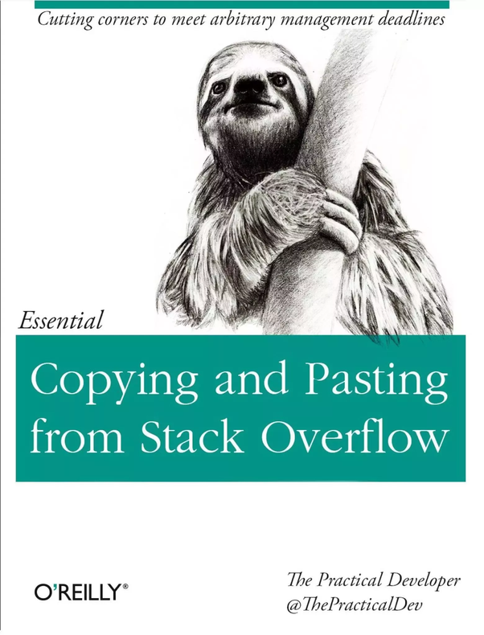

Slide 51


Time for our 9th ICA!

