Slide 1



MIS2502:
Data Analytics
Statistics Review
Descriptive Statistics and Hypothesis Testing
Zhe (Joe) Deng
deng@temple.edu
http://community.mis.temple.edu/zdeng

Slide 2


The Information Architecture of an Organization
Now we’re here…
Data entry
Transactional Database
Data extraction
Analytical Data Store
Data analysis
Stores real-time transactional data
Stores historical transactional and summary data

Slide 3
Descriptive Statistics
Tools for summarizing, organizing, and simplifying data
What data tells us about the population
  Measures of Central Tendency
  Measures of Dispersion
  Correlation
  Tables & Graphs

Slide 4
Descriptive Statistics
Tools for summarizing, organizing, and simplifying data
What data tells us about the population
  Measures of Central Tendency
  Measures of Dispersion
  Correlation
  Tables & Graphs

Slide 5
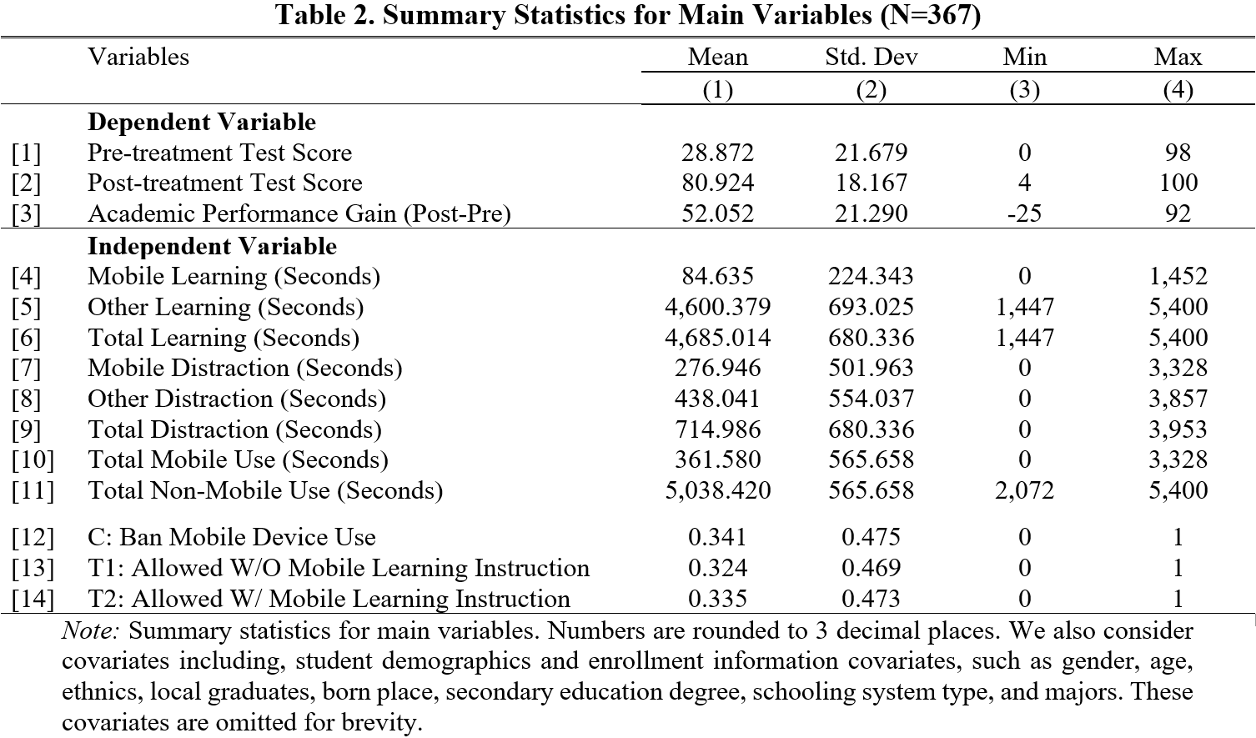
Sample from one of my working papers.

Slide 6
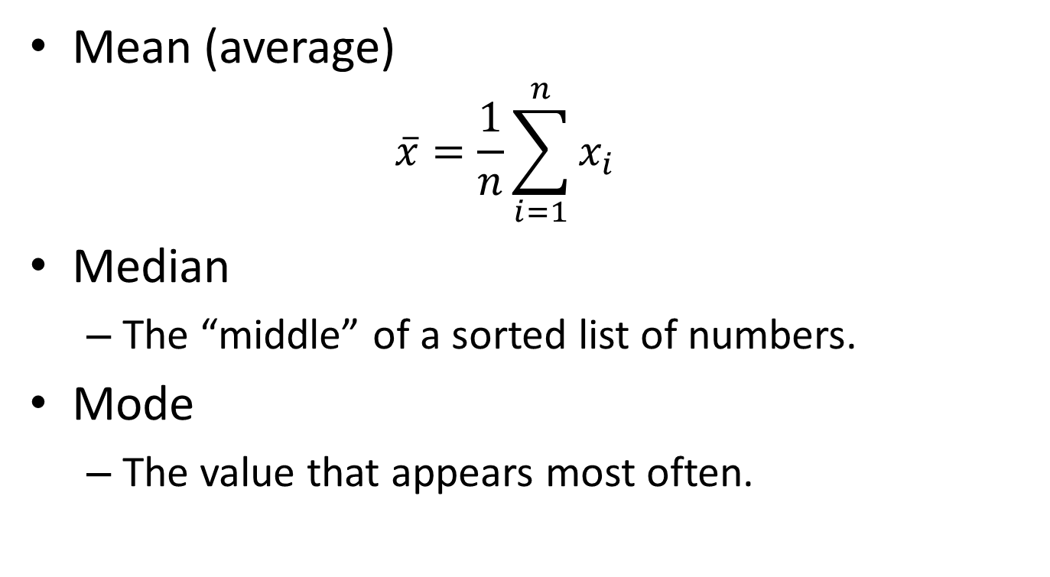
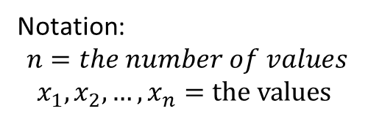
Central tendency
Mean (average)
  $$\overline{x}=\frac{1}{n}\sum_{i=1}^{n}{x_{i}}$$
Median
  The “middle” of a sorted list of numbers.
Mode
  The value that appears most often.
Notation:
$$n=the number of values$$
$$x_{1}, x_{2}, …, x_{n}=the values$$

Slide 7

Dispersion
Range
  i.e. max - min
Variance
  $$s^{2}=\frac{1}{n−1}\sum_{i=1}^{n}{{\left(x_{i}−\overline{x}\right)}^{2}}$$
Standard deviation
$$s=\sqrt{\frac{1}{n−1}\sum_{i=1}^{n}{{\left(x_{i}−\overline{x}\right)}^{2}}}$$

Slide 8
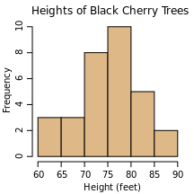
Histogram
A histogram is a graphical representation of the distribution of data.

Slide 9
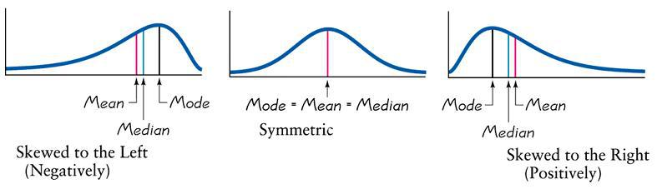
Skewness
Skewness is a measure of the asymmetry of the distribution.
http://rchsbowman.wordpress.com/2010/08/30/statistics-notes-the-shape-of-distributions/

Slide 10
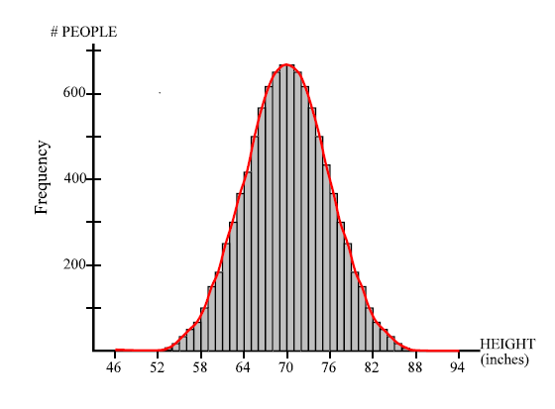
Normal Distribution
Symmetric
Bell-shaped

Slide 11
Correlation
The degree to which two variables have a tendency to vary together
  Can be positive or negative
  Range: -1 to +1, 0 means no correlation
Example 1: The more you study, the better you do on the exam
(Positive Correlation)
Example 2: The more I talk about correlation, the less you want to be here (Negative Correlation)

Slide 12
Sample vs. Population
Population
Sample

Slide 13
Learning from Sample
?
Population
Sample

Slide 14
Big Data
Population=Sample

Slide 15
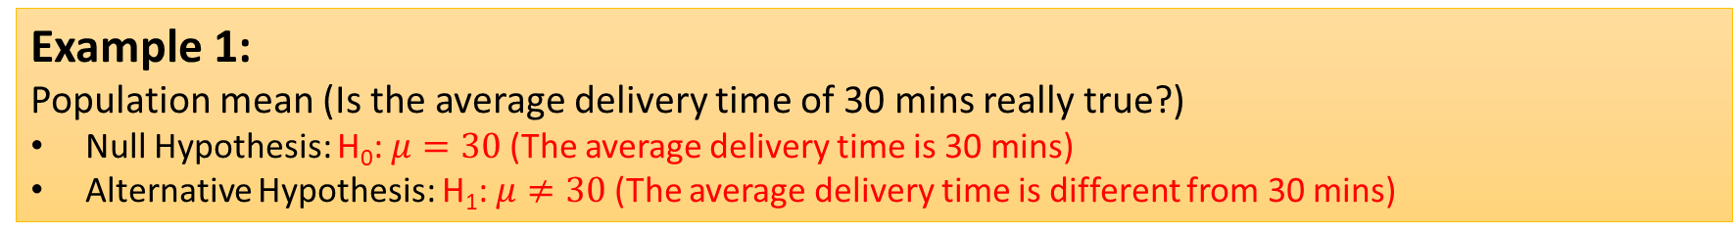
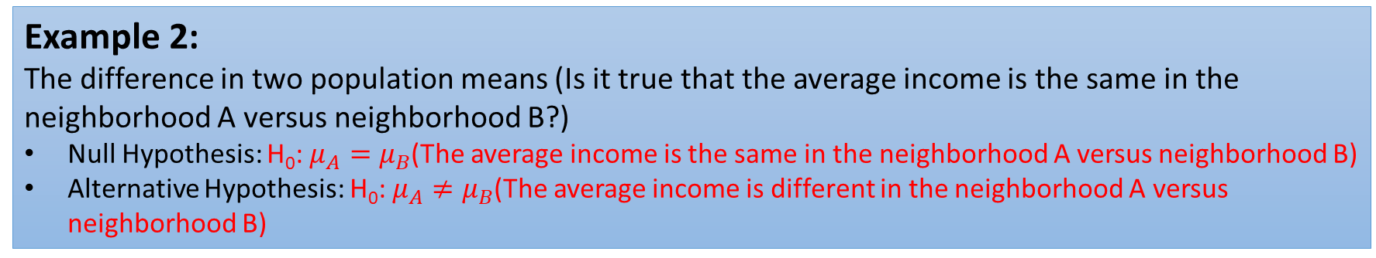
Hypothesis testing
Hypothesis Testing: A technique for using data to validate/invalidate a claim about a population.
Example 1:
Population mean (Is the average delivery time of 30 mins really true?)
Null Hypothesis: H₀: $μ=30$ (The average delivery time is 30 mins)
Alternative Hypothesis: H₁: $μ≠30$ (The average delivery time is different from 30 mins)
Example 2:
The difference in two population means (Is it true that the average income is the same in the neighborhood A versus neighborhood B?)
Null Hypothesis: H₀: $μ_{A}=μ_{B}$(The average income is the same in the neighborhood A versus neighborhood B)
Alternative Hypothesis: H₀: $μ_{A}≠μ_{B}$(The average income is different in the neighborhood A versus neighborhood B)

Slide 16
Steps in Hypothesis Testing
State the Null hypothesis.
State the Alternative hypothesis.
Calculate the test statistics and p-values.
Decision rule for rejection of the Null hypothesis using p-values.
Source: Wissel, et al (2001)

Slide 17
p-Value
Hypothesis testing uses p-values to weigh the strength of the evidence against the null hypothesis (what the data are telling you about the population).
The p-value is a number between 0 and 1.
A small p-value (typically ≤ 0.05) indicates strong evidence against the null hypothesis, so you reject the null hypothesis.
A large p-value (> 0.05) indicates weak evidence against the null hypothesis, so you fail to reject the null hypothesis.

Slide 18
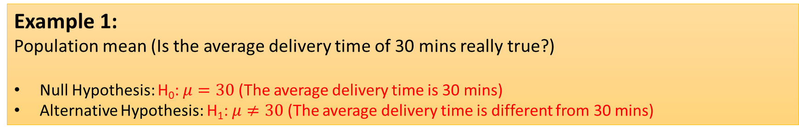
Back to Example 1
Example 1:
Population mean (Is the average delivery time of 30 mins really true?)
Null Hypothesis: H₀: $μ=30$ (The average delivery time is 30 mins)
Alternative Hypothesis: H₁: $μ≠30$ (The average delivery time is different from 30 mins)
If p-value ≤ 0.05, you reject the null hypothesis. Therefore, the average delivery time is statistically different from 30 mins.
If p-value> 0.05, you fail to reject the null hypothesis. Therefore, there is insufficient evidence to conclude that the average delivery time is different from 30 mins.

Slide 19
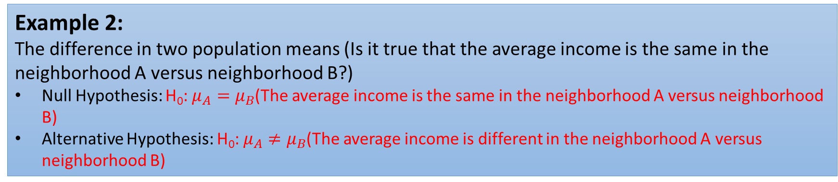
Back to Example 2
Example 2:
The difference in two population means (Is it true that the average income is the same in the neighborhood A versus neighborhood B?)
Null Hypothesis: H₀: $μ_{A}=μ_{B}$(The average income is the same in the neighborhood A versus neighborhood B)
Alternative Hypothesis: H₀: $μ_{A}≠μ_{B}$(The average income is different in the neighborhood A versus neighborhood B)
If p-value ≤ 0.05, you reject the null hypothesis. Therefore, The average income is significantly different in the neighborhood A versus neighborhood B.
If p-value> 0.05, you fail to reject the null hypothesis. Therefore, there is insufficient evidence that the average income is different in the neighborhood A versus neighborhood B.

