Slide 1



MIS2502:
Data Analytics
Principles of Data Visualization
Zhe (Joe) Deng
deng@temple.edu
http://community.mis.temple.edu/zdeng

Slide 2
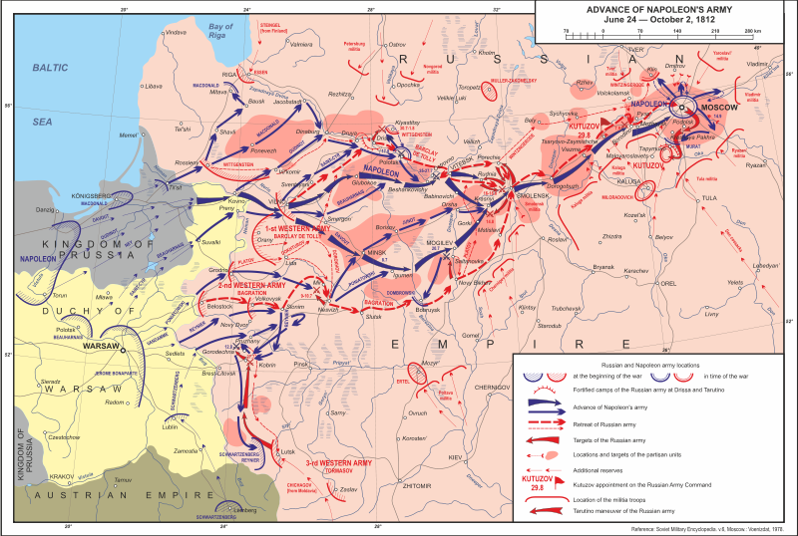
What makes a good chart?
Wikipedia: Patriotic War of 1812
http://en.wikipedia.org/wiki/File:Patriotic_War_of_1812_ENG_map1.svg

Slide 3
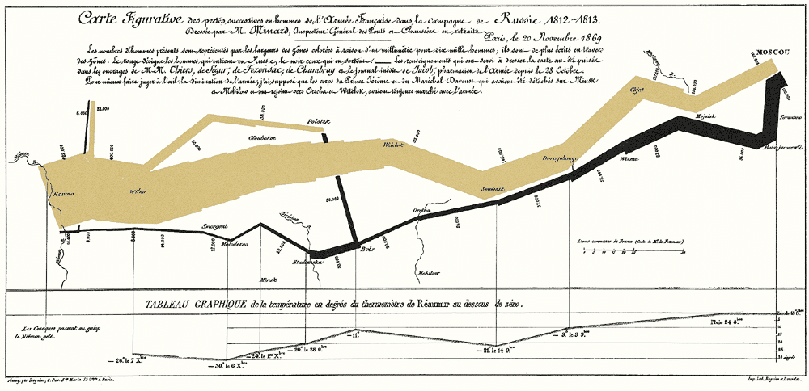

What makes a good chart?
Minard’s map of Napoleon’s campaign into Russia, 1869
Reprinted in Tufte (2009), p. 41

Slide 4
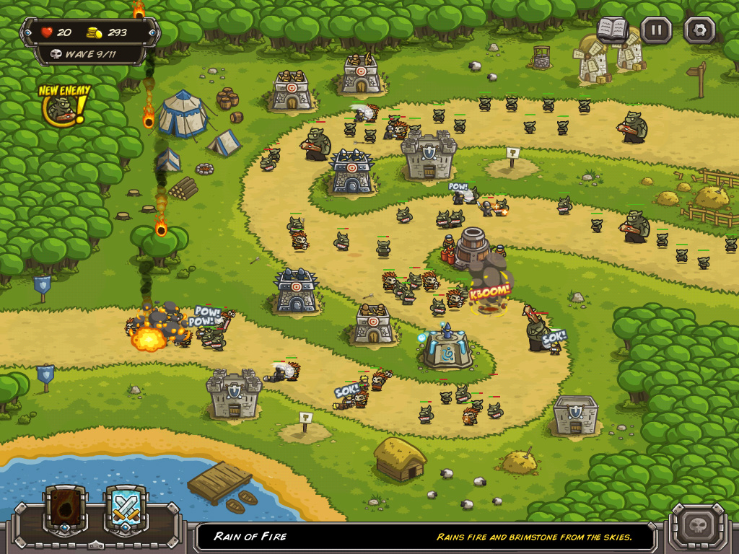
Video Games do this well…
Notes:
From the game “Pikmin 3”

Slide 5
Data visualization can:
provide clear understanding of patterns in data
detect hidden structures in data
condense information

Slide 6
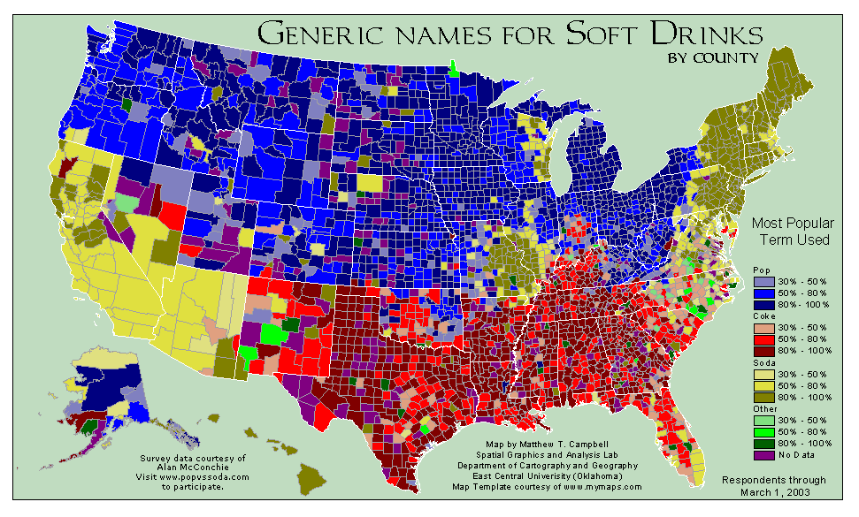
What can you learn from this map?
http://www.popvssoda.com/countystats/total-county.html

Slide 7
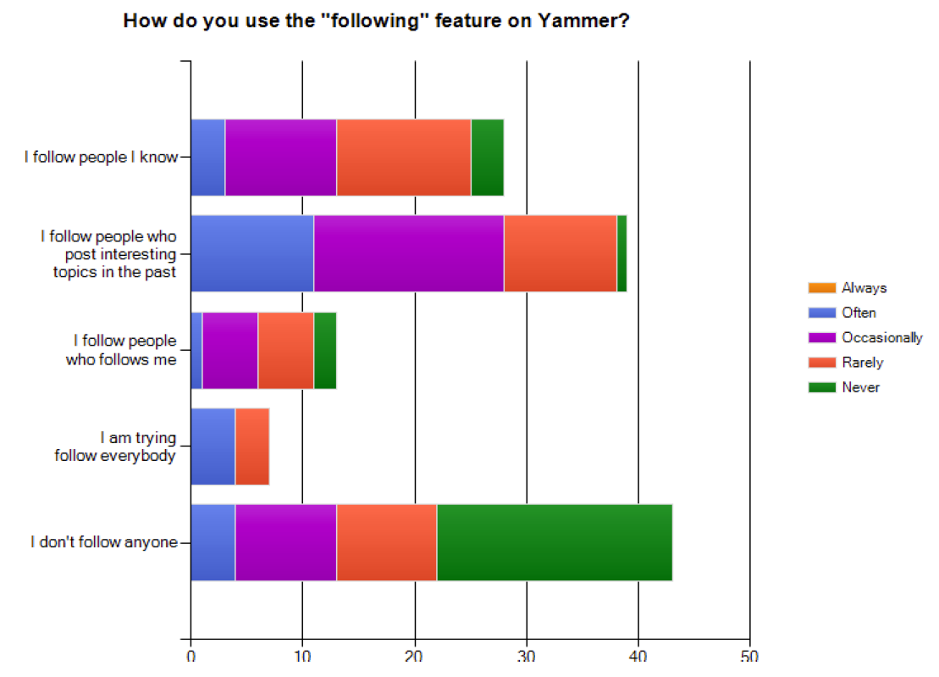
What makes a good chart?
This is from an academic conference paper.
What are the problems with this chart?
Zhang et al. (2010), “A case study of micro-blogging in the enterprise: use, value, and related issues,” Proceedings of the 28th International Conference on Human Factors in Computing Systems.
Notes:
The legend is for how often they find relevant information (given their “following” behavior”)

Slide 8
Some basic principles (adapted from Tufte 2009)
1
2
3
The chart should tell a story
The chart should have graphical integrity
The chart should minimize graphical complexity
Tufte’s fundamental principle:
Above all else show the data

Slide 9
Principle 1: The chart should tell a story
Graphics should be clear on their own
The chart should yield insight beyond the text
“If the statistics are boring, then you’ve got the wrong numbers.” (Tufte 2009)
The depictions should enable meaningful comparison

Slide 10
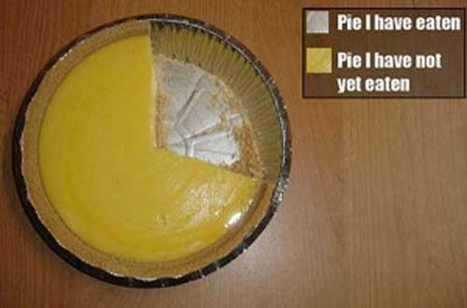
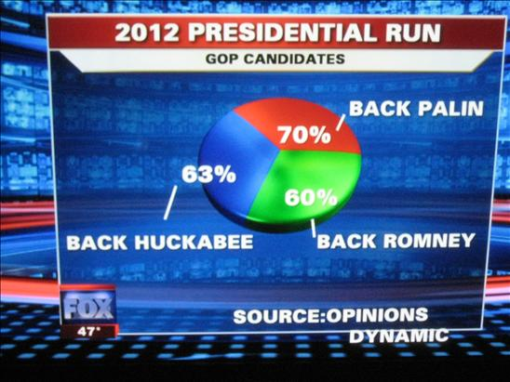
Do these tell a story?
http://www.evl.uic.edu/aej/491/week03.html
http://flowingdata.com/2009/11/26/fox-news-makes-the-best-pie-chart-ever/

Slide 11
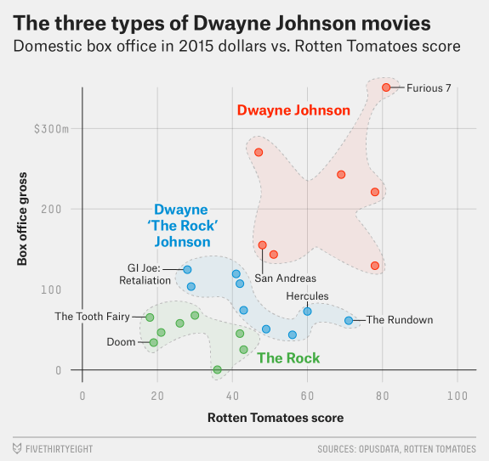
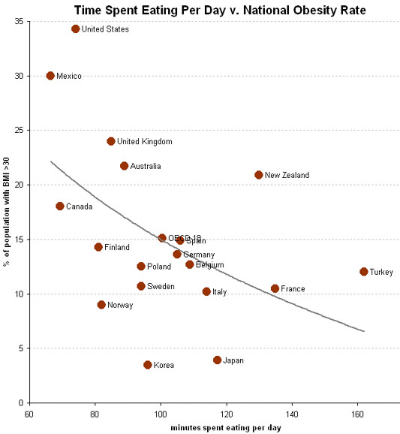
Telling a Story
http://fivethirtyeight.com/features/the-three-types-of-dwayne-the-rock-johnson-movies/
http://economix.blogs.nytimes.com/2009/05/05/obesity-and-the-fastness-of-food/

Slide 12
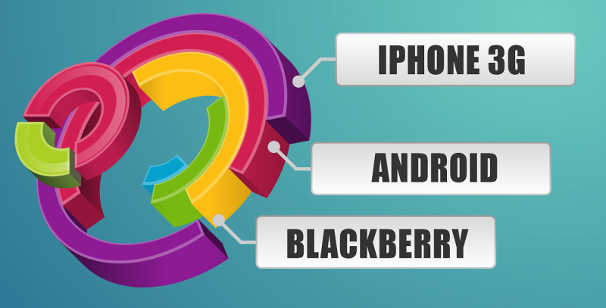
Does it tell a good story?
http://gizmodo.com/8-horrible-data-visualizations-that-make-no-sense-1228022038

Slide 13

Principle 2: The chart should have graphical integrity
Basically, it shouldn’t “lie” (mislead the reader)
Tufte’s “Lie Factor”:
  $Lie Factor=\frac{size of effect shown in graphic }{size of effect in data}$
Should be ~ 1
< 1 = understated effect
> 1 = exaggerated effect

Slide 14
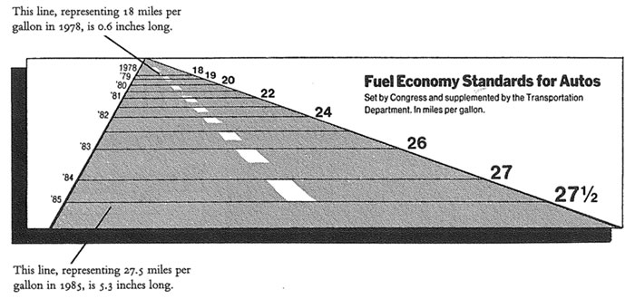
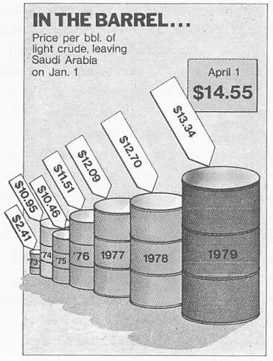
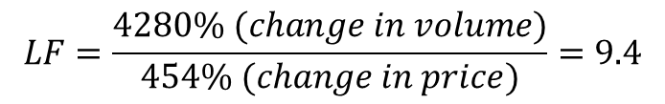
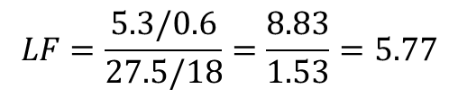
Examples of the “lie factor”
$$LF=\frac{5.3/0.6}{27.5/18}=\frac{8.83}{1.53}=5.77$$
Reprinted from Tufte (2009), p. 57 & p. 62
$$LF=\frac{4280\% (change in volume)}{454\% (change in price)}=9.4$$

Slide 15
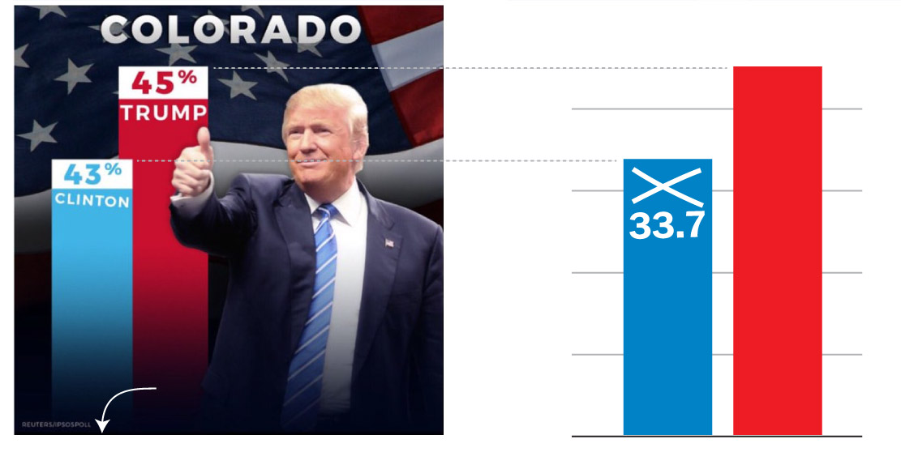
How might this be misleading?
The original graphic from President Trump’s tweet.
(Look at the y-axis)
Does the scale match the numbers?
https://www.washingtonpost.com/graphics/politics/2016-election/trump-charts/

Slide 16
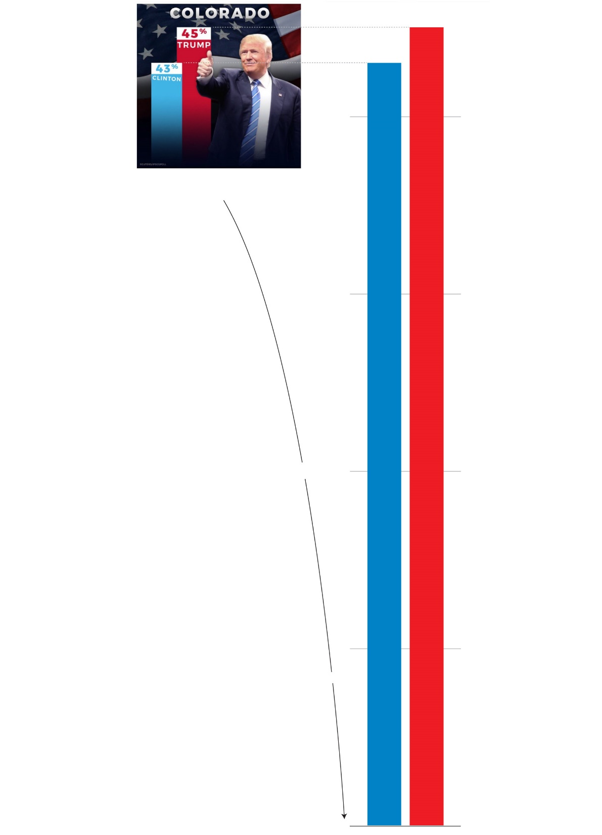
Where would the real baseline end up?
45
43
https://www.washingtonpost.com/graphics/politics/2016-election/trump-charts/

Slide 17
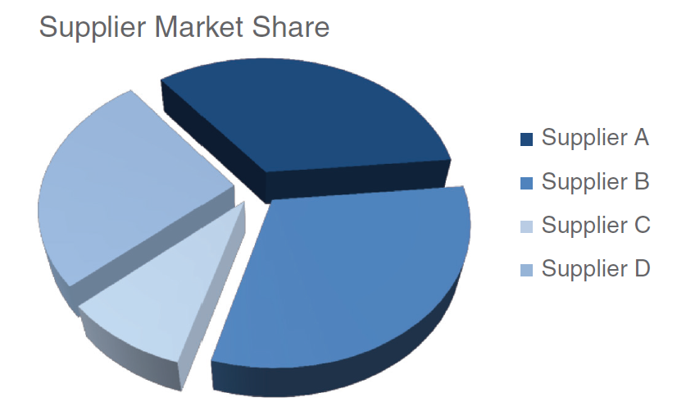
3D Pie Chart: which supplier is the largest?
Source: Knaflic (2015). Storytelling with Data: A Data Visualization Guide for Business Professionals. Chapter 2.

Slide 18
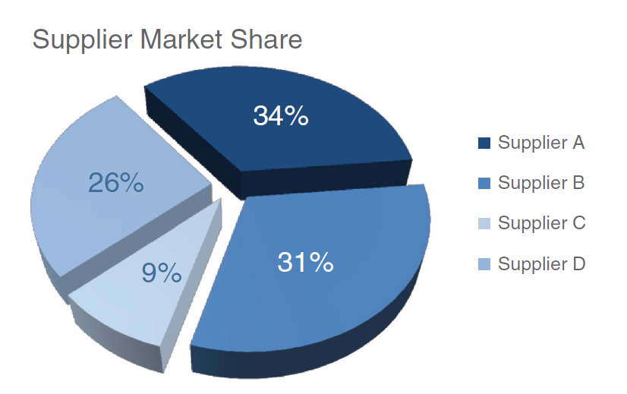
3D Pie Chart: which supplier is the largest?
Supplier B—which looks largest, at 31%—is actually smaller than Supplier A, at 34%!
Source: Knaflic (2015). Storytelling with Data: A Data Visualization Guide for Business Professionals. Chapter 2.

Slide 19
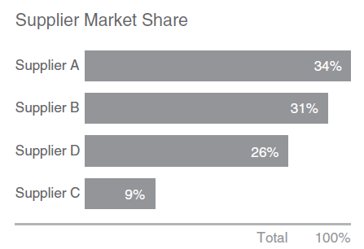
Use a bar chart instead

Slide 20
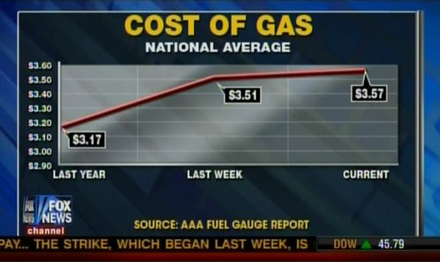
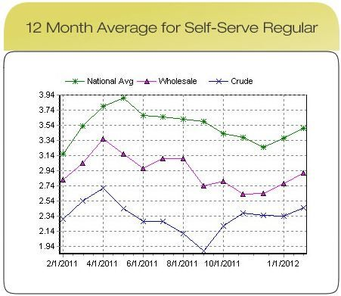
Present data in context
The original graphic from Fox News, Feb 2012.
In Reality…
http://mediamatters.org/research/2012/10/01/a-history-of-dishonest-fox-charts/190225

Slide 21
Principle 3: The chart should minimize graphical complexity
Generally, the simpler the better…
Key concepts
Data-ink
Sometimes a table is better
Chartjunk

Slide 22
When a table is better than a chart
For a few data points, a table can do just as well…
Salesperson | Total Sales
Peacock | $225,763.68
Leverling | $201,196.27
Davolio | $182,500.09
Fuller | $162,503.78
Callahan | $123,032.67
King | $116,962.99
Dodsworth | $75,048.04
Suyama | $72,527.63
Buchanan | $68,792.25
The table carries more information in less space
and is more precise.

Slide 23
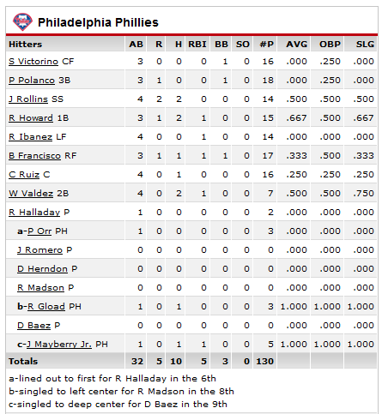
The Ultimate Table: The Box Score
Large amount of information in a very small space
So why does this work?
  Depends on the reader’s knowledge of the data

Slide 24

Data Ink
The amount of “ink” devoted to data in a chart
Tufte’s Data-Ink ratio:
  $Data−ink ratio=\frac{data−ink}{total ink used in graphic}$
Should be ~ 1
< 1 = more non-data related ink in graphic
= 1 implies all ink devoted to data
Tufte’s principle:
Erase ink whenever possible

Slide 25
Being conscious of data ink
Lower data-ink ratio
(worse)
Higher data-ink ratio
(better)

Slide 26
What makes a good chart?
Sometimes it’s really a matter of preference.
These both minimize data ink.
Why isn’t a table better here?

Slide 27
3-D Charts
Evaluate this from a data-ink perspective.
How does it affect the clarity of the chart?

Slide 28
One of the golden rules of data visualization is…..
Avoid 3D!
Data Integrity/ Lie Factor
3D skews numbers, making them difficult to interpret or compare
Graphical Complexity
Adding 3D to graphs introduces unnecessary chart elements like side and floor panels
Source: Knaflic (2015). Storytelling with Data: A Data Visualization Guide for Business Professionals. Chapter 2.

Slide 29
Chartjunk: Data Ink “gone wild”
Unnecessary visual clutter that doesn’t provide additional insight
Distraction from the story the chart is supposed to convey
When the data-ink ratio is low, chartjunk is likely to be high

Slide 30
Example: Moiré effects (Tufte 2009)
Creates illusion of movement
Stands out, in a bad way

Slide 31
Example: The Grid
Why are these examples of chartjunk?
What could you do to remedy it?

Slide 32
Data Ink Working For Us
Evaluate this chart in terms of Data Ink.
Imagine this as a bar chart. As a table!!

Slide 33
Review: Data principles (adapted from Tufte 2009)
1
2
3
The chart should tell a story
The chart should have graphical integrity
The chart should minimize graphical complexity
Tufte’s fundamental principle:
Above all else show the data

Slide 34
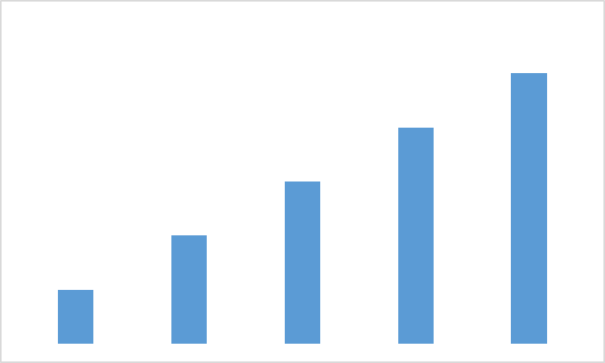
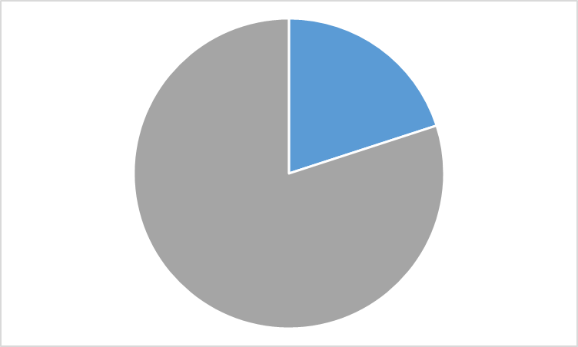
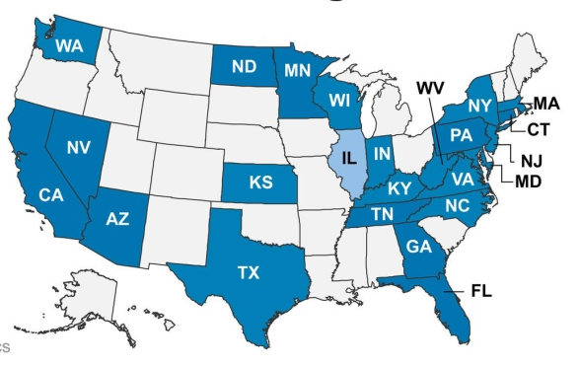
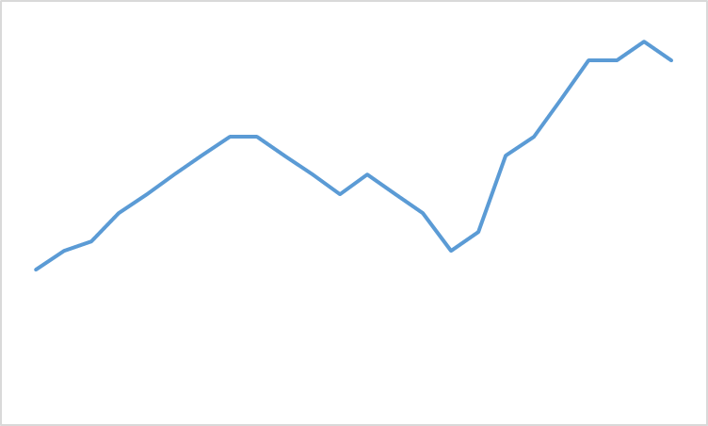
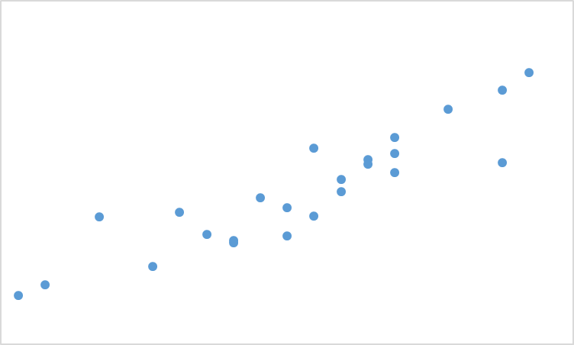
Common Chart Types
Bars
(For Comparison)
Pie
(For Composition)
Map
(For Spatial Comparison)
Line
(For Evolution)
Scatterplot
(Relationship)

Slide 35
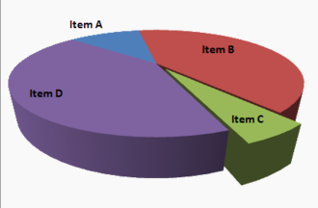
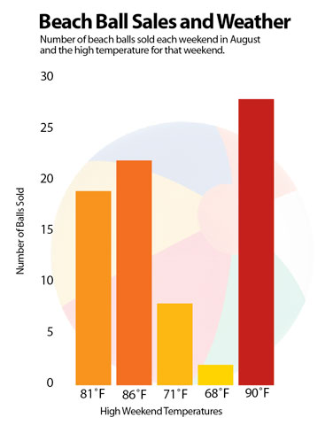
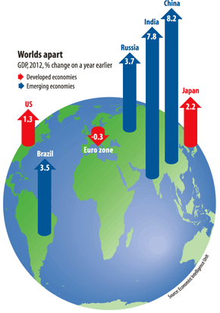
Review: What do you think of these?
https://www.boundless.com/statistics/frequency-distributions/frequency-distributions-for-qualitative-data/interpreting-distributions-constructed-by-others/images/3-d-pie-chart/
http://www.economist.com/node/21537909
http://images.macworld.com/images/howto/graphics/134708-create-charts-good_376.jpg

Slide 36


Time for our 16th ICA!

