Slide 1
MIS2502: Data Analytics SQL – Putting Information Into a Database

Slide 2
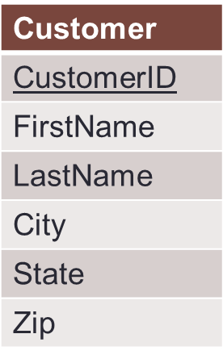
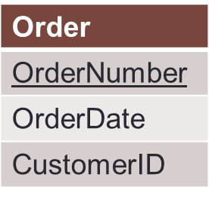
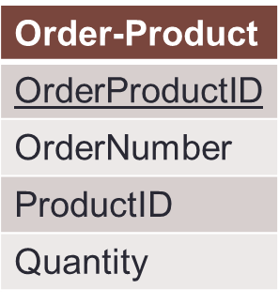
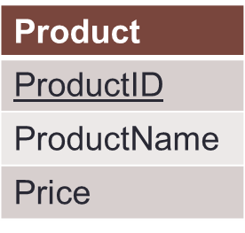
Our relational database
A series of tables
Linked together through primary/foreign key relationships

Slide 3
To create a database
We need to define
The tables
The fields (columns) within those tables
The data types of those fields
There are SQL commands that do each of those things
So let`s assume that our database didn`t exist and we needed to create the tables

Slide 4
CREATE statement (create a table)
CREATE TABLE schema_name.table_name ( columnName1 datatype [NULL][NOT NULL], columnName2 datatype [NULL][NOT NULL], PRIMARY KEY (KeyName) );
Item | Description
schema_name | The schema that will contain the table
table_name | The name of the table
columnName | The name of the field
datatype | The datatype of the field
[NULL][NOTNULL] | Whether the field can be empty (i.e., null) (The [] means the parameter is optional)
KeyName | The name of the field that will serve as the primary key

Slide 5
Example: Creating the Customer Table
Customer
CustomerID
FirstName
LastName
City
State
Zip
CREATE TABLE orderdb.Customer (
CustomerID INT NOT NULL ,
FirstName VARCHAR(45) NULL ,
LastName VARCHAR(45) NULL ,
City VARCHAR(45) NULL ,
State VARCHAR(2) NULL ,
Zip VARCHAR(10) NULL ,
PRIMARY KEY (CustomerID) );
Remember, your schema will use your mx MySQL ID (i.e., m999orderdb.Customer)
Based on this SQL statement:
The only required field is CustomerID – the rest can be left blank.
CustomerID is defined as the primary key.

Slide 6
Looking at the “new” Customer table
The database management system stores this information about the table
This is called metadata – “data about data”
It’s separate from the data in the table (i.e., Customer information)
Column name | Data type
CustomerID | INT
FirstName | VARCHAR(45)
LastName | VARCHAR(45)
City | VARCHAR(45)
State | VARCHAR(2)
Zip | VARCHAR(10)
Customer

Slide 7
Data types
Each field can contain different types of data
That must be specified when the table is created
There are many data types; we’re only going to cover the most important ones
Data type | Description | Examples
INT | Integer | 3, -10
DECIMAL(n,n) | Decimal | 3.23, 3.14159
VARCHAR(n) | String (numbers and letters) | Hello, I like pizza, MySQL!
DATETIME | Date/Time (or just date) | 2011-09-01 17:35:00, 2011-04-12
BOOLEAN | Boolean value | 0 or 1
So why do you think we defined “Zip” as a VARCHAR() instead of an INT?

Slide 8
So back to our CREATE statement
CREATE TABLE orderdb.Customer (
CustomerID INT NOT NULL , FirstName VARCHAR(45) NULL ,
LastName VARCHAR(45) NULL ,
City VARCHAR(45) NULL ,
State VARCHAR(2) NULL ,
Zip VARCHAR(10) NULL ,
PRIMARY KEY (CustomerID) );
FirstName can be a string of up to 45 letters and numbers.
Why 45? It’s the MySQL default.
State can be a string of up to 2 letters and numbers

Slide 9
Some more create statements
CREATE TABLE orderdb.`Order` (
OrderNumber INT NOT NULL , OrderDate DATETIME NULL ,
CustomerID INT NULL ,
PRIMARY KEY (OrderNumber) );
CREATE TABLE orderdb.Product (
ProductID INT NOT NULL ,
ProductName VARCHAR(45) NULL ,
Price DECIMAL(5,2) NULL ,
PRIMARY KEY (ProductID) );
Order
OrderNumber
OrderDate
CustomerID
Product
ProductID
ProductName
Price
DECIMAL(5, 2) indicates price can no larger than 999.99.

Slide 10
Removing tables
DROP TABLE schema_name.table_name;
Example: DROP TABLE orderdb.Customer;
Be careful!
This deletes the entire table and all data!
It’s a pain to get it back (if you can at all)!

Slide 11
Changing a table’s metadata
ALTER TABLE schema_name.table_name ADD column_name datatype [NULL][NOT NULL];
or
ALTER TABLE schema_name.table_name DROP COLUMN column_name;
or
ALTER TABLE schema_name.table_name CHANGE COLUMN old_column_name new_column_name datatype [NULL][NOT NULL];
Adds a column to the table
Removes a column from the table
Changes a column in the table

Slide 12
An example of each
Adds ‘Manufacturer’ column to Product table
ALTER TABLE orderdb.Product ADD COLUMN `Manufacturer` VARCHAR(45) NULL;
ALTER TABLE orderdb.Product DROP COLUMN `Manufacturer;
Removes ‘Manufacturer’ column from Product table

Slide 13
An example of each
Changes name of Price column in Product table to SalesPrice and its data type to DECIMAL(6,2)
ALTER TABLE orderdb.Product CHANGE COLUMN Price SalesPrice DECIMAL(6,2) NULL
ALTER TABLE orderdb.Product CHANGE COLUMN Price Price DECIMAL(6,2) NULL
Changes data type of Price column in Product table to DECIMAL(6,2) but leaves the name unchanged.

Slide 14
Adding a row to a table (versus columns)
Adding a column
Adding a row
A change in the table structure
A change in the table data
Done using ALTER TABLE
Done using INSERT INTO

Slide 15
Adding a row
INSERT INTO schema_name.table_name (columnName1, columnName2, columnName3) VALUES (value1, value2, value3);
Item | Description
schema_name | The schema that contains the table
table_name | The name of the table
columnName | The name of the field
value | The data value for the field
datatype | The datatype of the field
BIG TIP: The order of the values MUST match the order of the field names!

Slide 16
INSERT example
INSERT INTO orderdb.Customer (CustomerID, FirstName, LastName, City, State, Zip) VALUES (1005, 'Chris', 'Taub', 'Princeton', 'NJ', '09120');
CustomerID | FirstName | LastName | City | State | Zip
1001 | Greg | House | Princeton | NJ | 09120
1002 | Lisa | Cuddy | Plainsboro | NJ | 09123
1003 | James | Wilson | Pittsgrove | NJ | 09121
1004 | Eric | Foreman | Warminster | PA | 19111
1005 | Chris | Taub | Princeton | NJ | 09120
BIG TIP: Note that field names are surrounded by “back quotes” (`) and string field values are surrounded by “regular quotes” (')

Slide 17
Changing a row
UPDATE schema_name.table_name SET columnName1=value1, columnName2=value2 WHERE condition;
UPDATE `test`.`product` SET `ProductName`='Honey Nut Cheerios', `Price`='4.50' WHERE `ProductID`='2251';
Item | Description
schema_name | The schema that contains the table
table_name | The name of the table
columnName | The name of the field
value | The data value for the field
condition | A conditional statement to specify the records which should be changed

Slide 18
UDPATE example
UPDATE orderdb.Product SET ProductName='Honey Nut Cheerios', Price=4.50 WHERE ProductID=2251;
ProductID | ProductName | Price
2251 | Cheerios | 3.99
2282 | Bananas | 1.29
2505 | Eggo Waffles | 2.99
ProductID | ProductName | Price
2251 | Honey Nut Cheerios | 4.50
2282 | Bananas | 1.29
2505 | Eggo Waffles | 2.99
Product
The “safest” way to UPDATE is one record at a time, based on the primary key field.

Slide 19
Changing multiple rows
UPDATE orderdb.Customer SET City='Cherry Hill' WHERE State='NJ';
CustomerID | FirstName | LastName | City | State | Zip
1001 | Greg | House | Princeton | NJ | 09120
1002 | Lisa | Cuddy | Plainsboro | NJ | 09123
1003 | James | Wilson | Pittsgrove | NJ | 09121
1004 | Eric | Foreman | Warminster | PA | 19111
Be careful!
You can do a lot of damage with a query like this!
CustomerID | FirstName | LastName | City | State | Zip
1001 | Greg | House | Cherry Hill | NJ | 09120
1002 | Lisa | Cuddy | Cherry Hill | NJ | 09123
1003 | James | Wilson | Cherry Hill | NJ | 09121
1004 | Eric | Foreman | Warminster | PA | 19111

Slide 20
Deleting a row
DELETE FROM schema_name.table_name WHERE condition;
Item | Description
schema_name | The schema that contains the table
table_name | The name of the table
condition | A conditional statement to specify the records which should be changed

Slide 21
DELETE example
DELETE FROM orderdb.Customer WHERE CustomerID=1004;
CustomerID | FirstName | LastName | City | State | Zip
1001 | Greg | House | Princeton | NJ | 09120
1002 | Lisa | Cuddy | Plainsboro | NJ | 09123
1003 | James | Wilson | Pittsgrove | NJ | 09121
1004 | Eric | Foreman | Warminster | PA | 19111
CustomerID | FirstName | LastName | City | State | Zip
1001 | Greg | House | Princeton | NJ | 09120
1002 | Lisa | Cuddy | Plainsboro | NJ | 09123
1003 | James | Wilson | Pittsgrove | NJ | 09121

Slide 22
Deleting multiple rows
Avoid doing this!
DELETE FROM orderdb.Customer WHERE CustomerID>1002;
CustomerID | FirstName | LastName | City | State | Zip
1001 | Greg | House | Princeton | NJ | 09120
1002 | Lisa | Cuddy | Plainsboro | NJ | 09123
1003 | James | Wilson | Pittsgrove | NJ | 09121
1004 | Eric | Foreman | Warminster | PA | 19111
CustomerID | FirstName | LastName | City | State | Zip
1001 | Greg | House | Princeton | NJ | 09120
1002 | Lisa | Cuddy | Plainsboro | NJ | 09123

Slide 23
One more DELETE example
DELETE FROM orderdb.Customer WHERE State='NJ' AND Zip='09121'
CustomerID | FirstName | LastName | City | State | Zip
1001 | Greg | House | Princeton | NJ | 09120
1002 | Lisa | Cuddy | Plainsboro | NJ | 09123
1003 | James | Wilson | Pittsgrove | NJ | 09121
1004 | Eric | Foreman | Warminster | PA | 19111
CustomerID | FirstName | LastName | City | State | Zip
1001 | Greg | House | Princeton | NJ | 09120
1002 | Lisa | Cuddy | Plainsboro | NJ | 09123
1004 | Eric | Foreman | Warminster | PA | 19111

