Slide 1

MIS2502:
Data Analytics
The Things You Can Do With Data

Slide 2

Why Business Intelligence?
40%
61%
Say this is because there is “no good data”
72%
Want to increase their organization’s use of business intelligence
Of decisions by managers are made by using their “gut”
Source: http://advice.cio.com/thomas_wailgum/to_hell_with_business_intelligence_40_percent_of_execs_trust_gut

Slide 3

It all starts with data
Data
Gathering
Storing
Retrieving
Interpreting
Almost every business action requires at least one of these!

Slide 4
Examples of Data
Data
Quantity sold
Information
Course enrollment
Customer name
Discount
Star rating
?

Slide 5


So then how do you turn data into information?

Slide 6
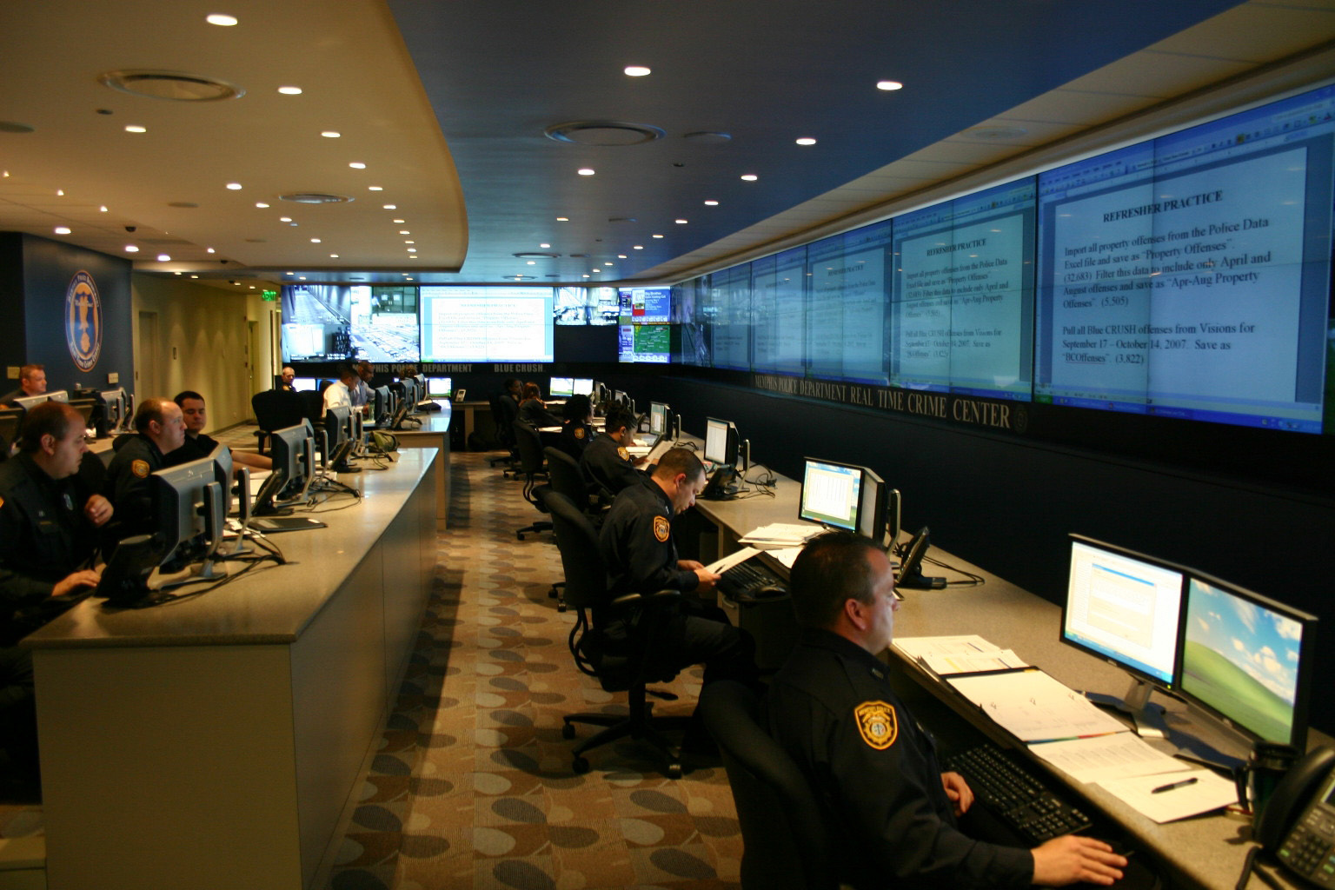
Memphis Police
  Used historical crime data
  Place police where and when crime was likely to occur
Example: Memphis Police
Used historical crime data
Place police where and when
crime was likely to occur
http://www-03.ibm.com/press/us/en/pressrelease/32169.wss

Slide 7

Example: Pioneer West Virginia Credit Union
  Used operational financial data, such as deposits
  Delinquent loans reported daily instead of monthly
  Reduced delinquency ratio by 95%
http://public.dhe.ibm.com/common/ssi/ecm/en/ytc03291usen/YTC03291USEN.PDF

Slide 8
Two types of data
Transactional
Captures data describing and event
An exchange between actors
Analytical
Captures data to support analysis and reporting
An aggregated view of the business
Real-time
Historical
!
Explain the role of transactional and analytical data in the examples on the previous slides.

Slide 9

The Information Architecture of an Organization
Data entry
Transactional Database
Data extraction
Analytical Data Store
Data analysis
Stores real-time transactional data
Stores historical transactional and summary data
Called OLTP:
Online transaction processing
Called OLAP:
Online analytical processing
!
But this is changing rapidly….

Slide 10
Data versus information
Data
Discrete, unorganized, raw facts
Information
The transformation of those facts into meaning

Slide 11
Components of an information infrastructure
Transactional Database
Supports management of an organization’s data
Analytical Data Store
For periodic analysis
For everyday transactions
Supports managerial decision-making
This is what is commonly thought of as “database management”
This is the foundation for business intelligence

Slide 12

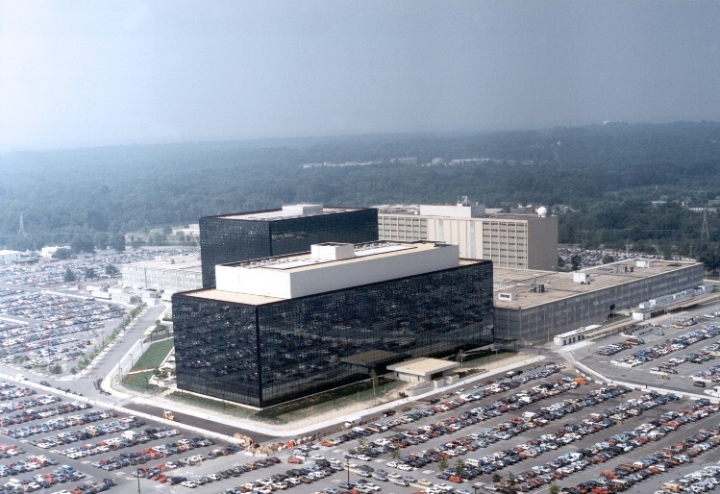
But it’s more than just the technology…
The 2008
Housing Bubble
Careless record keeping and complex bundling led to unclear mortgage ownership.
http://www.cbsnews.com/8301-504803_162-20049744-10391709.html
The 2013 NSA Spying Scandal
Collection of “telephony metadata” will continue even after proposed PATRIOT act reforms.
http://www.salon.com/2013/08/09/obama_nsa_reforms_still_allow_metadata_collection/

