Slide 1
PDO Database Connections
MIS 3501, Fall 2015
Jeremy Shafer
Department of MIS
Fox School of Business
Temple University
10/13/2015

Slide 2
Course Overview
We are
here.
MySQL
Weeks 6 & 7
PDO
PHP
HTML & CSS
Weeks 1 & 2
Weeks 3 – 5
Week 8 & 9
To do:
Organize your code with MVC (week 10)
Work with forms (week 11)
Use cookies and sessions (week 12)

Slide 3
PHP and MySQL
(One System)
Apache Web Service
?
MySQL
Databases
PHP Interpreter

Slide 4
PHP and MySQL (2)
(One System)
Apache Web Service
statement
PDO
PDO Exception
MySQL
Databases
PHP Interpreter
(objects)

Slide 5
What’s an object?
An object is a data type, like an integer, string or Boolean data type. Only it is very special. It can:
Have values (we call them properties)
Perform actions (we call them methods)
Consequently, objects are very, very flexible way of representing different ideas.
PHP defines a number of object classes (that is, kinds of objects) for you. PDO is one of those predefined classes of objects.

Slide 6
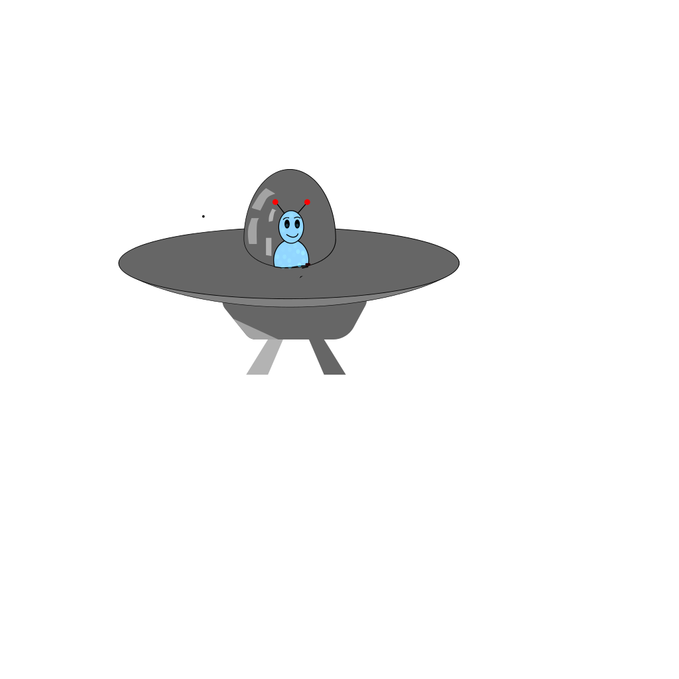
A (slightly) more concrete example:
Suppose we have a video game where there are a number of spaceships. The programmer of the video game would define each spaceship as an object.
The instances of the spaceship object would have properties like size, color, and type.
The instances of the spaceship object would also have methods like move left, move right, shoot, explode… etc.

Slide 7
Why are you telling me all this?
We’re discussing this object oriented concept so that the syntax of the PDO statements in PHP will make sense. We use the “new” command to create a new instance of an object, and the arrow shaped object operator “->” to reference attributes and methods. For example:
$spaceship1 = new SpaceShip();
$spaceship1->color = “Green”;
$spaceship1->size = “small”;
$spaceship1->jumpToCoordinates(0,0);
$spaceship1->moveLeft();
$spaceship1->shoot();
$spaceship1->destroy();

Slide 8
Working with a database connection
So, when we decide to use a database connection, we use PDO and statement objects, and their methods, to communicate with the database.
$db = new PDO("mysql:host=localhost;dbname=class15", "class15", "password");
$statement = $db->prepare("insert into names(name) values ('Bob')");
$statement->execute();
$statement->closeCursor();

Slide 9
Opening a PDO/MySQL connection
You can open a connection to a MySQL database server creating a new PDO() object.
Assign the return value from the new PDO() command to a variable. Then use that variable to represent the database in your script.
The PDO object takes three parameters that indicate what database to connect to and how. The connection string, the username, and the password.
$db = new PDO("mysql:host=localhost;dbname=class15","class15",
"password");

Slide 10
Opening a PDO/MySQL Connection (2)
$db = new PDO("mysql:host=localhost;dbname=class15","class15",
"password");
#1
The connection string argument specifies tells PDO what sort of database to connect to, and where it is.
These strings are also called dsn strings (dsn is short for “data source name”)
The connection string can indicate any number of settings necessary to connect.
The above example shows a very minimalistic connections string where the type of database is indicated (mysql) followed by a host and database name.

Slide 11
Opening a PDO/MySQL Connection (2)
$db = new PDO("mysql:host=localhost;dbname=class15","class15",
"password");
#1
#2
#3
The connections string argument specifies tells PDO what sort of database to connect to, and where it is.
The user argument specifies a MySQL account name
The password argument specifies a MySQL account password

Slide 12
Creating a PDO statement
Once you have a database connection, you can use the prepare() method to create a statement.
The prepare method takes a string of SQL text.
After you have prepared the statement, use the execute() method to send it to the database.
Finally, tell the system to clean things up by closing the statement with the closeCursor() method.
(See pdo1.php)

Slide 13
Passing values to the database
PDO gives you a way to send SQL statements to the database that contain variables.
In order to do that, use the bindValue() method of the statement object.
This method will allow you to substitute a placeholder in the SQL string with a value.
(See pdo2.php)

Slide 14
Catching connection errors
Connections aren’t always successful.
We can use try / catch to address this possibility.
If the connection fails, then the catch block of code will be executed.
We specify yet another object (the PDOException object) in the catch block.
We can then use the getMessage() method of the exception object to determine what went wrong.
(See pdo3.php and pdo4.php)

Slide 15
Give it a try…
Following the example files provided, can you create a form, with a single input tag, that populates the names table?
You don’t need to upload or send this to me. You should just try to do this.

