Slide 1
Class02 Introduction to web development concepts
MIS 3501, Fall 2015
Jeremy Shafer
Department of MIS
Fox School of Business
Temple University
8/27/2015

Slide 2
Web Applications
By their very nature, Web Applications require multiple technologies to work together. Some collections of technologies are common, that they are collectively referred to as a stack. For example: the "LAMP Stack“ is Linux, Apache, MySQL, and PHP.
In this class, you will use XAMPP – which is short for Cross (X) Platform, Apache, MySQL, PHP, and Perl.

Slide 3
Web Development
Similarly, Web Development requires that multiple programming languages work together. Each language has its special purpose.
A web application never uses just one programming language. In this class we will use:
HTML and CSS (for presentation) – aesthetics – how does the site look?
PHP (for scripting of all sorts) – functionality – what can the site do?
MySQL (for database queries) – content – what are the data that the site can display?

Slide 5
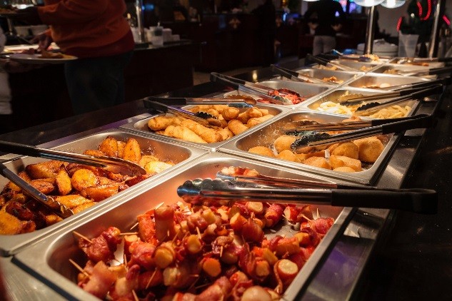

Slide 6
Your Computer Sends This Out
The Web Server Sends this back

Slide 7
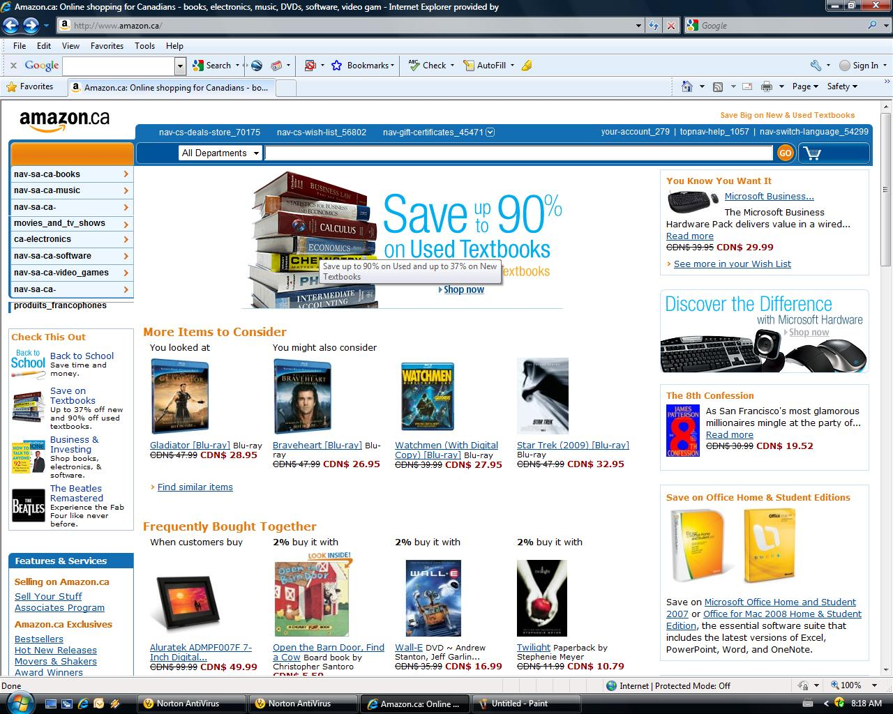
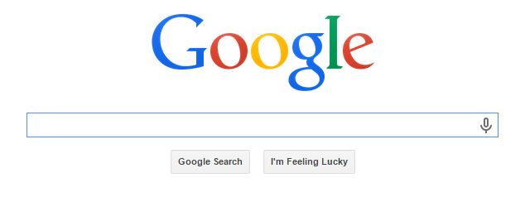
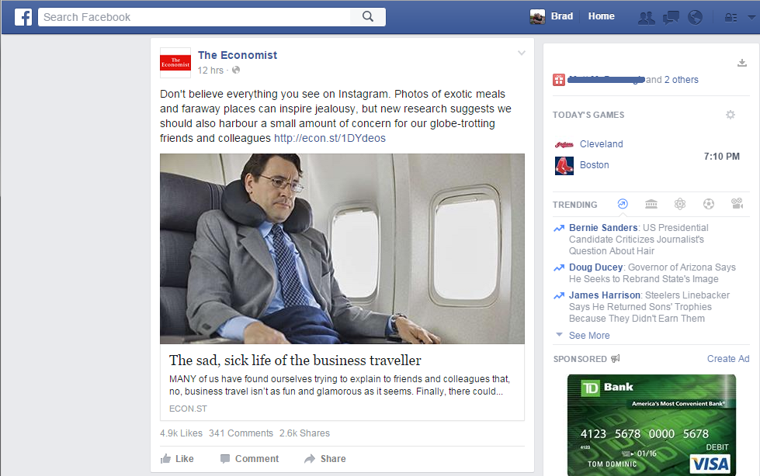

Slide 8
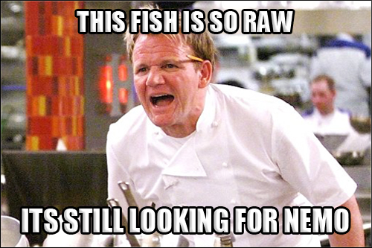
The Script makes the website dynamic

Slide 11
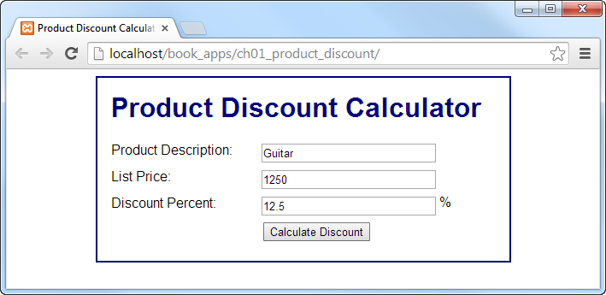

Slide 12
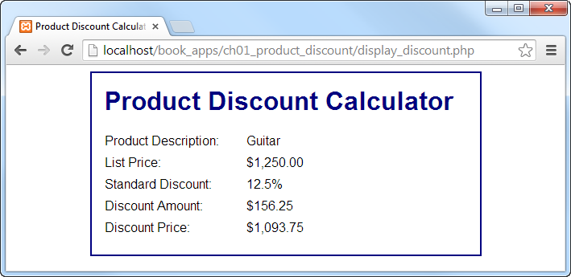

Slide 13
How Did We Get From A → B
Three Components
HTML (The Body)
CSS (The Style)
PHP (The actions)

Slide 14
HTML

Slide 15
How Did We Get From A → B
Three Components
HTML (The Body)
CSS (The Style)
PHP (The actions)

Slide 17
How Did We Get From A → B
Three Components
HTML (The Body)
CSS (The Style)
PHP (The actions)

Slide 19
How Did We Get From A → B

Slide 21
