Slide 1

Class05
How to get data from a form
MIS 3501, Fall 2015
Jeremy Shafer
Department of MIS
Fox School of Business
Temple University
9/8/2015

Slide 2
Course Overview
MySQL
Weeks 5 & 6
PDO
PHP
HTML & CSS
Weeks 1 & 2
Weeks 3 & 4
Week 7
We are
here.
To do:
Organize your code with MVC (week 8)
Debug your code (week 9)
Work with forms (week 10)
Use arrays (week 11 & 12)
Use sessions (week 13)

Slide 3
Discuss:
What is the role of these delimiters?
Notice how each PHP statement ends with a semicolon.
Why?

Slide 4
Discuss:
What is the significance of
first_name and last_name
???

Slide 5
Discuss:
What does echo do?

Slide 6
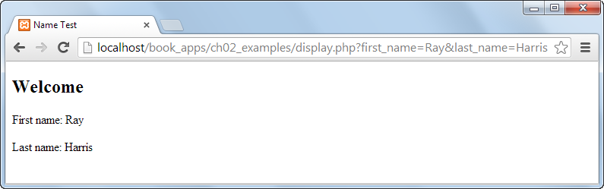
If I were to “View Source Code” here in the browser, would it be the same or different from the previous slide?

Slide 7
Discuss:
Comments don’t change the way the code works.
So why do we bother with comments?

Slide 9
Discuss:
What about these things?
What are they?

Slide 10

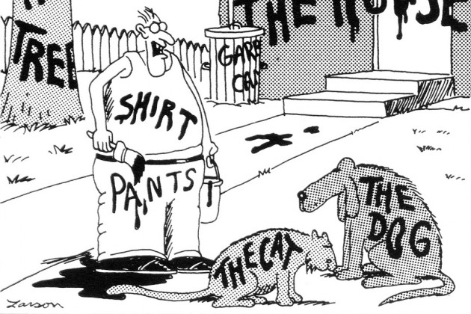

Slide 13
Things you can do with variables
<?php
// things you can do with variables
$a = 20; // assignment of values
$b = 10;
$c = $a + $b; // addition
echo $c; // 30
echo "<br>";
$c = $a - $b; // subtraction
echo $c; // 10
echo "<br>";
$c = $a * $b; // multiplication
echo $c; // 200
echo "<br>";

Slide 14
Things you can do with variables (2)
// continued from previous slide
$c = $a / $b; // division
echo $c; // 2
echo "<br>";
$c = $a . $b; // concatenation
echo $c; // 2010
echo "<br>";
// WHAT ABOUT THIS?
$c = $a . "%";
echo $c;
?>

Slide 15
When working with HTML forms, we have two techniques for transferring user supplied data to a PHP page. Those techniques are: GET and POST.
HTML
FORM
PHP
Method=“GET”
Method=“POST”

Slide 16
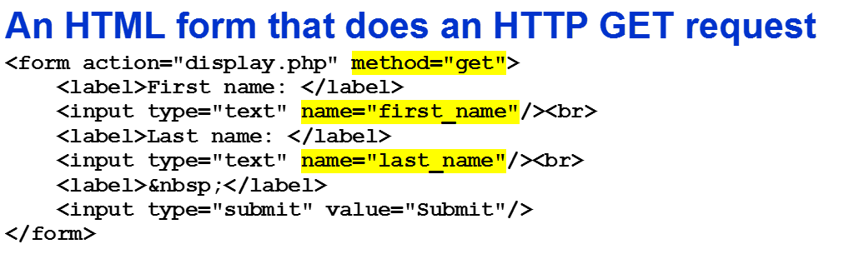

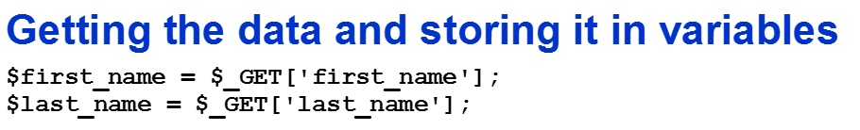
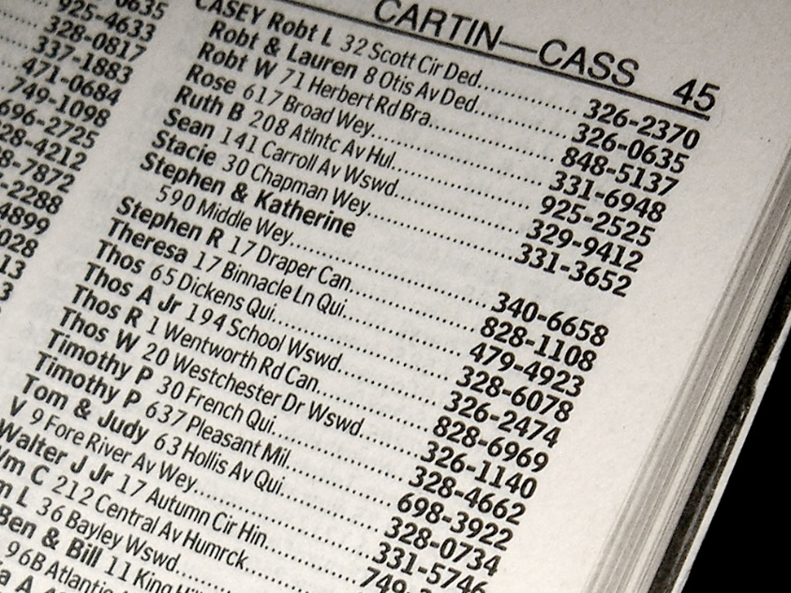

Slide 17
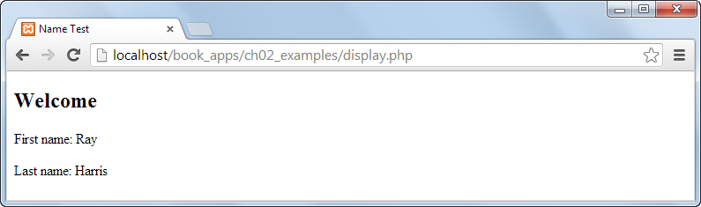

Slide 18
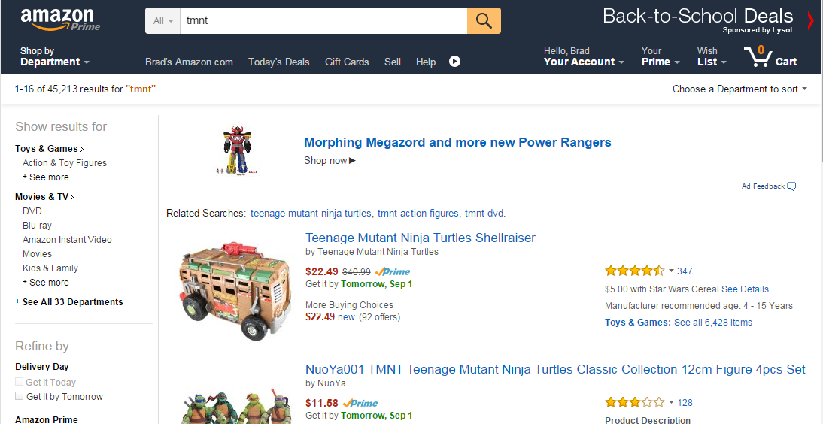
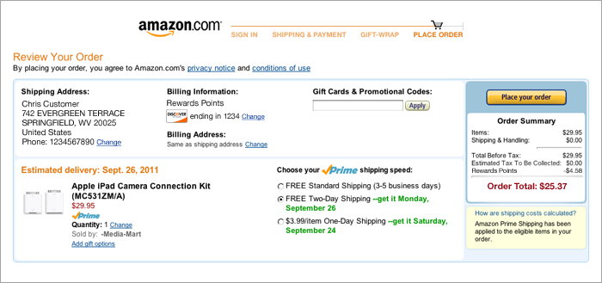

Slide 19


Slide 20
Instead of accessing the $_POST array directly, there is now a function called filter_input(). This new approach offers some advantages that we will investigate next class.
For now, it is enough to know that we can replace code that looks like this:
$last_name = $_POST['last_name'];
With this:
$last_name = filter_input(INPUT_POST,'last_name‘);

