Slide 1
Class03 Introduction to Web Development (Hierarchy and the IDE)
MIS 3501, Fall 2015
Jeremy Shafer
Department of MIS
Fox School of Business
Temple University
9/1/2015

Slide 2
Course Overview
MySQL
Weeks 5 & 6
PDO
PHP
HTML & CSS
Weeks 1 & 2
Weeks 3 & 4
Week 7
To do:
Organize your code with MVC (week 8)
Debug your code (week 9)
Work with forms (week 10)
Use arrays (week 11 & 12)
Use sessions (week 13)
You are here.

Slide 3
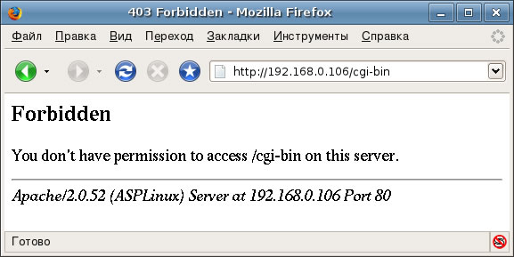
The Internet
We talked about this last time, but the internet is made up of a series of computers which are exchanging information.
Imagine a restaurant…
Your computer is a client… it makes a request of the waiter.
The language they speak is TCP/IP
The waiter is a server… it brings back what has been requested
Sometimes the client is not allowed to have what has been requested… the server will say no (like an angry spouse)
If we want to stretch the metaphor to the breaking point, your plate is a web browser… it displays things in http… salad plates do ftp…
What is important to remember though, is that the internet is just computers talking to computers. And the computer that your computer is talking to, has a file structure just like your computer (i.e. folders and files).

Slide 4
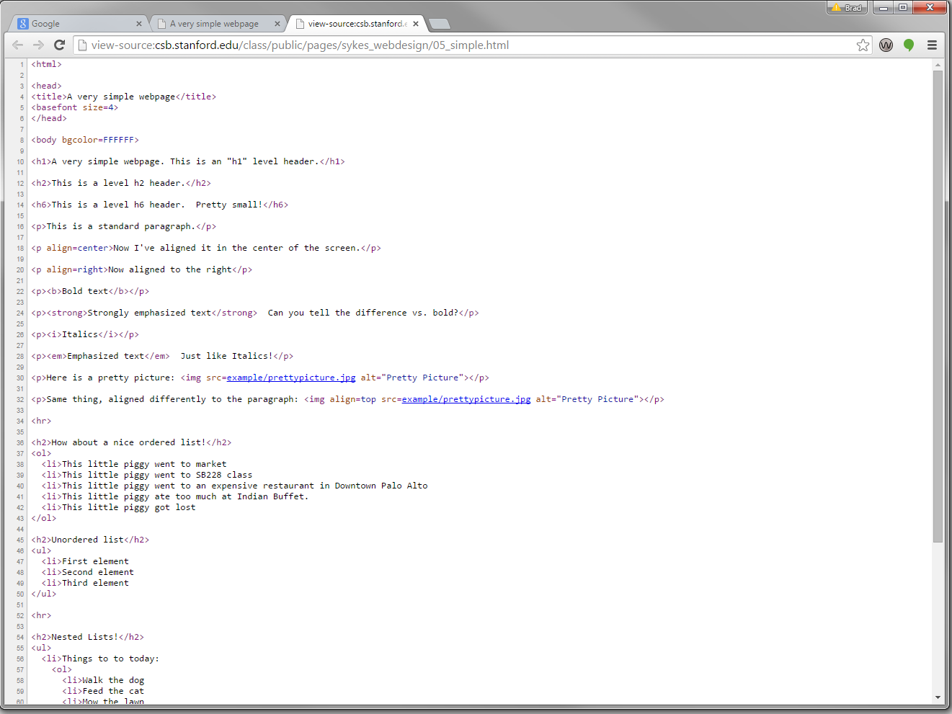
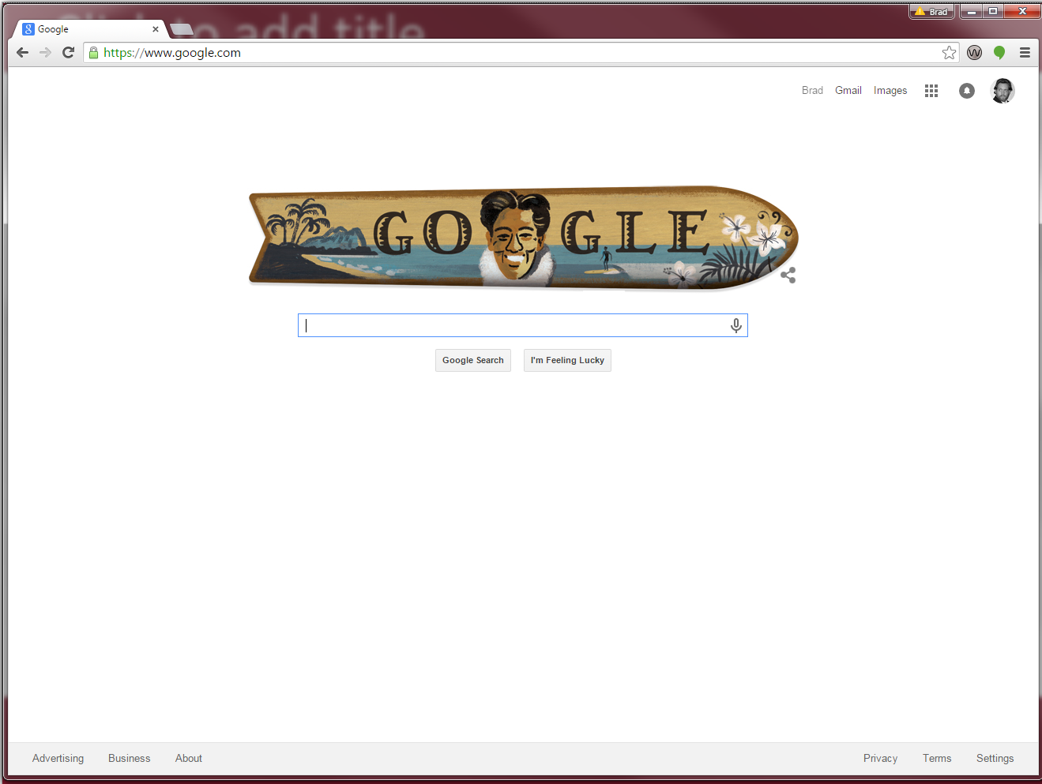
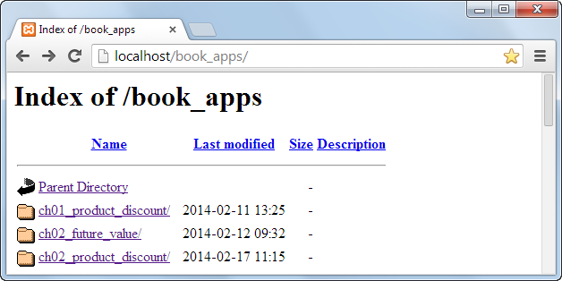
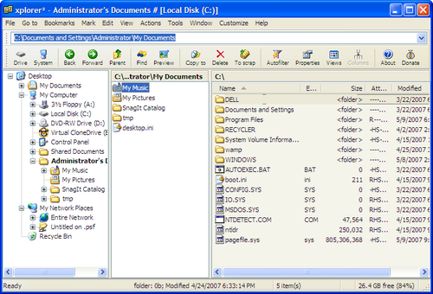
Discuss: Why are index.htm, index.html and index.php called “default pages”?

Slide 5
Discuss: Depending on the configuration of a server, you may not see a folder structure like this. Why would a server administrator choose to present things graphically vs. in a file structure?

Slide 6
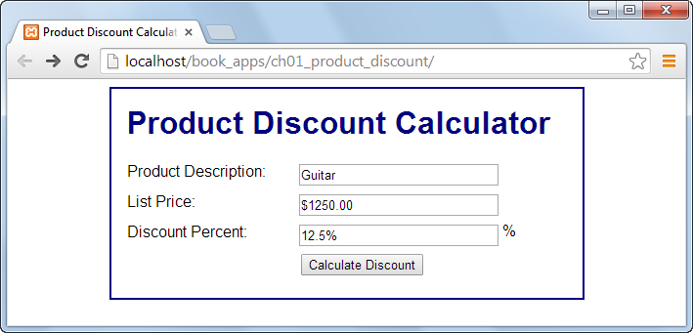
Just for Emphasis
See? No file specified here. *But* index.html was present.

Slide 7
PHP… Getting Going
Lets chat about PHP
PHP was designed a server side scripting language (it can be used for general purpose programming now as well)
Others Include: ASP, ASP.NET, R, Perl, JavaScript, Python, Ruby on Rails
As a concept
Some programs are run on your local machine
e.g. HTML
Server side languages run on the SERVER, which renders CUSTOMIZED results for each machine
This is different from things like JavaScript where the code is embedded

Slide 8
Watch out! Forgetting to refresh your browser is a common mistake for beginners. Also - you may encounter situations where it appears your changes are not taking effect. If that’s happening make sure that:
You are editing the right page
Completely shut down and restart your browser

Slide 9
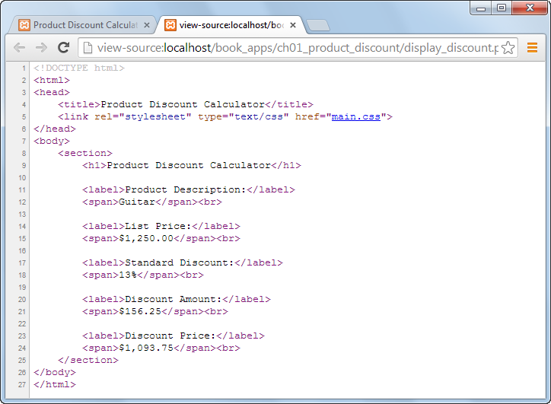
Hey, where’s the php code?
Why can’t we see it here?

Slide 10
Remember where the PHP code resides?

Slide 12
But This Class is About Creation…
In this class we don’t want to just view code
You could code in a text editor, e.g. notepad. This would be a pain though
Instead we often code in an “Integrated Development Environment” (IDE)
IDE’s offer a few benefits
They may format code for you (aesthetic). You’ll see why this is important later
They may have compilers and interpreters for you (which streamline the development process)
They often has nice graphic user interfaces (GUIs), these can automatically generate code for you
Recall your experience with the ePortfolio project in 2101
They often integrate multiple different code bases for you

Slide 13
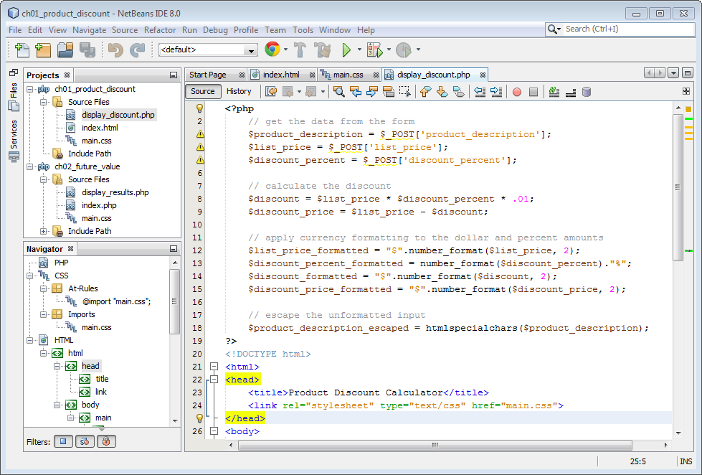

Slide 15
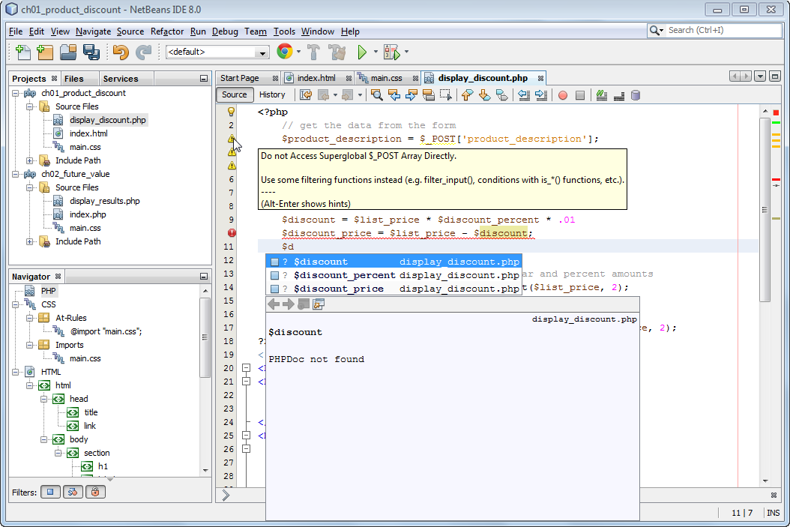
Warning icons
Error icon
Auto-completion list for names that start with $d

Slide 17
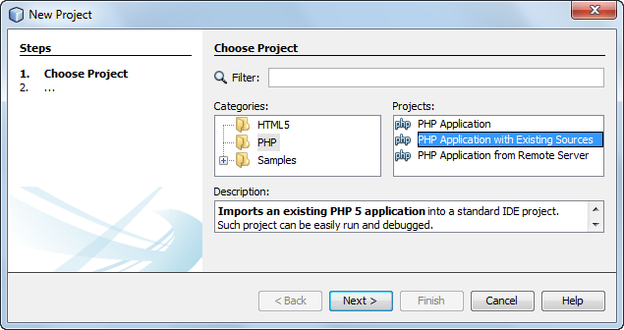
Most of the time, we will take this option when creating a new project.

