Slide 1
Class06 Conditional Statements
MIS 3501, Fall 2015
Jeremy Shafer
Department of MIS
Fox School of Business
Temple University
9/10/2015

Slide 2
Course Overview
MySQL
Weeks 5 & 6
PDO
PHP
HTML & CSS
Weeks 1 & 2
Weeks 3 & 4
Week 7
You are
here.
To do:
Organize your code with MVC (week 8)
Debug your code (week 9)
Work with forms (week 10)
Use arrays (week 11 & 12)
Use sessions (week 13)

Slide 3
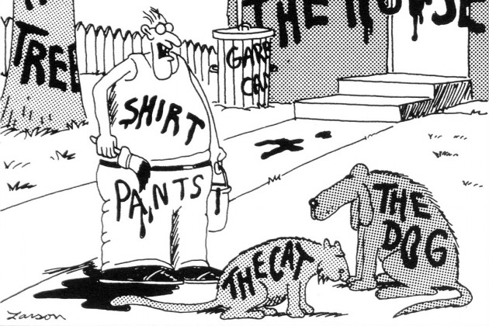
Variables

Slide 4
Data Types
For starters, we’ll just think about these four

Slide 9
Making Comparisons

Slide 10
Conditional Statements (simple)

Slide 11
Functions

Slide 12
Discuss – Based on your reading of the textbook, what is the difference between isset() and empty()? What do they do for us?

Slide 13
Very Useful!

Slide 14
<?php
//get data off the form
$description = filter_input(INPUT_POST,'product_description');
$price = filter_input(INPUT_POST, 'list_price',FILTER_VALIDATE_FLOAT);
$discount = filter_input(INPUT_POST, 'discount_percent',FILTER_VALIDATE_INT); ?>
Could be INPUT_POST or INPUT_GET

Slide 15
<?php
//get data off the form
$description = filter_input(INPUT_POST,'product_description');
$price = filter_input(INPUT_POST, 'list_price',FILTER_VALIDATE_FLOAT);
$discount = filter_input(INPUT_POST, 'discount_percent',FILTER_VALIDATE_INT); ?>
Corresponds to the name of a form input tag

Slide 16
<?php
//get data off the form
$description = filter_input(INPUT_POST,'product_description');
$price = filter_input(INPUT_POST, 'list_price',FILTER_VALIDATE_FLOAT);
$discount = filter_input(INPUT_POST, 'discount_percent',FILTER_VALIDATE_INT); ?>
Specifies the type of validation.
See PHP 5 Predefined Filter Constants here: http://www.w3schools.com/php/php_ref_filter.asp

Slide 17
<?php
//get data off the form
$description = filter_input(INPUT_POST,'product_description');
$price = filter_input(INPUT_POST, 'list_price',FILTER_VALIDATE_FLOAT);
$discount = filter_input(INPUT_POST, 'discount_percent',FILTER_VALIDATE_INT); ?>
The value of $discount will be either:
The value of ‘discount_percent’ provided by the user
FALSE (because the value was not an integer)
NULL (if there was no ‘discount_percent’ in the form post at all.)

Slide 22
Conditional Statements (fancy!)

Slide 24
Exercise

