Slide 1
Class08 Using the Documentation
MIS 3501, Fall 2015
Brad N Greenwood, PhD MBA
Department of MIS
Fox School of Business
Temple University
9/17/2015

Slide 2
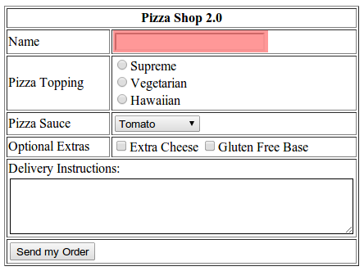
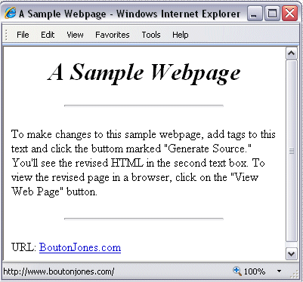
What Have We Done

Slide 4
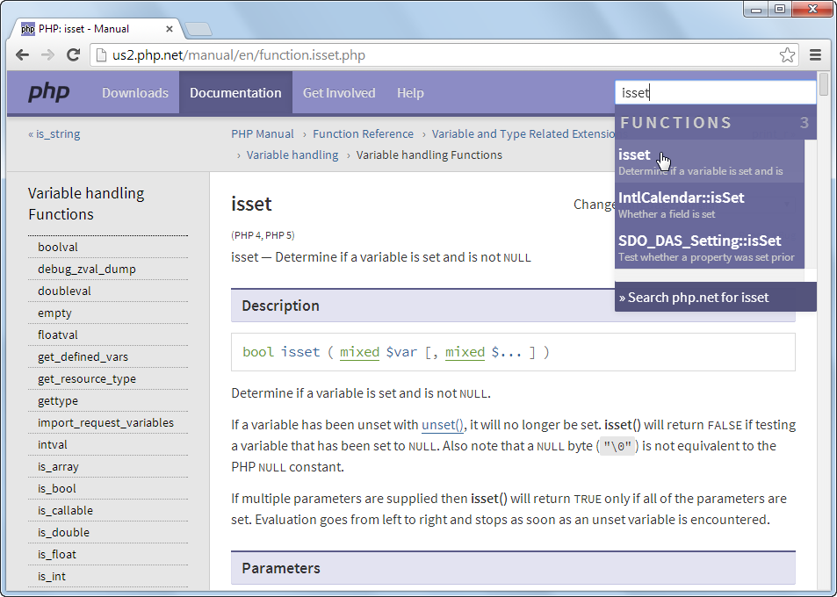

Slide 5
One step at a time…
From the php.net home page, enter a search term in the “Search” box in the upper right corner of the page. Press enter.
If a list of possible matches is provided, you may have to check multiple options to find the one you want.
Notice also that there is a “Full Website Search” option on the right. Typically you don’t want this.
Documentation for a function will include:
The version of PHP it appears in
The purpose / description of the function
The parameters that the function expects
The possible values that the function will return
Examples of usage
There are also (sometimes) User contributed examples. These can be lengthy.

Slide 6
Other resources you may find helpful:
http://www.w3schools.com
http://www.phptherightway.com
https://www.codecademy.com
https://teamtreehouse.com (Subscription Fee Required)
http://developer.Mozilla.org (for HTML / CSS)

