Slide 1
Sessions and cookies (part 2)
MIS 3501, Fall 2015
Jeremy Shafer
Department of MIS
Fox School of Business
Temple University
11/19/2015

Slide 2
Course Overview
MySQL
Weeks 6 & 7
We are here.
PDO
PHP
HTML & CSS
Weeks 1 & 2
Weeks 3 – 5
Week 8 & 9
To do:
Organize your code with MVC (week 11)
Work with forms (week 12)
Use cookies and sessions (week 13)

Slide 3
Objectives
Learning objectives for the week
Understand why HTML pages are referred to as “stateless”
Understand how cookies and sessions are used to preserve state, and the differences between cookies and sessions.
Understand the PHP commands used to manipulate cookies and sessions.

Slide 4
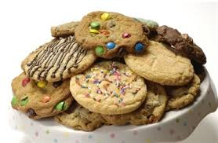
Cookies

Slide 5
Recall from last time…

Slide 6
Myths and Facts about cookies
Myth: Cookies Spy On You and Track Everything You Are Doing
Most cookies are as simple as a session token. More importantly, cookies are only sent back to the same site that originated them.
Myth: Cookies Are Viruses or Spyware and Create Spam and Popups
Cookies are nothing more than text files. They can’t contain executable code like viruses or spyware. However, cookies can be used by advertising web sites to track the sites you visit (assuming the sites are using the same advertising network), so most anti-spyware applications help you remove them.
Adapted from http://lifehacker.com/5461114/fact-and-fiction-the-truth-about-browser-cookies

Slide 7
Myths and Facts about cookies
Fact: Cookies Are Required for Logging Into Most Sites
The vast majority of web sites require cookies to be enabled in order to create an account and keep yourself logged in, so if you disable cookies in your browser, a large portion of the web is going to be broken.
Fact: Cookies are Used by Advertisers to Track Sites You Visit
Because cookies are always sent back to the site that originated them, an advertiser's cookie will be sent back to them from every web site you visit that is also using that same advertiser. This allows the advertiser to track the sites you visit, and send targeted advertising based on the types of sites that you visit.
Fact: Deleting or Blocking Cookies Can Cause More Annoying Ads
Interstitial ads are full screen ads that cover the interface of their host application. Most web site owners know that they are annoying, they are usually rate-limited so they aren't seen too often by the same person. Advertiser use a cookies to make certain that you don't see the same annoying ad too often.
Adapted from http://lifehacker.com/5461114/fact-and-fiction-the-truth-about-browser-cookies

Slide 8
Not-so-sinister uses for cookies
Remembering user preferences
Remembering user input
“Remember me” on this computer login feature

Slide 9
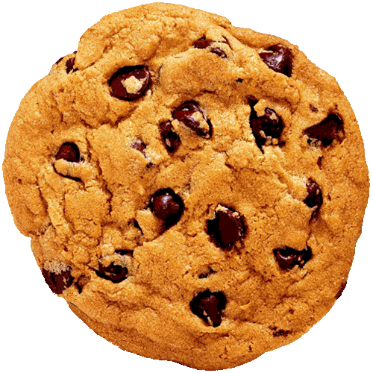
PHP Syntax – make a cookie
A cookie is created with the setcookie() function.
Syntax:
setcookie(name, value, expire, path, domain, secure, httponly); Parameters:
name - The name of the cookie. (This parameter is required. All others are optional.)
value - The value of the cookie. If the name is 'cookiename', this value can be retrieved through $_COOKIE['cookiename']
expire - The time the cookie expires. This is a Unix timestamp (epoch time) measured in seconds. Set this with the time() function plus the number of seconds before you want it to expire. For example: time()+60*60*24*30 will set the cookie to expire in 30 days. If set to 0, or omitted, the cookie will expire at the end of the session (when the browser closes).

Slide 10
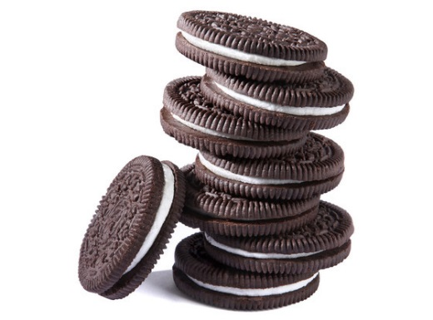
PHP Syntax – make a cookie (2)
Parameters continued:
path - The path on the server in which the cookie will be available on. Typically path is set to '/', so the cookie will be available within the entire domain, not just one directory of the application.
domain - The domain that the cookie is available to. For example: 'www.somebiz.com’ or ‘somebiz.com’ Browsers won’t allow you create cookies for just any old domain… only the one where your web application resides.
Secure - Indicates that the cookie should only be transmitted over a secure HTTPS connection from the client. When set to TRUE, the cookie will only be set if a secure connection exists.
httponly - When TRUE the cookie will be made accessible only through the HTTP protocol. This means that the cookie won't be accessible by scripting languages, such as JavaScript.

Slide 11
PHP Syntax – make a cookie example
<?php $cookie_name = "user"; $cookie_value = "John Doe"; setcookie($cookie_name, $cookie_value, time() + (60 * 60 * 24 * 30), "/"); ?>
Sanity check … how how long is this cookie set for?

Slide 12
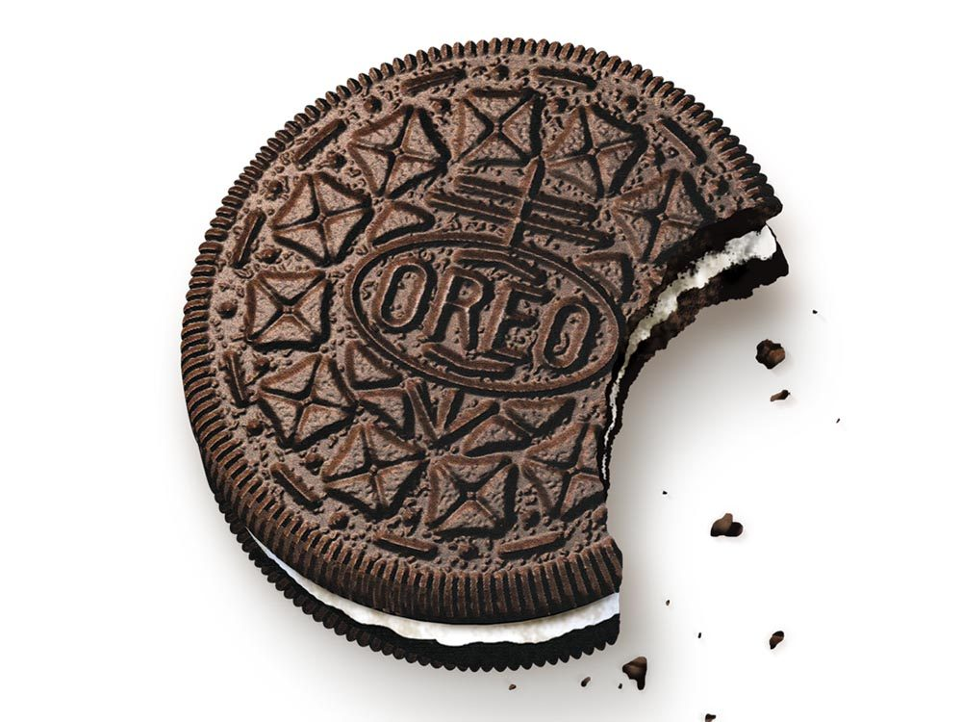
PHP Syntax – Modify a cookie
Modify a Cookie Value
To modify a cookie, just set the cookie again using the setcookie() function: <?php $cookie_name = "user"; // THE SAME NAME USED LAST SLIDE $cookie_value = “Irwin Allen"; setcookie($cookie_name, $cookie_value, time() + (60 * 60 * 24 * 30), "/"); ?>

Slide 13
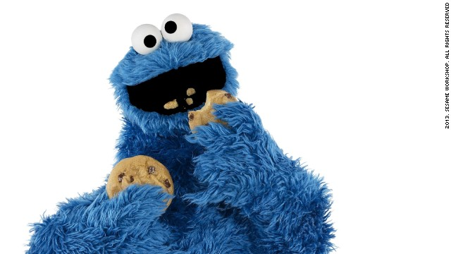
PHP Syntax – Delete a cookie
To delete a cookie, use the setcookie() function with an expiration date in the past. <?php
// set the expiration date to one day ago
setcookie("user", "", time() - 86400);
?>

Slide 14
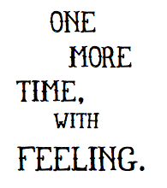
Let’s try it. As they say in show business…

