Slide 1
Class11 Introduction to relational databases and MySQL
MIS 3501, Fall 2015
Jeremy Shafer
Department of MIS
Fox School of Business
Temple University
9/29/2015

Slide 2
Course Overview
Now we are
here!
MySQL
Weeks 5 & 6
PDO
PHP
HTML & CSS
Weeks 1 & 2
Weeks 3 & 4
Week 7
To do:
Organize your code with MVC (week 8)
Debug your code (week 9)
Work with forms (week 10)
Use arrays (week 11 & 12)
Use sessions (week 13)

Slide 3
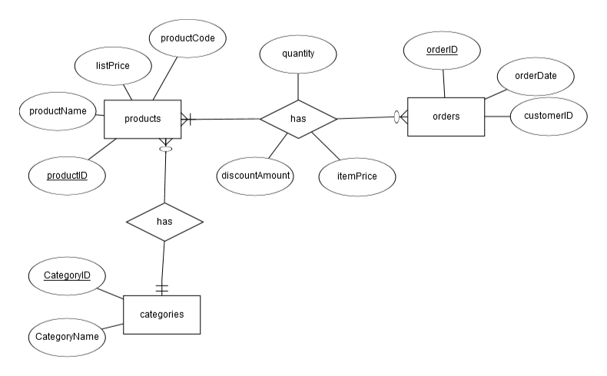
Remember MIS2502?
ERD Diagrams

Slide 4
Remember MIS2502? (2)
Schema Diagrams
SQL Statements
select productName, listPrice, productCode, categoryName from products, categories
where products.categoryID = categories.categoryID AND
categoryName = 'Basses';

Slide 5
Terminology
Schema Diagrams
Can you find an example of a ….
primary key
foreign key
one-to-many relationship
many-to-many relationship
bridge table

Slide 6
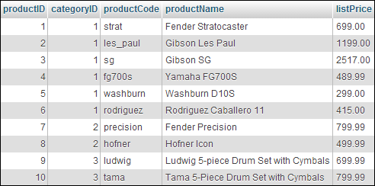
Terminology (2)
Primary key
Columns
Rows

Slide 7
Primary key
Foreign key

Slide 8
Another way of looking at it…
Products
Categories
The categoryID is common between the two.
Recall from before:
select productName, listPrice, productCode, categoryName from products, categories
where products.categoryID = categories.categoryID AND
categoryName = 'Basses';

Slide 9
Column name
Data Type
Will accept null?
productID will automatically increment by one with each new record.
This is the level of detail that a developer really needs to get work done.

Slide 10
There are a lot more MySQL data types… but knowing these allow you to do everything you need to do in this class, and in many practical situations.

Slide 12
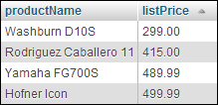

Slide 19
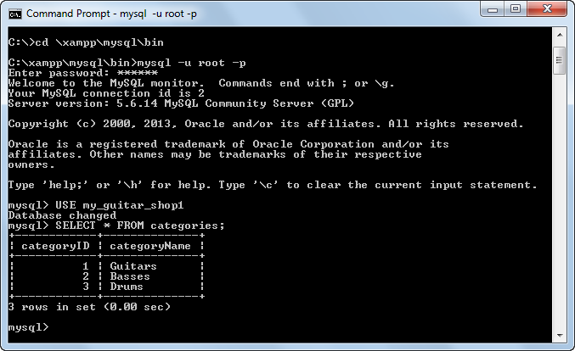
Yes, you could do it all from the command line…

Slide 20
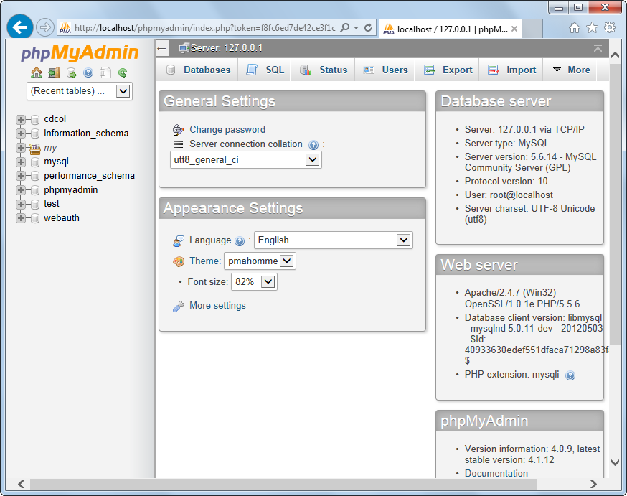
phpMyAdmin
This is what we’ll use.

