Slide 1
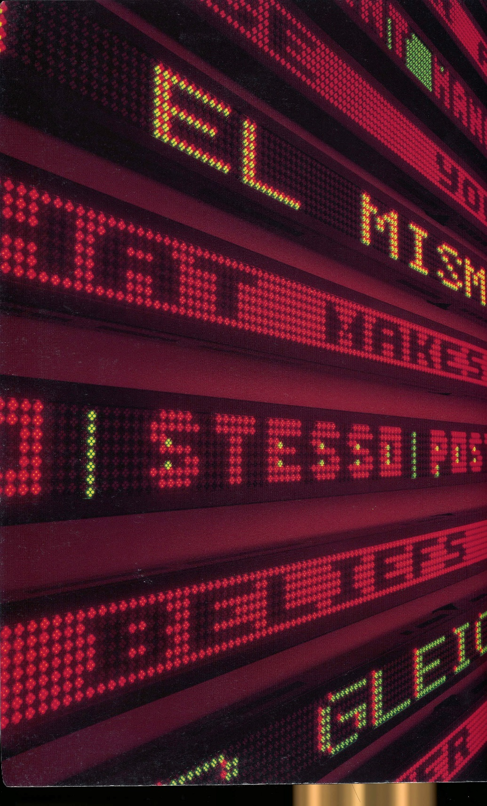
MIS 3504 Digital Design and Innovation
Week 11
Photo: Installation by Jenny Holzer, US Pavillion, Venice Biennale 1990

Slide 2
Final Project Deliverables: 1.A Project Scope Document 2. As Is State Documentation: Process Flow view(s) - Swim Lane Data view(s) – Entities Business Rules (written/tree view) 3. To Be State: Scenarios describing the solution Prototype demonstrating the solution Short (no more than 5 slide) PowerPoint presentation explaining your prototype

Slide 3
Project Presentation: Presentation using the PowerPoint Deck to sell the solution A walk through of the prototype from the personas point of view

Slide 4
Today: Selling Your Ideas

Slide 5
TELL A STORY People using your proposal + Technology needs/integration considered

Slide 6
The presentation: 5 parts Follow Design Inquiry Framework 1. what inspired you (good or bad) [What is your BIG IDEA] 2. who are the affected stakeholders [PEOPLE/PERSONA] 3. what are their unmet needs + why are they important [NEEDS AND OPPORTUNITIES] 4. what is your solution [DEMONSTRATE YOUR PROTOTYPE] 5. what resources do you need to create and sustain your solution [THE BUSINESS CASE]

Slide 7
The presentation: 5 parts 1. what inspired you (good or bad) [What is your BIG IDEA?] Focus on the essential problem, the business context and YOUR OBJECTIVES

Slide 8
The presentation: 5 parts 2. who are the affected stakeholders [PEOPLE] Focus on the AFFECTED STAKEHOLDERS (internal and external) and YOUR PERSONA.

Slide 9
The presentation: 5 parts 3. what are their unmet needs + why are they important [NEEDS AND OPPORTUNITIES] What are their needs? How are they currently not being met? Where are the opportunities for change? What are your assumptions and constraints

Slide 10
The presentation: 5 parts 4. what is your solution [Demonstrate your PROTOTYPE] How does YOUR SOLUTION solve their problems? YOUR SCENARIO explains the demonstration context. SHOW US using your prototype AS IF YOU ARE THE USER.

Slide 11
The presentation: 5 parts 5. what resources do you need to create and sustain your solution [Make the BUSINESS CASE] Why should they choose your solution? What resources (people/things/money) do they currently have and WHAT WILL THEY NEED to implement it?

Slide 12
Project Team Work Time

Slide 13
An opportunity to practice your presentations

Slide 14
Evaluation DIMENSIONS HOW WELL DOES IT TELL THE STORY? 1. what inspired you (good or bad) [What is your BIG IDEA] 2. who are the affected stakeholders [PEOPLE] 3. what are their unmet needs + why are they important [NEEDS AND OPPORTUNITIES] 4. what is your solution [DEMONSTRATE YOUR PROTOTYPE] 5. what resources do you need to create and sustain your solution [THE BUSINESS CASE]
This week focus your heuristic review on their PRESENTATION and prototype

Slide 15
Sit with your Review Pair

Slide 16
Pull it all together GOOD LUCK

Slide 17
Project Team Work Time

