Slide 1
Swim Lane Template items
Materials
Start/End
Data
Process
Decisions
Data
Swim lane

Slide 2
Swim Lane Process Mapping
Actor 1
Actor 2
Actor 3
Actor 4
Actor 5

Slide 3
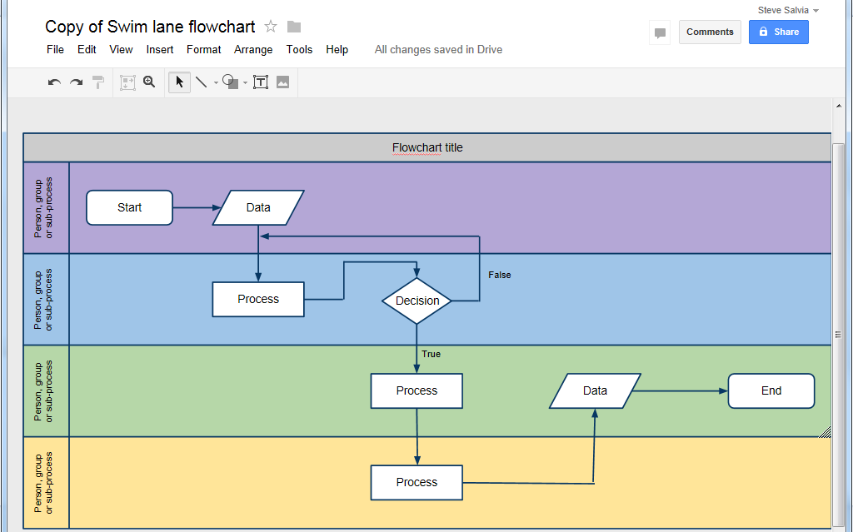
Google Docs Template

