Slide 1
AJ’s AI Frankendeck

Slide 2
Automation
When Benjamin Franklin was making scientific calculations by hand, his sister Jessica thought “I can do that much faster by writing a few lines of Python.” Automation was born.
In fact, automation and coding started with for example punchcards for Looms that were weaving fabric. The first design for a programmable computer (analytical engine) was made in the 1830s by Charles Babbage (he didn’t get to build it, though).
We are always looking for ways to automate physical and office work (labor is expensive).
Automating work that is repetitive is relatively easy. AI is letting us automate work that is more complex.

Slide 3
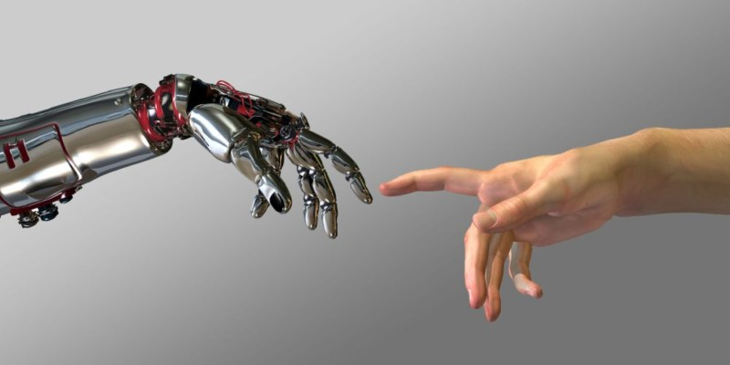
What is Artificial Intelligence?
Three Types
Narrow (ANI)
General (AGI)
Superintelligence (ASI) (“the singularity”)
Source: https://matrixni.org/artificial-intelligence-workshop-january-2018-register-now/
FOX
MIS
Notes:
https://matrixni.org/artificial-intelligence-workshop-january-2018-register-now/
Start the AI Discussion.
Then click the image to watch a quick (https://www.digitaltrends.com/cool-tech/what-is-artificial-intelligence-ai/)
This is a 1:53 minute video to further the discussion
The term AI was coined in 1956…the concept has been around for over 60 years!
Ask the students for examples of all 3 types:
Narrow (ANI) – all around us…google maps/waze/Facebook/autonomous cars/amazon suggestions
General (AGI) – Human Level Intelligence
Superintelligence (ASI) – Intelligence that exceeds that of a human
Moore’s Law – Computing Power doubles approximately every 2 years
An Executive and Strategic Perspective on AI
“AI promises to be one of the most disruptive and innovative classes of technologies during the next 10 years. It includes many areas of study and technologies behind capabilities — voice recognition, NLP, image processing and others — that benefit from advances in algorithms, abundant computation power and advanced analytical methods such as machine learning (ML) and deep learning (DL).”
Source: https://ssofed.gartner.com/sp/startSSO.ping?PartnerIdpId=https://fim.temple.edu/idp/shibboleth&TargetResource=https%3A%2F%2Fwww.gartner.com%2Fdocument%2F3899474%3Fref%3Dd-linkShare

Slide 4
Where is AI used?
Playing chess
Playing Go
Driving a car
Siri, Alexa, Google Assistant
Pattern recognition: e.g. cats in images, faces, fraudulent credit card transactions, key areas of text in a document.

Slide 5
AI and Strategy
Can AI give your company a strategic advantage?
If yes, how?
If no, why use AI?

Slide 6
What is Classification?
A statistical method used to determine to what category (or “class”) a new observation belongs
  On the basis of a training data set containing observations whose categories were known
Examples
Task | Observations | Categories (Classes)
Flagging a credit card transaction as a fraudulent charge | Credit card transactions | Fraudulent vs. legitimate
Filtering spam emails | Emails | Spam vs. non-spam
Determining whether a customer should be given a loan | Customers | Default vs. no default

Slide 7
How Classification Works
Training Set
TID | Income | Debt | Owns/ Rents | Outcome
1 | 25k | 35% | Owns | Default
2 | 35k | 40% | Rent | Default
3 | 33k | 15% | Owns | No default
4 | 28k | 19% | Rents | Default
5 | 55k | 30% | Owns | No default
6 | 48k | 35% | Rent | Default
7 | 65k | 17% | Owns | No default
8 | 85k | 10% | Rents | No default
…
Derive model
Classification software (such as R)
Validation Set
TID | Income | Debt | Owns/ Rents | Outcome
1 | 80k | 35% | Rent | ?
2 | 20k | 40% | Owns | ?
3 | 15k | 15% | Owns | ?
4 | 50k | 19% | Rents | ?
5 | 35k | 30% | Owns | ?
Apply model

Slide 8
Example: Credit Card Default
Predictors
Classification
Child node
Leaf node
TID | Income | Debt | Owns/ Rents | Outcome
1 | 25k | 35% | Owns | Default
2 | 35k | 40% | Rent | Default
3 | 33k | 15% | Owns | No default
4 | 28k | 19% | Rents | Default
5 | 55k | 30% | Owns | No default
6 | 48k | 35% | Rent | Default
7 | 65k | 17% | Owns | No default
8 | 85k | 10% | Rents | No default
…
Root node
Debt > 20%
Default
Income
<40k
Owns house
No Default
Debt < 20%
Rents
Default
Credit
Approval
Owns house
No Default
Debt > 20%
Income
>40k
Rents
Default
Debt < 20%
No Default
Training Set

Slide 9
Reading the Decision Tree Result
Outcome cases are not 100% certain
  There are probabilities attached to each outcome in a node
  So let’s code “Default” as 1 and “No Default” as 0
Credit
Approval
Income <40k
Income >40k
Debt >20%
Debt <20%
Debt >20%
Debt <20%
Owns house
Rents
Owns house
Rents
0.85
0.20
How many leaf nodes are there?
0.30
0.22
0.60
0.26

Slide 10
Robotic Process Automation

Slide 11
Robotic Process Automation (RPA)
Uses software to mimic a human completing multiple tasks
Automate repetitive tasks based on rules
New software available to handle longer processes
Able to integrate with other systems, like SAP
Forrester estimates that by 2021, there will be 4 million “robots” completing various tasks for firms
“Robots” can become a virtual team for a company
Watch Demo2

Slide 12
Some simple “robot” tasks
Log into applications
Connect to systems
Copy and paste data
Move files and folders
Extract content from documents
Read/write to databases
Open emails and attachments
Get data from the web
Make calculations

Slide 13
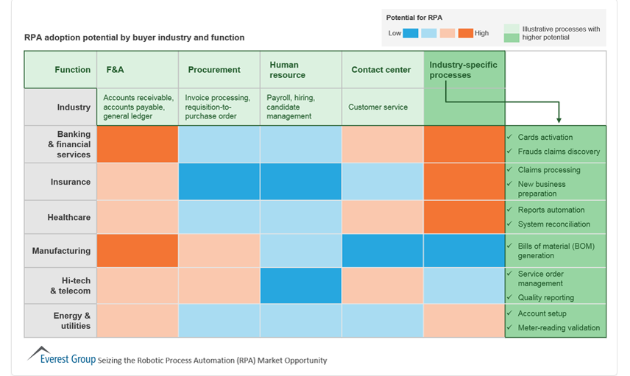
What processes are relevant for RPA?

Slide 14
Last Remarks
Business
  Are knowledge workers prepared to work with a “robot” as an assistant?
  Why haven’t more firms incorporated RPA into their business process yet?
Education
  How should our curriculum change to prepare our students to work in this environment?
Society
  What happens to global outsourcing?

Slide 15
How does AI work?
Simple AI: rules (expert systems, case based reasoning)
Advanced AI: Neural networks (machine learning)

Slide 16
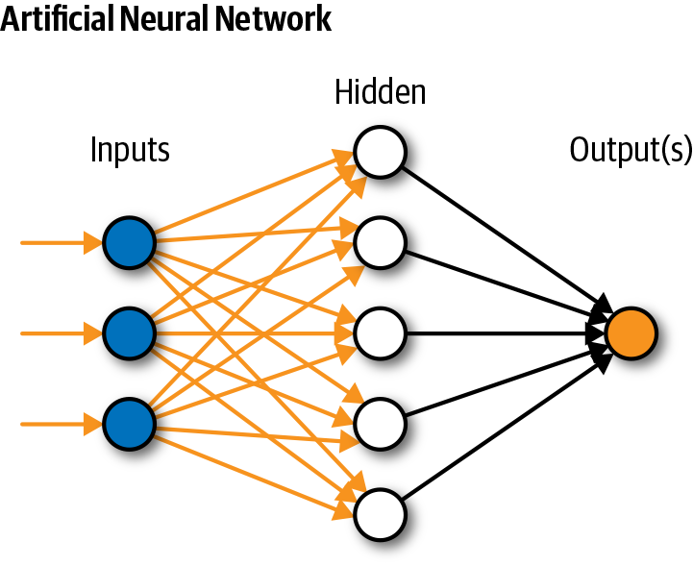

Slide 17
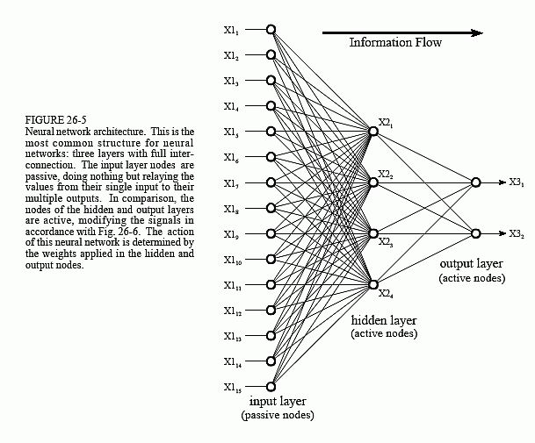

Slide 18
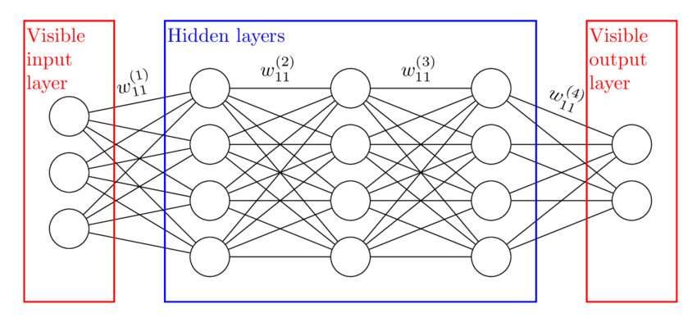
Deep Learning: Many Hidden Layers

Slide 19
AI and Faces

Slide 20
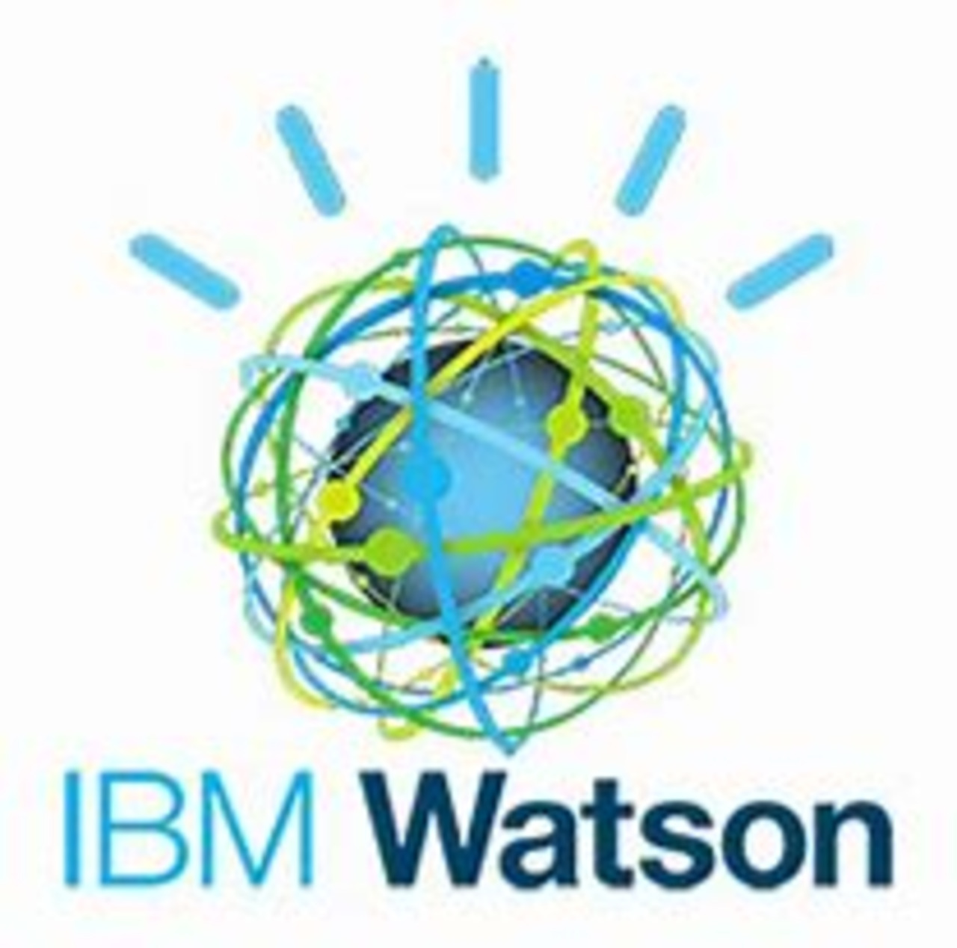
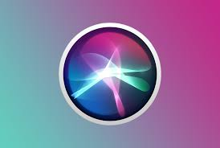
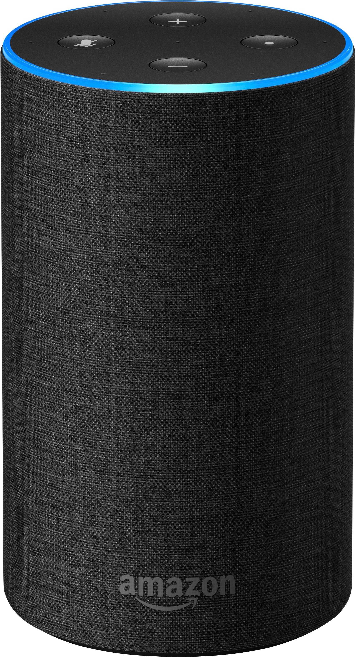
What if we put a face on
Siri, Alexa, Watson…?

Slide 21
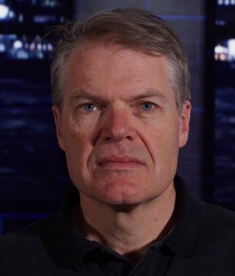
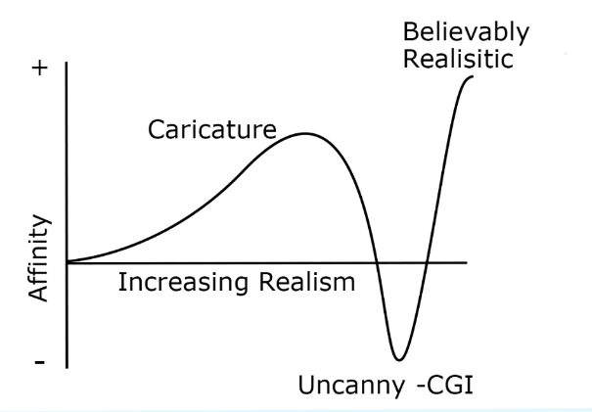
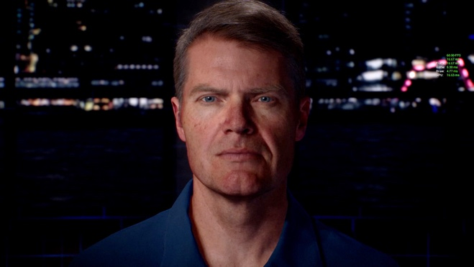
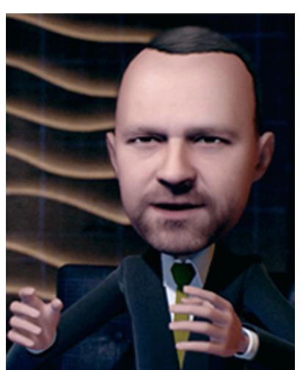
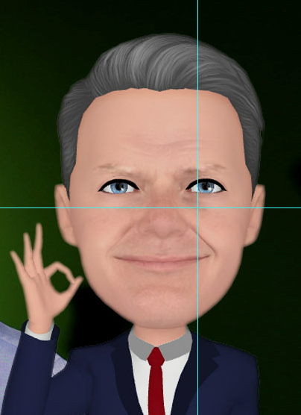
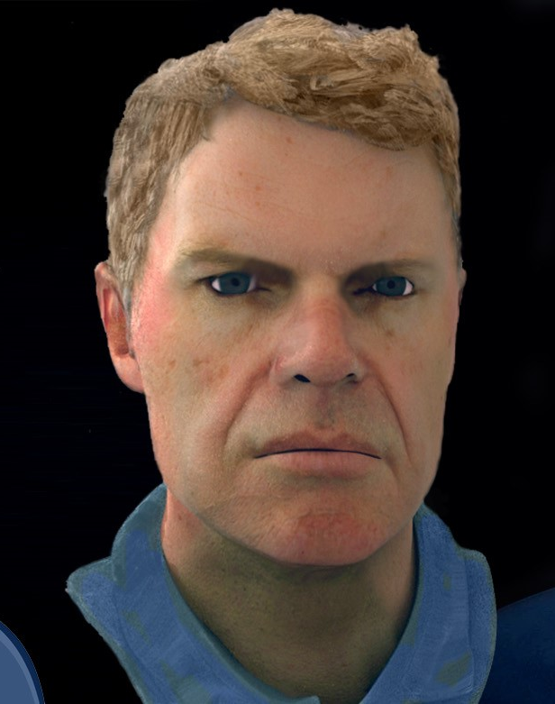
Faces and the Uncanny Valley
https://www.youtube.com/watch?v=6MIkoLBWRv0

Slide 22

To Help AI Succeed
likeable
Put a face on it
V

Slide 23
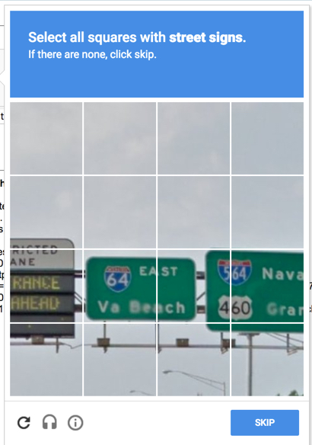
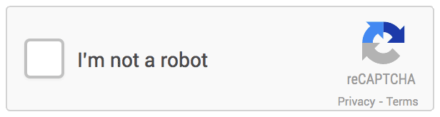
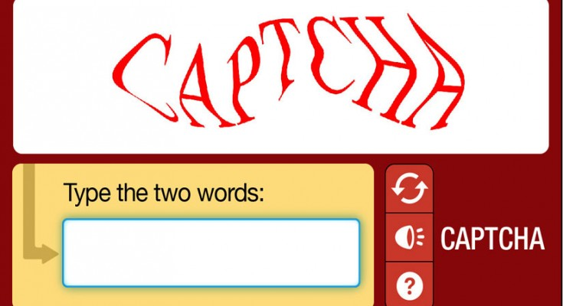
The AI Revolution: Are you a Robot?
What tests have you encountered?
What makes this challenging for AI?
https://www.webnots.com/fix-im-not-a-robot-captcha-issue-in-google-search/
Source: https://www.gohacking.com/what-is-captcha-how-it-works/
FOX
MIS
Notes:
Computers have difficulty distinguishing this info.
John Mulvaney did a great parody of “Am I a Robot” on Saturday Night Live on 04/14/2018 check it out!!!
https://twitter.com/nbcsnl/status/985369977975902208?lang=en
Ask the students how many of them have had to pick out a “Traffic Light”?

Slide 24
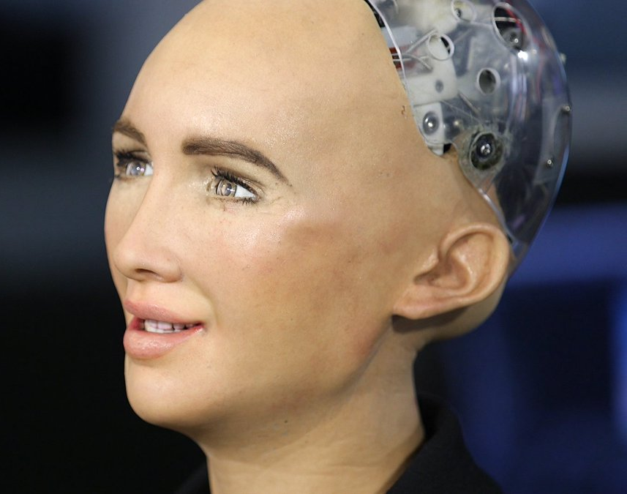
Meet Sophia
Granted legal Citizenship in Saudi Arabia
Source: https://youtu.be/78-1MlkxyqI
FOX
MIS
Notes:
Meet Sophia, the 1st Robot Citizen!
https://youtu.be/78-1MlkxyqI
https://www.sfgate.com/technology/businessinsider/article/A-robot-that-once-said-it-would-destroy-humans-12308532.php?ipid=articlerecirc#photo-14425805

Slide 25
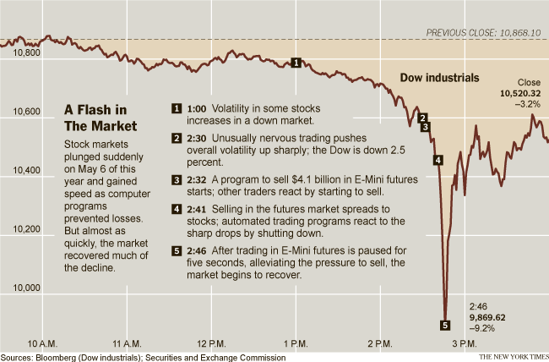
The AI Revolution
2010 Flash Crash
ANI caused stock market to plummet
$1 trillion decline in value
Quick recovery
Source: http://graphics8.nytimes.com/images/2010/10/02/business/flash-crash-dow/flash-crash-dow-popup.png
FOX
MIS
Notes:
ANI systems as they are now aren’t especially scary. At worst, a glitchy or badly-programmed ANI can cause an isolated catastrophe like knocking out a power grid, causing a harmful nuclear power plant malfunction, or triggering a financial markets disaster
(like the 2010 Flash Crash when an ANI program reacted the wrong way to an unexpected situation and caused the stock market to briefly plummet, taking $1 trillion of market value with it, only part of which was recovered when the mistake was corrected).

Slide 26
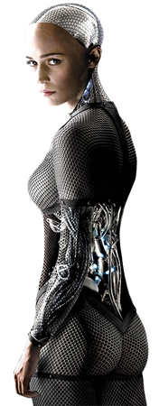
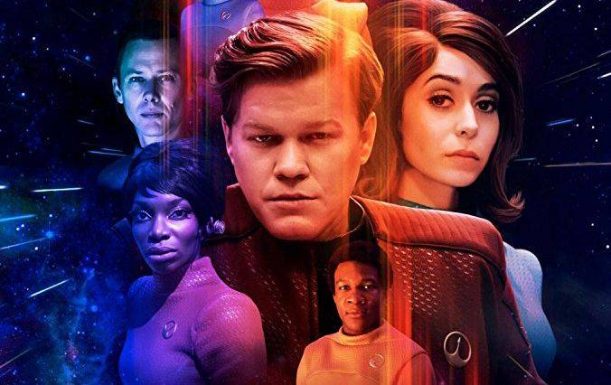
AGI Tests
The Turing Test
The Coffee Test
The College Student Test
Source: https://www.newsweek.com/black-mirror-season-4-callister-star-trek-769795
Source: http://robotfacebook.edwindertien.nl/product/ex-machina/
FOX
MIS
Notes:
The Turing Test, developed by Alan Turning in 1950, tests a machine’s ability to exhibit intelligent behavior equivalent to, or indistinguishable from, that of a human. It is essentially having a person interact with either a machine or a person and not being able to tell the difference
Black Mirror episode:
https://www.newsweek.com/black-mirror-season-4-callister-star-trek-769795

