Slide 1
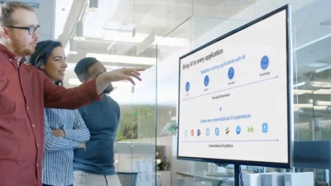
Building a Schedule & Setting up a project profile MIS3535 | LEAD GLOBAL DIGITAL PROJECTS

Slide 2
?
Work?
Duration?
PERT?
How long will this take?
Contingency?
SWAG?

Slide 3
What is worse, padding your estimates and never being late or low-balling your estimates and proposing faster projects?

Slide 4
In estimating, what is a “SWAG” and how are estimates refined over time?
Scientific Wild-Ass Guess or Rough Order of Magnitude Estimate for selecting projects +- 50-75%
2nd round for organization-wide budgeting +- 25%
Final project budget +- 10%
For VERY large projects (i.e. multi-year) you may refine budget over time

Slide 5
As the project manager, how do you know how long it will take to build the server or install the database or write the code?

Slide 6
What is “bottom up”, “top down”/ “parametric” and three-point estimating?

Slide 7
What is PERT and when would you use it?
PERT: Program Evaluation Review Technique
Use it only when there is great uncertainty with estimates

Slide 8
PERT Formula and Example
PERT weighted average =
optimistic time + 4X most likely time + pessimistic time
6
Example:
PERT weighted average =
8 workdays + 4 X 10 workdays + 24 workdays = 12 days 6
where optimistic time = 8 days
most likely time = 10 days, and
pessimistic time = 24 days
Therefore, you’d use 12 days instead of 10 when using PERT

Slide 9
Why is padding your estimates bad? You don’t want to be late, do you?

Slide 10
What are “contingency funds” and “management reserves”? Are they OK?

Slide 11
Setting up a project file

Slide 12
What do we mean by “sequencing activities”? What are “dependencies” between activities? What types of dependencies are listed in the video? Which are the most frequently used?
Web research /
VIDEO
Determining the sequence in which the activities need to occur
Dependencies are the relationships of the preceding tasks to the succeeding tasks. Tasks may have multiple preceding tasks and multiple succeeding tasks.

Slide 13
Can you give an example of tasks with the following types of dependencies?
Finish-to-start (FS)
Start-to-start (SS)
Finish-to-finish (FF)
Start-to-finish (SF)
You have to finish the testing phase before you start the pilot
When the vendor starts specifying equipment for the conference center, they also start specifying equipment for hotel rooms
When the IT team finishes connecting equipment to the network, they also finish their testing of the connections
The start of the race triggers the end of the pre- race music

Slide 14
What is the “critical path”? Does the critical path ever change? What are 3 techniques to shorten the schedule?
Web research /
VIDEO
The critical path is the sequence of tasks in your schedule with the longest duration. Why is the critical path so critical? Because any delay on that path delays the finish date of the project. Just as significant, you can shorten the project schedule if you can figure out how to shorten the critical path.
Fast tracking, crashing & cutting scope!

Slide 15
What is a “buffer”? What is “Murphy’s Law”? What is “Parkinson’s Law”?
Web research
A buffer is additional time to complete a task
Murphy’s Law states that if something can go wrong, it will!
Parkinson’s Law states that work expands to fill the time allotted for its completion (time allowed).

Slide 16
What is “critical chain scheduling”?
Web research /
VIDEO
It is not the same as critical path!
The Critical Chain Scheduling has a resource focus, whereas Critical Path is task focused
Critical path and critical chain are both methods of project scheduling
Critical chain is completed after determining critical path by entering resource availability and the resulting schedule produces a resource-constrained critical path, which is usually altered from the original.
The critical chain method is a technique that modifies the project schedule to account for limited resources by adding time buffers to give the project some breathing room. Steps to follow :
Remove all buffers from individual tasks
Add a single project buffer at the very end
Selectively add feeding buffers to tasks on the critical path

Slide 17
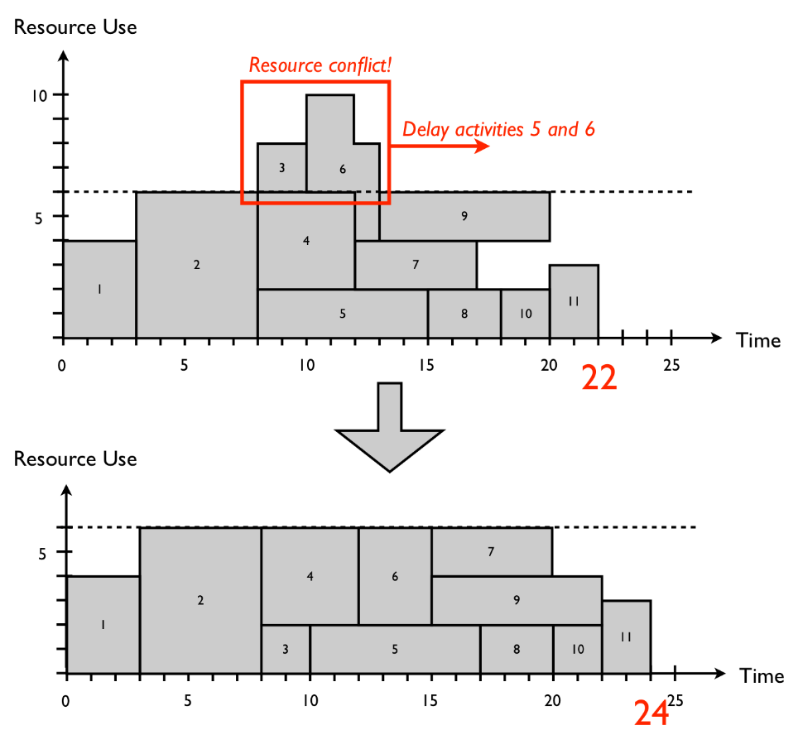
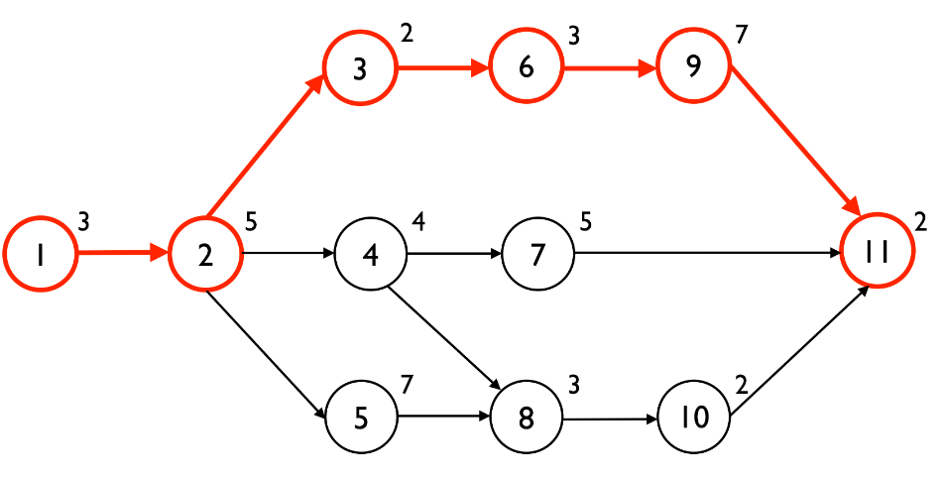
Tasks focused
Resources focused
Figure 1: An example project network with the critical path equal to 22 time periods
Figure 2: The resource profiles for the critical chain schedule and a resource-feasible schedule
Source : PM Knowledge Center

Slide 18
What is a project “milestone”? Can you give a few examples of where you would use one?
Web research /
VIDEO
A milestone is a significant event that normally has no duration

Slide 19
Studio day : Friday
First draft of : Your Project Charter
Then start working on your WBS….
For both: use the format posted on our course blog

Slide 20
Monday : Change Leadership Day!
Read Kotter Chapter 1
Prepare a brief PowerPoint presentation (2-5 slides) for your 3 favorite short stories:
The first slide will “tell the story”.
The following slide(s) will include key lessons learned the reader should take away from the case and how it relates to your current project.
Students will be selected at random to lead the class discussion
Kotter Chapter 1 : Increase Urgency
Getting the Boss’ Approval
The Videotape of the Angry Customer
When Alligators are Nipping at Your Heels
Gloves on the Boardroom Table
The CEO Portrait Gallery

Slide 21
Studio day : Wednesday
Create your schedule (tasks and milestones)

