Slide 1
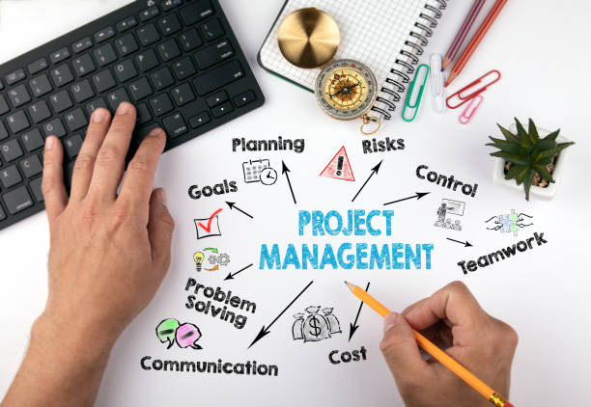
Introduction to Project Management MIS3535 | LEAD GLOBAL DIGITAL PROJECTS

Slide 2
What is a “project”? What differentiates a project from operational work activities? What differentiates a project from a product?
unique endeavor with clear-cut objectives, a starting point, an ending point, and usually a budget.
Operations is work done to sustain the business, same work or task day after day, producing the same result.
A product is offered to the market to solve a problem or satisfy a need. A product does not have a specific end point but rather lifecycles and stages it goes through. Multiple projects can exist during a product’s life.

Slide 3
Why Manage Projects?
Why Manage Projects?
Happy Customers (more future revenue!)
Achieved Objectives
Timely completion
Flexibility/Ability to react (Plan B!)
Better Financial performance
Happier, more productive workers

Slide 4
What percentage of IT projects are successful?
Web research

Slide 5
68% of companies are more likely to have a marginal project or outright failure than a success due to the way they approach business analysis (i.e. : gather & document requirements)
Large projects are twice as likely to be late, over budget, and missing critical features than small projects.
A PricewaterhouseCoopers study found that overall, half of all projects fail and only 2.5% of corporations consistently meet their targets for scope, time, and cost goals for all types of project
As per an IBM study, about 40% projects meet budget, schedule and quality goals. (Harvard Business Review)

Slide 6
Why do projects fail?
Scope Creep
Overallocated Resources
Poor Communications
Bad Stakeholder Management
Unreliable Estimates
No risk Management
Unsupported Project Culture
The Accidental Project Manager
Lack of Team Planning Sessions
Monitoring and Controlling
Web research

Slide 7
What are some of the key factors which influence the success of a project?
Executive support
User involvement
Experienced project manager
Clear business objectives
Minimized scope
Planning, Planning, Planning
Firm basic requirements
Formal methodology or framework
Reliable estimates
Other criteria, such as small milestones, competent staff, and ownership

Slide 8
What is “project management”?
The art of balancing project objectives against the constraints of time, budget, quality & scope

Slide 9
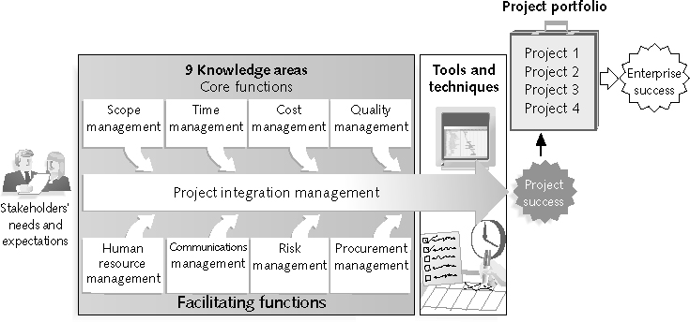
Project Management Framework The 10 Knowledge Areas – Need to master ALL!
Project Management Framework The 10 Knowledge Areas – Need to master ALL!
Stakeholder Management
10

Slide 10
What are some of the most important skills and competencies of excellent project managers? What is an alpha project manager?
Web research
1. People skills & Interpersonal Skills
2. Strong Leadership : inspire your people, hold them accountable (inspire a share vision)
3. Listening, empathy
4. Integrity, ethical behavior, consistent
5. Strong at building trust
6. Verbal communication
7. Strong at building teams
8. Conflict resolution, conflict management
9. Critical thinking, problem solving
10. Understands, balances priorities
11. Technology & Business Skills : Competence!

Slide 11
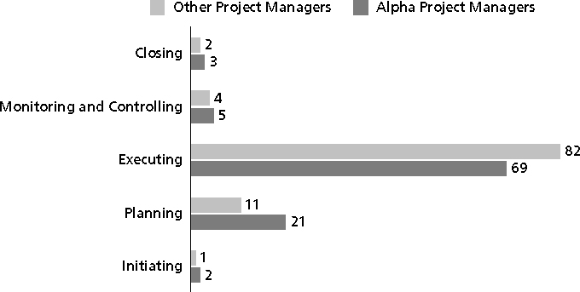
Percentage of Time Spent on Each Process Group
Percentage of Time Spent on Each Process Group

Slide 12
What are the five phases of project management?
Initiating
Planning (what? how? How will we know that we are done?)
Executing
Monitoring & Controlling
Closing : client accept, document & gather lessons learned

Slide 13
What is the “triple constraint”?
Web research

Slide 14
In-Class Exercise
Find a partner
Draw the “Scope Triangle”
Can you increase the scope without changing time or cost?
What changes if you reduce scope?
Keeping quality/scope constant, cut cost in half. What happens?
Keeping quality/scope constant, cut time in half. What happens?
Notes:
S
Q
C
T
S
Q
C
T

