Slide 1
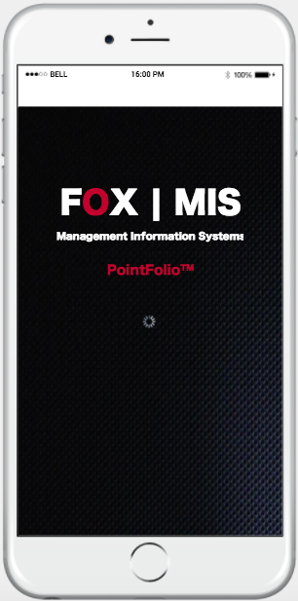
MIS Pointfolio App
Marc Gold, Adriana Shuster, Josh Veloso, Run Zhu
Notes:
Slide 1-3: Adriana (1 min)
Slide 4-6: Marc (2 min)
Slide 7-9: Josh (2 min)
Slide 10: Adriana (1 min)
Slide 11: Marc (1 min)
Slide 12: Josh (1 min)

Slide 2
About the Program
Professional Development
MIS Department Points Program
Recognition
Rewards
Notes:
According to its website, Temple’s MIS department points program focuses on the professional development of its students and getting them ready for the workforce. The highest achieving students are recognized throughout the program through scholarships and awards, and their progress is measured through the department’s Points program.

Slide 3
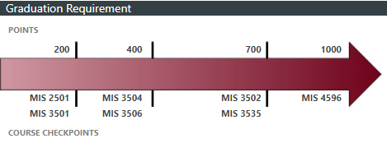
The Current Process
Students earn points
Students meet checkpoints
Students meet 1000 points requirement to graduate
Notes:
Students participate in events, projects, and job fairs to earn these points, which are set up as checkpoints necessary to pass in order to register for the next class in the structure. While many newer students are unaware of these checkpoints, it is a requirement to have a minimum of 1,000 in order to graduate as an MIS major.

Slide 4
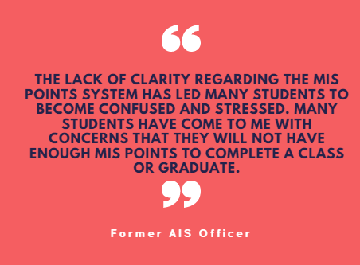
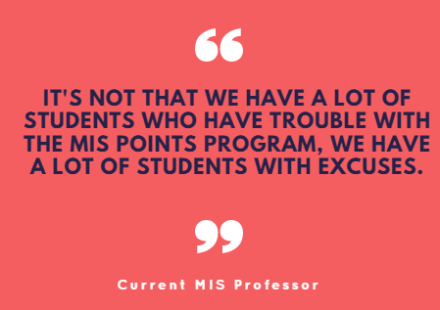
Trust the Process?
Notes:
Issues with program
Students unable to achieve points
Unable to graduate or register for classes on time
What is working
What is not working

Slide 5
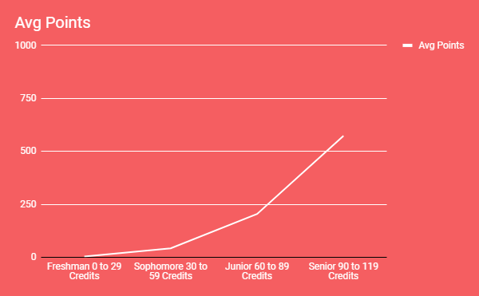
Average Points by Class
Avg Points by Class:
Freshman: 3.75
Sophomore: 42.31
Junior: 204.60
Senior: 573.32
Source:
Data Provided by Munir Mandviwalla
Notes:
Average Points by class:
Freshman: 3.75
Sophomore: 42.31
Junior: 204.60
Senior: 573.32

Slide 6
25%
Students in MIS 4596 capstone class who currently do not meet the 1000 point requirement to graduate
60%
MIS Majors who are involved in AIS
20%
Participants of AIS events who are considered active members
Source: Data provided by Tony Messina and Hana Yu
Notes:
THE PROBLEM
As you can see, the program faces several challenges. From the student’s perspective, they are not given enough time and information to achieve the necessary points to meet the checkpoints. Many of them are confused and are not aware of all the opportunities. On the other hand, you can see by the data that students are not engaging enough in the opportunities presented to them, such as AIS. Through our Pointfolio App and admin changes, we hope to solve this problem.

Slide 7
Our goals
Eliminate Confusion
Higher Engagement
Easier administration
Our solution will make it easier to engage in the MIS Points Program and achieve the 1000 points to graduate
Notes:
What we hope Pointfolio accomplishes
Eliminate confusion students have about the program. They will be better informed and be knowledgeable about all the opportunities to earn points
More students will be involved in these events, which will lead to better attendance at these events
Bypassing the middleman and having points directly added to student’s profile, admins will not have to input much data and act more as reviewers

Slide 8
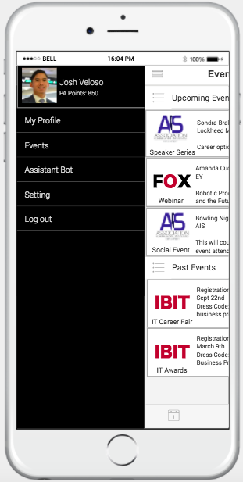
THE
SOLUTION
Points Tracker
Events Scheduler
Student Assistant
Notes:
What is it
Points Tracker
Events scheduler
Tool to help students

Slide 9
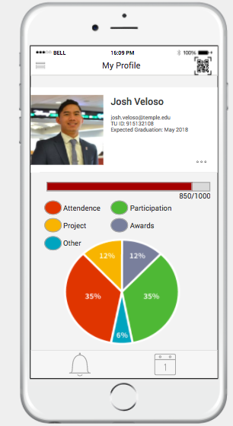
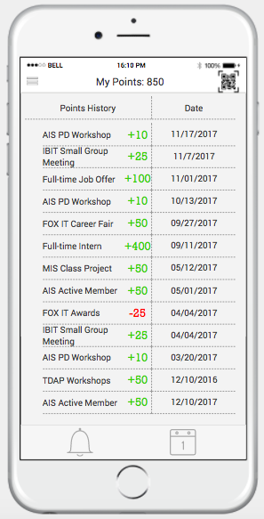
Points Tracker
Notes:
Many students already have this points distribution pie chart on their Eportfolio dashboard
This app integrates with their Eportfolio so that students can easily view their point distribution
Moreover, this app will allow students to see exactly when and how they got their points
Students who choose to make their profile public will allow other students to see their point distribution and help them plan their own path to 1000

Slide 10
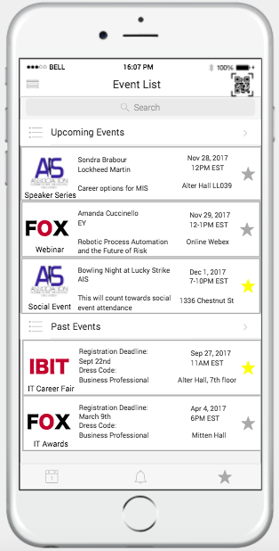
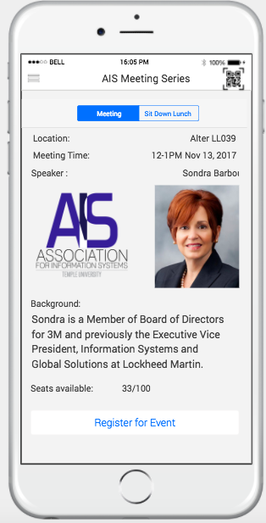
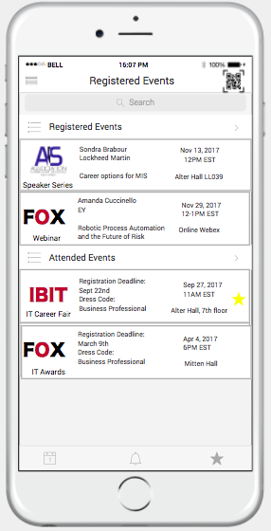
Events Scheduler
Notes:
Students can view all upcoming events on the event list page
They can learn more about each event and register for the events right on the app
Once they register for an event, the event will be listed on their registered events page
On the day of each event, they will scan the given QR code and the points will be automatically added to the students profile
For each event the student registers for, they will receive push notifications
Students can view all upcoming events on the event list page, including a quick summary of basic details such as time and location. If a particular event catches their interest, they can click to learn more details on the event and register. Once registered, students can attend the event and scan the QR code provided for the points to automatically be added to their profiles. This will also cut down manual work for the MIS department. That will then move the event over to the registered events section of the app, where students can keep track of their events.

Slide 11
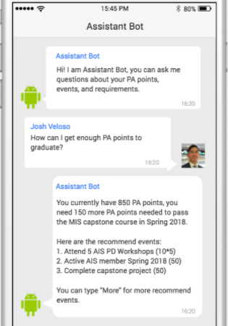
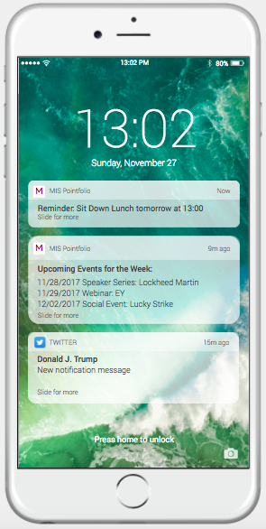
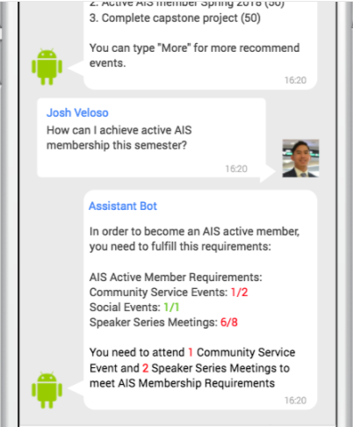
Student Assistant
Notes:
Push notifications will remind students when they have events coming up
Also a weekly notification of events for the week allows no more excuses for students who complain about not knowing about ways to earn points
The assistant bot powered by IBM Watson will utilize the departments and the students own data to help the student in the points earning process. This is an implementation

Slide 12
Implementation
Updates & New Versions
Rankings
MIS Store
More analytics
Maintenance
Event Owners
Administrators
Ongoing Support
Development
One-time Development
IBM Watson Assistant Bot
Est. Initial Cost = $5000
Student Orientation
MIS Orientation
+50 points for download

Slide 13
Financials
 | Year 0 | Year 1 | Year 2 | Year 3
One Time Development | $3000¹ | $0 | $0 | $0
IBM Watson Bot | $2000² | $25³ | $25³ | $25³
Updates | $0 | $0 | $1000³ | $1000³
Total | $5000 | $25³ | $2025 | $2025
 |  |  | Total 3 Year Cost | $9075
1 - Cost of Developer for app (not including bot)- $100/hr * 30 hours = $3000
2 - Cost of Developer for Chat Bot- $100/hr * 20 hours = $2000
3 - $0.0025/API call * 500 students * 20 queries = $25
4 - Cost of Developer for updated features - $100/hr * 10 hours = $2000

Slide 14
Implementation
Updates & New Versions
Rankings
MIS Store
More analytics
Maintenance
Event Owners
Administrators
Ongoing Support
Development
One-time Development
IBM Watson Assistant Bot
Est. Initial Cost = $5000
Student Orientation
MIS Orientation
+50 points for download

Slide 15
MIS Pointfolio App
THANKS FOR VIEWING!

Slide 16
Appendix
IBM Watson Chat Bot Price Plan
Data Model
Process Model
Systems Architecture
Data Analysis

Slide 17
1. IBM Watson Chat Bot Price Plan
Notes:
Chatbot: https://www.ibm.com/blogs/watson/2016/12/build-chat-bot/

Slide 18
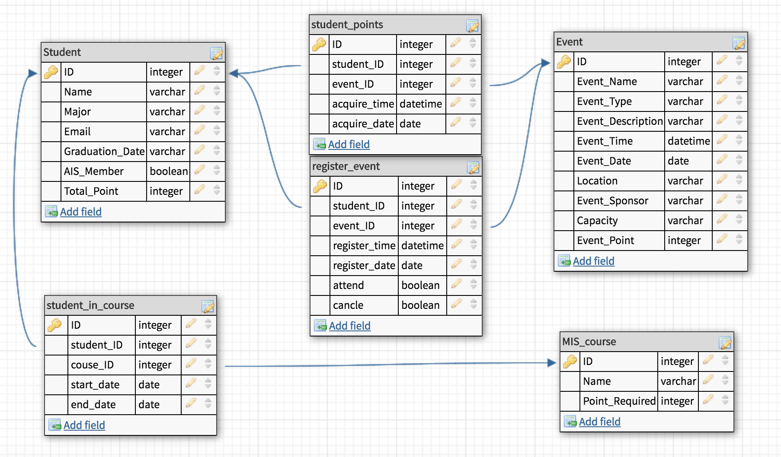
2. Data Model

Slide 19
3. Process Model

Slide 20
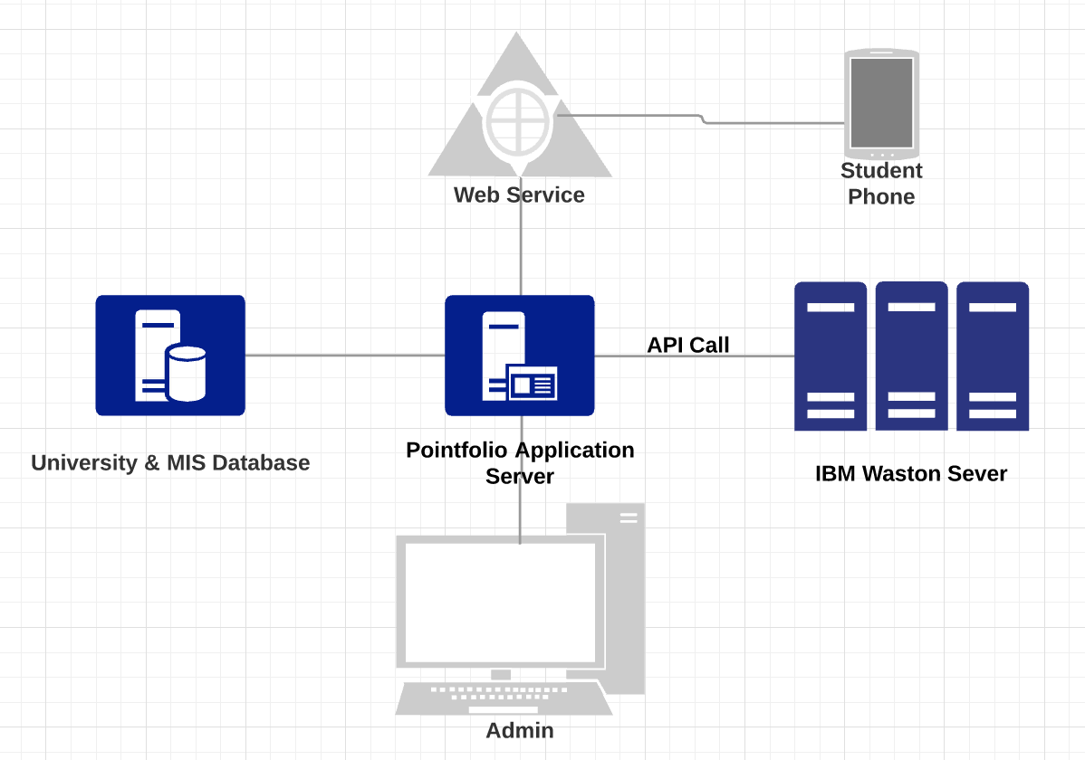
4. Systems Architecture

Slide 21
5. Analysis References
Notes:
From pointsanalysis09_2017_Shared.xlsx

Slide 22
5. Analysis References
Notes:
mis_pointsOct2017Anonymized.xlsx

Slide 23
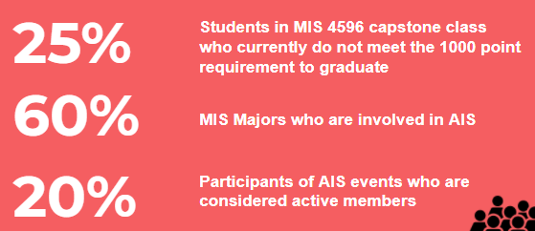
5. Analysis References
25%, 10/40. Source: Tony Messina
60%, 281/450. Source: AIS Spring 2017 info and Joe Allegra
20%, 56/281. Source: AIS Spring 2017 info

