Slide 1
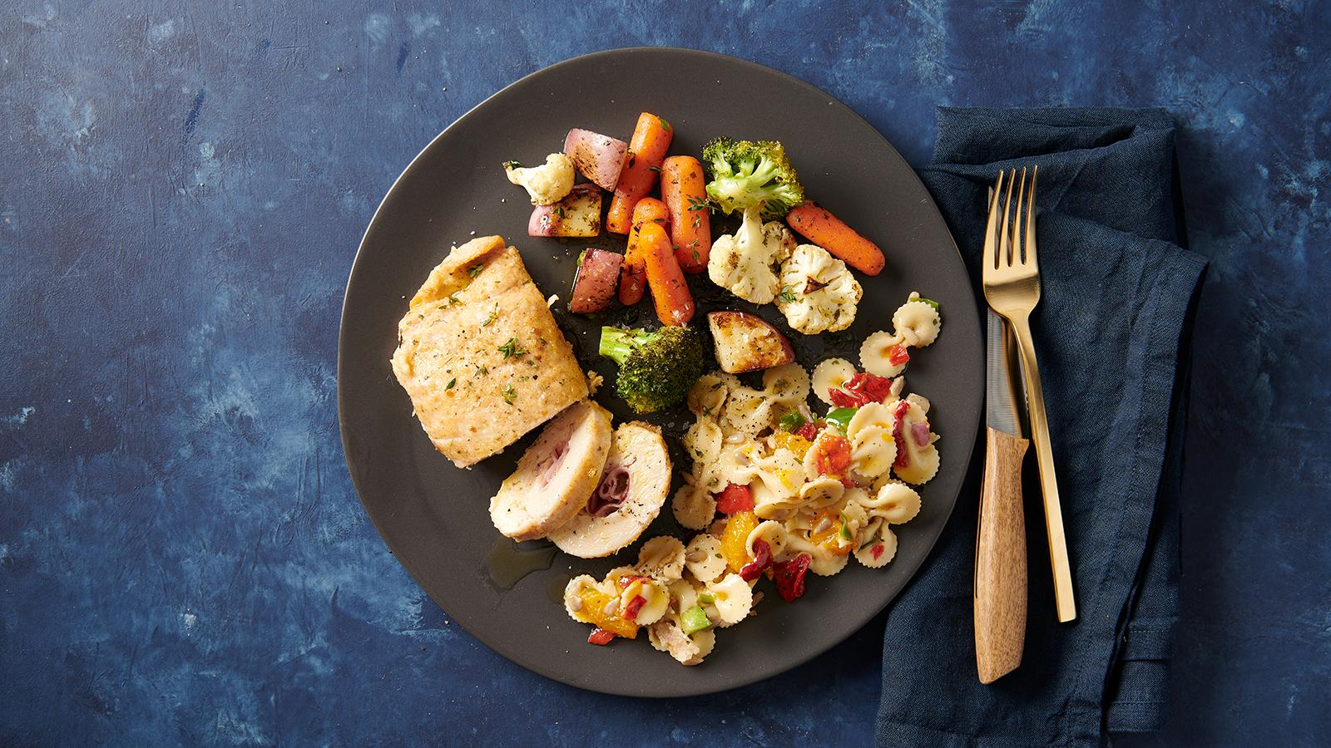
Potluck
Christian Hettinger | Crystal Van | Grisselle Rivera | Chanyang Choi

Slide 2
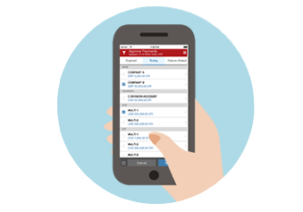
Market Opportunities
Trend of Meal Planning to:
Save Money
Eat Healthier
Reduce Waste
49% of millennials planned to cook at home more in 2017
59% of 25-34 year olds cook with smartphones or tablets on hand
Notes:
Currently consumer trends indicate a shift towards cooking at home more and meal planning to save money, eat healthier to reduce waste →
Millenials are starting to cook at home more but lack the set of skills/knowledge that their parents/grandparents have. Others interested in cooking at home more say their main limitation is finding recipe inspiration,
There is a large market for tools, especially mobile ones to help people plan/schedule their meals and find recipe inspiration.

Slide 3
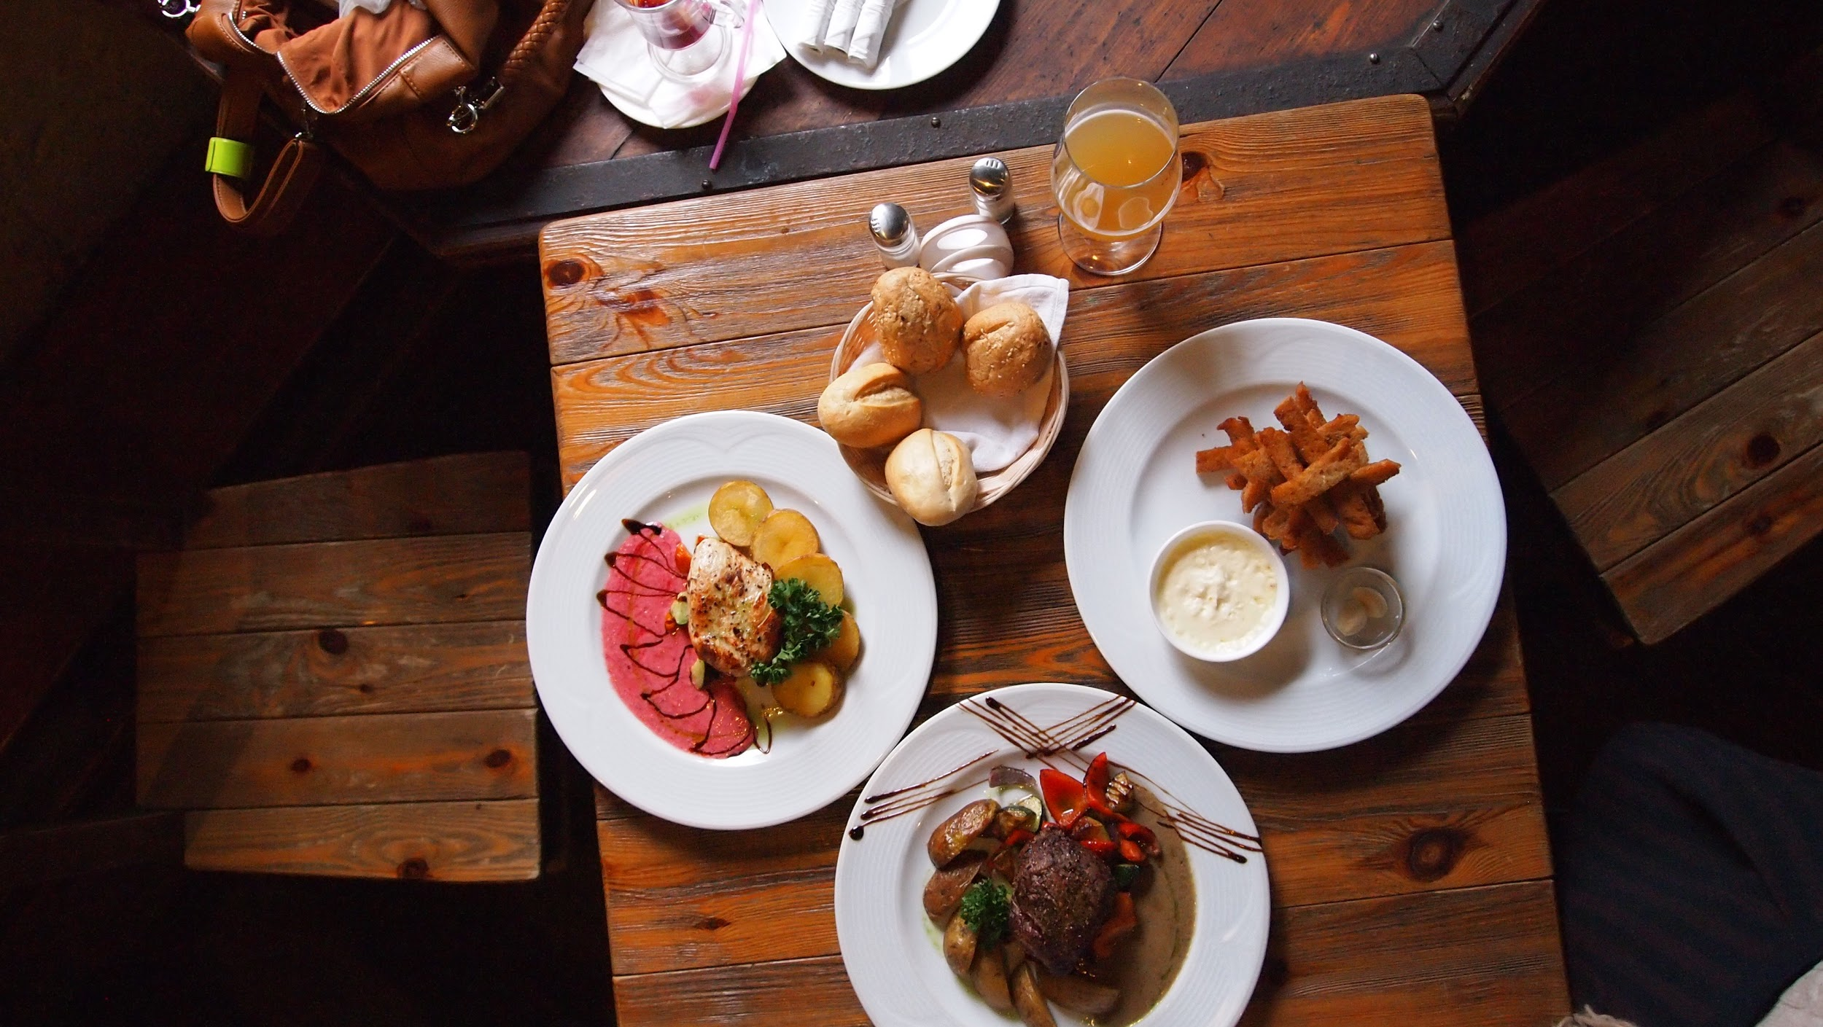
Current Situation
Lack of Integrated Features
Trade off: Social Features vs. Food Focus
Poor Data Quality Limits Value Creation
Notes:
Lack of integrated features forces users to use multiple apps to find and share recipes, create meal plans, and plan social events around food. When trying to view recipes in apps like pinterest and yummly, it redirects you to another site, which i personally find annoying and it takes away from the in app experience.
Recipe indexers lack the community aspect and general social media sites lack recipe focus. There’s so much content on social media sites like facebook, that even if you see a recipe you’re interested in, it gets lost in the feed.
These apps collect a lot of consumer data but they do not properly leverage it to provide value to customers.
User-provided data lacks uniformity and prevents existing apps from leveraging it to provide value to customers. Ex. All prev referenced apps
Social media apps do not collect data regarding the ingredients or dietary restrictions when you post content about food
Recipe-building apps do not contain your friends interests/preferences so they can not provide features that leverage both your food preferences and your friend’s

Slide 4
Potluck as the Solution
Integrated Set of Features
Eliminates the Trade Off
Leverages Data to Provide Value
Recipe Finder
Meal Planner
Event Planner
Grocery List
Blends Social Media with Recipe Indexers to capitalize on social aspect of food
Suggested recipes and added insight into friends’ preferences
Notes:
With our solution, we will incorporate aspects of social media sites, like being able to create a profile and having a social feed with aspects of recipe finding sites, like finding recipes based on dietary restrictions and allergies. This blend will eliminate the tradeoff and allow us to capitalize on the social aspect of food. Additionally, we will leverage consumer data to provide value through tailored recipe suggestions and added insights about friends recipe preferences. How all these features work together will become more clear as we walk through our prototype.
Data: We collect data like the ingredients for all recipes, the materials needed and the instructions
Having the ingredients helps us our machines learn what you like and suggest more recipes
Also having ingredient and materials as data types allows users to more easily purchase the ingredients/materials they need
Having friends data allows us to provide features that leverage both your information and your friends to boost the community aspect of our app (explain more in prototype?)

Slide 5
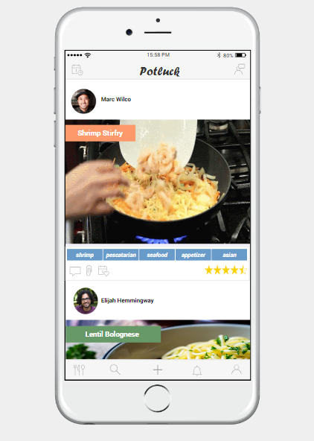
Prototype Demonstration

Slide 6
Sources of Revenue
Product Referral Revenue
Promoted Posts
Premium Account Subscribers
Advertising

Slide 7
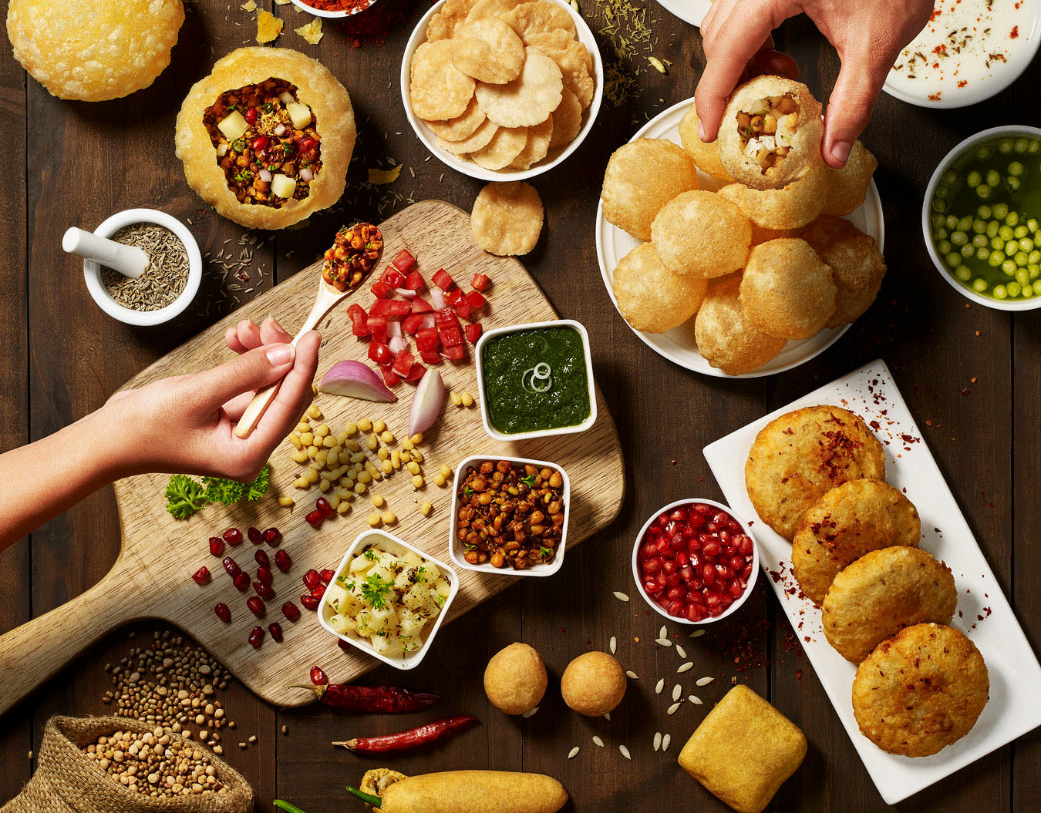
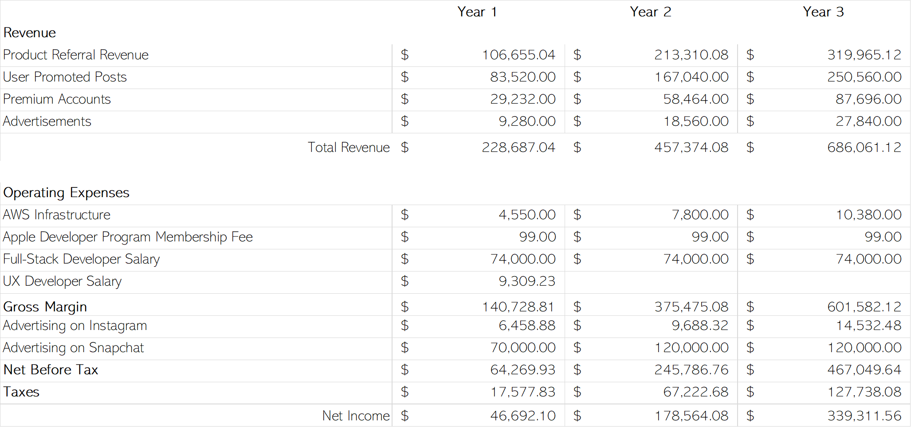
Earnings Projection
Notes:
This is our three year projected revenue and earnings forecasts based on our research and generally conservative assumptions.
Some of which being:
30% of users who download app will create account
3.5% of users with accounts will upgrade to Premium
Price for Premium: $2.50/month
5% of users will make in-app purchases averaging $13
15% of referral purchases will go to Potluck
Based on these assumptions, our largest source of revenue will be via product referrals. We have considered that a few of our expenses, infrastructure for example, must be scaled as we grow.
As an additional analysis, a breakeven scenario was created for Year 2 wherein we would need to have about 25,000 free account users to avoid a loss in that year.

Slide 8
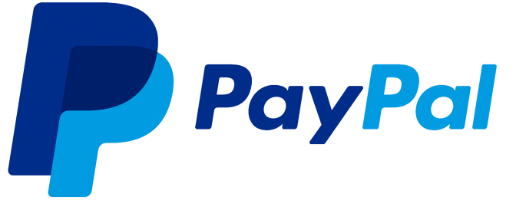
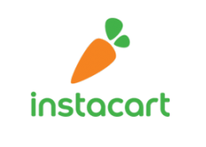
Systems Architecture
Paypal
API
Amazon API
Instacart
API
Potluck
App
Premium Membership
Purchasing Items
Firewall
Internet
Network Backbone
App Server
User Device
(Customers, Advertisers, Partners)
Facebook API
Google API
Login Authentication
DB Server
Notes:
This architecture provides a high level overview of the systems our application will rely upon. We will host our application on AWS servers. APIs will also play a crucial role as they will support login features, purchasing, and subscription payment.

Slide 9
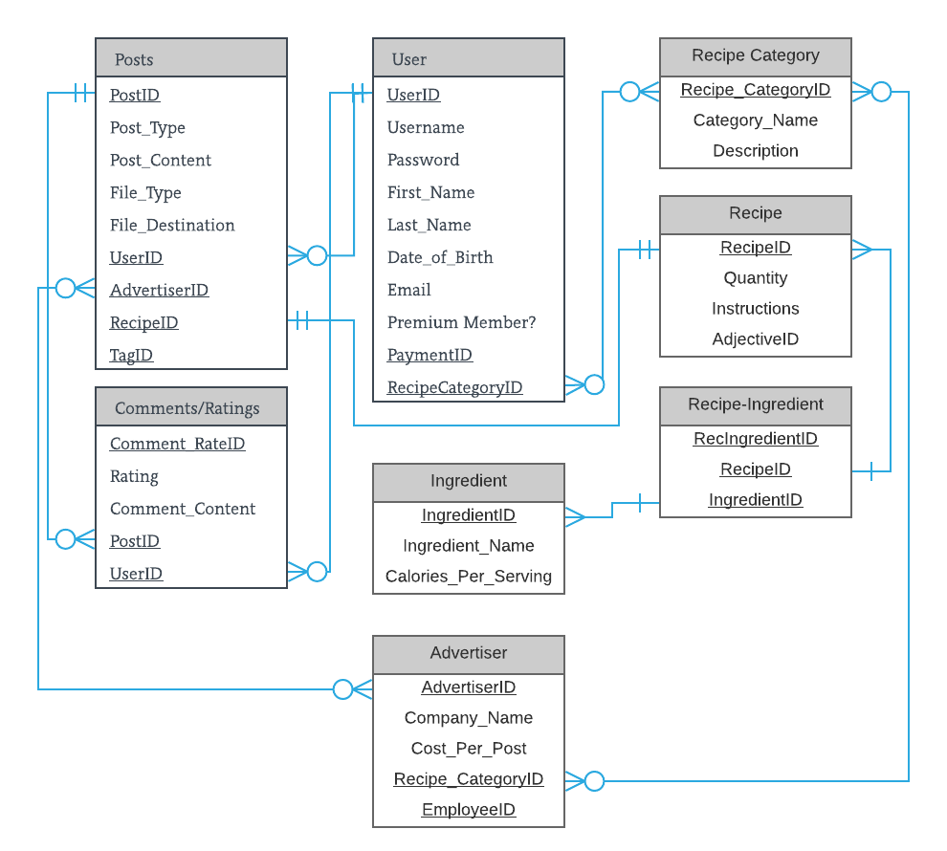
Data Model (High Level)
Notes:
This data model provides a high level overview of the data our app will collect. We will use this data provide value to our customers. Ex: The dinner party feature, searching by different field types, ect...

Slide 10
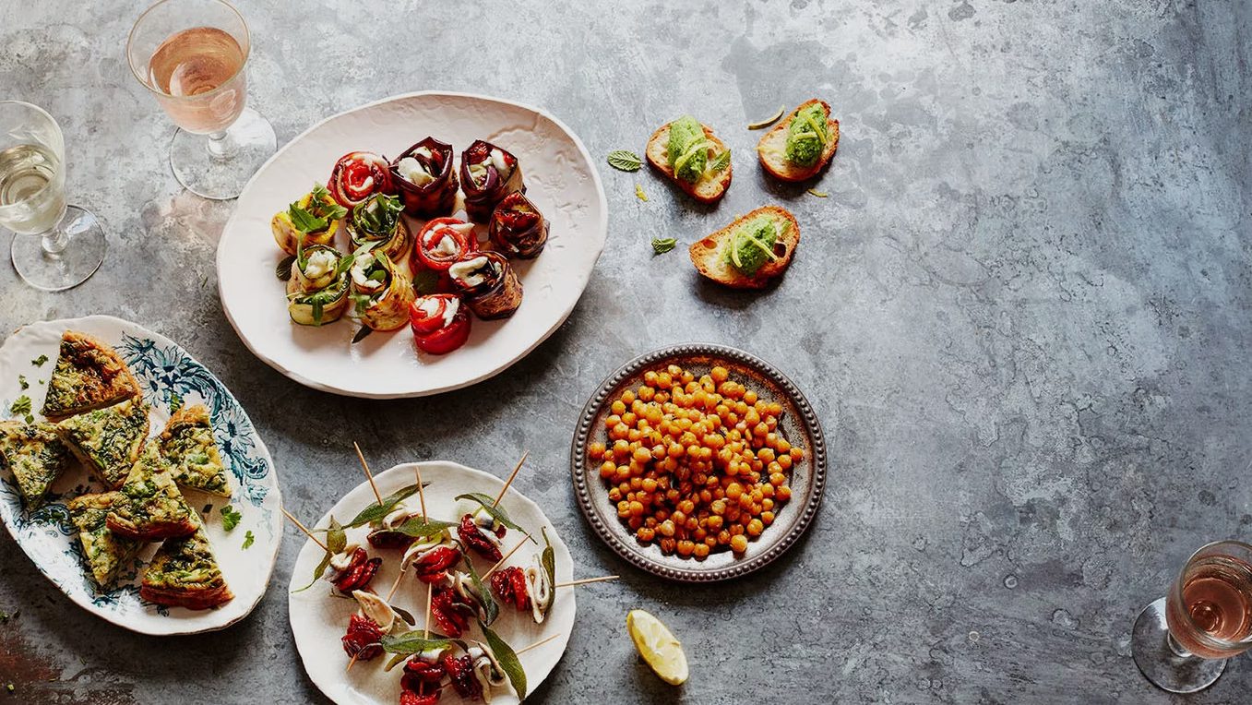
Implementation Strategy
Application Development
Marketing & Advertising
5 months
budgeted for development & testing
Advertise on Instagram and Snapchat
In-app incentives
Notes:
Looking forward, the overarching goals will be actual app development which includes finalizing design, programming, and testing. In addition, financing options must be agreed upon and obtained. As the app reaches completion, advertising on Instagram and Snapchat should be planned to begin as soon as the application is live.

Slide 11
Project Site

Slide 12
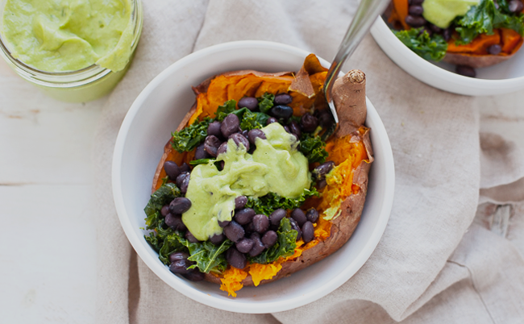
Thank You, Questions?

