Slide 1
Persuasion and Communication with Decks It’s performing arts!

Slide 2
DISCUSS WITH YOUR FRIEND (or a person sitting next to you)
What are the most difficult things you have experienced when presenting in front of an audience?
What makes you feel good about presenting in front of an audience?

Slide 3
AGENDA
Do
we
really
need
all
this?

Slide 4
Physical
Cognitive
Writing
Visual
Technology
How do you present yourself?
How do you act/react during the presentation?
How do you use the written word?
What is the look-and-feel?
How do you leverage the tools?
Take inventory
When you have to prepare a presentation, how many of these do you think about?

Slide 5
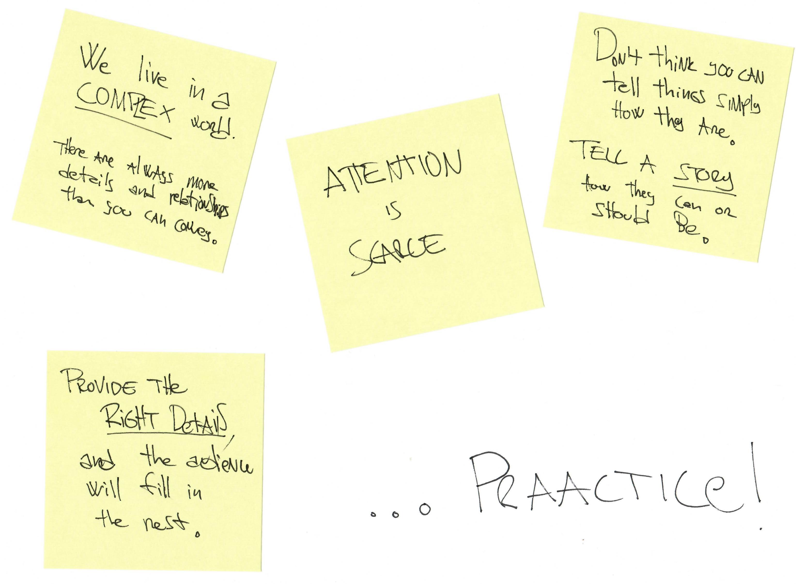

Slide 6
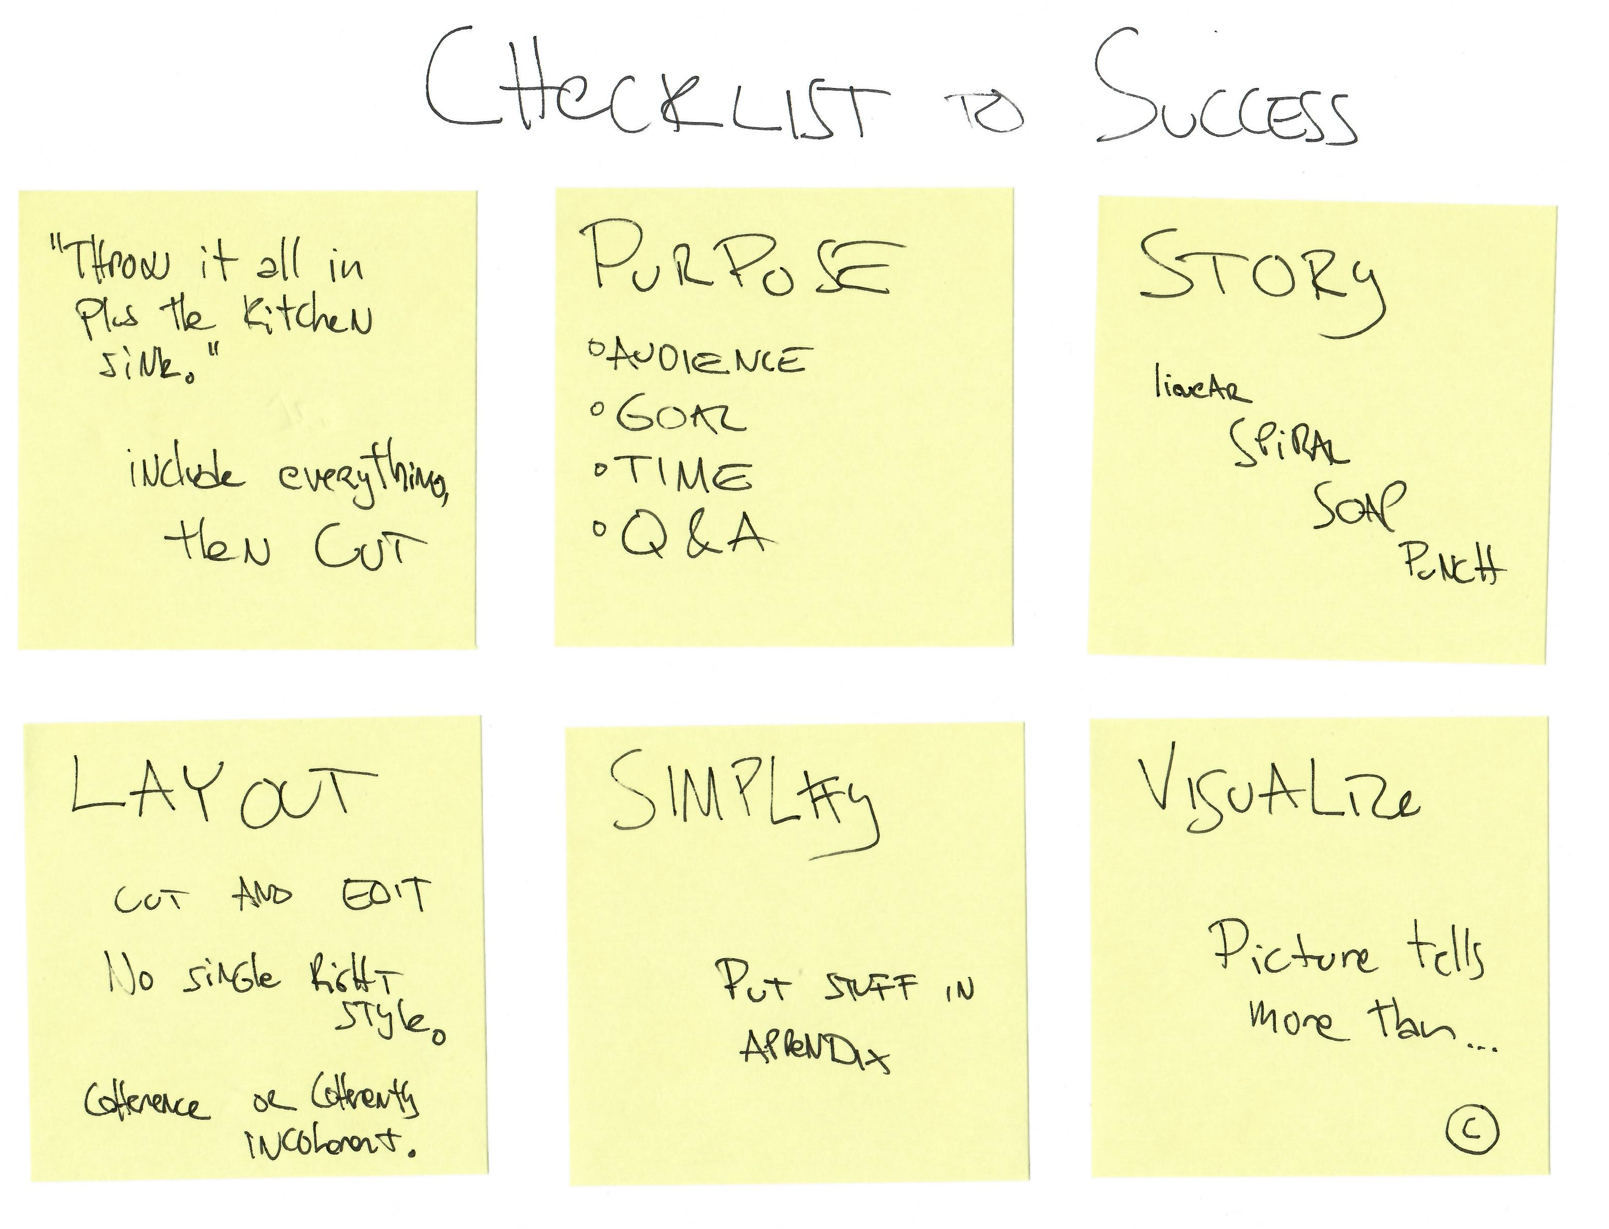

Slide 7
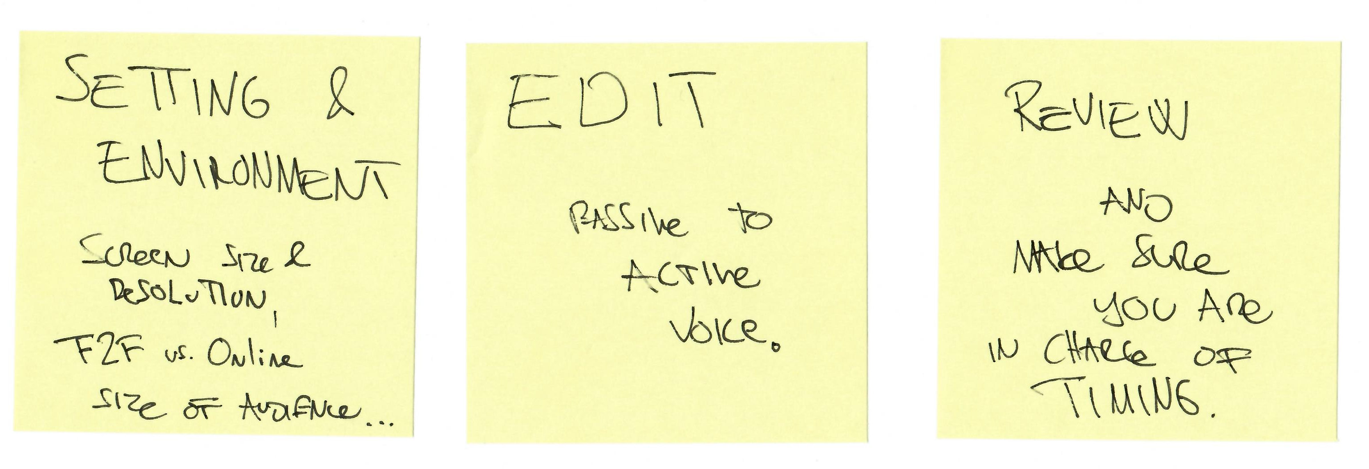

Slide 9
FIVE TRICKS & CONSIDERATIONS
HUMOR – Know when to us
THEMES – Colors, fonts, look-and-feel
TEMPLATES – What fits the story
VIDEO – Length, embedding
INTERNET – Hyperlinks, speed
e

Slide 10
EXAMPLES
Apple CEO Steve Jobs launching iPhone:
https://youtu.be/wGoM_wVrwng
Notes:
14 min video

Slide 11
EXAMPLES
Prior* Microsoft CEO Steve Ballmer’s Monkey Boy Dance entrance:
https://youtu.be/7Ie7ypBNzFc
The style is quite different from what Steve Jobs used to do. Is it wrong? Would it work if Steve Ballmer would try to present like Steve Jobs?
* Steve Ballmer was Microsoft CEO from 2000 – Feb 4, 2014
Notes:
1 min video

Slide 12
HOMEWORK
BLOG comment 1:
Review the materials on effective presenting, and comment on the post about Steve Jobs launching iPhone by the beginning of our next class.
Reminder : Late submissions will receive zero credit, but you must complete all deliverables to receive a course grade.

