Slide 1
Systems and Systems Thinking Solving Business Problems with IT
Photo (CC): U.S. Department of Agriculture

Slide 2
AGENDA
What is an organization?
Business processes
Introduction to systems thinking
Analyzing a system
Information systems projects and enterprise architecture

Slide 3
WHAT IS AN ORGANIZATION?
To understand the role of IT projects in business, you need to have an idea of what is a (large-scale) organization.

Slide 4
EXERCISE: FILL IN ORGANIZATIONAL UNITS FOR…
Media corporation
Fast food chain
Consumer goods manufacturer
Hospital
Airline

Slide 5
Example : Delivery Org
VP of Enterprise Delivery
Marie
North East Regional Director
Linda
South East Regional Director
Lucie
Centrals Regional Director
Robert
NE Team
PM’s and Consultants
SE Team
PM’s and Consultants
Central Team
PM’s and Consultants
North West Regional Director
Jeff
NW Team
PM’s and Consultants
South West Regional Director
Brian
SW Team
PM’s and Consultants
Segment Leader
Sylvie
Notes:
Talk about sub dept and Matrix organization (Sectors/Industry and/or competency in addition to Regions)

Slide 6
LARGE-SCALE ORGANIZATION
Large-scale organizations have similarities in how they are structured and operate (this is called isomorphism).
Despite similar components (processes, units, operations), every actual organization is different.
No individual has complete understanding of how a specific organization works in detail → organization are complex entities.
Notes:
Talk about differences between IBM, HP and Oracle – Business & Sales Operations different in each

Slide 7
YOU NEVER FULLY COMPREHEND AN ORGANIZATION
An organization can be viewed as…
Machine
Organism
Brain
Culture
Political system
Psychic prison
Flux and transformation
Instrument of domination
Try defining a company you know using 2 of the above categories (refer to p10-12)
Morgan, G. 2006. Images of Organization (Updated Edition). Thousand Oaks: SAGE Publications. Pp. 3–8.

Slide 8
LARGE-SCALE ORGANIZATION
Some academic theories about organization:
Economics: Organization is a nexus of contracts that emerges from the need to optimize transaction costs.
Resource/knowledge based views: Organization is a bundle of resources and knowledge which allow the production of things that would not be otherwise possible.
Sociological view: organization is a bureaucracy system made of a role structure, rules and routines
…and many others.

Slide 9
Enterprise IT is technology that is provisioned by an organization and is fundamentally intertwined in how its business works.
Enterprise IT differs from consumer IT, albeit the latter (smartphones, apps, web services, etc.) is increasingly penetrating the corporate IT environment.
Notes:
Tell story about IBM : first pager, then corporate cell then combine personal & corporate phone then even MAC!

Slide 10
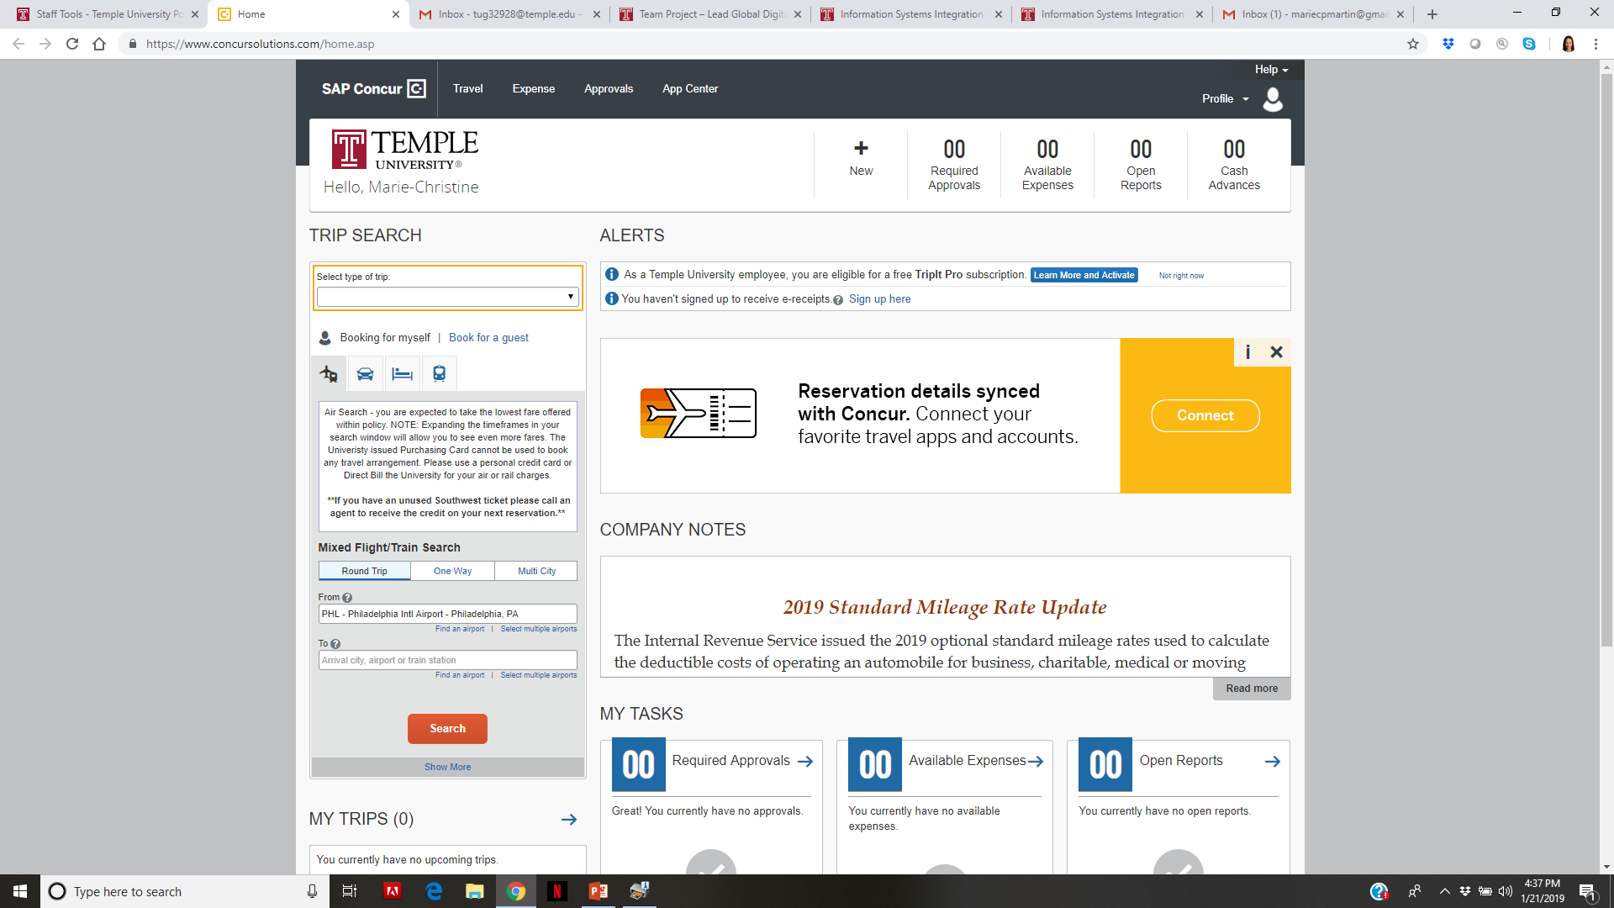
EXAMPLE OF ENTERPRISE IT SYSTEM: CONCUR
Notes:
Automation of travel reservation & expenses report
Another example : Procurement tool
Example : talk about ITACS BNAI and when IBM acquired PwCC (consulting, early 2000s – in 2002!)

Slide 11
FROM THE PERSPECTIVE OF ENTERPRISE IT
Organizations are dependent on organizational systems that result from projects.
Organizational systems support (automate, enhance, enable…) business processes.
An enterprise architecture is a roadmap for key organizational systems.
Enterprise architecture
Systems
Processes

Slide 12
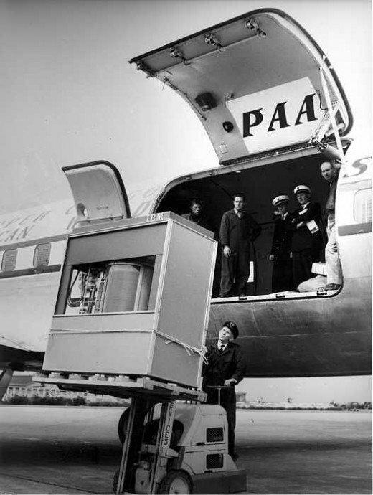
WHAT MAKES ENTERPRISE IT PROJECTS DIFFICULT?
Speed of change in business and technology
Conflicting business requirements
Lack of understanding and resistance to change
Regulatory requirements
Different stakeholder interests
It would take seven of these to store this presentation!

Slide 13
THE USABILITY OF ENTERPRISE IT IS OFTEN SUBPAR
Notes:
Build for the accounting dept!

Slide 14
THE USABILITY OF ENTERPRISE IT IS OFTEN SUBPAR
Book flights
Make expenses claim
View unpaid claims (1)
These three use cases probably cover 90 % of system use for 90 % of users.

Slide 15
THE USABILITY OF ENTERPRISE IT IS OFTEN SUBPAR

Slide 16
EXERCISE: HOW TO IMPROVE CONCUR?
Let’s assume you are asked to suggest improvements to Temple Concur. Discuss in your groups the following topics:
Why do you think the system looks as ugly and difficult to use as it currently is?
How would you start exploring possible improvements?
What could be the business case (benefits) of improving the system and to whom?

Slide 17
THE PROBLEM OF BUSINESS PROBLEMS
Managers rarely face clear problems but rather problematic situations that need some action to improve → How to understand the problem?
IT project take place and are intertwined in a complex organizational setting including other systems and technological infrastructures → How to make sure your proposed solution makes sense in a particular organizational setting?

Slide 18
Business processes and systems thinking

Slide 19
PROCESS VS. SYSTEMS THINKING
Process Thinking
Viewing an organization as a collection of independent processes
Decompose and optimize
Systems Thinking
Viewing the organization as a system of integrated subsystems and processes
Synthesize and optimize

Slide 20
Business processes

Slide 21
BUSINESS PROCESSES
Loan approval
Source: Alter (2006)
a structured, measurable set of activities designed to produce a specific output ... It implies a strong emphasis on how work is done within an organization, in contrast to a product focus’s emphasis on what... A process is thus a specific ordering of work activities across time and space, with a beginning and an end…Processes are the structure by which an organization does what is necessary to produce value ...
Source: Davenport (1993)
Notes:
Source: Alter, S. (2006) The Work System Method: Connecting People, Processes, and IT for Business Results,” Larkspur, CA: Work System Press.

Slide 22
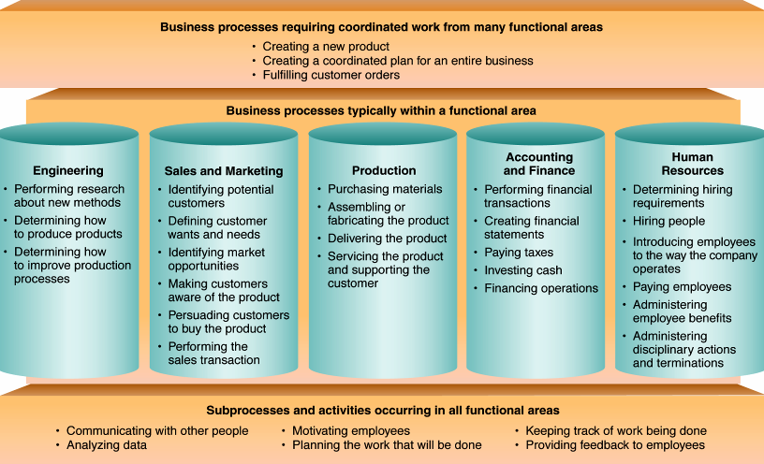
MORE BUSINESS PROCESSES
Source: Alter (2006)
Notes:
Source: Alter

Slide 23
Pause!

Slide 24
Sprint 1 Presentation
Create and be prepared to present a deck in which you report :
What is the problem or potential business application and why did you choose a particular project/technology,
What are your success factors for the project,
How do you intend to approach the problem, and
What is your ToDo for the next sprint.
Each team has 10 minutes to present and 5 minutes for questions and answers (Q&A)

