Slide 1
Systems and Systems Thinking
Solving Business Problems with IT
Photo (CC): U.S. Department of Agriculture

Slide 2
AGENDA
What is an organization?
Business processes
Introduction to systems thinking
Analyzing a system
Information systems projects and enterprise architecture

Slide 3
Introduction to systems thinking

Slide 4
DEFINITION OF SYSTEM
“a regularly interacting or interdependent group of items forming a unified whole”
http://www.merriam-webster.com/dictionary/system
“…system is delineated by its spatial and temporal boundaries, surrounded and influenced by its environment, described by its structure and purpose and expressed in its functioning.”
http://en.wikipedia.org/wiki/System

Slide 5
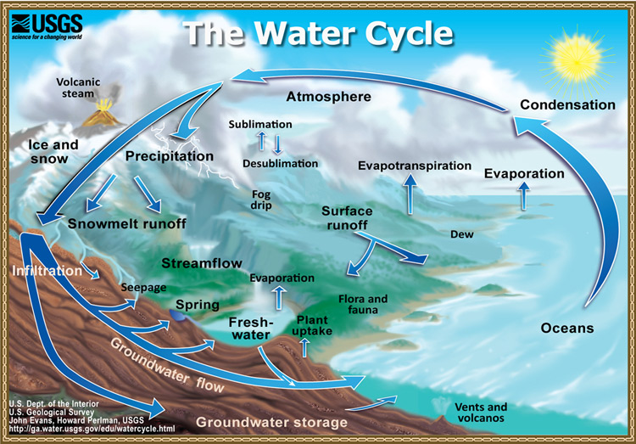
MOVEMENT OF MATERIAL WITHIN A SYSTEM (PROCESS FLOW)
Water moves from one sphere to another through a wide variety of processes. The water cycle is a small, but significant, part of the Earth system.
http://water.usgs.gov/edu/watercycle.html
Notes:
One way to examine a system is to study the movement of material within it. For example, hydrologic cycle tracks the movement of H2O through the Earth system. Water may be temporarily stored in the atmosphere (in clouds), in the hydrosphere (in the oceans, rivers, lakes, or other surface waters, or in snow or glacial ice), in the biosphere (in plants, animals, or other living organisms), or in the lithosphere (in groundwater, soil, pore spaces in bedrock, or even within "hydrous" mineral grains in solid rock). Water moves from one sphere to another through a wide variety of processes. Any place water can be stored is called a reservoir; the motion of water from one reservoir to another is called a flux. On the diagram to the right, the words and arrows represent fluxes. More generally, any cycle can be depicted as a collection of reservoirs with a set of related fluxes. The water cycle is a small, but significant, part of the Earth system

Slide 6
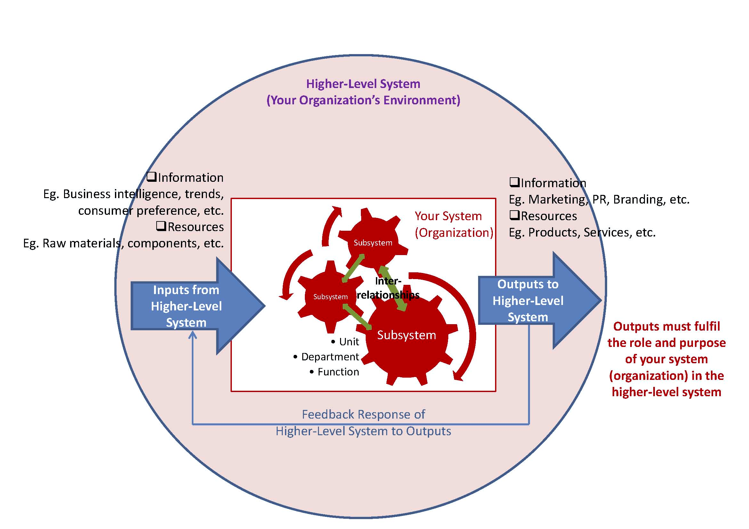

“ORGANIZATIONAL SYSTEMS” HAVE MULTIPLE MEANINGS
Organizational System
Technological System
http://www.thebluediamondgallery.com/tablet/images/computer-software.jpg
A set of interacting or interdependent component parts forming a complex/intricate whole (Wikipedia)
The software (and hardware) used to automate organizational systems.
Notes:
systems thinking is a way of helping a person to view the world, including its organizations, from a broad perspective that includes structures, patterns and events, rather than just the events themselves.
In other words, a way to view a system as a series of interconnected processes
Or A way to consider both intended and unintended consequences in a systematic way

Slide 7
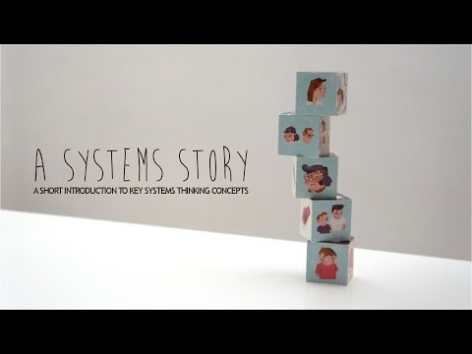
Love as a system
https://www.youtube.com/watch?v=rDxOyJxgJeA
Notes:
https://www.youtube.com/watch?v=rDxOyJxgJeA
5 min video

Slide 8
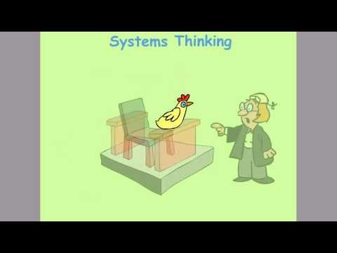
and some chickens….
https://www.youtube.com/watch?v=pElXE9DI9e4
Notes:
https://www.youtube.com/watch?v=pElXE9DI9e4
2 min video

Slide 9
SYSTEMS THINKING
Systems thinking is applicable to almost anything; but it is complex…
How to draw the boundaries of the system? How much to open up the ‘internals’ of the system?
When analyzing organization as a system, remember that organizational systems are made of all many components (people, rules, IT, buildings, cultural beliefs, etc.)
Notes:
systems thinking is a way of helping a person to view the world, including its organizations, from a broad perspective that includes structures, patterns and events, rather than just the events themselves.
https://managementhelp.org/organizations/systems.htm

Slide 10
Analyzing a system

Slide 11
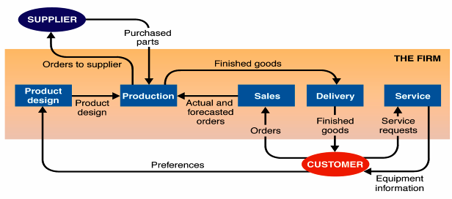
DESCRIBING A SYSTEM
  Purpose/transformation – reason for existence
  Boundary – begins and ends
  Components – pieces that make up the system
  Environment – elements outside the system boundary
  Inputs – objects and information that enter system
  Outputs – objects and information that leave system
Five subsystems of a firm-system
Source: Alter (2006)

Slide 12
DEFINITION
A useful way to think about a system is to focus on the transformation it provides.
E.g. raw materials to consumer products, students to degree holders, ink to narrow strokes on paper…

Slide 13
DEFINING A SYSTEM
A system is a group of interacting components that take input from its environment (hence, the system has a boundary) and transform it into some sort of output.
System
Input
Output

Slide 14
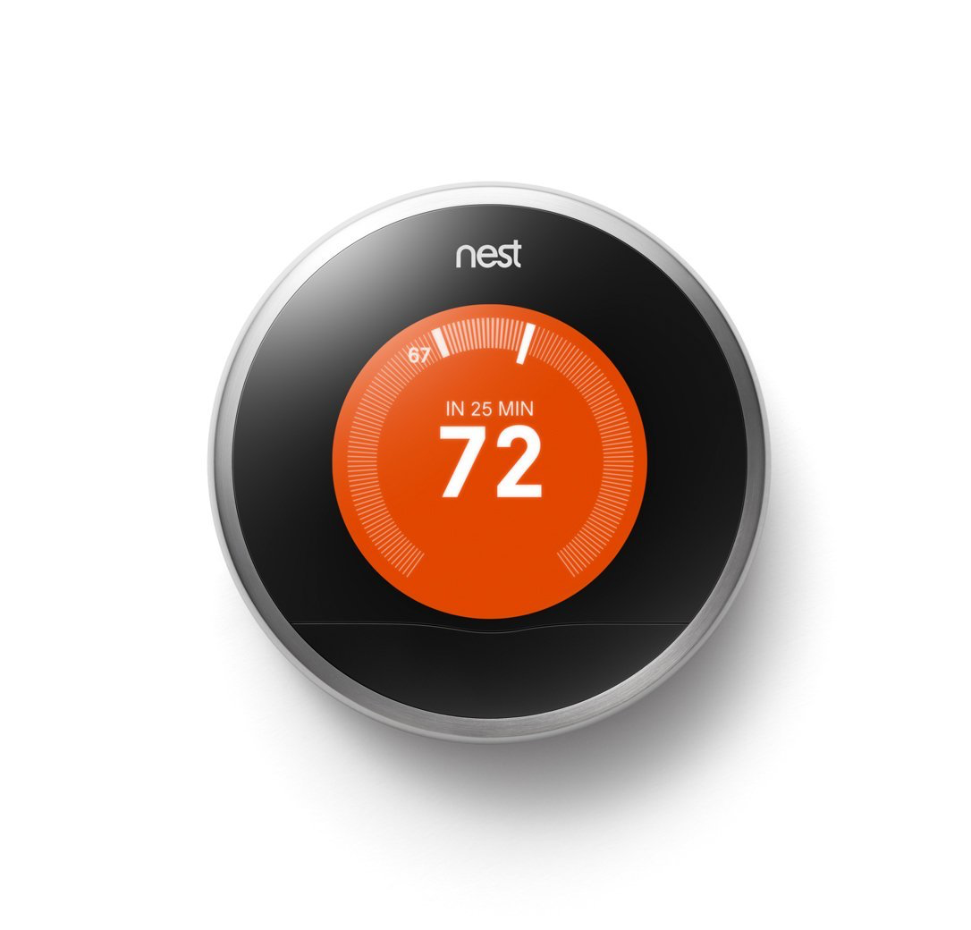
A SYSTEM FOR REGULATING TEMPERATURE

Slide 15
EMERGENCE
A system is often made of subsystems that are organized hierarchically. The components (subsystems) and their arrangement gives rise to emergent properties that none of the components possess alone.
Desired temperature
Subsystems
Sensors
User interface
Heating control
Heating on/off
Actual temperature
Emergent property:
regulate temperature
Feedback
Notes:
Emergent system feature : Feature that exists as a result of specific components working together as a system

Slide 16

ANALYSE A COW OR A BALLPOINT PEN AS A SYSTEM
What are the inputs and outputs? What is the transformation it provides?
What are its components/subsystems and emergent features?
Does it provide some sort of feedback?
What could be an appropriate performance measures?

Slide 17
WHEN YOU JUST SEE A PART OF A SYSTEM…

Slide 18
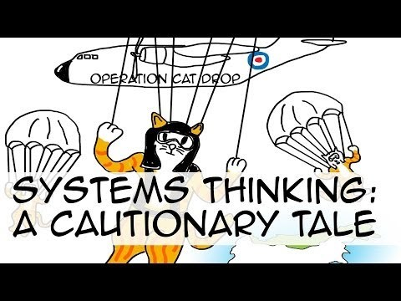
https://www.youtube.com/watch?v=17BP9n6g1F0
Notes:
https://www.youtube.com/watch?v=17BP9n6g1F0
3 min video

Slide 19
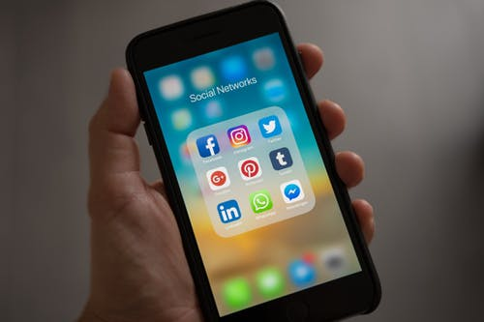
MODELING OBJECTS OF REALITY AS SYSTEMS : your phone!
Source: http://www.lix.polytechnique.fr/~golden/systems_architecture.html

Slide 20
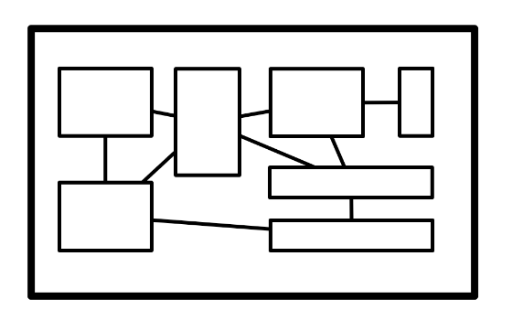
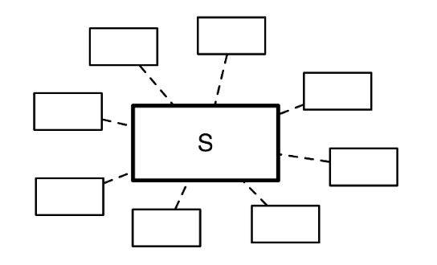
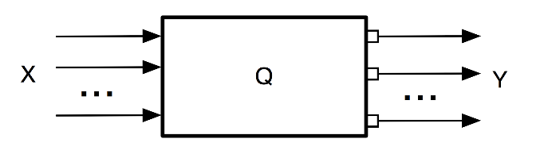
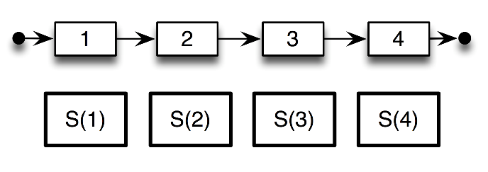
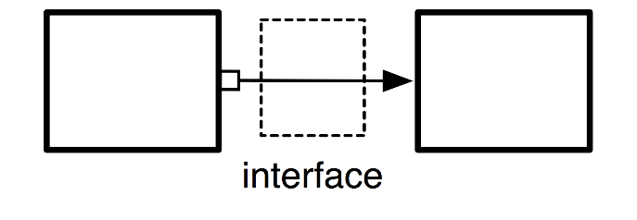
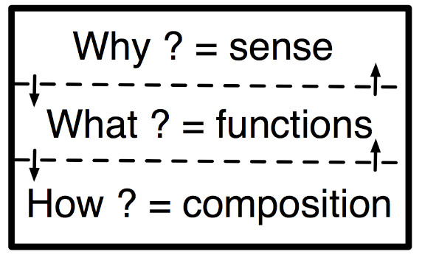
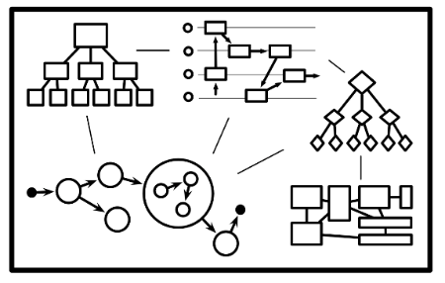
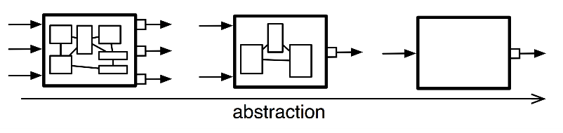
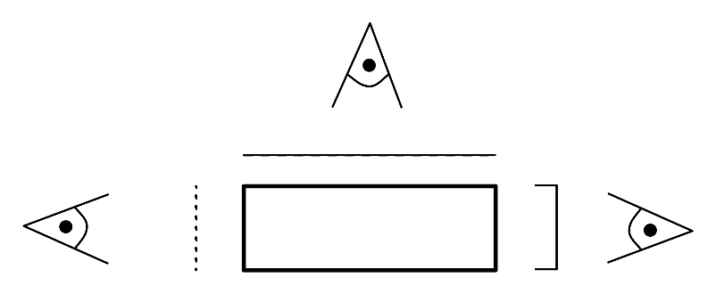
MODELING OBJECTS OF REALITY AS SYSTEMS
Source: http://www.lix.polytechnique.fr/~golden/systems_architecture.html
Notes:
the objects of the reality are modelled as systems (i.e. a box performing a function and defined by its perimeter, inputs, outputs and an internal state). Ex: a mobile phone is a system which takes in input a voice & keystrokes and outputs voices & displays. Moreover, it can be on, off or in standby. Overall, the phone allows to make phone calls (among other functions).
a system can be broken down into a set of smaller subsystems, which is less than the whole system (because of emergence). Ex: a mobile phone is in fact a screen, a keyboard, a body, a microphone, a speaker, and electronics. But the phone is the integration of all those elements and cannot be understood completely from this set of elements.
a system must be considered in interaction with other systems, i.e. its environment. Ex: a mobile phone is in interaction with users, relays (to transmit the signal), repair personnel (when broken), the ground (when falling), etc. All these systems constitute its environment and shall be considered during its design.
a system must be considered through its whole lifecycle. Ex: a mobile phone will be designed, prototyped, tested, approved, manufactured, distributed, sold, used, repaired, and finally recycled. All these steps are important (and not only the moment when it is used).
a system can be linked to another through an interface, which will model the properties of the link. Ex: when phoning, our ear is in direct contact with the phone, and there is therefore a link between the two systems (the ear and the phone). However, there is a hidden interface : the air! The properties of the air may influence the link between the ear and the phone (imagine for example if there is a lot of noise).
a system can be considered at various abstraction levels, allowing to consider only relevant properties and behaviors. Ex: do you consider your phone as a device to make phone calls (and other functions of modern phones), a set of material and electronics components manufactured together, or a huge set of atoms ? All these visions are realistic, but they are just at different abstraction levels, whose relevancy will depend on the context. Abstraction is the act of representing essential features without including the background details or explanations. In the computer science and software engineering domain, the abstraction principle is used to reduce complexity and allow efficient design and implementation of complex software systems.
a system can be viewed according to several layers (usually three: its sense, its functions, and its composition). Ex: a phone is an object whose sense is to accomplish several missions for its environment : making phone calls, being a fashionable object, offering various features of personal digital assistants, etc. But it is also a set of functions organized to accomplish these missions (displaying on the screen, transmitting signal, delivering power supply, looking for user inputs, making noise if necessary, etc). And finally, all these functions are implemented through physical components organized to perform these functions.
a system can be described through interrelated models with given semantics (properties, structure, states, behaviors, data, etc). Ex: from the point of view of properties, the phone is a device expected to meet requirements like "a phone must resist to falls from a height of one meter". But a phone will also change state : when a phone is off and that the power button is pressed, the phone shall turn on. Function dynamics of the phone are also relevant: when receiving a call, the screen will display the name and the speaker will buzz, but if the user presses no button the phone will stop after 30 seconds... This will typically be described with diagrams in SysML (an evolution of UML).
a system can be described through different viewpoints corresponding to various actors concerned by the system.. Ex: commercials, designers, engineers (in charge of software, electronics, acoustics, materials, etc) users, repairers... All these people will have different visions of the phone. When the designer will see the phone as an easy-to-use object centered on the user, the engineer will see it as a technological device which has to be efficient and robust. A commercial may rather see it as a product which must meet clients' needs and market trends to be sold. All these visions are important and define the system in multiple and complementary ways.

Slide 21
UNIVERSITY AS A SYSTEM
Systems concept | Example: a university
has a purpose - exists for a reason and achieves some change or transformation
performance can be measured
there is a mechanism for control
has components, that is, subsystems
components are related and interact
interacts with a wider system - environment
has a boundary
has its own resources
has an expectation of continuity
reacts to feedback
Notes:
Systems cannot be understood and fully leveraged by analysis – the properties or parts can only be fully understood within the larger context of the whole

Slide 22
UNIVERSITY AS A SYSTEM
Systems concept | Example: a university
has a purpose - exists for a reason and achieves some change or transformation | university 'transforms' students into graduates
performance can be measured | ranking, student/faculty ratios, placement
there is a mechanism for control | management structure
has components, that is, subsystems | faculty, administration, departments, students
components are related and interact | board meetings, shared courses
interacts with a wider system - environment | education system, community
has a boundary | the chair is part of the college, the local mayor is not
has its own resources | staff, buildings, finance
has an expectation of continuity | expects and plans to exist into the future
reacts to feedback | student satisfaction surveys, enrollment numbers, rankings

Slide 23
Information systems projects
and
enterprise architecture

Slide 24

What is an Information System?
INFORMATION SYSTEM
IF SSNO <> 9 Char THEN
Error
END IF
Hardware
Software
Networking
Business Processes
People
Data
A set of interrelated components that collect (or retrieve), process, store, and distribute information to support decision making and control in an organization
Source: Laudon, K., & Laudon, J. Management Information Systems. 8/e
Notes:
Note the similarity between this definition and our earlier systems definitions (i.e., interrelated components)…

Slide 25
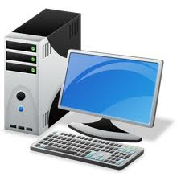
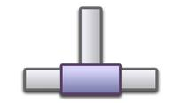


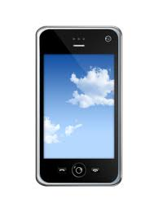

ENTERPRISE ARCHITECTURE COMPONENTS (MIS2501)
ERP
CRM
Devices
Network
Applications
Data
ENTERPRISE ARCHITECTURE LEGEND

Slide 26

INFORMATION ARCHITECTURE OF AN ORGANIZATION (MIS2502)
Data entry
Transactional Database
Data extraction
Analytical Data Store
Data analysis
Stores real-time transactional data
Stores historical transactional and summary data
Notes:
From MIS2502 – This is an architecture diagram at the very highest, most conceptual level.
But it does show basic components and the relationships between them.

Slide 27
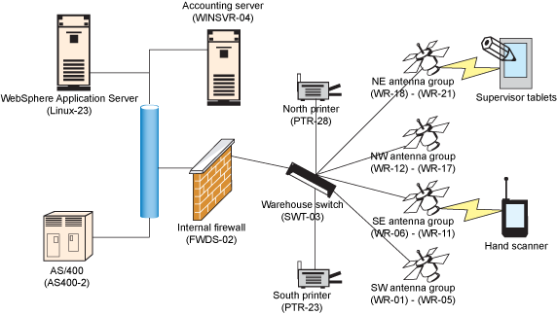
ENTERPRISE ARCHITECTURE EXAMPLE
Source: IBM
Notes:
Citation: http://www.ibm.com/developerworks/library/ar-enterarch4/
Source: Enterprise architecture essentials, Part 4: Test (and retest) your enterprise architecture - IBM

Slide 28
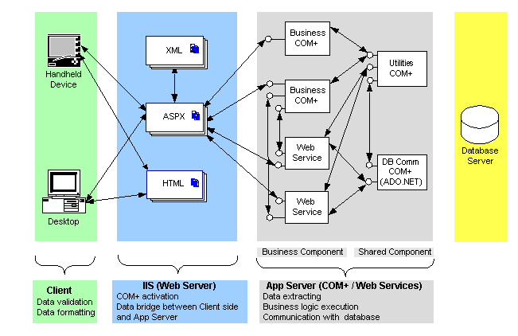
ENTERPRISE ARCHITECTURE EXAMPLE
Source: Quest4Web
Notes:
Citation: http://quest4web.com/framework.html

Slide 29
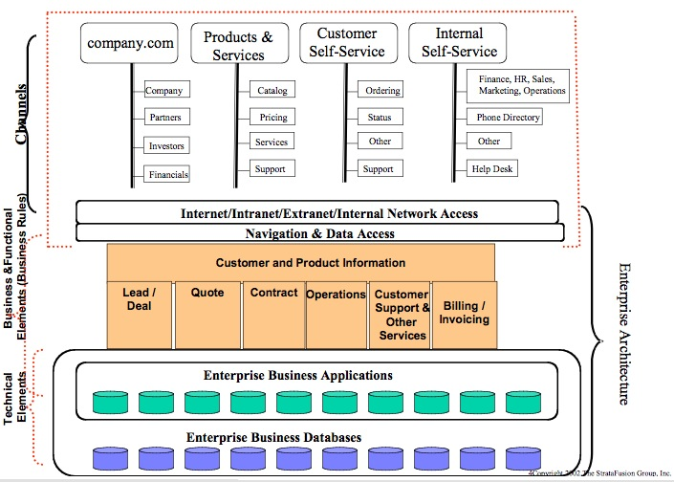
ENTERPRISE ARCHITECTURE EXAMPLE
Source: Collabri Group LLC
Notes:
Citation: http://www.collabri.com/images/CIOWisdom.Architecture_files/architecture2.jpg
Source: Collabri Group LLC

Slide 30
INFORMATION SYSTEMS - LEGACY
Transaction Processing Systems
Strategic
Sales force automation
Decision
Making
Managerial
Personnel
Payroll
Electronic invoicing
Operational
Human
Resources
…
Manufacturing
Accounting
Sales
Finance
Distribution
Notes:
In computing, a legacy system is an old method, technology, computer system, or application program, "of, relating to, or being a previous or outdated computer system," yet still in use. Often referencing a system as "legacy" means that it paved the way for the standards that would follow it.
Legacy systems often are replaced with integrated applications

Slide 31
INFORMATION SYSTEMS - TODAY
Strategic
BI
Decision
Making
CRM
KM
Managerial
Operational
ERP
TPS 1, TPS 2, …..
Human
Resources
…
Manufacturing
Accounting
Sales
Finance
Distribution
Notes:
TPS : transaction process system

Slide 32
INFORMATION SYSTEMS – ENTERPRISE APPLICATIONS
TRENDS
Web 2.0
Social Media
Analytics
Corporate IT
Consumer IT
ERP
DM
KM
CRM
BI
SM
DIGITAL BUSINESS MODELS
Grow
Save Money

Slide 33
INFORMATION SYSTEMS
ERP – Enterprise Resource Planning
DM – Digital Marketing
KM – Knowledge Management
CRM – Customer Relationship Management
BI – Business Intelligence
SM – Social Media
Enterprise wide systems that automate and integrate key organizational processes such as sales, purchasing, etc. (e.g., SAP)
An emerging discipline in Marketing which integrates the application of ecommerce, social media, and direct sales (e.g., Google Ads).
Organizational and consumer applications that focus on processes that have to do with interactivity (e.g., Facebook)
A concept and set of systems/processes to retain, transfer, and leverage organizational knowledge (e.g., Lotus Notes)
A specific system that automates direct sales, sales force management, and customer relationship processes (e.g., Salesforce.com)
AKA Analytics / Big Data
A set of capabilities and processes to get value from organizational data

Slide 34
ENTERPRISE ARCHITECTURE (RE)DEFINED
MIT Center for Information Systems Research
Enterprise Architecture Body of Knowledge
Gartner
The organizing logic for business processes and IT infrastructure reflecting the integration and standardization requirements of the company's operating model.
A practice, which analyzes areas of common activity within or between organizations.
A discipline for proactively and holistically leading enterprise responses to disruptive forces by identifying and analyzing the execution of change toward desired business vision and outcomes.
Wikipedia
A practice for conducting enterprise analysis, design, planning, and implementation, using a holistic approach at all times, for the successful development and execution of strategy.
At it’s core, it’s about the roadmap of key organizational systems (hardware and software) and how those systems interrelate.
https://en.wikipedia.org/wiki/Enterprise_architecture

Slide 35
STRATEGIC ALIGNMENT
The idea of strategic alignment is that enterprise IT, that is, organizational information systems should be aligned with business strategy.
This means that technological systems support the competitive advantage of the company and/or make new strategies possible.
A key practice for achieving and retaining the alignment in rapidly changing business is enterprise architecture.

