Slide 1
DISRUPTIVE INNOVATION
© Copyright 2016
This deck contains copyrighted material. Please do not distribute or post on a public location.

Slide 2
AGENDA
Theory of disruptive innovation
Where does the theory of ‘disruptive innovation’ go wrong?

Slide 3
Disruptive innovation
“Disruptive innovation is the transformation of an expensive, complicated product into something much more affordable and accessible, allowing many more people to use the product or service.” – The Christensen Institute

Slide 4
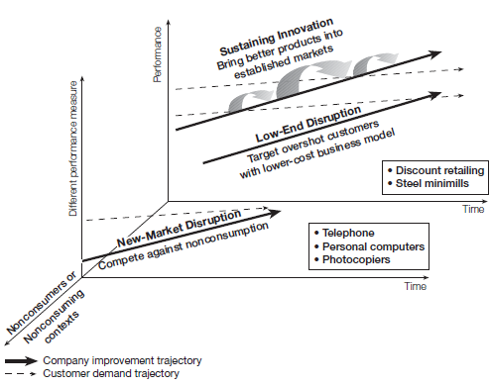
DISRUPTIVE INNOVATION THEORY
TYPES
Sustaining
Move along a known path such as improve an existing product.
Low-end
Existing products are “too good” and relatively expensive
New-market
Change the product to get new people by changing its nature or by making it more convenient
Source: Christensen, C., Anthony, S., and Roth, E. “Seeing What’s Next: Using the Theories of Innovation to Predict Industry Change.” Harvard Business School Press, 2006, p.4.

Slide 5
EXAMPLES OF DISRUPTIVE INNOVATIONS
Sustaining
Low end
New market
TYPES
Sustaining
Low end
New market
A new WiFi standard
Chromebooks
Blue Apron
Online education
Amazon Echo
Pretty much any smartphone at this point
Budget airline
Facebook
Sustaining
Move along a known path such as improve an existing product.
Low-end
Existing products are “too good” and relatively expensive
New-market
Change the product to get new people by changing its nature or by making it more convenient
Source: Christensen, C., Anthony, S., and Roth, E. “Seeing What’s Next: Using the Theories of Innovation to Predict Industry Change.” Harvard Business School Press, 2006, p.4.

Slide 6
MEANS AND TYPES TO GENERATE SYSTEMS
MEANS
TYPES
New capability
Ease of use
New place
New time
Change in legislation
Low cost
Undershot Customers
Overshot Customers
Non-consumers
Nonmarket Contexts
Sustaining
Move along a known path such as improve an existing product.
Low-end
Existing products are “too good” and relatively expensive
New-market
Change the product to get new people by changing its nature or by making it more convenient

Slide 7
UNDERSTANDING SIGNALS OF CHANGE
Undershot Customers
Overshot Customers
Non-consumers
Nonmarket Contexts
When companies are filling up-market need
When companies are filling down-market need
When new markets are being created
Barriers to innovation are changing
Examples: Uber illegal in some cities; Airbnb facing greater scrutiny
Example: Fuji Instax Camera
Example: Chromecast
Example: LED “high light quality” bulbs

Slide 8
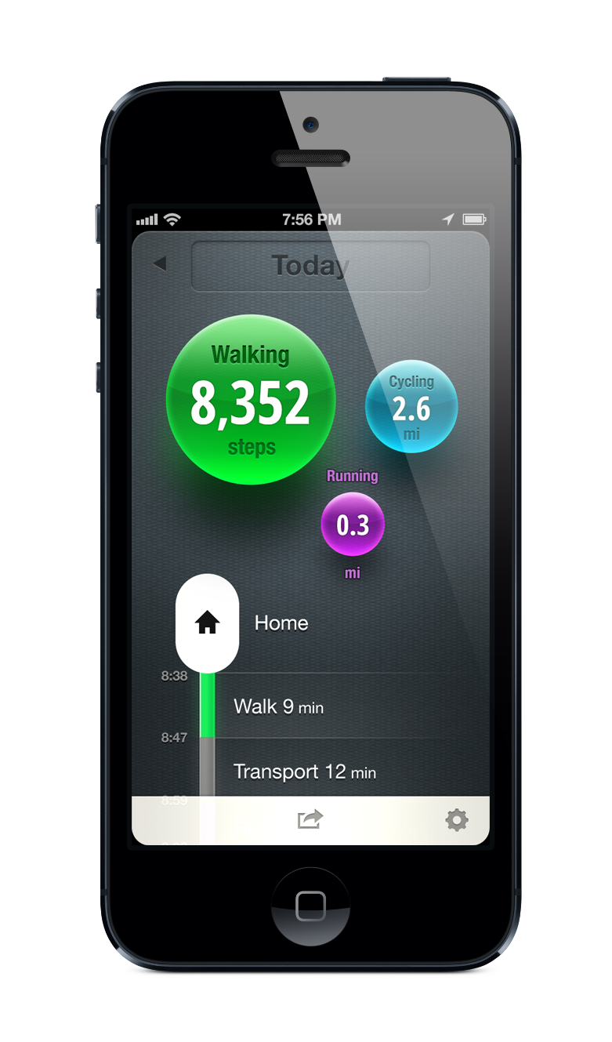
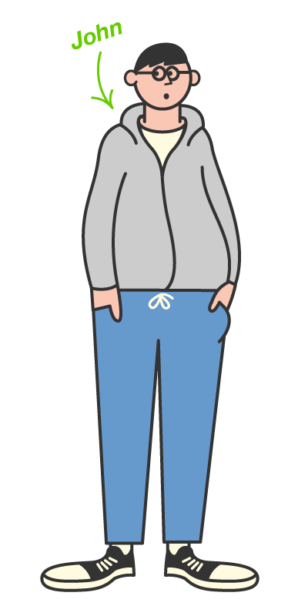
MOVES – Positioning for low-end/non-consumers
No need to carry, charge and buy yet another device
No need to start and stop the app
One billion Johns who should get bit more physical exercise.

Slide 9
EVALUATING NEW TECHNOLOGY - DISRUPTIVE INNOVATION RUBRIC
What is it?
What will it cost?
What is the ease of use?
New feature
New attribute / representation / bundling that simplifies previously complex features
New kind of product/service
Much lower cost than now = low end
Much easier = low end or new market
Cost more or a new type of cost = new market/sustaining
Require a new learning curve = new market
How does it compare?
Significantly better = new market
Who is using existing products/services?
Nobody = new market
Somebody = low end or sustaining
Who will use it?
Use similar = sustaining
Use adjacent or completely different = low end or new market
Not sure = new market?
Where will it be used?
Where existing similar products are used = sustaining or low end
In a new location / time / context = new market
Slightly better = sustaining
Maybe worse = low-end

Slide 10
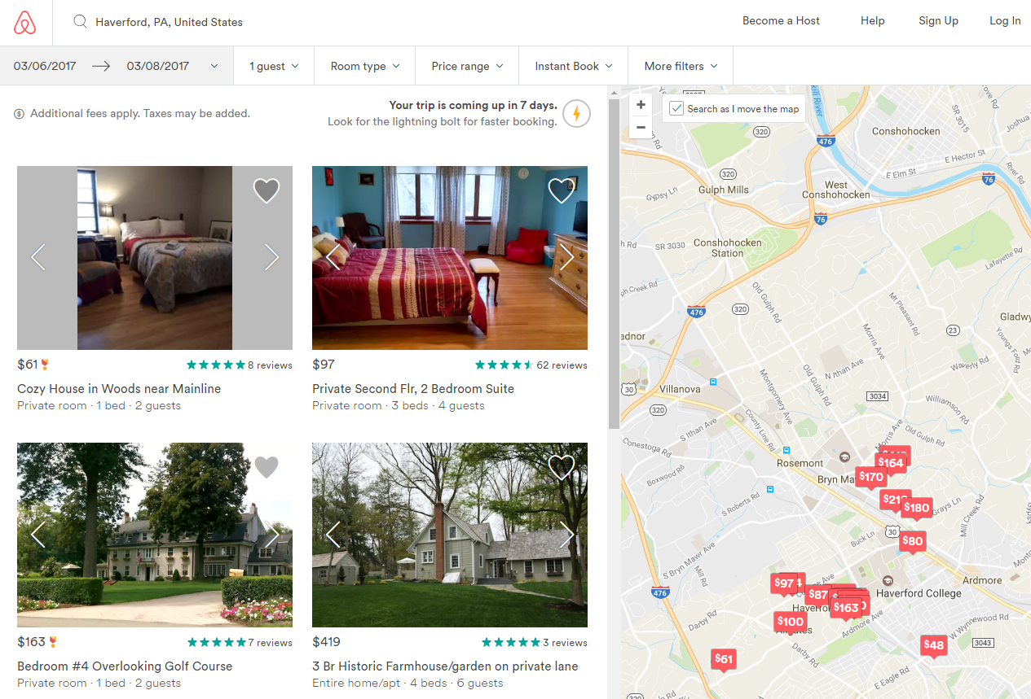
EVALUATING NEW TECHNOLOGY - AIRBNB

Slide 11
Exercise:
Work through the schema with Airbnb. What kind of innovation is Airbnb?

Slide 12
Where does the theory of ‘disruptive innovation’ go wrong?
“As striking as the disruption in the disk-drive industry seemed in the nineteen-eighties, more striking, from the vantage of history, are the continuities.” (Lepore 2014)

Slide 13
THE DISRUPTION OBSESSION
Apr. 2016
Nov. 2015
Apr. 2016
Sept. 2016
Aug. 2016
May 2013!

Slide 14
Why isn’t Boeing 737 MAX being ‘disrupted’?
Old design (first flight 1967) that is not necessarily optimal. Yet, ‘startup’ has not been able to disrupt the dominant product design.
Production sold out until late-2020s.
New version (737 MAX) currently grounded due to accidents; yet this has little impact on the future of the product.
Why isn’t Boeing being disrupted by sticking to 737?

Slide 15
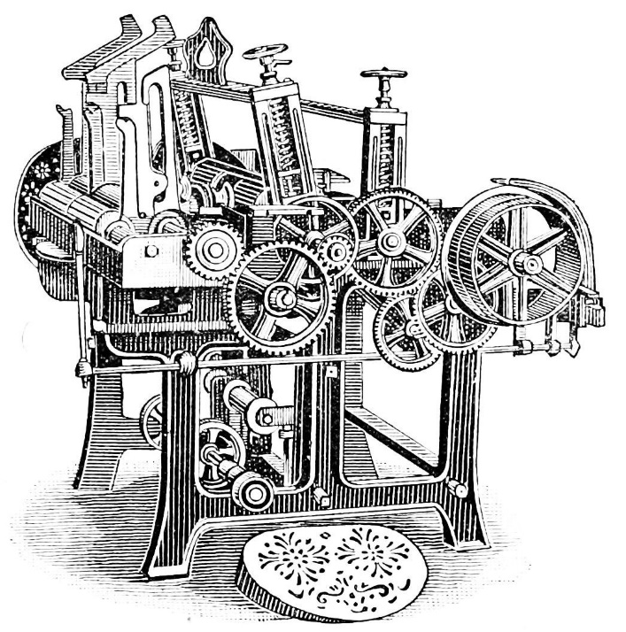
WHERE “DISRUPTION” GOES WRONG
Consider “The Disruption Machine” (Lepore, 2014)
What are some criticisms of Christensen’s Disruptive Innovation Theory?
How might it get misapplied? How might “innovation” suffer from a similar problem?
“…the sobering conclusion of Christensen’s research: companies faced with disruptive threats almost never manage to handle them gracefully.”
What does this say about what companies actually need to do to remain competitive?

Slide 16
WHERE “DISRUPTION” GOES WRONG
Explains why some firms fail – not how they succeed!
Extensions to domains where the theory may not apply (e.g. education)
Change and continuity are relative to observation period (Seagate example)
The industry has adopted a narrow, sometimes dogmatic view of ‘disruption’
Notes:
Seagate example : hard drive

Slide 17
Case Analysis # 2
Telsa Motors

Slide 18
CASE ANALYSIS : TELSA MOTORS
Describe the evolution of Tesla using the theory of disruptive innovation.
How does Tesla’s strategy differ from traditional car manufacturers? Whose approach is better?
What kind of a role digital technology plays on Tesla’s strategy?

