Slide 1
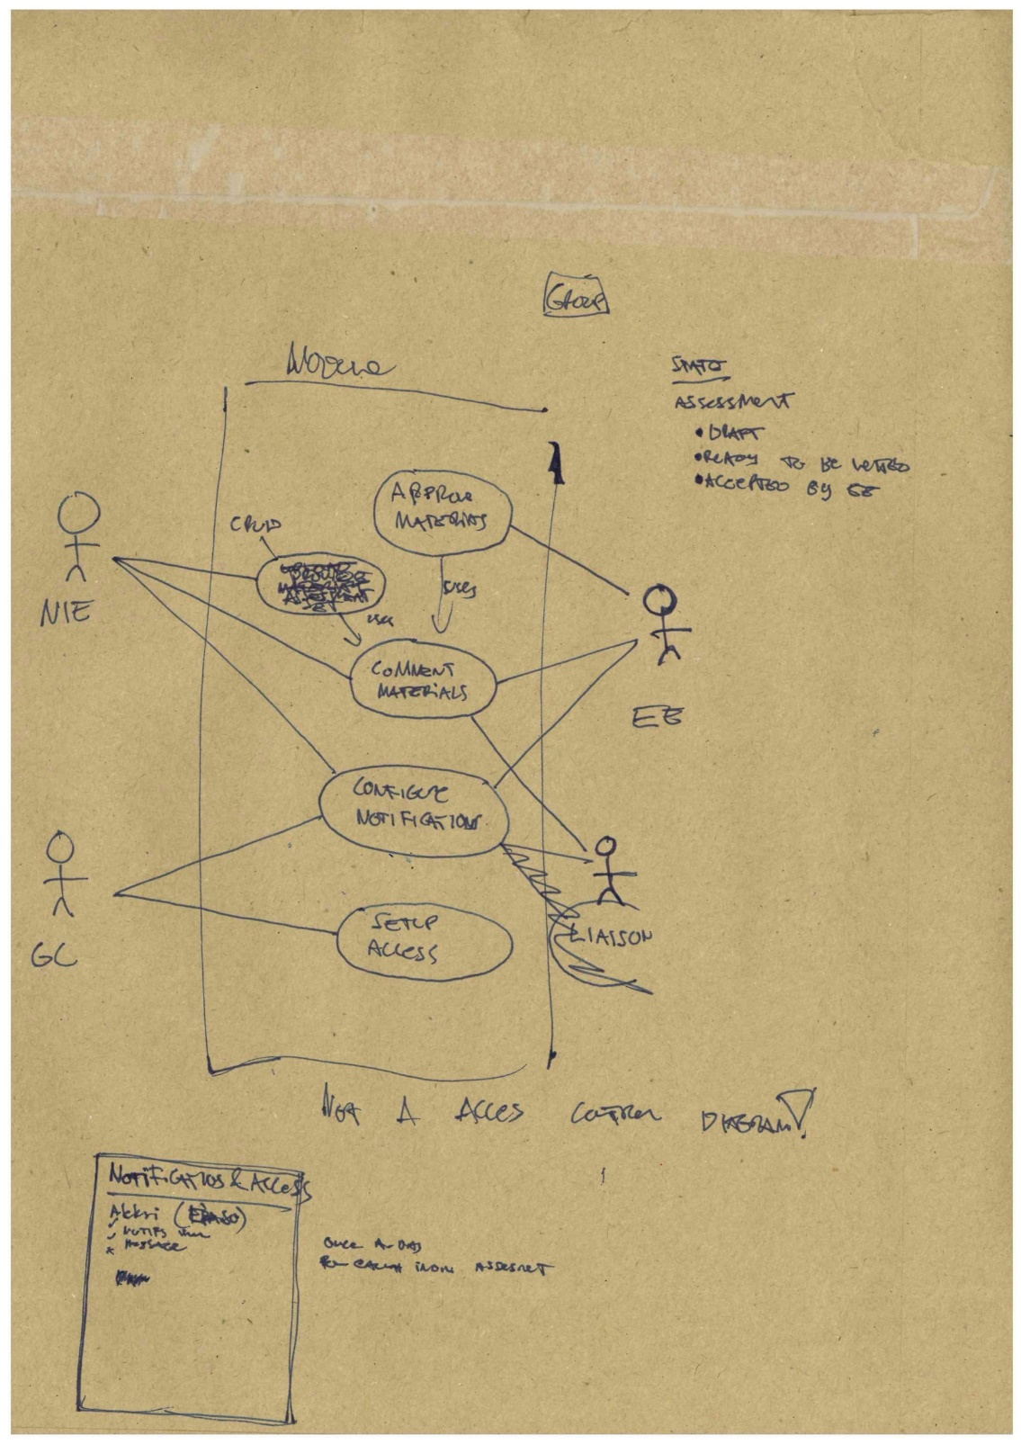
Prototyping
Modeling the user and the system

Slide 2
Think of different types of “models” or “modeling” – how many can you list?

Slide 3

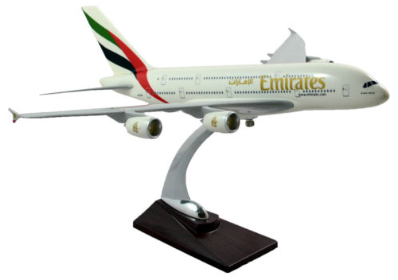

Architectural 3D model
Physical scale model
Relational database model (ERD)
Mathematical model

Slide 4
A model is a particular kind of representation of reality (or intended reality). It picks out and emphasises certain aspects – while ignoring many (most) others.

Slide 5
Agenda
Models and modelling in general
Modelling the user:
User personas
User scenarios
Use cases (UML)
Modelling the system:
Wireframe (user-interface) models
Class diagrams (UML)
Unified Modelling Language (UML)

Slide 6
Modelling in general - summary
All models are abstractions and hence simplifications of the phenomenon (e.g. system) they describe.
The purpose is NOT to capture every detail in the real system, but rather to highlight the features (and relationships) that are relevant to the task at hand.
No model description is ‘complete’. We often need several models to adequately describe a system.
Clear idea of why/for what purpose a model is being constructed is a key to successful modelling.

Slide 7
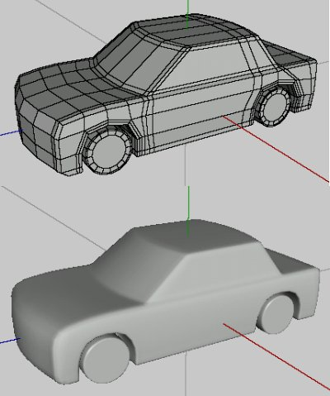
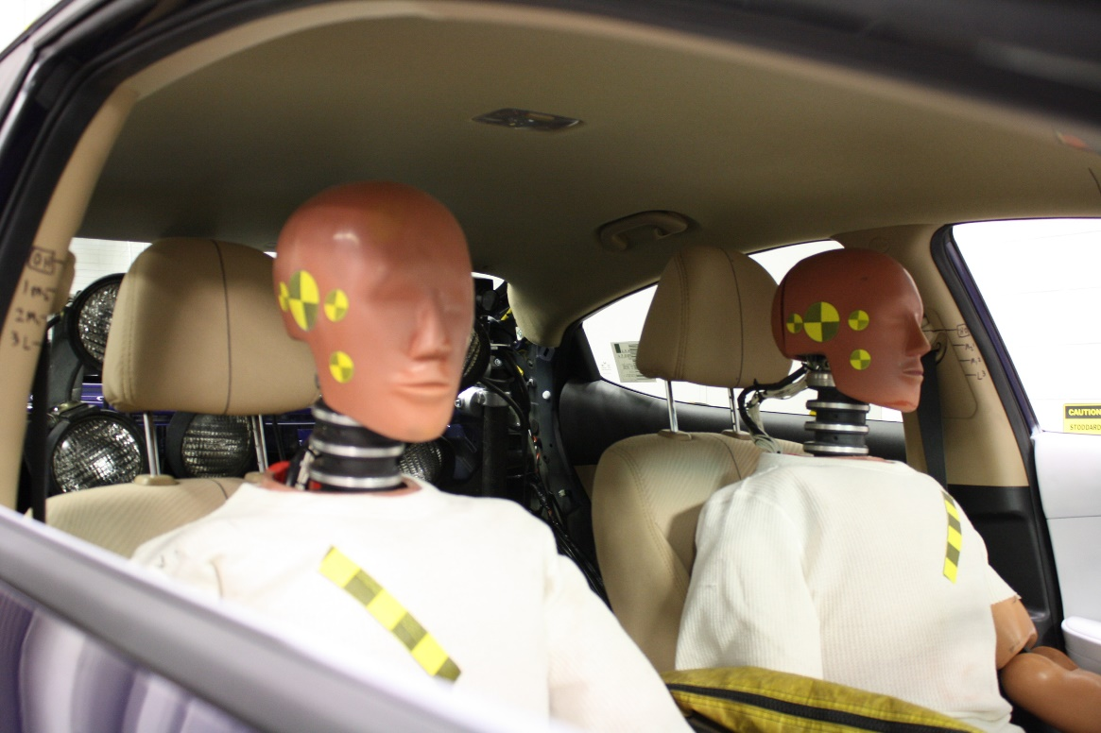
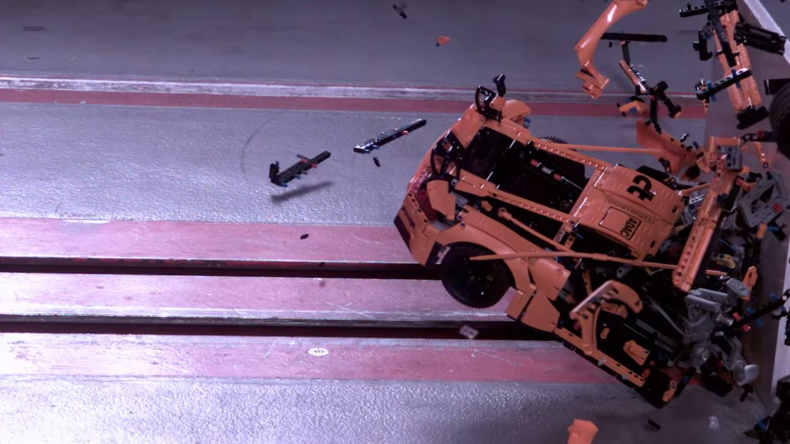
Multiple models are usually needed…
…and it is important to choose the right kind of model for the task.

Slide 8
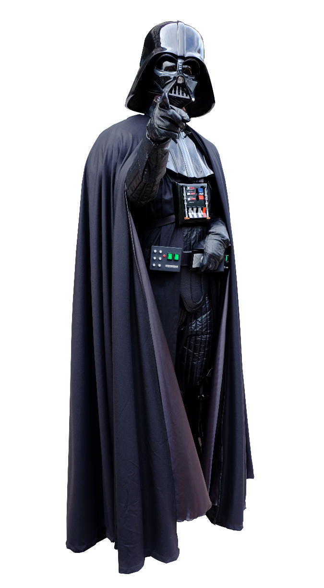
Don’t underestimate the power
of low-end tools!
It is easy to get carried away with the modelling tool itself. Therefore, consider using low-end tools such as a pen and paper.
Photo credit: 玄史生 / MathKnight - https://commons.wikimedia.org/wiki/File:Darth_Vader_-_cosplay_(white).jpg

Slide 9
“Having built a hopefully relevant model or two, we are then ready to begin the structured discussion about the situation, and how it could be changed, which will eventually lead to action being taken. The models are the devices which enable that discussion to be a structured rather than a random one.”
Checkland and Poulter (2006, p. 49)
The objective is to do better business – not fancy models!

Slide 10
Modeling the user

Slide 11
User personas
User “personas” are stories or structured descriptions that capture the person, personality, motivations, context, etc. of intended primary/early adopter users.
Personas should be based on research; the aim is not to fantasise about users but to capture important attributes of user as a believable character. Do not make the personas generic but rather rich and realistic.
Three or four personas is usually best (one or two maybe enough) – they are not intended to be representative of all intended audiences and the whole team must internalize the personas (i.e. they are difficult to change afterwards).
Personas help in different design decision by providing an external reference point for discussing the look and feel, tone of voice and overall interaction patterns of the product.

Slide 12
User personas
What are the Best Practices for developing Personas?

Slide 13
User personas – Best Practices
Conduct user research
Condense your research (what is universal to the system and its users?)
Brainstorm
Refine
Make them realistic!

Slide 14
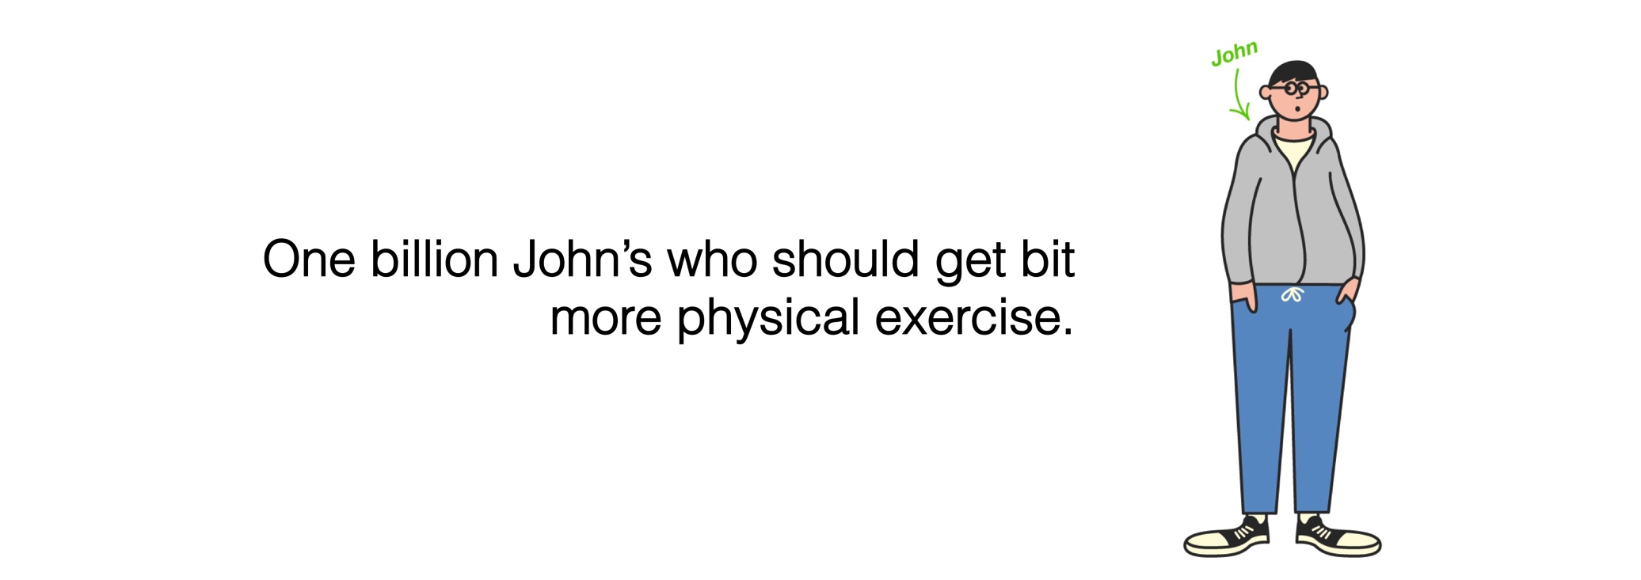
User personas example
For Moves app, we developed “John” by interviewing a real person about his exercise habits and by writing a fictional but plausible story describing his daily life.
During the development, it was then possible to answer questions such as: “Would John like to use this? Would this be useful for John?”
a

Slide 15
User scenario
Scenarios are stories of how and why users use the product – from the individual user’s perspective.
A scenario can capture the initial take up, typical usage session, when something goes wrong, etc., i.e. how does the product operate in the user’s context and serve his or her aims and preferences.
Scenarios help both in design and testing the user interface.
Scenarios help, for instance, capturing major requirements (but perhaps not details), arguing against excessive features – and to move gradually toward use cases.

Slide 16
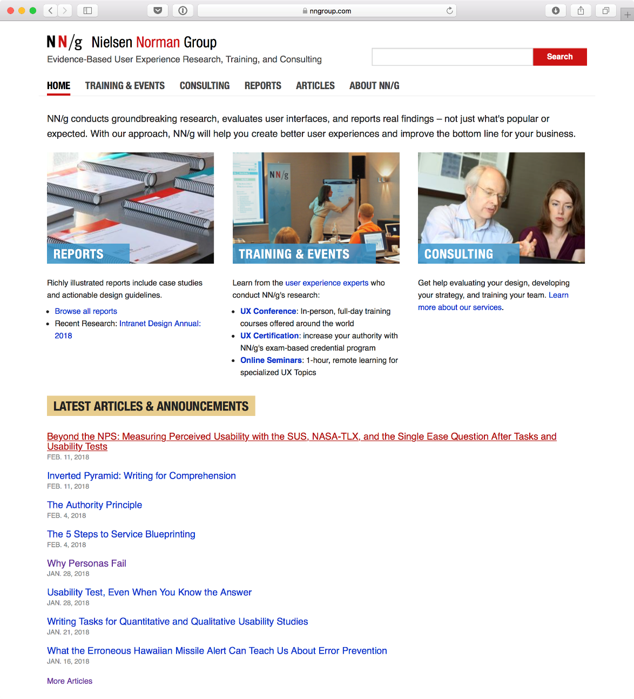
nngroup.com has lots of good resources and articles regarding user research and usability, provided by some of the pioneers in the field.
See also links on the community site:
https://www.usability.gov/how-to-and-tools/methods/scenarios.html
https://www.usability.gov/how-to-and-tools/methods/personas.html

Slide 17
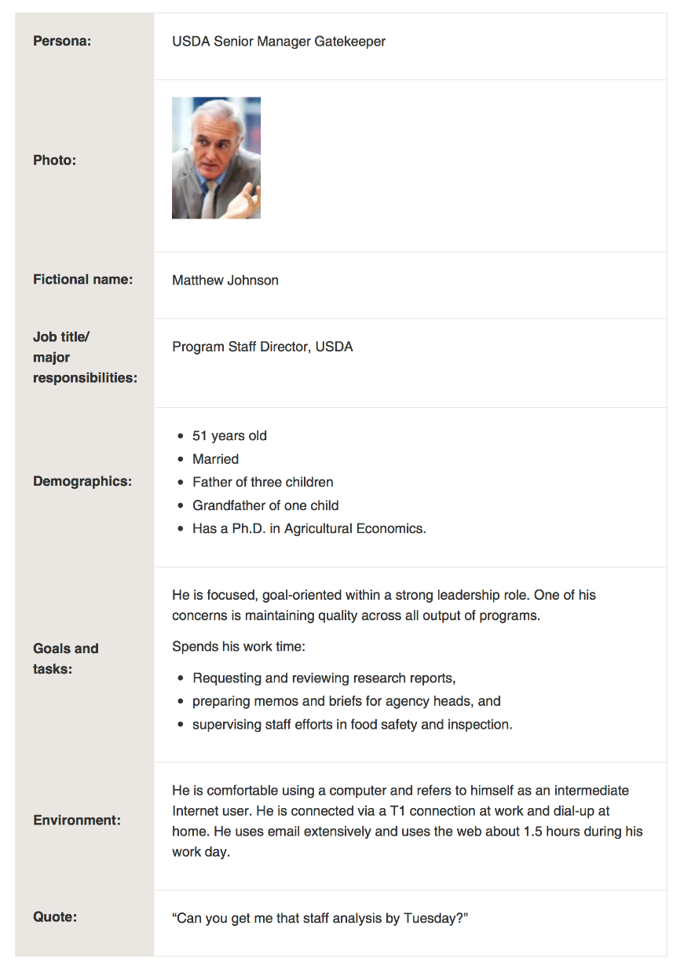
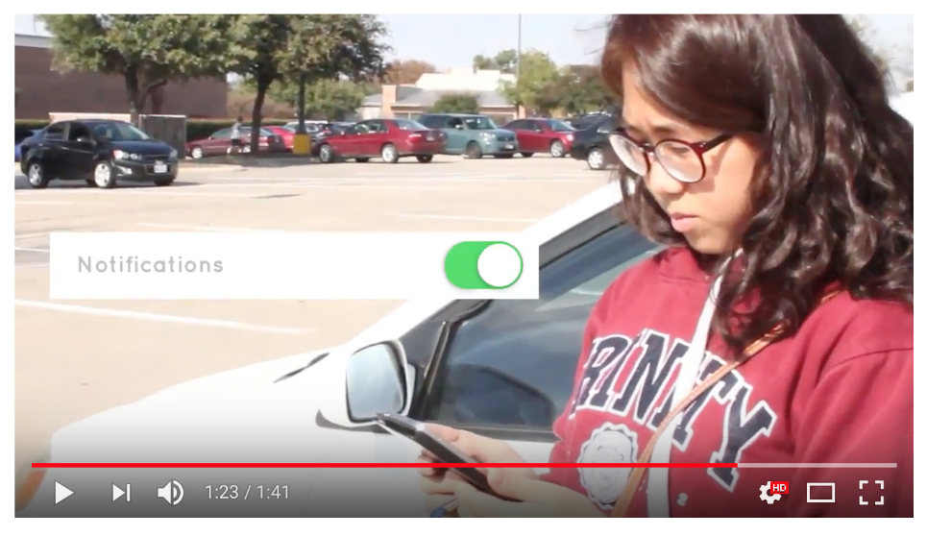
There is no standard notation for user personas and scenarios.
You can use ordinary writing, structured text, role playing, video clips, etc. to capture and communicate live experience.

Slide 18
Use cases (UML)
A use case describes a function the system provides for an external actor. It revolves around the system, unlike user personas and use scenarios – important difference!
An external actor can be a human or another system.
Use cases are described as a diagram
and a narrative with potentially some
structured definition.
NOT A FLOW CHART!

Slide 19
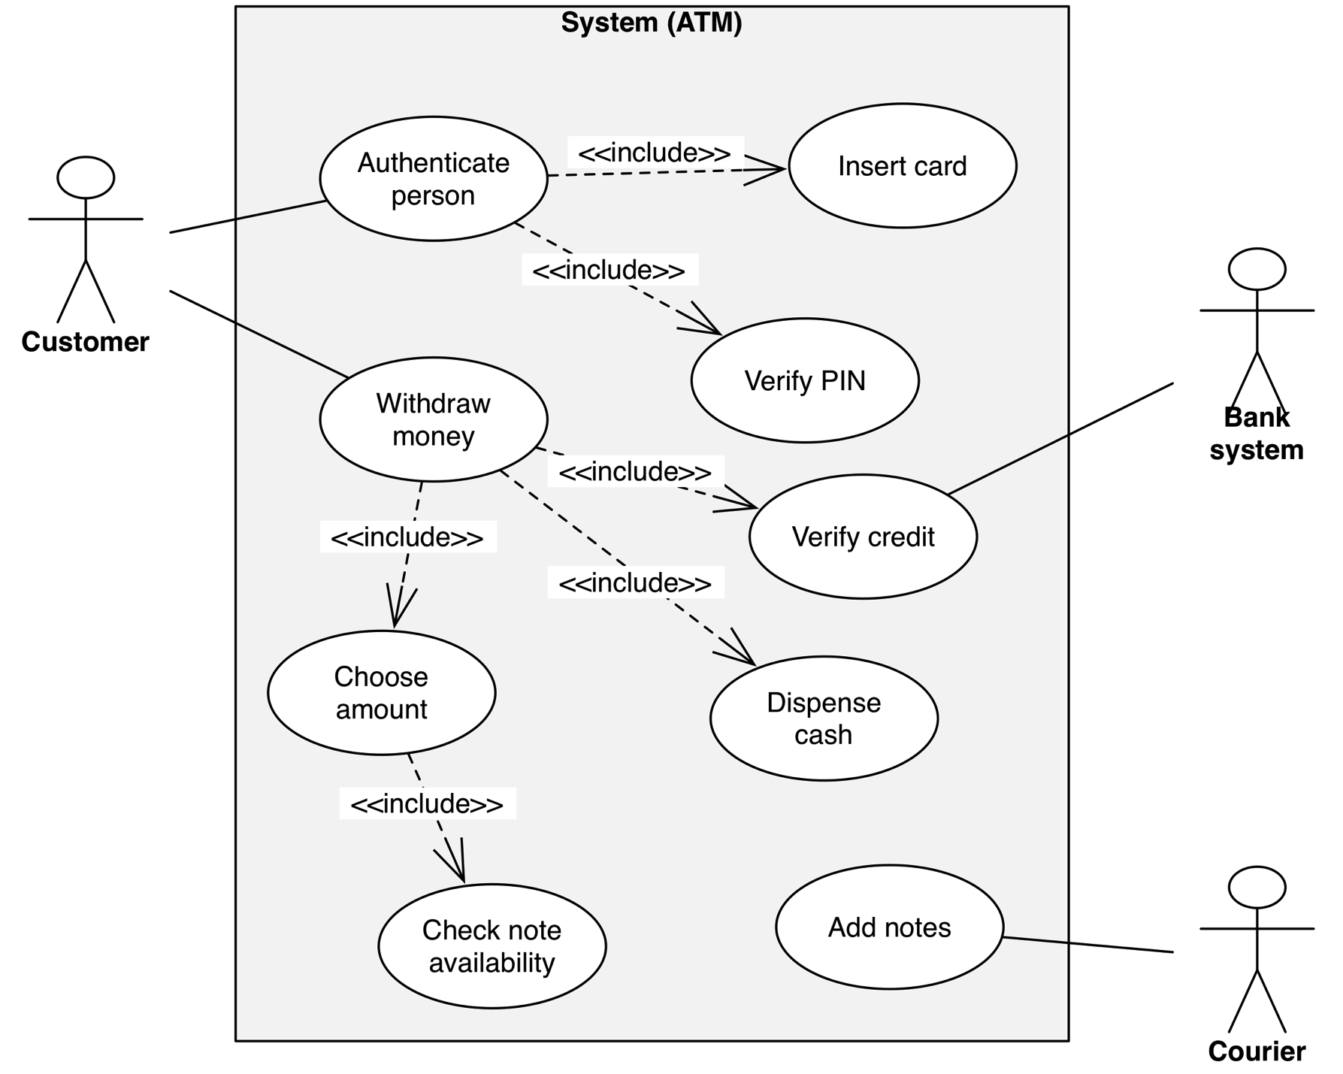
2) Boundaries
3) Use Cases
1) External Actors (human or system)

Slide 20
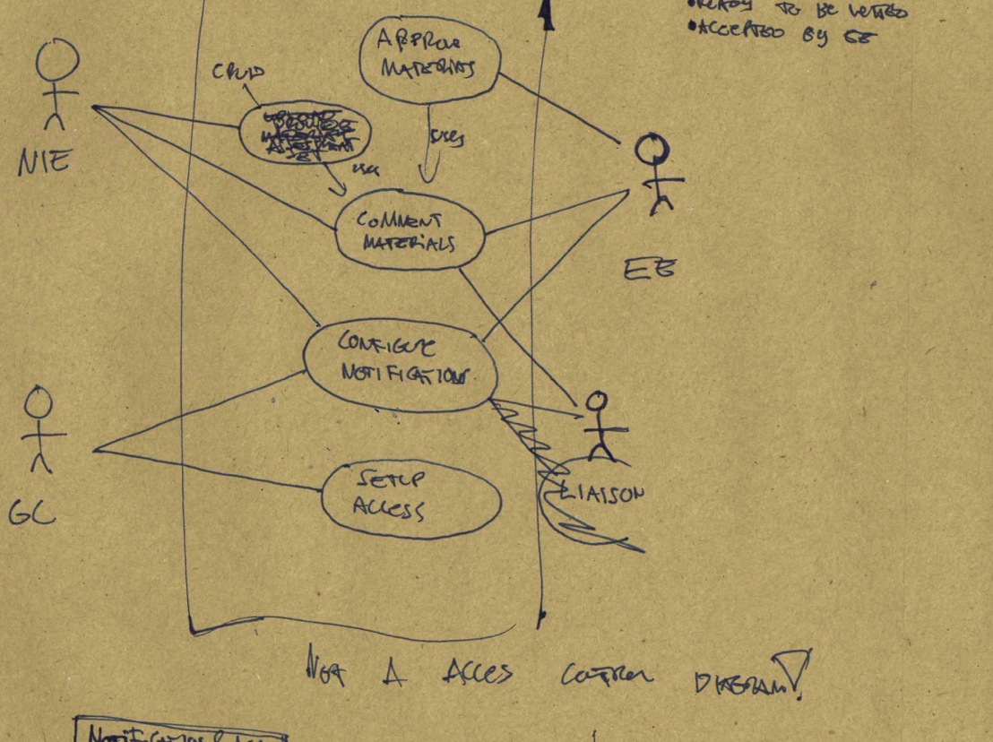
The back-of-an-envelope design for a new system

Slide 21
User modelling tips
Do the modelling yourself, that is,
do not use consultants except for facilitating the process.
Strong user models combined with MVP (minimum viable product) thinking helps you to avoid
feature creep.
What is that?
Notes:
A minimum viable product (MVP) is a development technique in which a new product or website is developed with sufficient features to satisfy early adopters. The final, complete set of features is only designed and developed after considering feedback from the product's initial users.

Slide 22
What is feature creep?
“Tendency to constantly add features which inevitably leads to complex products that are confusing and hard to use.”

Slide 23
Feature creep is another word for ”overshooting customers” – from the disruption theory.
Microsoft Word, circa 2006…
More details here :
https://www.chargify.com/blog/feature-creep/
Notes:
New York Times columnist David Pogue was one of the first people to publicly call attention to feature creep when he “famously demonstrated to a rapt audience at the 2006 TED conference what happened when he opened every possible toolbar in his Microsoft Word program—there was no room on the screen for the primary value-adding function of composing a simple text document,” explains Matthew May.

Slide 24
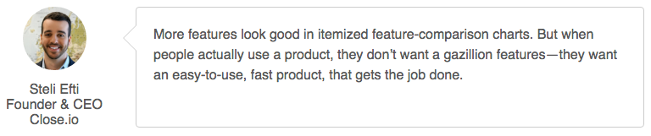

Slide 25
Modelling the information system

Slide 26
Wireframe (user-interface) models
There are many different ways to model the user-interface of an information system that often mix prototyping and even simulating the system-to-be-built.
These are often called “wireframe” models if they depict user interface elements and their functions without actual visual imagery and design.
Provide a common point-of reference that designers, engineers, marketing and business people can understand.

Slide 27
Hand-drawn, paper prototypes are great for quick sketching and can even serve user testing with real users.
Image by Mike Rohde
(CC BY-NC-ND 2.0)

Slide 28
https://www.axure.com
(free trial available)
DESIGN THE RIGHT SOLUTION
Download a free trial and see why 87% of the Fortune 100 use Axure RP
to wireframe and prototype their most important software projects.

Slide 29
www.justinmind.com

Slide 30
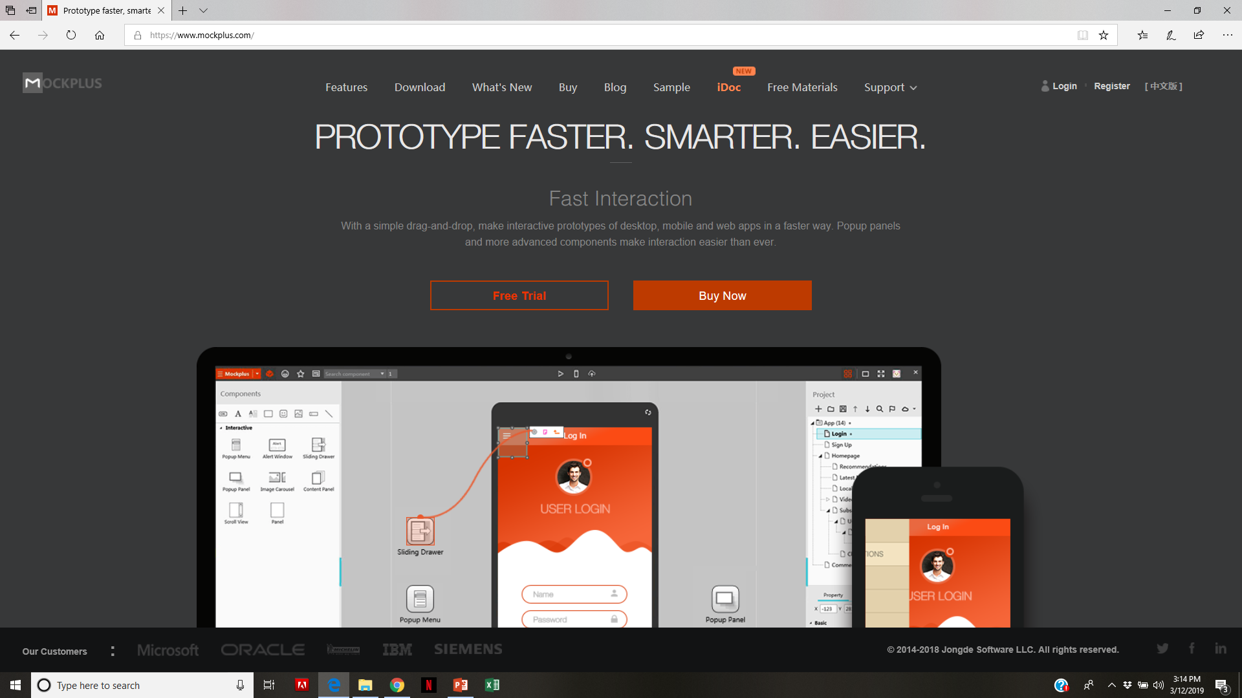
https://www.mockplus.com

Slide 31
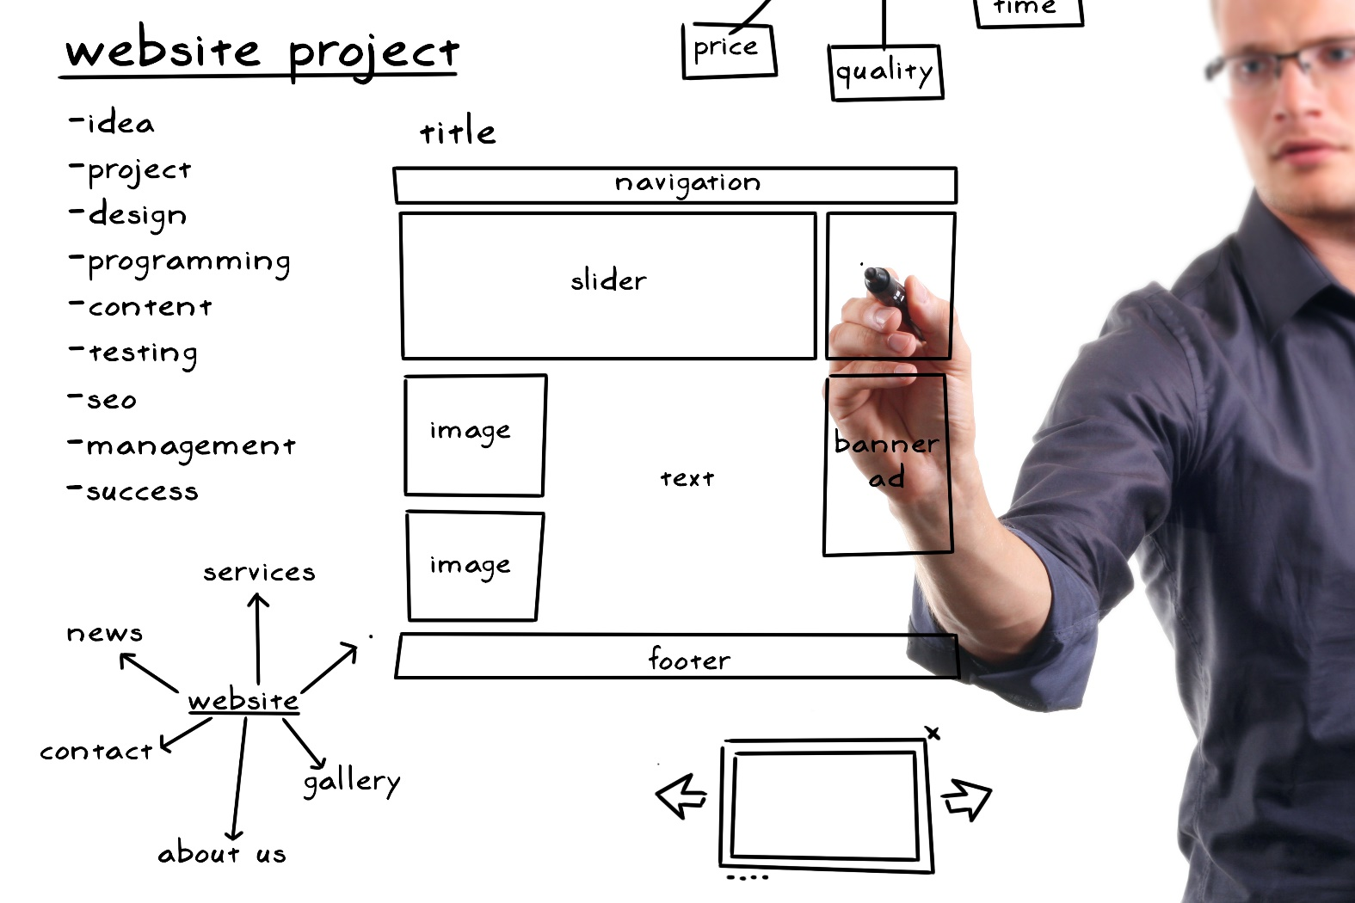
Comparison of the 3 prototyping tools:
https://www.mockplus.com/blog/post/justinmind-vs-axure-vs-mockplus-the-best-prototyping-tools-out-there
“Each prototyping tool gains its special characters. If you need “realistic” prototypes, Justinmind is recommended. If you prefer the “comprehensive” prototypes, Axure is recommended. If you like “fast” prototypes, Mockplus is recommended. ”

Slide 32
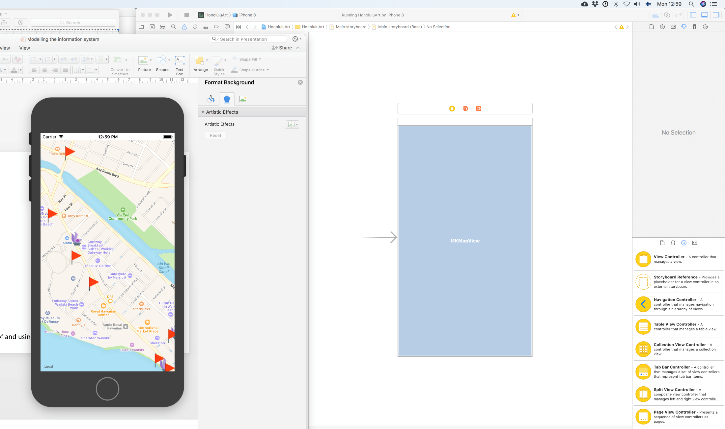
Quick-and-dirty build using advanced software development tools.

Slide 33
User-interface mock-up benefits
Provides a common point-of reference that designers, engineers, marketing and business people can understand. NOTE! This can be critical to project success!
Should be quick to change and modify to allow various degrees of rapid prototyping.
Can sometimes be used for user studies/testing before the system has been built.

Slide 34
Unified Modeling Language (UML)

Slide 35
Unified Modeling Language (UML)
It is important that people from different organizations and communities of practice can have a shared idea about the details of a complex system.
UML is a popular, fairly standardized notation for performing object-oriented analysis and design.
UML offers a gradual transition from analysing a human activity system to design and implementation of an information system.

Slide 36
UML diagrams
Use case diagram
Class diagram
Activity diagram
Sequence diagram
State diagram
Package diagram
Timing diagram
Deployment diagram
Etc.

Slide 37
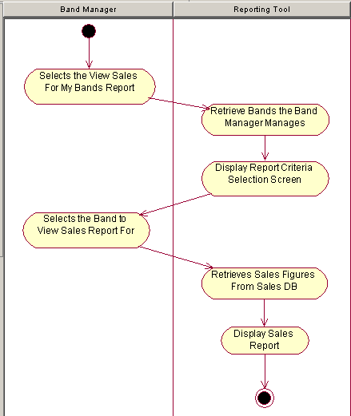
Activity diagram (example)
Similar to swim lane diagram :
two swim lanes to indicate control of activity by two objects: the band manager and the reporting tool
activity diagrams are best used to model higher-level processes. Business-minded people tend to understand them more quickly.

Slide 38
Object-oriented analysis
Thinking in terms of classes of objects is a powerful way to model systems.
A key distinction is between a class (a type of thing, for example “car”) and an object (instance of a class, that is, a thing for example a white BMW X5).
Object-oriented analysis provides a stepwise transition from real-world things and events to a software system that can be implemented using standard tools, languages and techniques.

Slide 39
Object-oriented analysis
Relationship between classes and instances is similar to that of a database table (columns definitions) and its rows.
Class diagrams are similar to entity relationship diagrams in that they are used to model possible relationships between classes of objects.
However, classes encapsulate not just data (attributes) but also actions (methods) that the object can do or perform.

Slide 40
Entity relationship diagram (ERD)
DIVISION
*divname
…
DEPARTMENT
*deptname
…
POSITION
*begdate
enddate
posttitle
…
EMPLOYEE
*empid
…
PAYCHECK
*payid
paydate
payamount
…

Slide 41
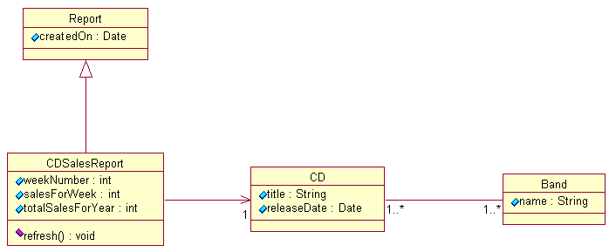
Class diagram
Class name
Attributes
Methods

Slide 42
The anatomy of class diagram
Class name
Car
Color
Make
Model
Cardinality
Some other class
Attributes
0…1
4
accelerate()
decelerate()
openTrunk()
Methods
An instance of a class (object) has values for its attributes (White, BMW, X5).

Slide 43
Class can be almost anything
Tangible thing – boat, car, plane…
Role – student, customer, inspector…
Incident – election, booking, arrival of order…
Interaction – marriage, contract, purchase…
Specification – recipes, orders, rules…
Etc.
→ The difficult task is to identify classes so that they are useful for the task at hand.

Slide 44
Encapsulation and inheritance
An object has attributes and methods (operations)
  This is known as encapsulation
  The entire system is made up of objects and their relationships.
The attributes (Name) and methods (setSalary) of individual objects (John, Mary, Sean) are described by their class (Employee), that is, an object instantiates a class.
A class (Employee) can inherit attributes (Name) and methods from a superclass. I.e. classes are organized into a hierarchy, where children inherit the attributes and methods of the parents.

Slide 45
Class diagram
The CDSalesReport class inherits from the Report class
Class name
Attributes
Methods
Encapsulation
Notes:
In Figure 3, we see both the inheritance relationship and two association relationships. The CDSalesReport class inherits from the Report class. A CDSalesReport is associated with one CD, but the CD class doesn't know anything about the CDSalesReport class. The CD and the Band classes both know about each other, and both classes can be associated to one or more of each other.

Slide 46

Identify 3 classes, their attributes (2 to 3).
List methods for one class.

Slide 47
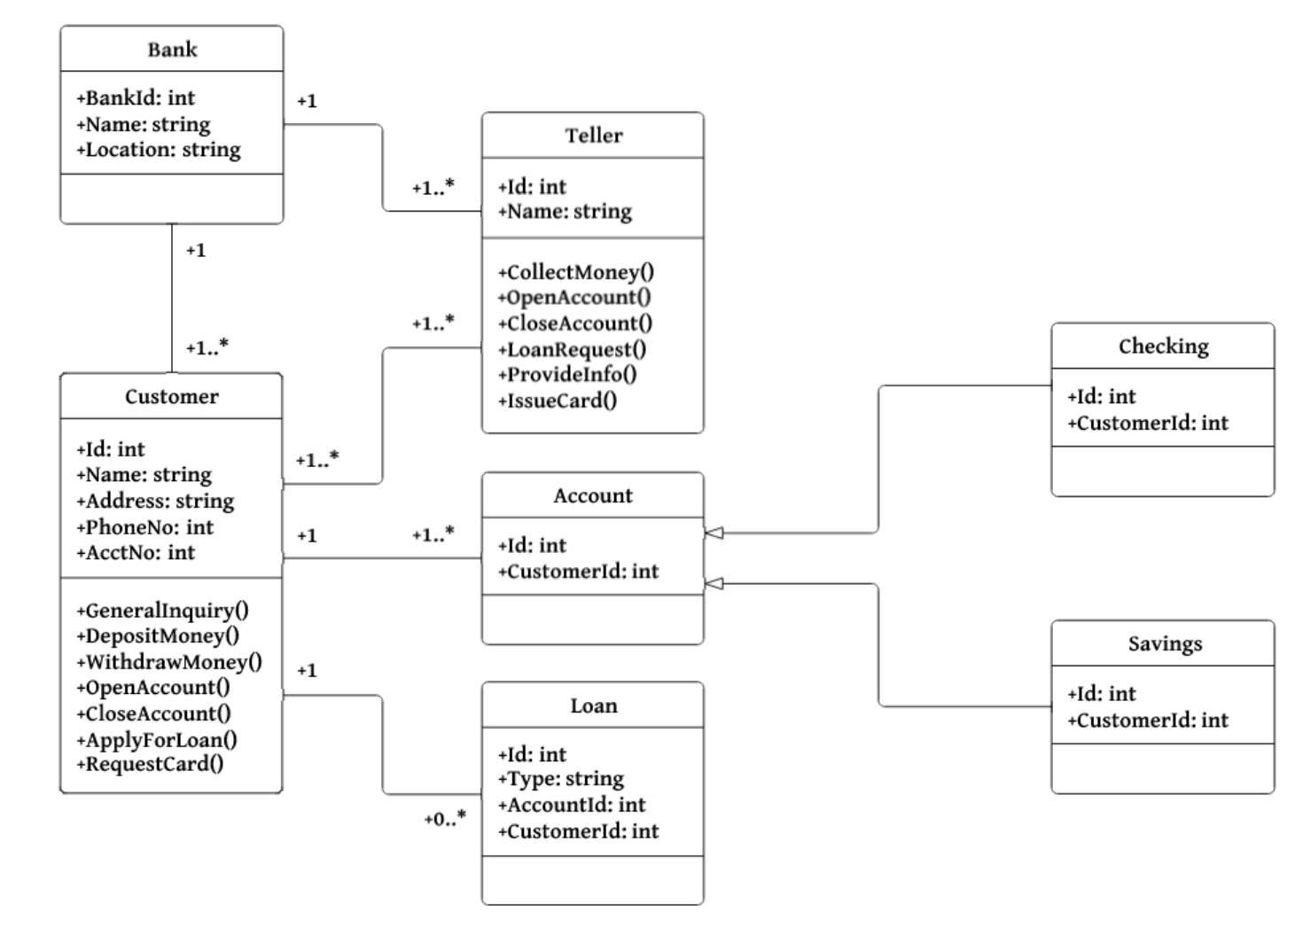
Possible solution : Banking System Class Diagram

Slide 48
More about UML
There are lots of resources available on the Web
Google “UML basics” or “UML tutorial”
http://www.ibm.com/developerworks/rational/library/769.html

