Slide 1

PUTTING IT ALL TOGETHER

Slide 2
WHAT WE’VE COVERED IN THIS COURSE
Persuasion and communication with PPT decks
Business benefits from IT
Disruptive innovation
Prototyping – user, system
Systems, systems thinking and business processes

Slide 3
COMMON THEMES
Uncertainty/risk. Business, users and technology pose considerable uncertainties for IS development.
Complexity. How can we comprehend and deal with complex systems?
Business benefits. How do we make IS development serve business?
These are not just problems to be solved; properly managed IT can create substantial opportunities for the business.

Slide 4
PUTTING IT AL TOGETHER
Common mistakes in human decision making

Slide 5
HUMAN DECISION MAKING IS OFTEN FLAWED
Four problems of human decision making:
Narrow focus
Confirmation bias
Short-term emotion
Overconfidence
Decision-making process to tackle the problems:
Widen options
Test assumptions
Distance yourself
Prepare to be wrong
From https://michaelhyatt.com/decisive/ (a review of “Decisive” by Chip and Dan Heath)

Slide 6
BREAKOUT DISCUSSION (10 MINUTES)
Thinking of your own capstone project, can you recognize any of the mistakes?
Narrow focus
Confirmation bias
Short-term emotion
Overconfidence

Slide 7
PUTTING IT AL TOGETHER
Integrative thinking
“Integrative Thinkers embrace complexity, tolerate uncertainty, and manage tension in searching for creative solutions to problems”
Source: Martin and Austen (1999)

Slide 8
INTEGRATIVE THINKING
Salience
Causality
Sequencing
Resolution
Integrative thinking is a creative process: it may feel running in circles as earlier decisions and assumptions are revisited, and analysis changed.
Creative work in progress!
Source: Martin and Austen (1999)

Slide 9
BREAKOUT DISCUSSION (10 MINUTES)
Choose one step in the process
Salience
Causality
Sequencing
Resolution
How can you relate/link the step to a major concept in the course?
Systems, systems thinking and business processes
Business benefits from IT
Prototyping – user, system
Disruptive innovation
Source: Martin and Austen (1999)

Slide 10

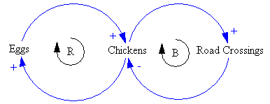
INTEGRATIVE THINKING AND SYSTEMS THINKING
Salience
Causality
Sequencing
Resolution
Hey, I thought we were done with this…

Slide 11
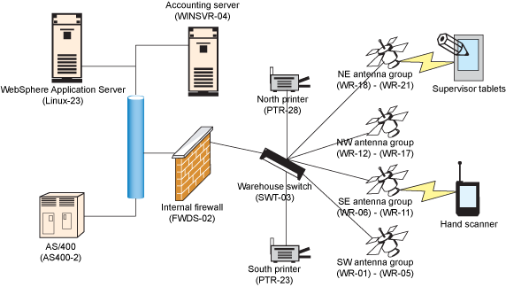
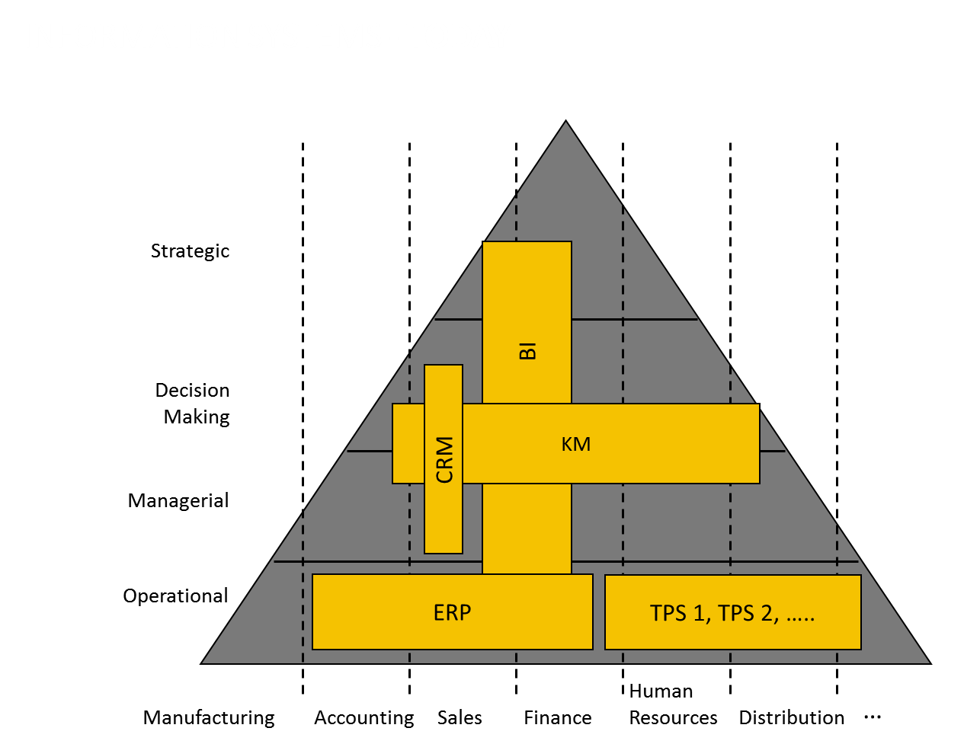
INTEGRATIVE THINKING AND ENTERPRISE ARCHITECTURE
Salience
Causality
Sequencing
Resolution
Source: IBM

Slide 12
INTEGRATIVE THINKING AND THE ROLE OF THE IT ORGANIZATION
Salience
Causality
Sequencing
Resolution
Source: Gartner (2012)

Slide 13
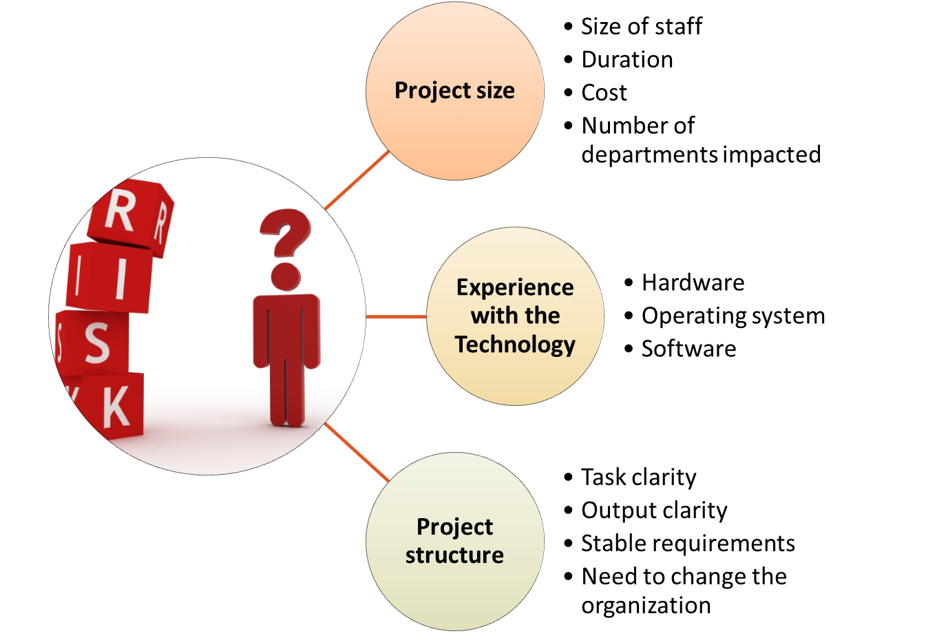
INTEGRATIVE THINKING AND IT RISK
Salience
Causality
Sequencing
Resolution

Slide 14
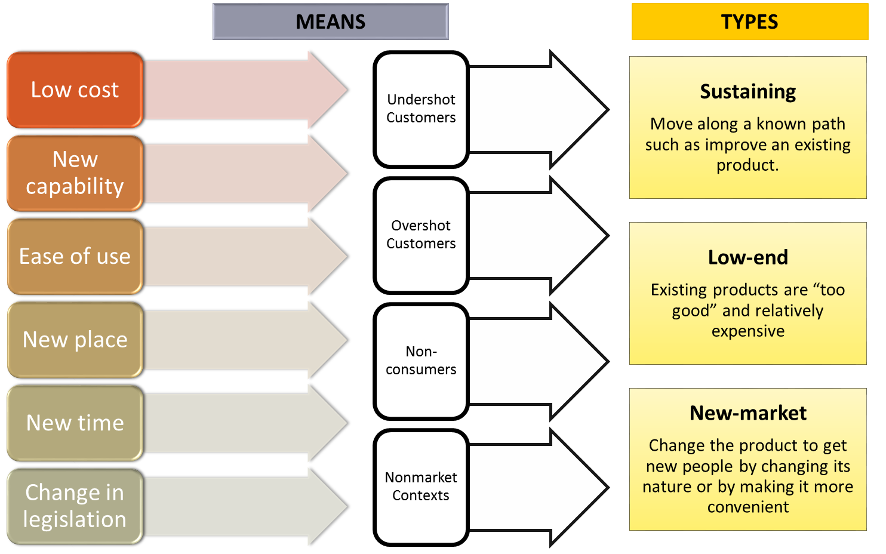
INTEGRATIVE THINKING AND DISRUPTIVE INNOVATION
Salience
Causality
Sequencing
Resolution
PUTTING IT AL TOGETHER

Slide 15
EXAM 2
Similar structure as Exam 1 (combination of multiple-choices and short answers, 50% each)
Review the materials (slides, readings, video, etc.) that have been covered since Exam 1
Topics summary:
Prototyping – User
Prototyping – System
Disruptive innovation
Putting it all together

Slide 16
END OF SPRINT #5
Each team has 10 minutes to present a status of their solution and any content they want to receive feedback on and 5 minutes for Q&A

