Slide 1
Progress Report 2
By: Michael Blum, Sean Doyle, Nicholas Napolitan, and Steven Suender

Slide 2
Status Report
Completed as of 10/2
Process and data models, preliminary architecture design, updated business case
Upcoming goals
Revise project charter
Brainstorm financial analysis
Continue to brainstorm prototype
Narrow down end dates
Preparing for mentor meeting on Thursday

Slide 3
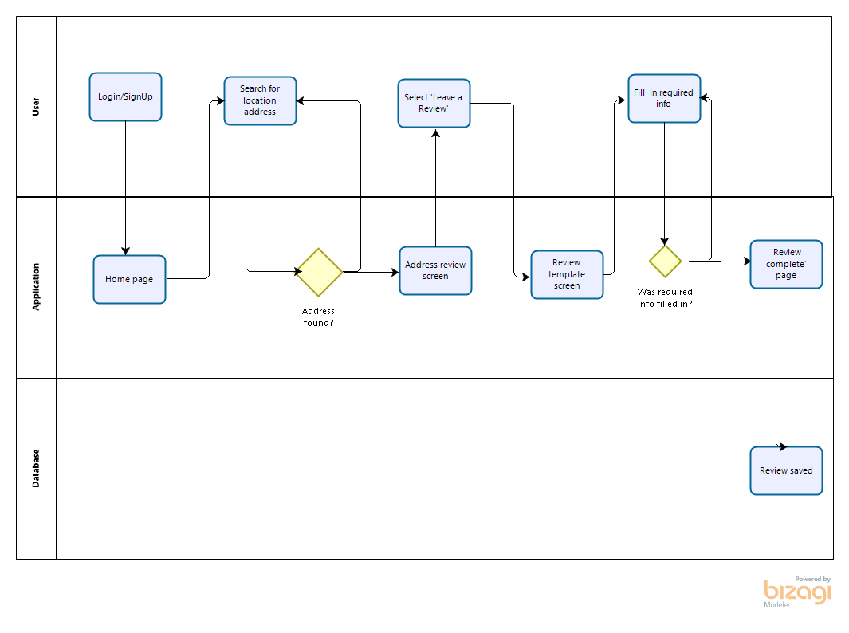
Process Model - Writing a Review
No
No
Yes
Yes

Slide 4
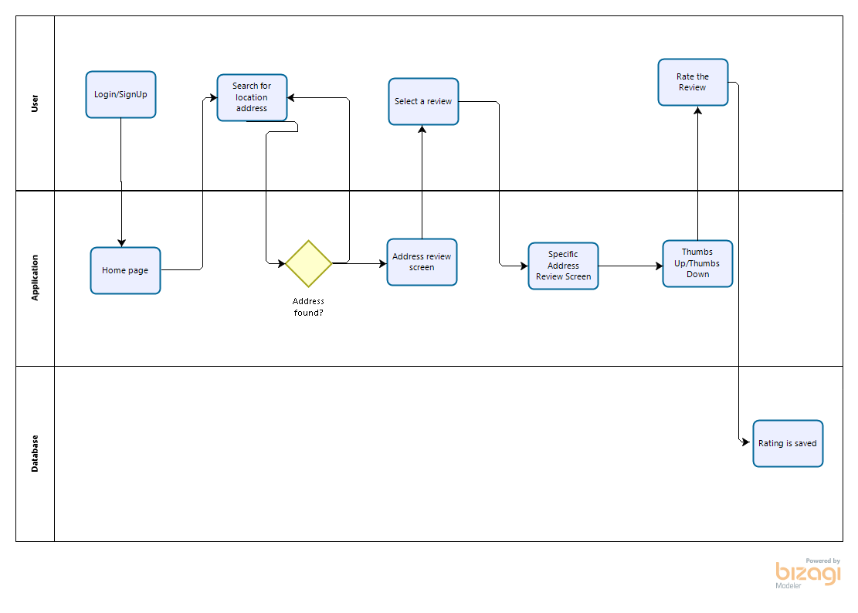
Process Model - Reading a Review
No
Yes

Slide 5
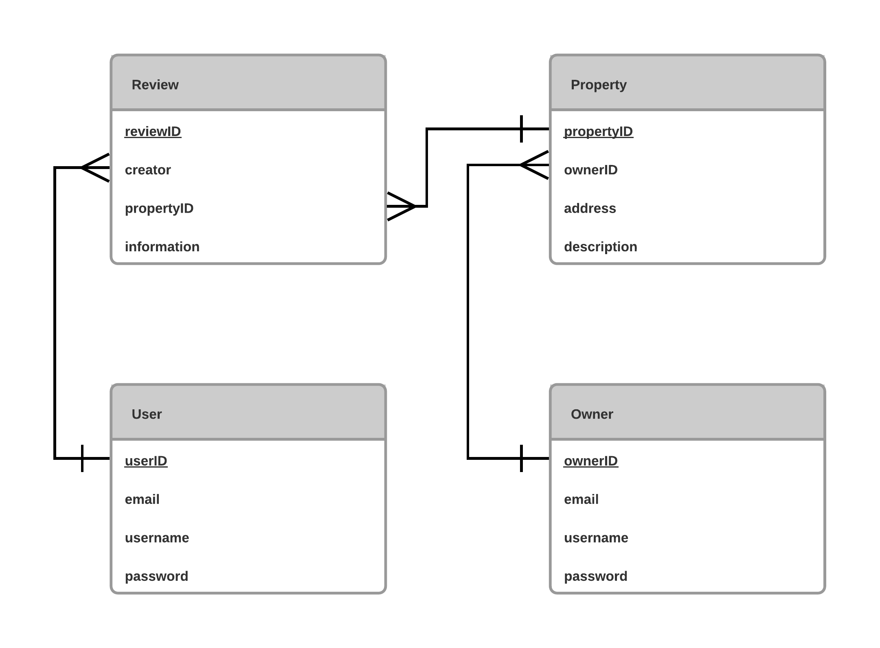
Data model

Slide 6
Preliminary System Architecture Design
Users
Internet
App Server
Db Server

Slide 7
Business Case
Market Potential
~40,000 students + prospective students
Hundreds of lessors & property managers
Competitive Factors
Unique, university-driven solution for niche audience
Ability to reach entire student organization
Relies on participation
Commercial services exist/adapt
Business Value
Public favor & attractiveness to prospective students
New student applications & improved student longevity
Builds university reputation

