Slide 1
Progress Report 3
By: Michael Blum, Sean Doyle, Nicholas Napolitan, and Steven Suender

Slide 2
Revised Overview
Project Description
Current search conditions unfavorable
Significant unknowns and risks
Reduce uncertainty with collaborative platform
Assess housing factors & share experiences
Safety most essential factor
Customer Benefits
Better living experience Better school experience
More controlled off-campus environment
Expected Business Results
Revenue from local ads & landlord association
Reduction in negative publicity
Recruiting & retention

Slide 3
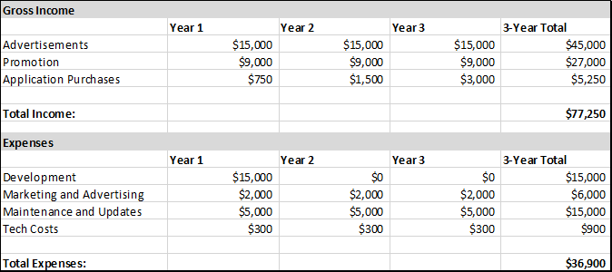
Business Case and Financials

Slide 4
Prototype
Home Page
Menu
Sign Up / Log in
Write A Review
Search for an apartment
Find an apartment
OR
Street Name
Rent
Beds x Baths
Search
FEATURED Off-Campus Housing!

Slide 5
Prototype
Home Page
AD
FEATURED Off-Campus Housing!
AD
X beds/ X baths
$x/mo per room
Address (with link)
Overall rating
X beds/ X baths
$x/mo per room
Address (with link)
Overall rating
AD
AD

Slide 6
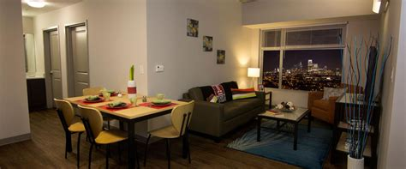
Prototype
Ratings Page
Menu
Sign Up / Log in
Write A Review
AD
ADDRESS - PROPERTY OWNER/MGR
$750-$1000/room
2 bed / 1 bath
Overall rating- 2.5/3
AD
Selected reviews
Safety - 3
Noise - 3
Neighborhood - 2
Grounds - 2
I would recommend!
I enjoyed living here! The surrounding area is very well kept and the neighborhoods are friendly. My only complaint is that I could still hear my roommates talking in the common area when I was in my room studying.
Was this review helpful? 4

