Slide 1
Michael Blum, Sean Doyle, Steven Suender, Nicholas Napolitan
November 13th, 2018

Slide 2
Project Overview
Provide students at Temple with off-campus housing platform
Focused on safety and transparency through reviews
Incentivize landlords and property management companies to offer better services
Enhance students’ overall experience
Reduce Temple’s loss of revenue from students leaving
Notes:
Provide students/Temple with off-site housing platform, focused on safety and transparency in choosing housing. Currently students don’t have an outlet to gain any insight about the area around a prospective housing option. We hope to solve this problem for students through housing reviews and a more informative housing resource. This will help students focus on grades improving their overall experience at Temple, and Temple will benefit from a reduction in loss of revenue from this housing platform.

Slide 3
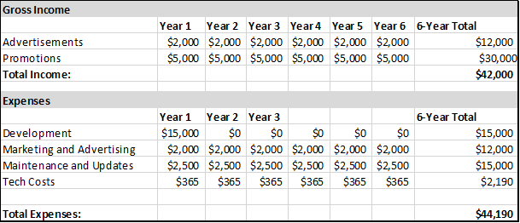
Business Case

Slide 4
Prototype

