Slide 1
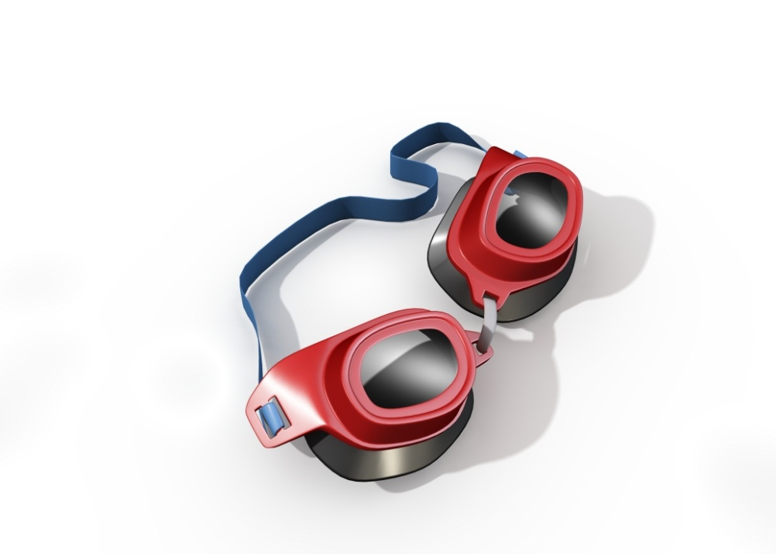
Enterprise IT
PROCESSES | SYSTEMS | BUSINESS MODELS
Bruce Hohne

Slide 2
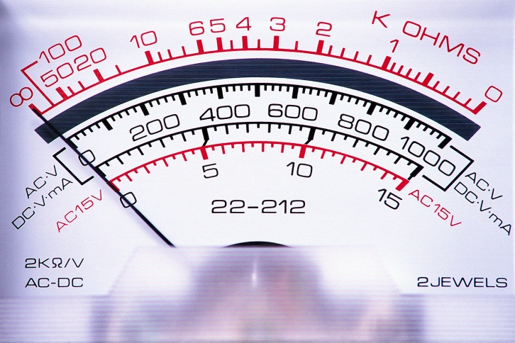
ENTERPRISE ARCHITECTURE
Enterprise architecture
Systems
Processes
Organizations are dependent on organizational systems.
Organizational systems automate and/or change key business processes.
An enterprise architecture is a roadmap of key organizational systems

Slide 3

LENSES

Slide 4
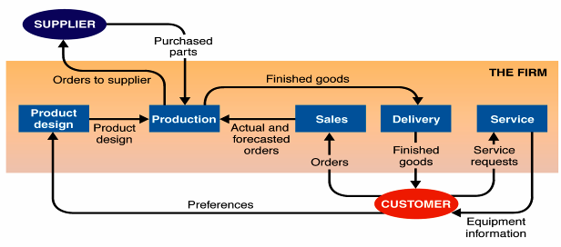
SYSTEMS
  Purpose – its reason for existence
  Boundary – where it begins and ends
  Components – the pieces that make up the system
  Environment – things outside the system boundary
  Inputs – objects and information that enter system
  Outputs – objects and information that leave system
A system with five subsystems
Source: Alter (2006)

Slide 5

LENSES

Slide 6
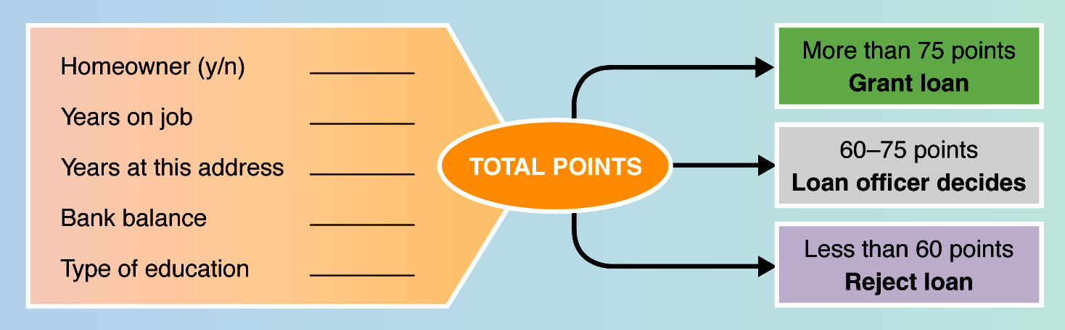
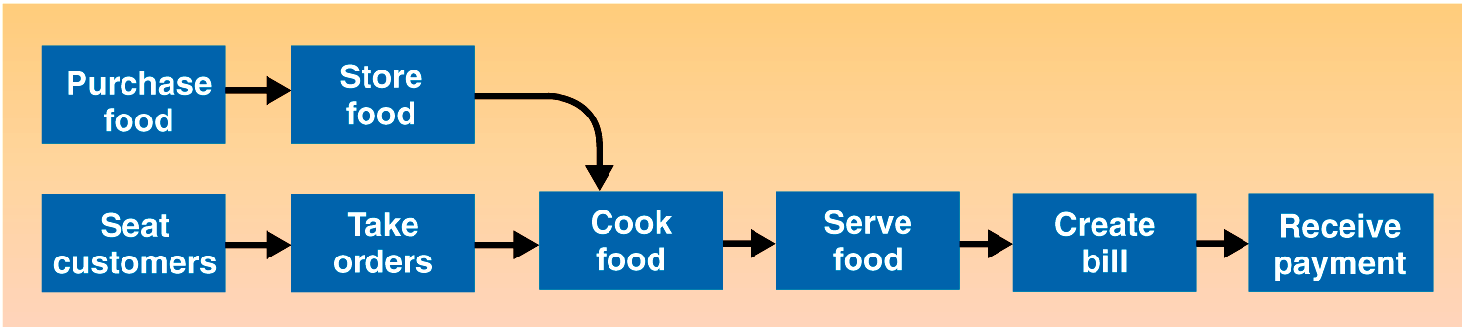
BUSINESS PROCESSES
Source: Alter (2006)
a structured, measurable set of activities designed to produce a specific output ... It implies a strong emphasis on how work is done within an organization, in contrast to a product focus’s emphasis on what... A process is thus a specific ordering of work activities across time and space, with a beginning and an end…Processes are the structure by which an organization does what is necessary to produce value ...
Source: Davenport (1993)
Notes:
Source: Alter, S. (2006) The Work System Method: Connecting People, Processes, and IT for Business Results,” Larkspur, CA: Work System Press.

Slide 7
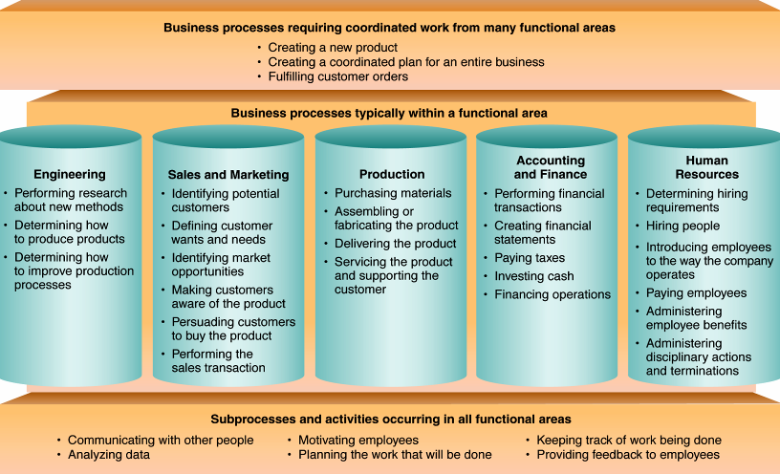
MORE BUSINESS PROCESSES
Source: Alter (2006)
Notes:
Ask students who have internships or jobs which pillar they were in.
Highlight connections between the pillars.

Slide 8

LENSES

Slide 9

What is an Information System?
INFORMATION SYSTEM
IF SSNO <> 9 Char THEN
Error
END IF
Hardware
Software
Networking
Business Processes
People
Data
A set of interrelated components that collect (or retrieve), process, store, and distribute information to support decision making and control in an organization
Source: Laudon, K., & Laudon, J. Management Information Systems. 8/e

Slide 10

LENSES

Slide 11
INFORMATION SYSTEMS - LEGACY
Strategic
Sales force automation
Decision
Making
Managerial
Personnel
Operational
Payroll
Electronic invoicing
Human
Resources
…
Manufacturing
Accounting
Sales
Finance
Distribution

Slide 12
INFORMATION SYSTEMS – ENTERPRISE APPLICATIONS
TRENDS
Web 2.0
Social Media
Analytics
Corporate IT
Wyeth
Amazon Web Services
Consumer IT
Google
Amazon
Apple
Facebook
ERP
DM
KM
CRM
BI
SM
DIGITAL BUSINESS MODELS
Grow
Save Money

Slide 13
INFORMATION SYSTEMS
ERP – Enterprise Resource Planning
DM – Digital Marketing
KM – Knowledge Management
CRM – Customer Relationship Management
BI – Business Intelligence
SM – Social Media
Enterprise wide systems that automate and integrate key organizational processes such as sales, purchasing, etc. (e.g., SAP)
An emerging discipline in Marketing which integrates the application of ecommerce, social media, and direct sales (e.g., Google Ads).
Organizational and consumer applications that focus on processes that have to do with interactivity (e.g., Facebook)
A concept and set of systems/processes to retain, transfer, and leverage organizational knowledge (e.g., Lotus Notes)
A specific system that automates direct sales, sales force management, and customer relationship processes (e.g., Salesforce.com)
AKA Analytics / Big Data
A set of capabilities and processes to get value from organizational data

Slide 14

LENSES

Slide 15

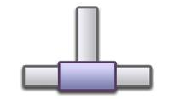




ENTERPRISE ARCHITECTURE COMPONENTS
ERP
CRM
Devices
Network
Applications
Data
ENTERPRISE ARCHITECTURE LEGEND
Notes:
So who cares?
Why?

Slide 16
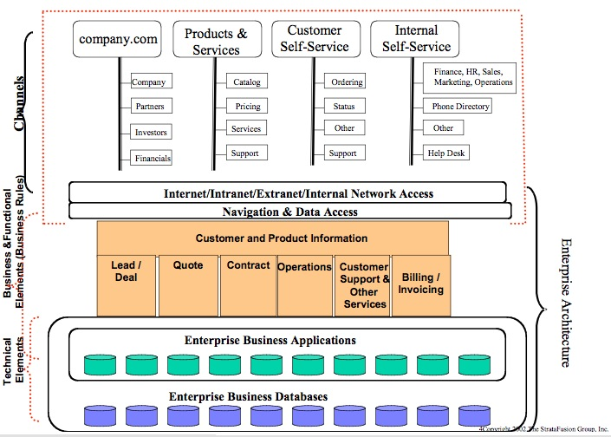
ENTERPRISE ARCHITECTURE EXAMPLE
Source: Collabri Group LLC
Notes:
Citation: http://www.collabri.com/images/CIOWisdom.Architecture_files/architecture2.jpg
Source: Collabri Group LLC

Slide 17
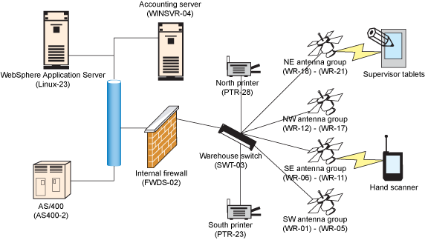
ENTERPRISE ARCHITECTURE EXAMPLE
Source: IBM
Notes:
Warehouse wireless design
Citation: http://www.ibm.com/developerworks/library/ar-enterarch4/
Source: Enterprise architecture essentials, Part 4: Test (and retest) your enterprise architecture - IBM

Slide 18
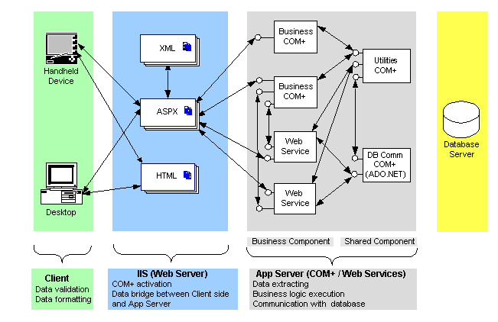
ENTERPRISE ARCHITECTURE EXAMPLE
Source: Quest4Web
Notes:
The following diagram overviews the Enterprise Application Framework Multi-tier Architecture:
Citation: http://quest4web.com/framework.html

Slide 19
ACTIVITY: ENTERPRISE ARCHITECTURE
Process
• Form groups (count off 1 – 2 – 3, 1 – 2 – 3, ...)
• As a group, discuss the following
• 2-3 ± minutes discussion per question
• One person reports out the group’s answer
Questions
• What is the architecture of each eportfolio on the FOX MIS
Community Platform?
• What did you learn about enterprise architecture from this
activity?

Slide 20

LENSES

Slide 21

REFLECTION
What would you like to remember about enterprise architecture?
What do you have questions about?

Slide 22
LENSES

Slide 23

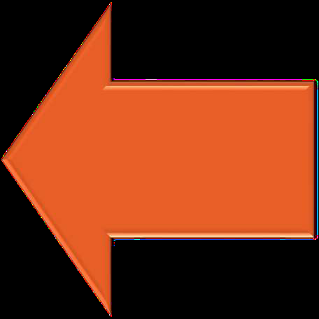
SYSTEMS THINKING VERSUS PROCESS THINKING
Process Thinking
• A series of steps and flows
• Decompose
Systems Thinking
• Collection of processes and
technological components
• Feedback loop
• Synthesize

Slide 24

ACTIVITY: SYSTEMS THINKING
1. Please stand and for the duration of the exercise.
2. You are not allowed to talk or use hand signals!
2. Each person will silently choose two other
people in the room as their points of reference.
3. Stand in a place which is equidistant from your 2 points of reference.
4. Don’t reveal who your points of reference are to the others .
5. It doesn't make any difference how far apart you are – they key is to be equidistant from both your points of reference.

