Slide 1
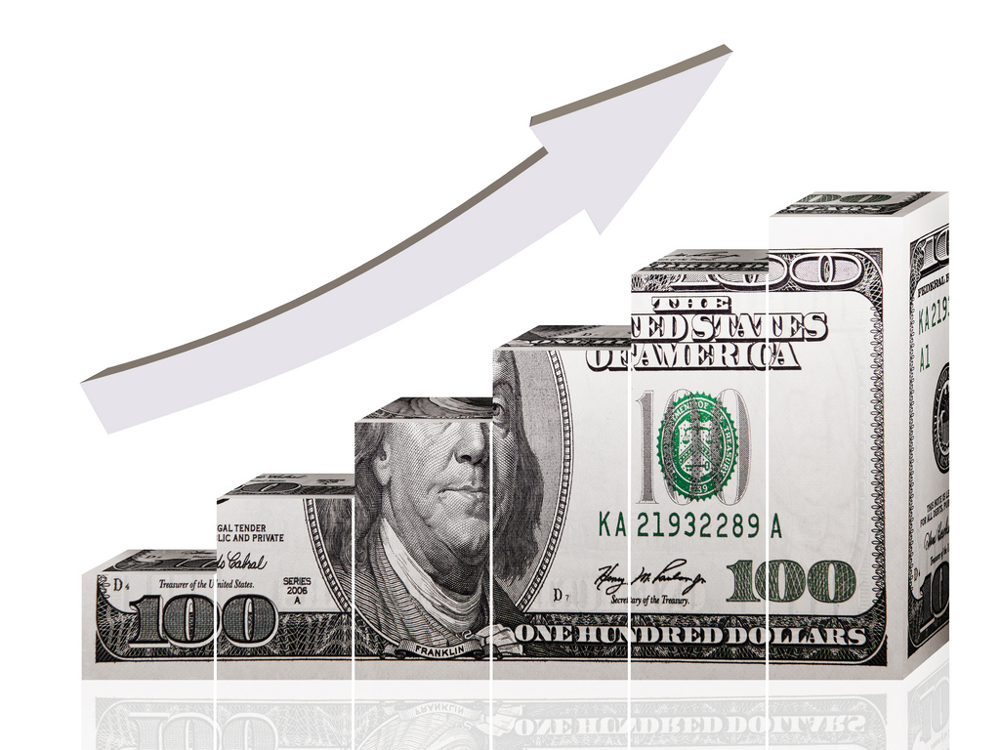
Business Benefits from IT
Strategic, Financial,
Technical Value
https://www.flickr.com/photos/68751915@N05/6551520247

Slide 2
AGENDA
Strategy and strategic value from IT:
  Strategic alignment
  Digital business strategies
Assessing the financial and technical value of an IT project; Net Present Value
IT risks and project failures
Scorecards

Slide 3
Strategy and strategic value from IT

Slide 4
IT DOESN’T MATTER: NICHOLAS CARR (2003)
IT performs core functions
IT becomes necessary infrastructure
IT is just a cost of doing business
IT Doesn’t Matter
Can IT create competitive advantage?
Or is it just something the company has to pay for?
https://hbr.org/2003/05/it-doesnt-matter

Slide 5
IT DOESN’T MATTER – REALLY?
Most valuable companies 2018
Apple
Amazon
Alphabet (that is, Google)
Microsoft
Facebook
https://www.statista.com/statistics/263264/top-companies-in-the-world-by-market-value/
Most valuable brands 2018
Amazon
Apple
Google
Samsung
Facebook
https://www.inc.com/business-insider/amazon-google-most-valuable-brands-brand-finance-2018.html

Slide 6
IT DOESN’T MATTER – REALLY?
Was Carr’s Harvard Business Review article wrong?
Maybe you should not believe everything they print in business journals…

Slide 7
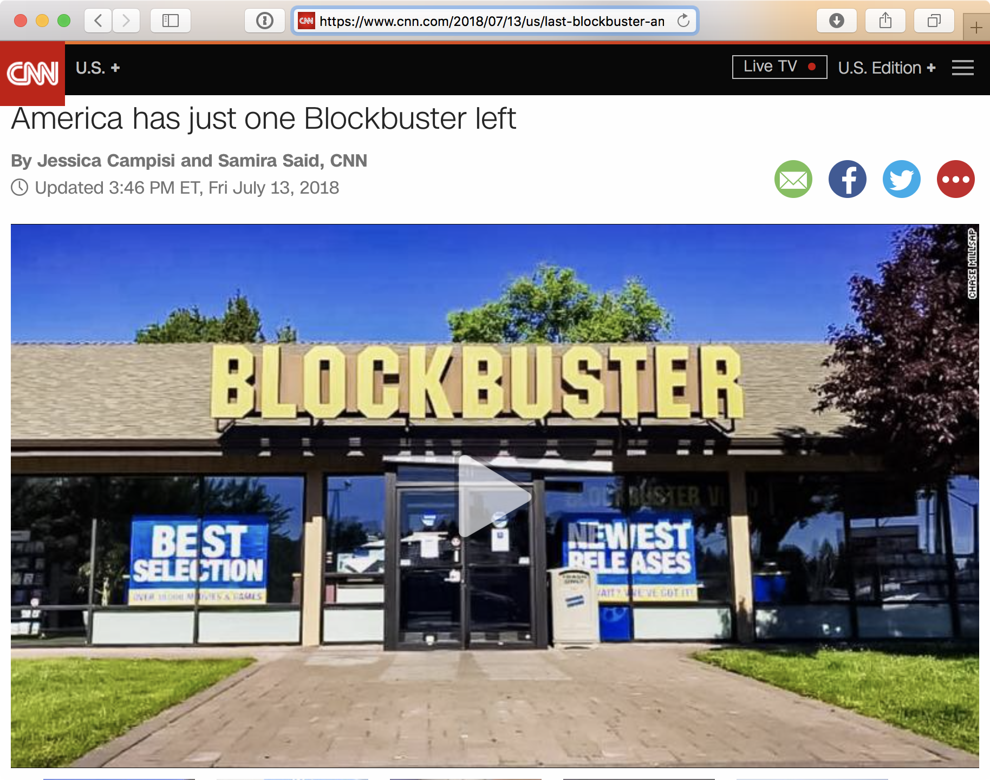
IT DOESN’T MATTER – REALLY?

Slide 8
UNDERSTANDING STRATEGY
In a perfectly competitive market,
no company can make profits.

Slide 9


UNDERSTANDING STRATEGY
A market for 1M soft drinks, one bottle costs 1 USD to produce.
Let’s enter the market and sell a bottle for 1.25 USD.
Let’s enter the market and sell a bottle for 1.5 USD.
Let’s enter the market and sell a bottle for 2 USD.
We need to lower our sales price, too!
profit: 1M
profit: 0.5M
profit: 0.25M
t₁
t₂
t₃

Slide 10
UNDERSTANDING STRATEGY
Strategy is about achieving sustainable competitive advantage, that is, beating the competition to make profits – e.g. by differentiating your products from others.
Let’s build a brand that allows us to keep selling soft drinks at 2 USD – even when others sell them for less.

Slide 11
DISCUSS
Why is it difficult to outmanoeuvre your competitors by simply applying new technologies to your business?

Slide 12
WHAT IS STRATEGY ABOUT?
Typical strategic issues: entering/exiting a specific market, vertical integration with suppliers and distributors, strategic resources and core capabilities, innovation, outsourcing organizational functions and processes, etc.
Generic business strategies: cost/price leadership, differentiation, etc.
Product strategy: vision for product offerings by stating where the products are going, how they will get there and why they will succeed.

Slide 13
IT and Strategy
  Strategic alignment
  Digital business strategies

Slide 14
STRATEGIC ALIGNMENT
The idea of strategic alignment is that enterprise IT, that is, organizational information systems should be aligned with the overall business strategy.
This means that technological systems support the competitive advantage of the company and/or make new strategies possible.
A key tool for achieving and retaining the alignment in rapidly changing business is enterprise architecture.

Slide 15
DIGITAL BUSINESS STRATEGY
New strategies become possible with new information systems. E.g. airline: A traditionally bundled product (flight, food, luggage, etc.) is broken down into small chunks that customers purchase through a self-service interface.
Industry-wide information infrastructures shape the business environment (e.g. newspaper business)
Data is not just a representation of external reality but the primary resource in a variety of businesses (e.g. Last.fm)
Digital business strategy touches upon the 4 “s’: the 1) scope, 2) scale, 3) speed, and the 4) sources of value creation and capture.
Business strategy can’t be separated from IT strategy.

Slide 16

DISCUSS
What kind of a role IT might play in Netflix strategy?
https://hbr.org/2018/07/to-see-the-future-of-competition-look-at-netflix

Slide 17
Financial and technical value

Slide 18
THE IT INVESTMENT PORTFOLIO
Risks and project failures
Scorecard
Financial measures
Whatever you do, has an opportunity cost.

Slide 19
Opportunity cost ?
The cost of, that is, the lack of benefits from the best alternative that was NOT chosen

Slide 20
THE IT VALUE LANDSCAPE
Financial Metrics
Revenue
Profit
Increased sales
Inventory turns
Days outstanding receivables
% increase in productivity
IT-Specific Metrics
% uptime
IT Spend as % of revenue
Response time
% within Service Level Agreement (SLA)
Return on Net Assets (RONA)
Earnings Before Interest, Depreciation And Amortization (EBIDA)
Net Present Value
The IT Spending Guide
(as % of gross revenue)
< 1%
1% to 2%
3% to 6%
6% to 15%
> 15%
Starving IT and cheating your business
Survival mode
Robust spending; pursue strategic projects
Be cautious of spending
Spending out of control?
2% to 3%
Well funded IT in a large firm

Slide 21
THE ROLE OF IT FUNCTION – MORE THAN A COST CENTER?
Source: Gartner (2012)

Slide 22
Role of IT
IT as Engine Room
IT as a world-class utility and infrastructure provider
IT as Global Business Service Provider
Expanded and integrated shared-service organization that runs like a business
IT “IS” the Business
Non-traditional customer/provider relationship between IT and the enterprise
Everyone's IT
Dominated by highly distributed IT and/or consumer-driven IT.
Delivers ongoing cost improvement
Leverages new and alternative delivery models (such as cloud computing)
Delivers IT products/services; also IT-enabled enterprise functions like HR, legal and real estate
CIO responsible for business result, up to and including revenue accountability
The enterprise integrates IT decisions into everything it does. “Information is the Product”
It is IT "in the wild" — unfettered and unharnessed. Little or no central IT authority
Employees empowered to acquire/develop IT necessary to drive their success
Virtual centralized organization
Source: Gartner (2012)

Slide 23
Role of IT : Temple U
Temple University IT Structure and Roles
Central IT – network infrastructure, phone, help desk, staff computing resources
Central IT – Banner (ERP), Concur (Travel & Expense)
Faculty computing, student BYOD

Slide 24
Assessing the financial value of an IT project
Net Present Value (NPV) and Expected Value (EV)

Slide 25
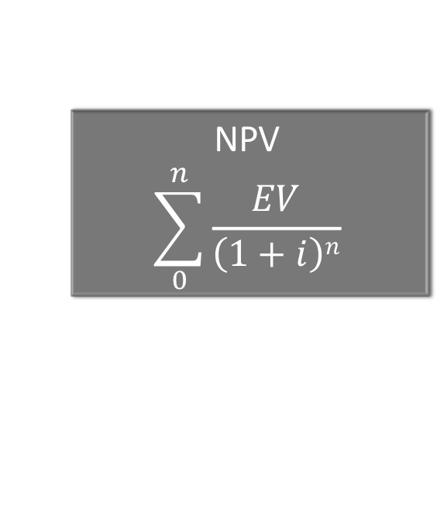
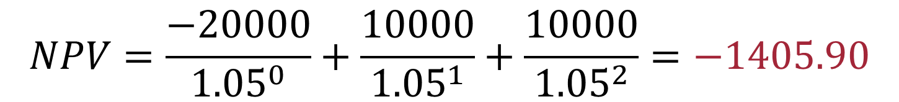
CALCULATING IT VALUE: NET PRESENT VALUE
Project X
  Year 0: $20,000 cost
  Year 1: $10,000 benefit (estimated)
  Year 2: $10,000 benefit (estimated)
NPV
$$\sum_{0}^{n}{\frac{EV}{\left(1+i\right)n}}$$
$20,000
($20,000)
?
$$NPV=\frac{−20000}{{1.05}^{0}}+\frac{10000}{{1.05}^{1}}+\frac{10000}{{1.05}^{2}}=−1405.90$$
Assume 5% rate of return on capital

Slide 26
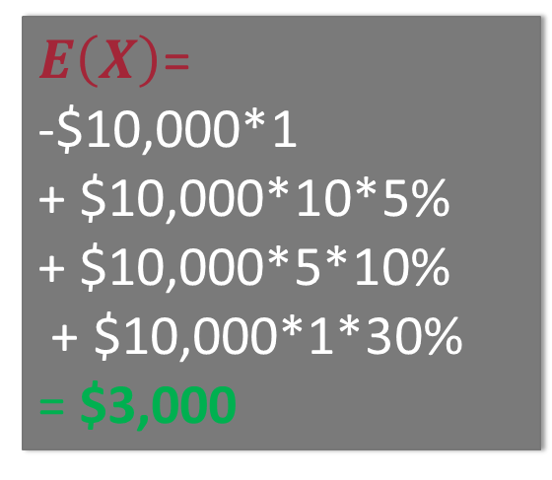
CALCULATING IT VALUE: EXPECTED VALUE
E(X) = ΣxP(x)
where x is the outcome and
P(x) is the probability of that outcome
Project Y
  Security system costs $10,000 and
  prevents all downtime
  If you don’t buy the system
    5% chance 10 days of downtime
    10% chance 5 days of downtime
    30% chance 1 day of downtime
    Each day of downtime costs $10,000
What does the expected value mean?
  Cost of system is $10,000; E(x) = $3,000
Can you combine?
  NPV = (E(X_{year1}))(1.05)⁻⁰ + (E(X_{year2}))(1.05)⁻¹ + (E(X_{year3}))(1.05)⁻² + … =
$E\left(X\right)$=
-$10,000*1
+ $10,000*10*5%
+ $10,000*5*10%
+ $10,000*1*30%
= $3,000

Slide 27
OTHER COMMON IT VALUATION METRICS
Total Cost of Ownership (TCO)
Return on Investment (ROI)
Return on Assets (ROA)
Net income an IT project generates divided by the total cost of the assets
Estimate direct and indirect costs.
Profits in relation to capital invested
So how are IT projects like an investment portfolio?

Slide 28
ARE ALL BUSINESS BENEFITS MEASURABLE?
There are many different views about this. Discuss the merits and problems of the two views presented in readings:
YES – “Everything is measurable” by Douglas Hubbard
NO – “The Beauty and Perils of Metrics” by Aleksi Aaltonen

Slide 29
IT risks and project failures

Slide 30

PROJECT MANAGEMENT TRIANGLE
Project Management is the application of knowledge, skills, tools, and techniques to project activities in order to meet a desired result on time, within budget, and according to the project specifications (scope / quality).
Project Management
Triangle : Triple constraint!

Slide 31
DIMENSIONS OF RISK
Project size and complexity
Size of staff
Experience with the Technology
Hardware
Project structure
Task clarity
Duration
Cost
Number of departments impacted
Operating system
Software
Output clarity
Stable requirements
Required level of organizational change
Development platform

Slide 32
WHEN DO PROJECT FAILURES HAPPEN?
Project
Post-project use
The generally talked about category of system failures
But the roots for these system failures lie in the project phase
An IT project can be technically successful (in the sense that the system implements its specification within budget and schedule) but never result in any business value.

Slide 33
Assessing Risk of Individual Projects
KEY QUESTIONS
Question | Assessment/Tool
Are the benefits enough to offset the risk? | Use expected value calculation
Can the affected parts of the organization survive if the project fails? | Assess Enterprise Architecture and Business Processes
Have the planners considered appropriate alternatives? | Use a scorecard
Would there be a better way to use the resources? | Assess opportunity costs

Slide 34
Scorecards

Slide 35

SCORECARDS
Structured comparison of features
Level of rigor can vary
Quantitative or qualitative
 | Product 1 | Product 2 | Product 3 | Product 4
Criteria A (%) | score | score | score | score
Criteria B (%) | score | score | score | score
Criteria C (%) | score | score | score | score
Criteria D (%) | score | score | score | score
(Weighted) Total | SCORE | SCORE | SCORE | SCORE

Slide 36
EXAMPLE
Community authored textbooks published in a web-based content management system
Create a report that scores each product
Team choses top two
Evaluate in a test environment
The final choice will come from those three
Where do you get the list of products?
Where do you get the criteria?
How do you choose the weights?
Do you just pick the product with the highest score?

Slide 37
EXAMPLE: SCORECARD
Criterias | Weight | Word-Press | Joomla | Drupal | Share-point
Access controls to give people different levels of authoring (add, edit, delete) by entry | 5% | 10 | 5 | 3 | 10
Version control at the page level and at the “publication” level (Ability to “freeze” an entry and archive it) | 5% | 9 | 6 | 8 | 8
Ability to incorporate multimedia into an entry | 10% | 8 | 7 | 4 | 6
Support discussion-board style feedback from readers through different, access-controlled forums (student forum versus instructor forum) | 10% | 9 | 8 | 3 | 7
Support login-based access control and account management | 10% | 9 | 5 | 7 | 5
Convert an entry or a “publication” into a PDF for offline viewing and printing | 10% | 10 | 6 | 5 | 6
Scalability – ability to support a large number of users | 25% | 8 | 8 | 5 | 7
Delivery to browser in standard HTML (web-based delivery) | 25% | 9 | 8 | 9 | 8
TOTAL | 100% | 8.8 | 7.15 | 5.95 | 7.05

Slide 38
“…[IT] makes little direct contribution to the overall performance of a company or the economy until it’s combined with complementary investments in work practices, human capital, and organizational restructuring.”
—Erik Brynjolfsson The IT Productivity Gap

Slide 39


Slide 40
Sprint 2 Presentation
Present a deck in which you report :
What have you achieved – against your ToDo,
Any changes you feel are necessary to the overall framing of the project, and
What is your ToDo for the next sprint.
Each team has 10 minutes to present and 5 minutes for questions and answers (Q&A)
Due : website and project charter (charter & deck posted on site) – these will be assessed as Pass or Fail

Slide 41
Exam 1
Duration : 80 minutes
Closed book
Content : week 1-5
Format : combination of multiple choice and short answers

