Slide 1
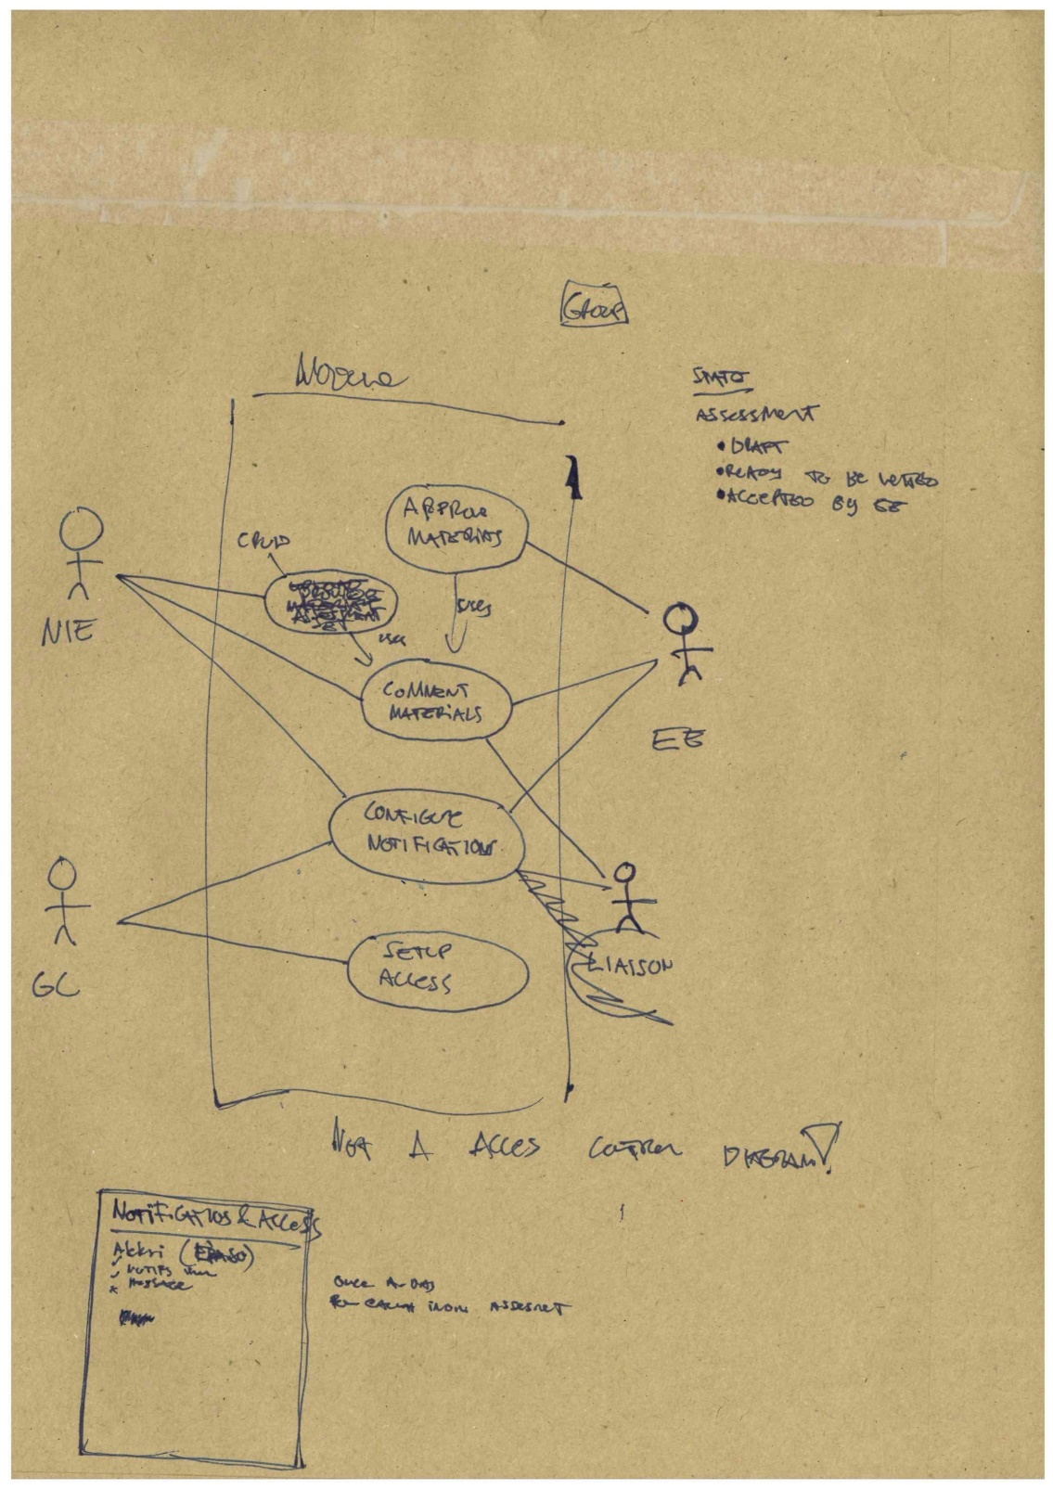
Prototyping
Modeling the user and the system

Slide 2
Think of different types of “models” or “modeling” – how many can you list?

Slide 3
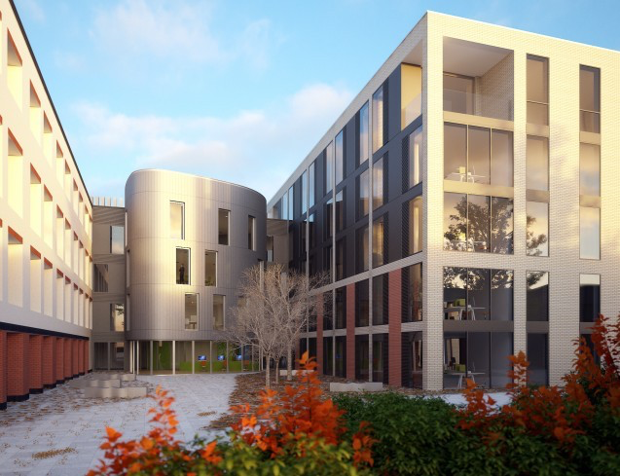
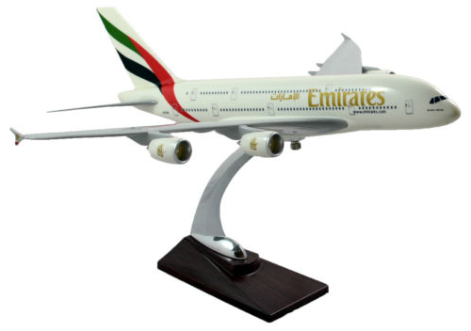

Architectural 3D model
Physical scale model
Relational database model (ERD)
Mathematical model

Slide 4
A model is a particular kind of representation of reality (or intended reality). It picks out and emphasises certain aspects – while ignoring many (most) others.

Slide 5
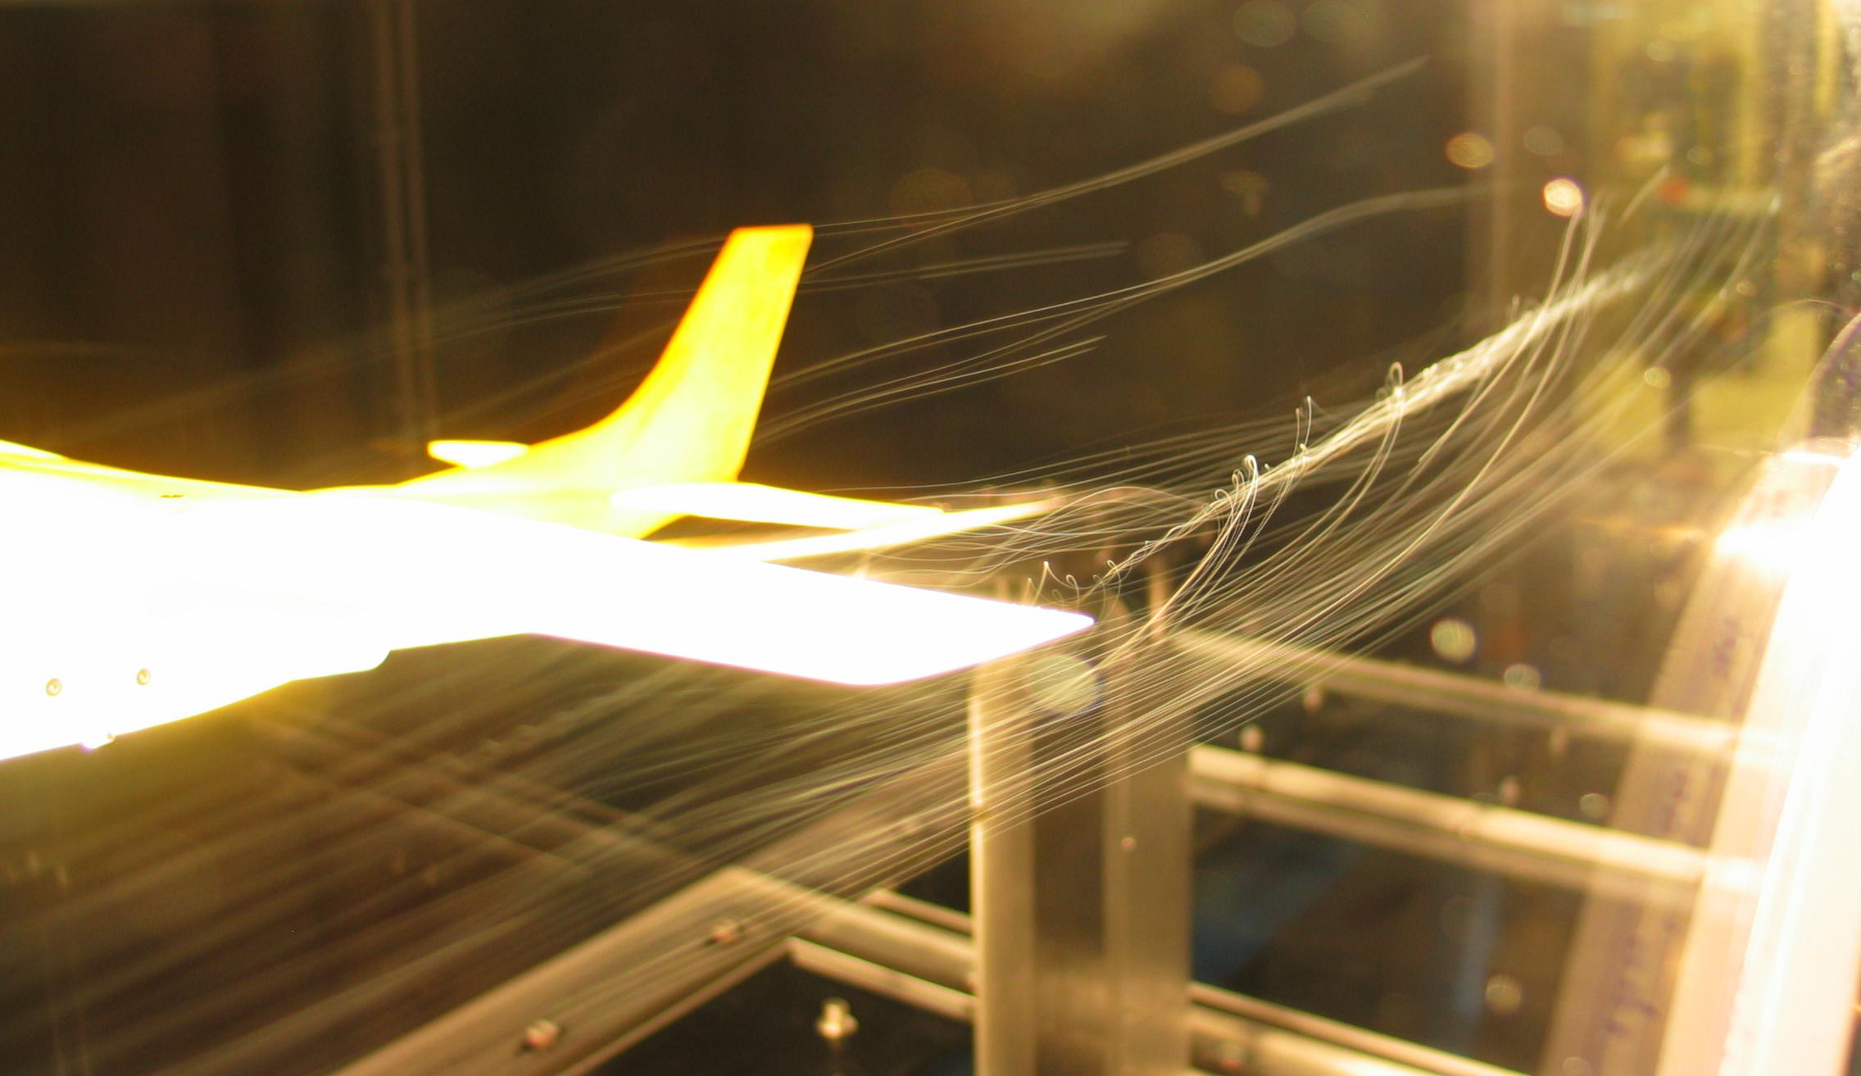
Photo by BenFrantzDale, downloaded from http://en.wikipedia.org/wiki/Wind_tunnel#mediaviewer/File:Cessna_182_model-wingtip-vortex.jpg

Slide 6
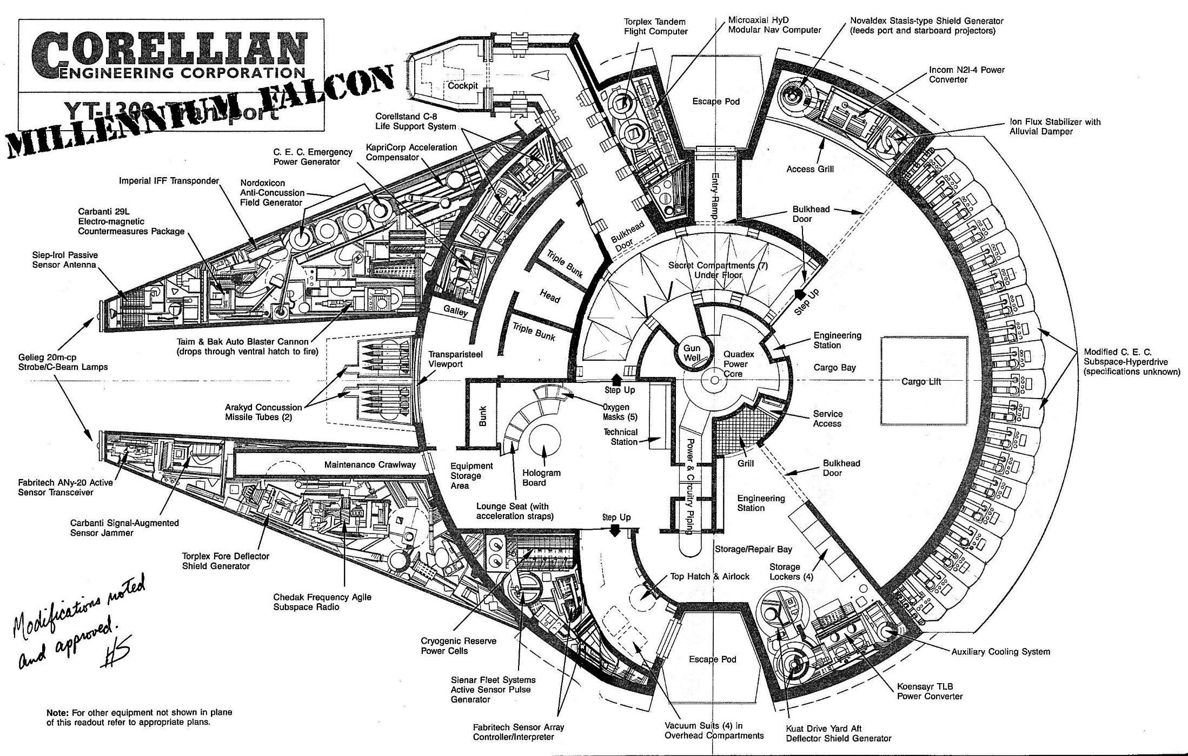

Slide 7
Model based interactive simulation
Photo by Pi3.124 (CC BY-SA 4.0)

Slide 8
Agenda
Models and modelling in general
Modelling the user:
User personas
User scenarios
Use cases (UML)
Modelling the system:
Wireframe (user-interface) models
Class diagrams (UML)
Unified Modelling Language (UML)

Slide 9
Modelling in general - summary
All models are abstractions and hence simplifications of the phenomenon (e.g. system) they describe.
The purpose is NOT to capture every detail in the real system, but rather to highlight the features (and relationships) that are relevant to the task at hand.
No model description is ‘complete’. We often need several models to adequately describe a system.
Clear idea of why/for what purpose a model is being constructed is a key to successful modelling.

Slide 10
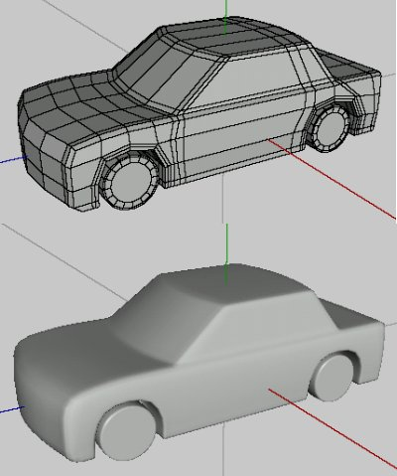
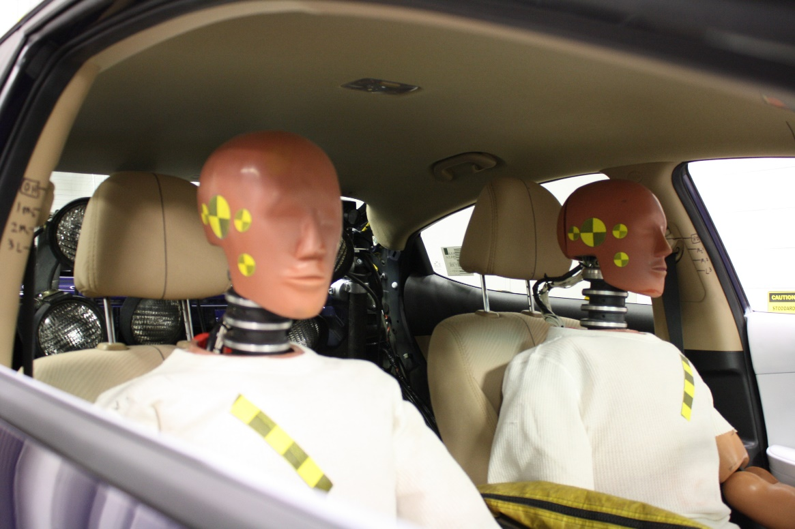
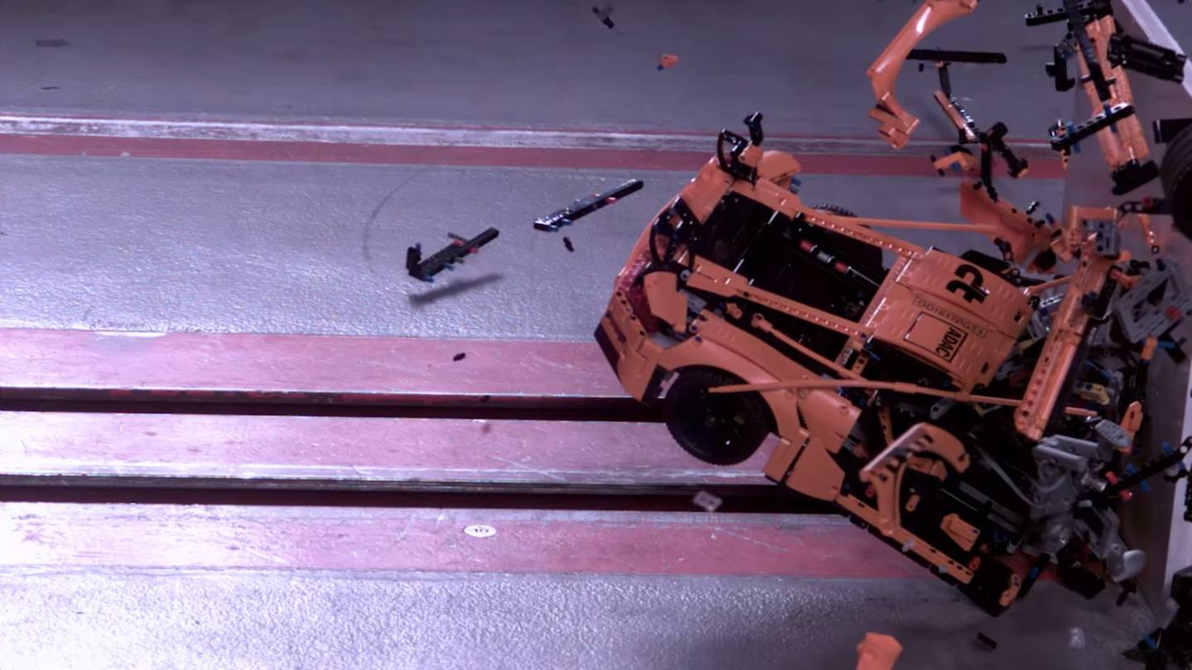
Multiple models are usually needed…
…and it is important to choose the right kind of model for the task.

Slide 11
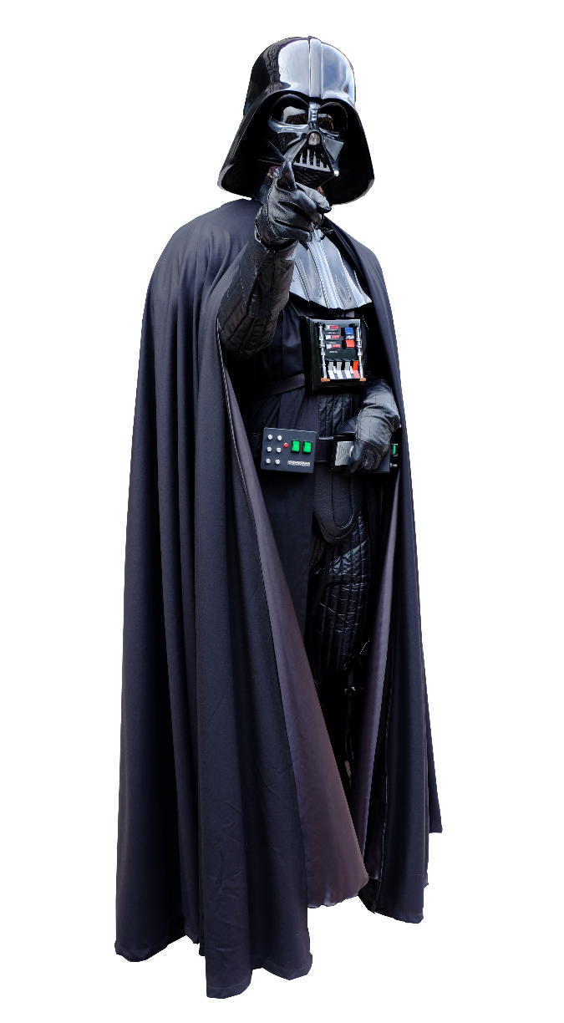
Don’t underestimate the power
of low-end tools!
It is easy to get carried away with the modelling tool itself. Therefore, consider using low-end tools such as a pen and paper.
Photo credit: 玄史生 / MathKnight - https://commons.wikimedia.org/wiki/File:Darth_Vader_-_cosplay_(white).jpg

Slide 12
“Having built a hopefully relevant model or two, we are then ready to begin the structured discussion about the situation, and how it could be changed, which will eventually lead to action being taken. The models are the devices which enable that discussion to be a structured rather than a random one.”
Checkland and Poulter (2006, p. 49)
The objective is to do better business – not fancy models!

Slide 13
Modeling the user

Slide 14
User personas
User “personas” are stories or structured descriptions that capture the person, personality, motivations, context, etc. of intended primary/early adopter users.
Personas should be based on research; the aim is not to fantasise about users but to capture important attributes of user as a believable character. Do not make the personas generic but rather rich and realistic.
Three or four personas is usually best (one or two maybe enough) – they are not intended to be representative of all intended audiences and the whole team must internalize the personas (i.e. they are difficult to change afterwards).
Personas help in different design decision by providing an external reference point for discussing the look and feel, tone of voice and overall interaction patterns of the product.

Slide 15
User personas
What are the Best Practices for developing Personas?

Slide 16
User personas – Best Practices
Conduct user research
Condense your research (what is universal to the system and its users?)
Brainstorm
Refine
Make them realistic!

Slide 17
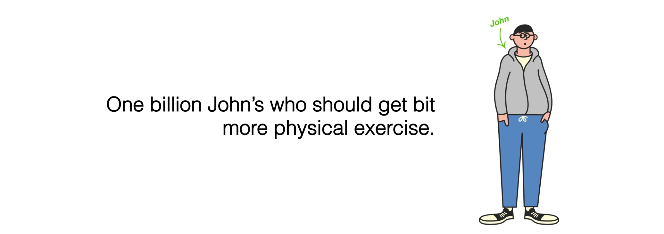
User personas example
For Moves app, we developed “John” by interviewing a real person about his exercise habits and by writing a fictional but plausible story describing his daily life.
During the development, it was then possible to answer questions such as: “Would John like to use this? Would this be useful for John?”
a

Slide 18
User scenario
Scenarios are stories of how and why users use the product – from the individual user’s perspective.
A scenario can capture the initial take up, typical usage session, when something goes wrong, etc., i.e. how does the product operate in the user’s context and serve his or her aims and preferences.
Scenarios help both in design and testing the user interface.
Scenarios help, for instance, capturing major requirements (but perhaps not details), arguing against excessive features – and to move gradually toward use cases.

Slide 19
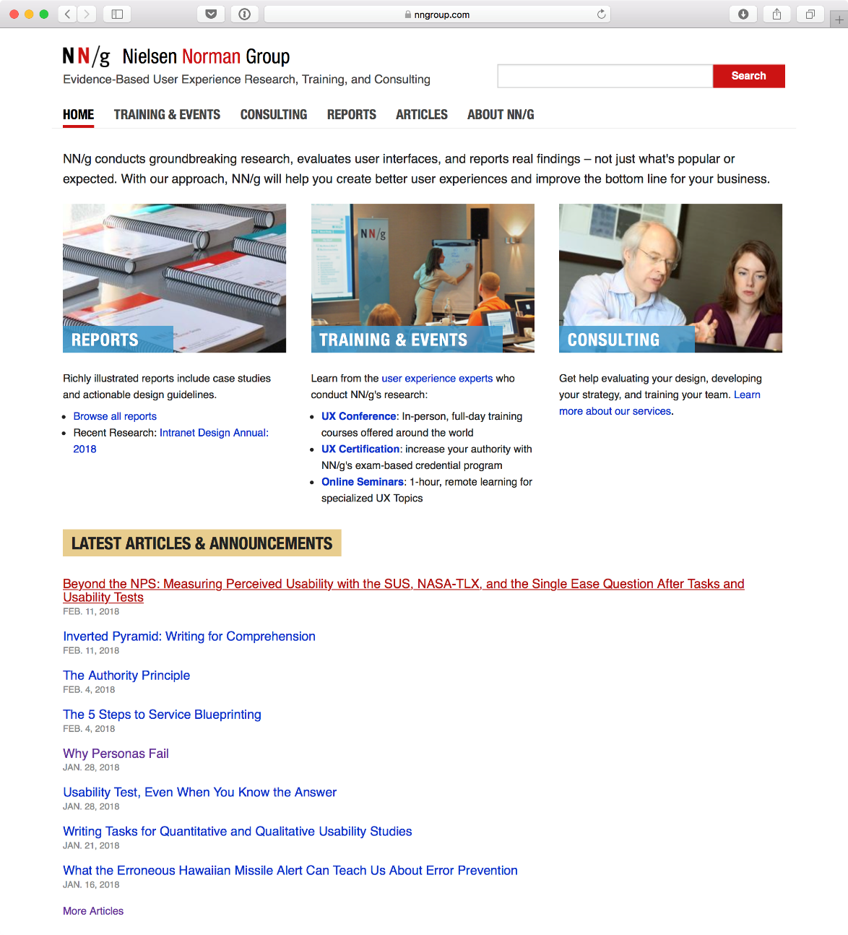
nngroup.com has lots of good resources and articles regarding user research and usability, provided by some of the pioneers in the field.
See also links on the community site:
https://www.usability.gov/how-to-and-tools/methods/scenarios.html
https://www.usability.gov/how-to-and-tools/methods/personas.html

Slide 20
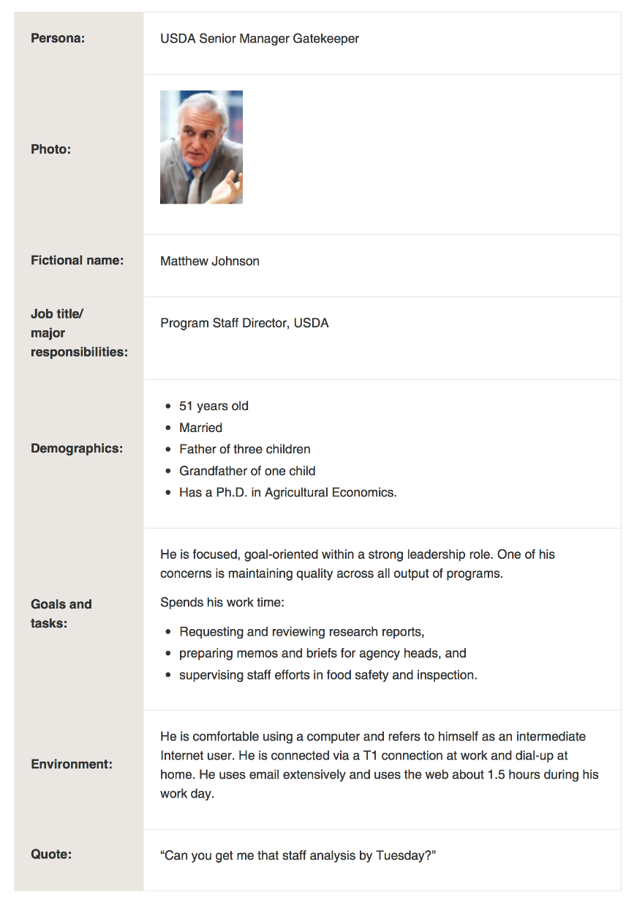
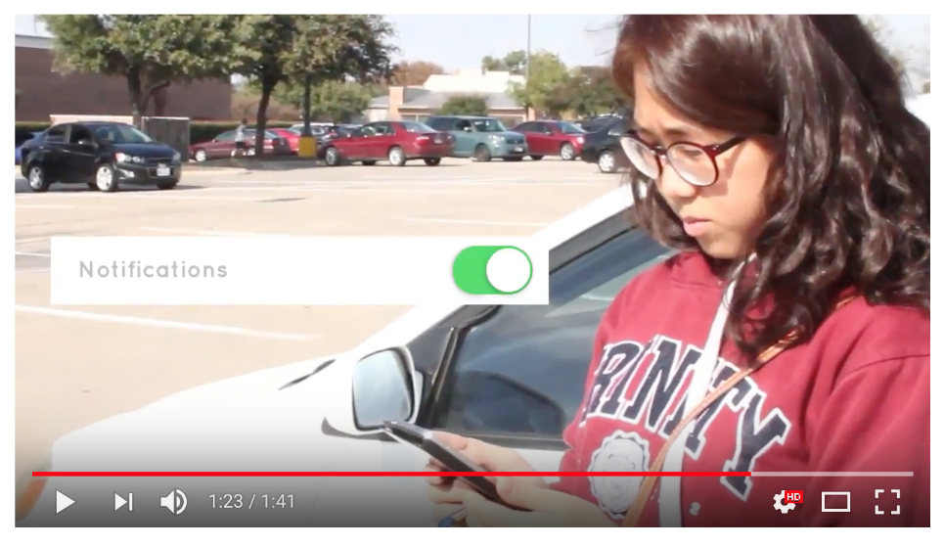
There is no standard notation for user personas and scenarios.
You can use ordinary writing, structured text, role playing, video clips, etc. to capture and communicate live experience.

Slide 21
Use cases (UML)
A use case describes a function the system provides for an external actor. It revolves around the system, unlike user personas and use scenarios – important difference!
An external actor can be a human or another system.
Use cases are described as a diagram
and a narrative with potentially some
structured definition.
NOT A FLOW CHART!

Slide 22
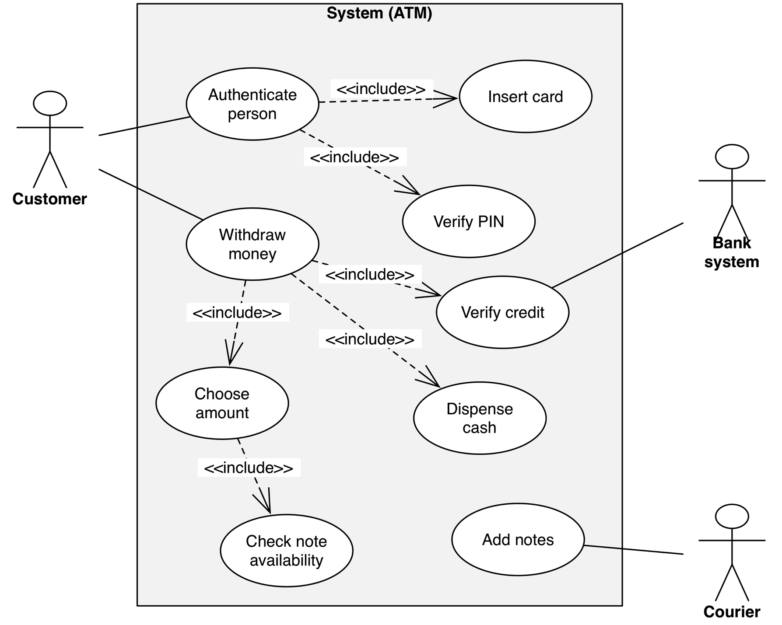
2) Boundaries
3) Use Cases
1) External Actors (human or system)

Slide 23
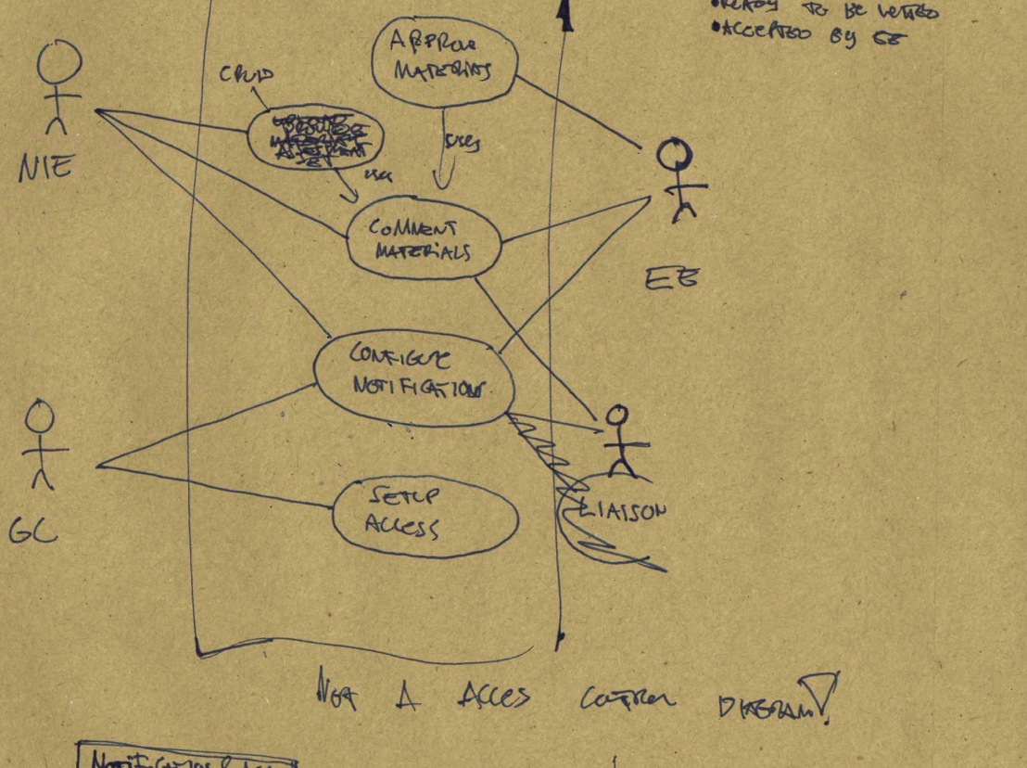
The back-of-an-envelope design for a new system

Slide 24
User modelling tips
Do the modelling yourself, that is,
do not use consultants except for facilitating the process.
Strong user models combined with MVP (minimum viable product) thinking helps you to avoid
feature creep.
What is that?
Notes:
A minimum viable product (MVP) is a development technique in which a new product or website is developed with sufficient features to satisfy early adopters. The final, complete set of features is only designed and developed after considering feedback from the product's initial users.

Slide 25
What is feature creep?
“Tendency to constantly add features which inevitably leads to complex products that are confusing and hard to use.”

Slide 26
Feature creep is another word for ”overshooting customers” – from the disruption theory.
Microsoft Word, circa 2006…
More details here :
https://www.chargify.com/blog/feature-creep/
Notes:
New York Times columnist David Pogue was one of the first people to publicly call attention to feature creep when he “famously demonstrated to a rapt audience at the 2006 TED conference what happened when he opened every possible toolbar in his Microsoft Word program—there was no room on the screen for the primary value-adding function of composing a simple text document,” explains Matthew May.

Slide 27
