Slide 1
CRM for Entrepreneurs
Chandni Antala
Ariana Castaneda
Sarita Cini
Fatimata Sall

Slide 2
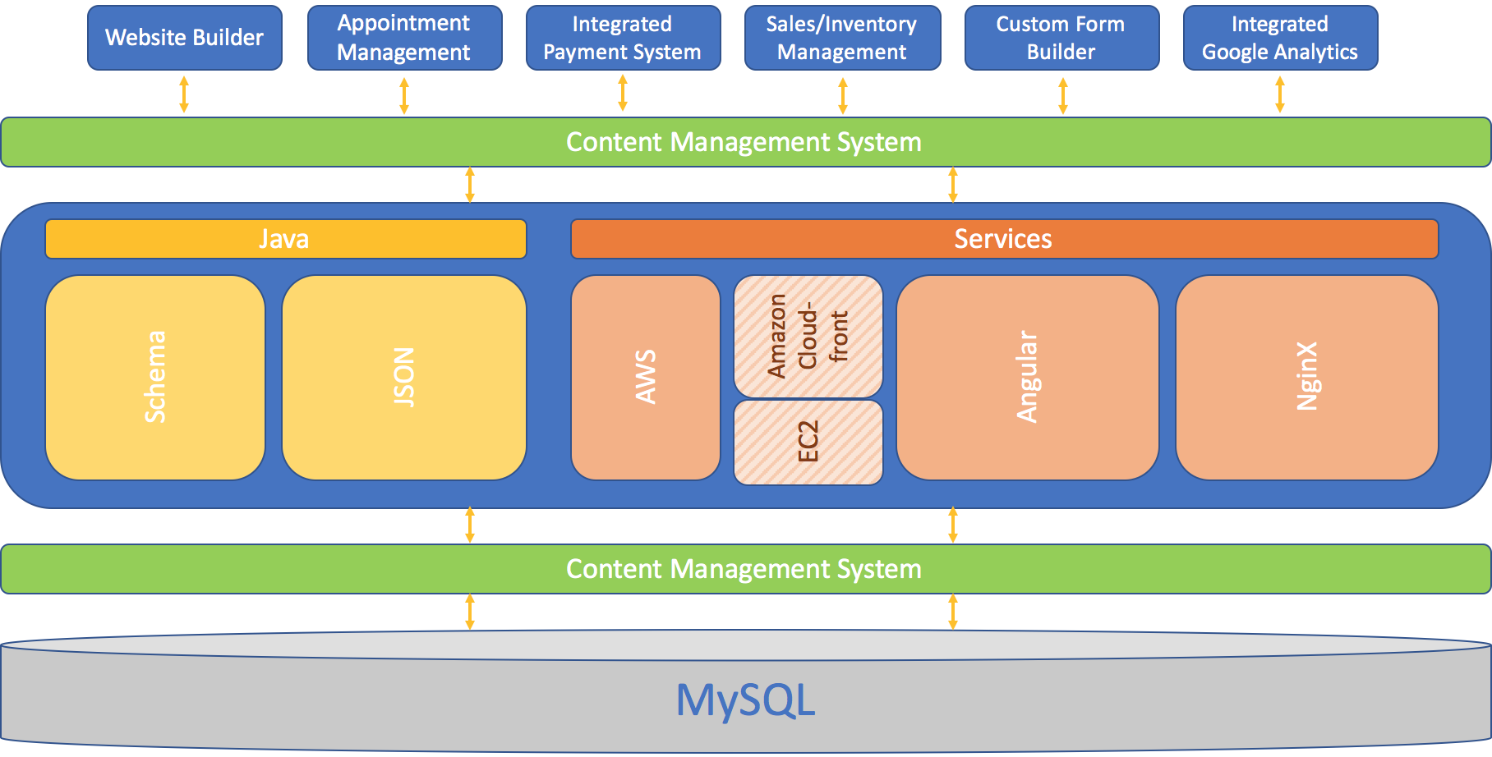
Systems Architecture
1
2
3
2
4
Notes:
Vitris --> Services Provided --> What? Content Management tool --> How? Section 3 --> Content Management tool --> Stored in Database
Programming Language:
- Schema: Set of extensive schemas that enables webmasters to embed structure data on their web pages
- JSON: Language data-interchange format between a server and a web application
Web Services:
- AWS: Cloud computing platform
- EC2: web service that provides secure, resizable compute capacity in the cloud
- Amazon CloudFront: content delivery network service that securely delivers data, videos, applications, and APIs
- Angular: Application Platform
NginX: Web Server. Accelerates content and application delivery, improves security, facilitates availability and scalability for the busiest web sites on the Internet.

Slide 3
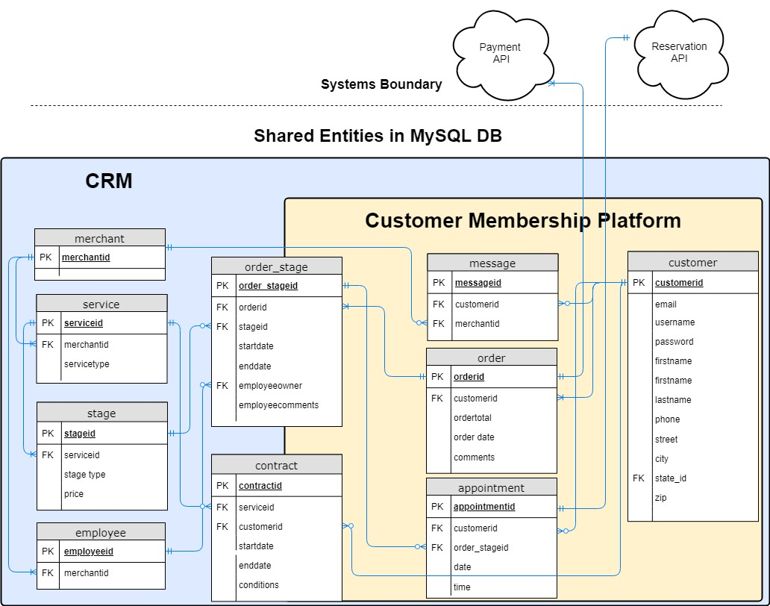
Data Model
Notes:
Our company uses a MySQL DB to store data about entities. Entities are shared between the CRM system and the Customer Member Platform to interface the data across systems. The tables on the left are updated by the merchant, creating data consistency. Moving from right to left, the influence the customer has to make updates to the data increases through their interaction with the website. At the boundary of the system are the API's that handle payment and reservation functionality and display the information where needed.
An example to go with the model:
A merchant provides many services and each service has stages. For example, a contractor may provide a service called Kitchen Renovation. KR has stages like demo, flooring, cabinets, appliances, counter tops, and plumbing. An employee handles one or many of these stages. A customer places an order and pays through an API at each stage. A customer can make 0 or many reservations at each stage with an API presenting the details. Countertops have one appointment for measurements and another for install. A customer signs one contract for the service. A customer and merchant can share many messages.

Slide 4
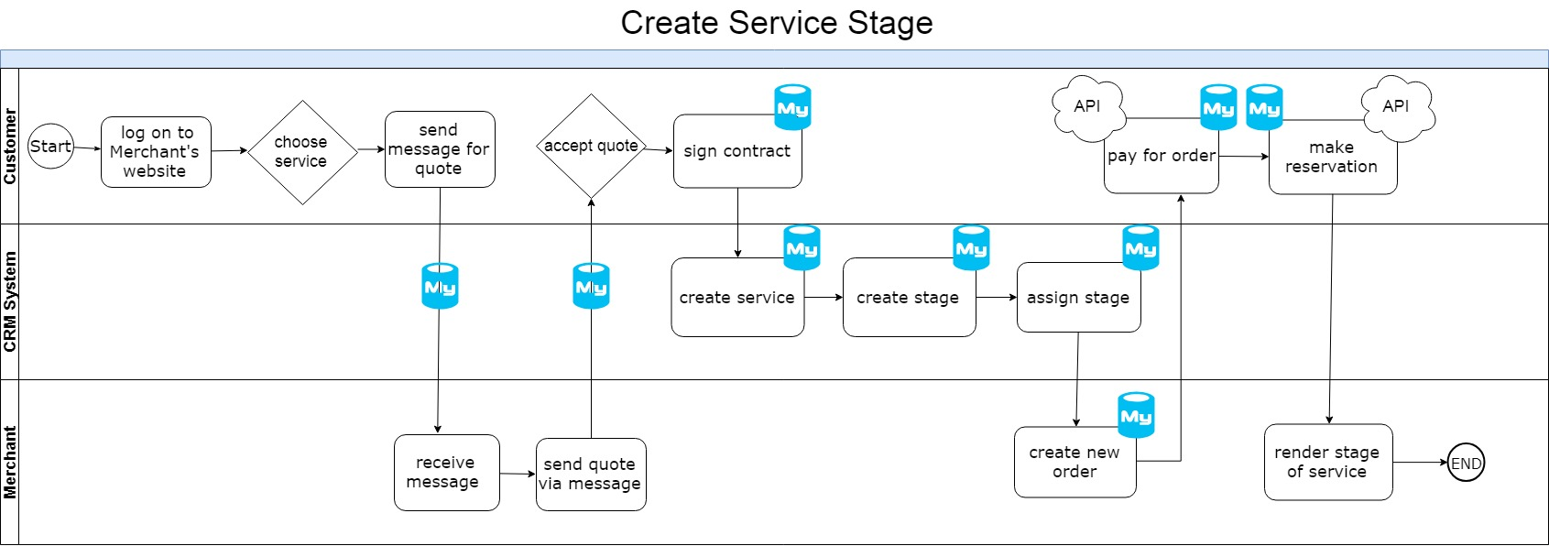
Process Model
Notes:
Payment API is actually Square, not PayPal
All of the information submitted by the customer and merchant is stored in the database.

Slide 5
Market Potential: High
Business Case
Competitive Analysis
Thryve
MindBody
Projected Business Value
Growth of the Market
Opportunity with Small Businesses
Size
Competition
Profitability
Customer Type
Growth
Notes:
Three minutes for this slide
Size: Close to 1 million SB in PA http://www.pasbdc.org/resources/small-biz-stats
Growth: Pennsylvania economy growing at 2.5% versus 1.9 overall US. https://www.sba.gov/sites/default/files/advocacy/Pennsylvania.pdf
Global Enterprise Software market growing past 575 billion with US taking largest share https://markets.businessinsider.com
Competitors: Microsoft and Salesforce cost drastically more due to cost model of charging per user. Barrier to entry is high to develop a site and acquire customers
Profitability: margins increase with scale
Customer Type: subscription-based, once a merchant builds their system, the switching costs are very high
http://sbecouncil.org/about-us/facts-and-data/
Small Biz: https://www.prnewswire.com/news-releases/expectations-for-small-business-growth-in-2018-on-the-rise-as-confidence-in-the-us-economy-steadies-300573887.html
https://www.convergehub.com/blog/small-business-need-of-crm
Competitive Analysis:
Thryve = main competition
- lower prices for beginner package
- bigger staff
- more contacts (bought YellowPages)/resources
MindBody
- higher prices
- same services as both companies
Vitris: all- inclusive,
Business Value:
90% of small & mid-size businesses are confident their business will grow in 2018
- GES allows owners to be more organized and keep track of customer data
- with CRM system showing to increase sales by 29%, owners will take advantage of companies offering this for them
Since GES is used in various industries, there's a big market for it
-

