Slide 1

CRM for Entrepreneurs
Chandni Antala
Ariana Castaneda
Sarita Cini
Fatimata Sall

Slide 2
Overview
Providing tools for small businesses to grow at an affordable price
Creating a customer portal while maintaining a low cost
Prototype for potential customers

Slide 3
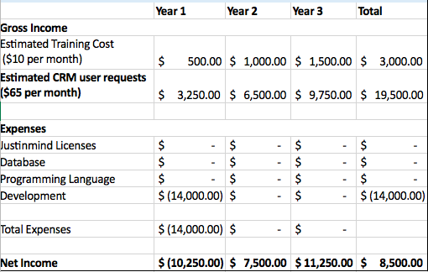
Financial Analysis

Slide 4
Business Case
Retaining Customers
Merchants want ability to retain customers
Cutting Costs
CRM and building website costs $21k a year
With Vitris, total is $900
IT Spending
92% of business w/o websites say they will be building one in 2018.
Businesses w/ fewer employees see spending growth of 4.7%
5% increase of customer retention increases profitability by 75%
Notes:
Business Case Notes:
$14k is being allocated to this project.
For merchant
to purchase CRM from another company: $79 user/month. (freshsales)
To get website designed by developer: $2k, or to build on squarespace: $18/m for website and $26/m for online store.
Fitness company that has 20 users = costs them $20960/year when hiring developer to build or $19272/year when building your own.
With Vitris - $65 per month flat fee – only $780 a year for CRM and Website.
Shift in IT Spending
92% of businesses w/o websites say they will be building one in2018
Small Businesses will spend $602 billion on IT services & software, compared to $411 billion of medium sized and larged sized businesses combined.
Businesses w/ fewer employees see spending growth of 4.7%
Retaining Customers
Merchants want ability to retain customers.
w/o consistent support, customers go elsewhere.
Customers leave bc of dissatisfaction and inactivity
5% increase of customer retention increases profitability by 75%
Mobile ready version results in 70% of task completion
Sources:
https://smallbusiness.com/digital-marketing/how-many-small-businesses-have-websites/
https://digital.com/blog/how-much-does-website-cost/
https://www.zdnet.com/article/small-business-it-spending-to-pass-600-billion-in-2018-idc/

Slide 5
Prototype

