Slide 1
CRM for Entrepreneurs
Chandni Antala
Ariana Castaneda
Sarita Cini
Fatimata Sall

Slide 2
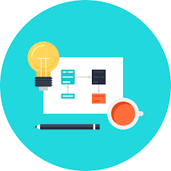
Overview
Providing tools for small businesses to grow at an affordable price
Creating a customer portal while maintaining a low cost
Prototype for potential customers

Slide 3
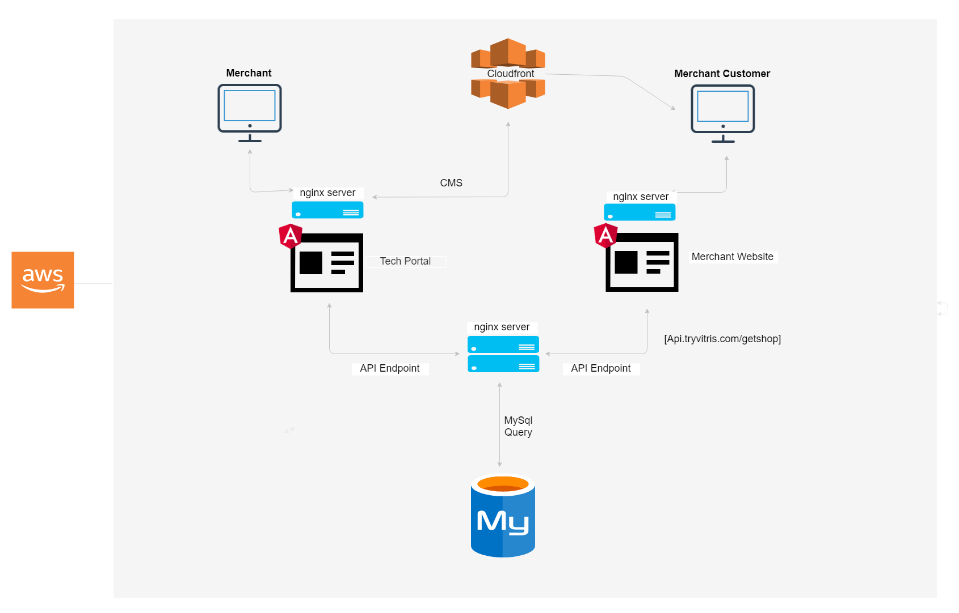
Systems Architecture

Slide 4
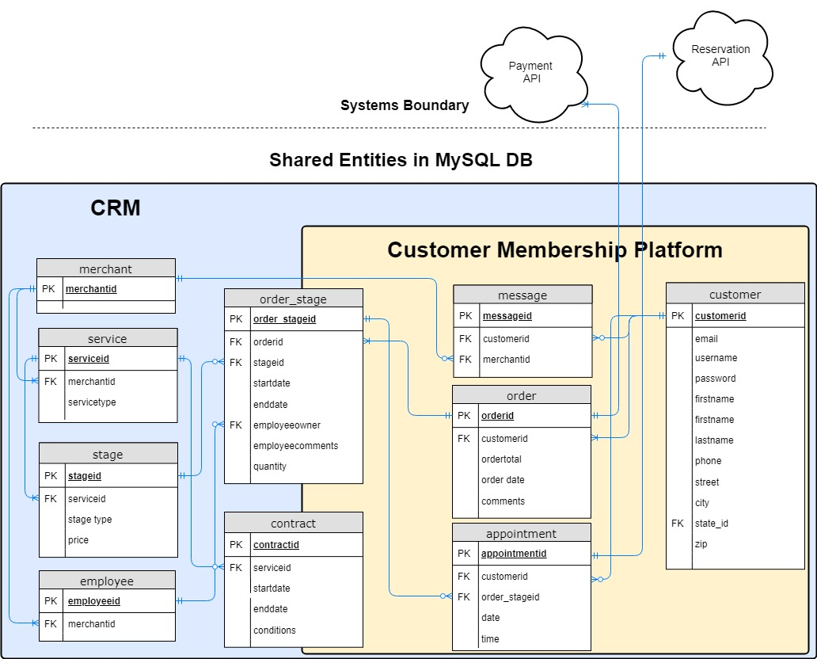
Data Model Version 1
Notes:
Our company uses a MySQL DB to store data about entities. Entities are shared between the CRM system and the Customer Member Platform to interface the data across systems. The tables on the left are updated by the merchant, creating data consistency. Moving from right to left, the influence the customer has to make updates to the data increases through their interaction with the website. At the boundary of the system are the API's that handle payment and reservation functionality and display the information where needed.
An example to go with the model:
A merchant provides many services and each service has stages. For example, a contractor may provide a service called Kitchen Renovation. KR has stages like demo, flooring, cabinets, appliances, counter tops, and plumbing. An employee handles one or many of these stages. A customer places an order and pays through an API at each stage. A customer can make 0 or many reservations at each stage with an API presenting the details. Countertops have one appointment for measurements and another for install. A customer signs one contract for the service. A customer and merchant can share many messages.
Payment, square vs home improvement is important to have cash and check, financing options available on their website. No "service-aggregator" option.

Slide 5
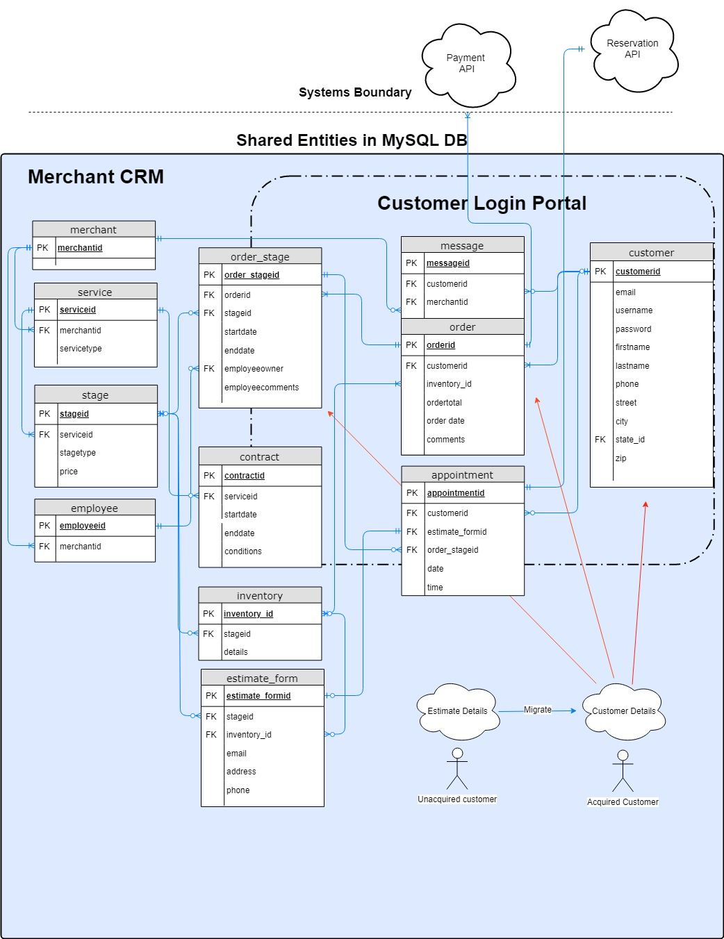
Data Model Version 2

Slide 6
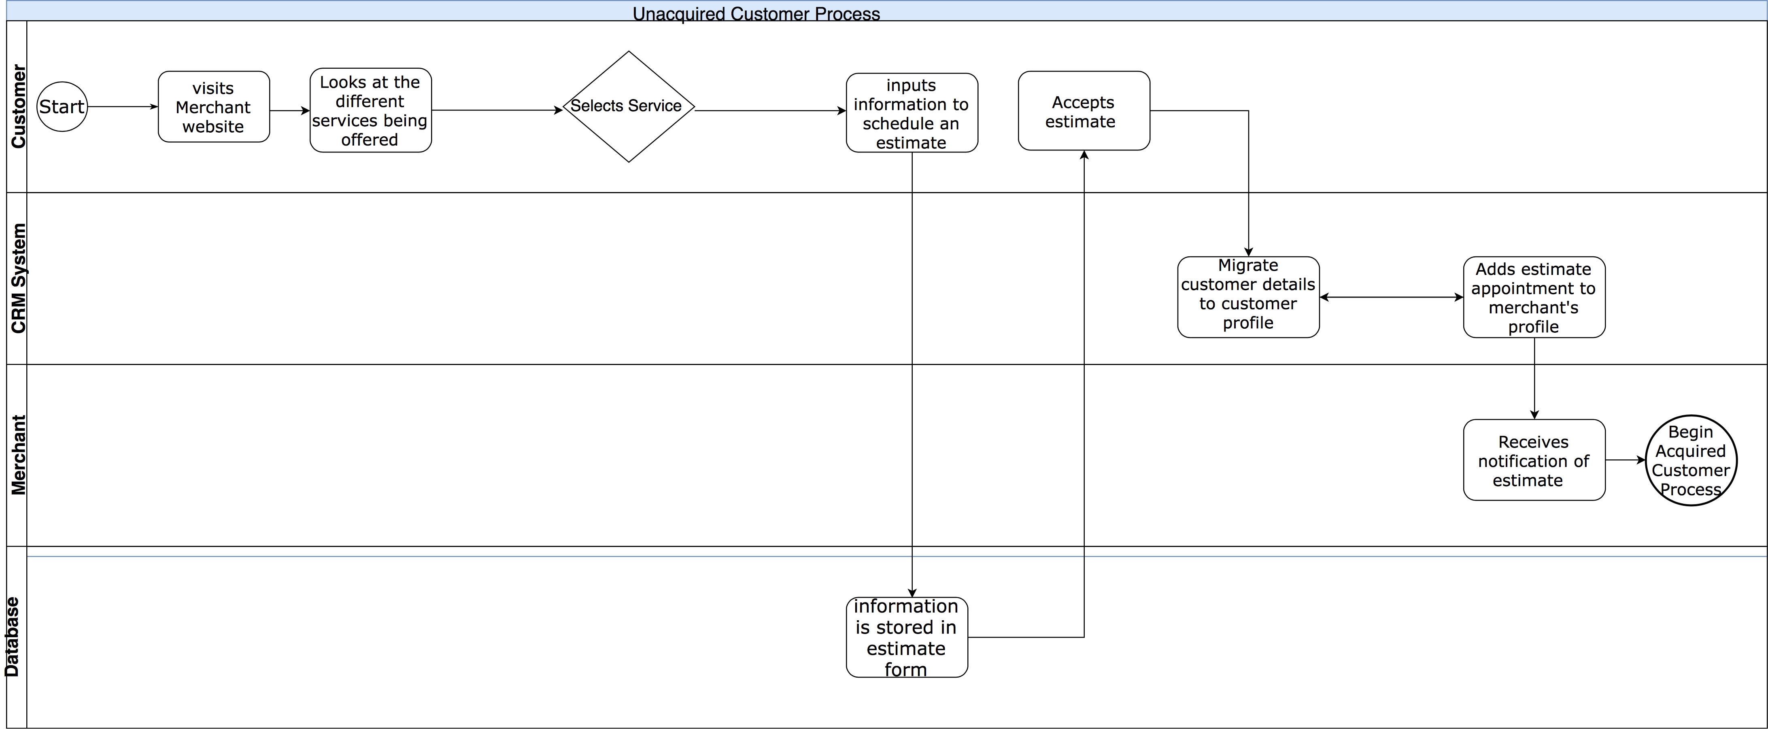
Process Model
Unacquired Customer Process

Slide 7
Business Case
Benefits to Merchants
Easier customer retention
Less data entry required
Benefits to Vitris
Growth of the Market
Increased Revenue Opportunities
Notes:
Business Case Notes:
https://www.usatoday.com/story/money/usaandmain/2018/06/28/strauss-column-let-technology-lead-way-your-small-business/733087002/
Merchants don’t want to do a lot of manual input
Solution reduces amount of input that merchants have to
Vitris – offering more services to the merchants, not just building website
More customer relationship management – focus on customer rentention
Sources:
https://smallbusiness.com/digital-marketing/how-many-small-businesses-have-websites/
https://digital.com/blog/how-much-does-website-cost/
https://www.zdnet.com/article/small-business-it-spending-to-pass-600-billion-in-2018-idc/

Slide 8
Prototype

