Slide 1

MIS5001:
Information Technology Management
Course Introduction
Larry Brandolph
Larry.Brandolph@temple.edu
http://community.mis.temple.edu/mis5001sec401f13/

Slide 2

The World is Changing

Slide 3

Management Information Systems
The use of technology as a strategic driver of innovation and change in the organization.
  Envision new products and services
  Improve organizational performance
Careers
  Technology management
  consultant
  Technology strategist
  Business analyst
  Data analyst
  IT entrepreneur

Slide 4
What MIS is not…
Programming
Computer networking
Web development
Support for other business units
These are lower-value, entry-level skills that can be outsourced.
You want to be technology strategists and thought leaders

Slide 5

Let’s look at the syllabus…

Slide 6



Major tools for this course
Enterprise Architecture
Disruptive Innovation
Systems Thinking
Roadmap of key organizational systems
Creates new markets and displaces existing ones
Impact of processes in complex environments

Slide 7
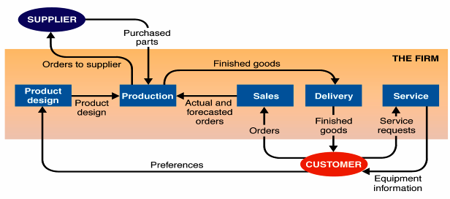
A system with five subsystems
Each system has
Boundary: where it begins and ends
Components: the pieces
Environment: things outside the system boundary
Inputs: objects and information that enter system
Outputs: objects and information that leave system
Purpose: reason for existence
Source: Alter (2006)

Slide 8

The way we used to think about systems
Strategic
Dashboards
Tactical
Salesforce automation
Personnel Management
Operational
Inventory
Accounts Payable
Human
resources
Production
Accounting
Sales
Marketing
Legal

Slide 9
An enterprise architecture approach
ERP
Social
Media
Knowledge Management
CRM
Business Intelligence
DIGITAL BUSINESS MODELS
Web 2.0
Social Media
Analytics

Slide 10


The shift in thinking
IT supports the business
IT is the business

Slide 11
Enterprise Architecture Strategy
EA Approach
Governance and growth model
Centralization vs. decentralization
Processes and standards
Platforms
Best of breed vs. integration
Organic growth vs. acquisitions
Infrastructure
Scalability
Risk management
Outsourcing
Cloud
Security
Project Prioritization
Business continuity
Privacy
Portfolio assessment
Revenue
Cost
Growth

