Slide 1
MIS5001: Information Technology Management Governance of the IT Function
Larry Brandolph Larry.Brandolph@temple.edu http://community.mis.temple.edu/mis5001sec401f13

Slide 2
IT Governance
Making decisions about IT investments and strategy
A strategic decision with financial ramifications, or the other way around?

Slide 3
Cost Justification
How do you quantify?
Is everything measurable?
Net Present Value
Takes into account the time value of money

Slide 4

Example: Simple Net Present Value Analysis
Consider a development project:
Year 0: $20,000 expenditure
Year 1: $10,000 savings
Year 2: $10,000 savings
Assume a 5% discount rate (the next best investment)
$$NPV=\sum{\frac{R_{t}}{{(1+i)}^{t}} }$$
R_{t} = cash flow in current period
i = interest rate in current period
t = time period
$$NPV=\frac{−20000}{{1.05}^{0}}+\frac{10000}{{1.05}^{1}}+\frac{10000}{{1.05}^{2}}=−1405.90$$
So you would lose $1405.90 on this project!

Slide 5
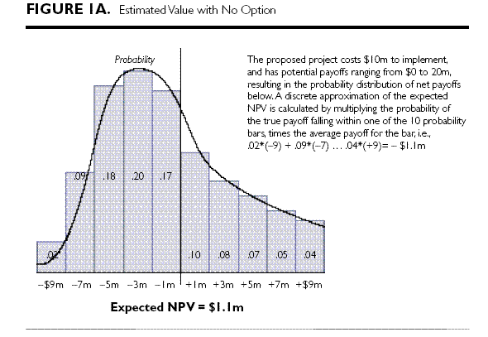
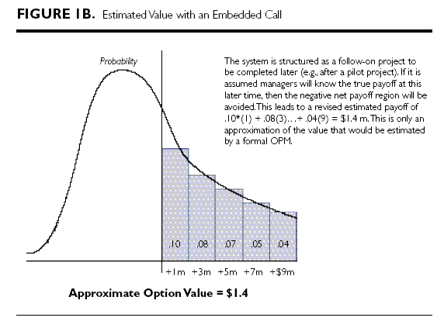
Goal of real options:
Build in flexibility
Change from “must do” to “may do”
Typo in article: Actually -$1.1m

Slide 6
How this works…
If you don’t do a pilot test, any of these outcomes could happen.
Bad outcomes
Good outcomes

Slide 7
When you do the pilot test, you know what works…
…and you can make adjustments to avoid negative outcomes.
Bad outcomes
Good outcomes

Slide 8
Types of options
Abandon
Defer
Strategic Growth
Change Scale
Switch
Stage
What do these all have in common?
What are some examples?
What are some best practices?

