Slide 1

MIS5001:
Information Technology Management
Global Management and Platform Strategies
Larry Brandolph
Larry.Brandolph@temple.edu
http://community.mis.temple.edu/mis5001sec401f13

Slide 2
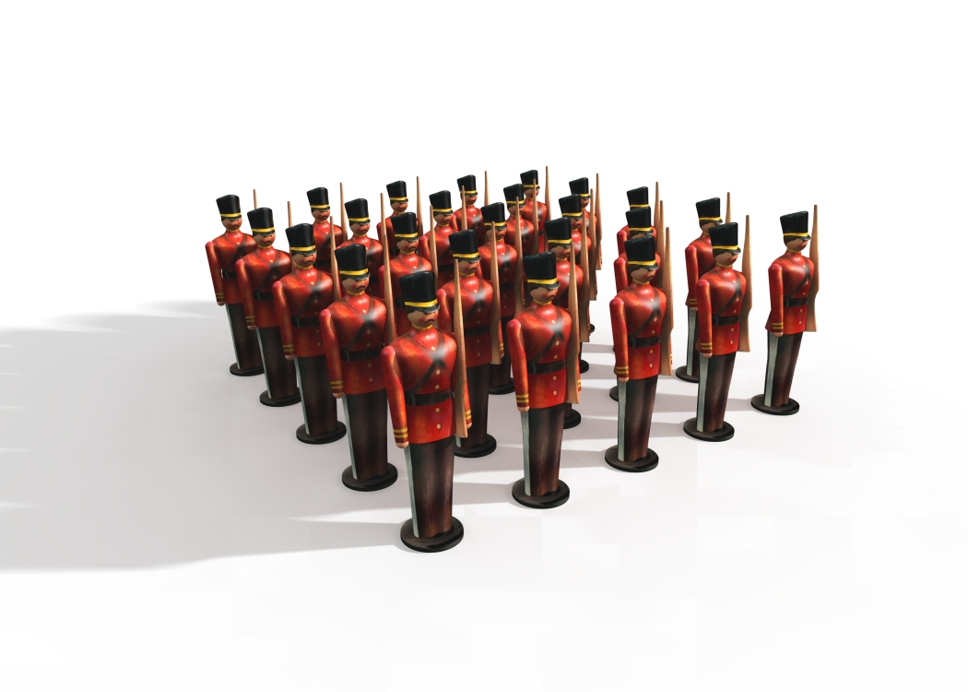
Centralization versus Decentralization

Slide 3
Comparing the Models
Centralized
Control
Decentralized
Innovation
Customization
Agility
Reliability
Scale

Slide 4

Why Does the Pendulum Swing?
What is the governance model in your organization?
Is it a good fit for your organization?

Slide 5
The Hybrid Approach
Shared Services
Business-Unit Services

Slide 6
How can technology support a hybrid approach?
The Cloud
Enterprise Systems
Web 2.0
Knowledge Management
Business Intelligence
Governance Model

Slide 7
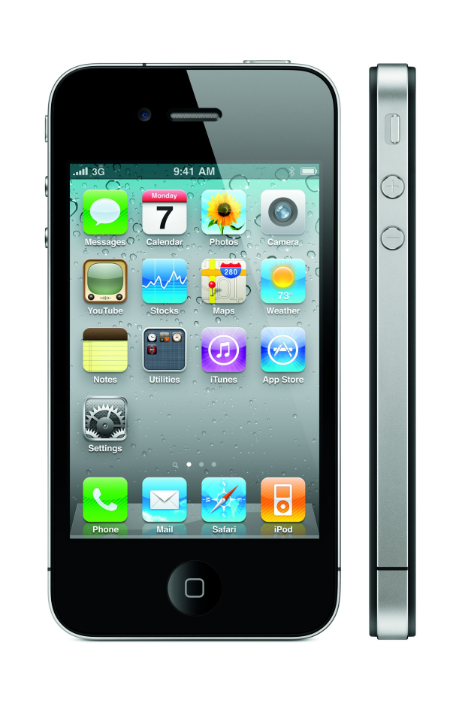
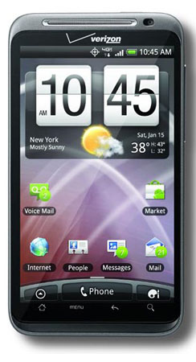
Platform Structures Create Ecosystems
Apple’s iOS
Google’s Android

Slide 8
Many Similarities
Built on an operating system
App-based platforms
Encourage communities of developers
Hardware is important

Slide 9
Many Differences
Apple
Tight control
Single ecosystem
Google
Looser control
Many device manufacturers
One device manufacturer
Multiple, overlapping ecosystems

Slide 10

What is the future?
Single Ecosystem?
Multiple Ecosystems?

