Slide 1
MIS5001: Information Technology Management Systems Thinking and Managing Complexity
Larry Brandolph larry.brandolph@temple.edu http://community.mis.temple.edu/mis5001sec401f13/

Slide 2
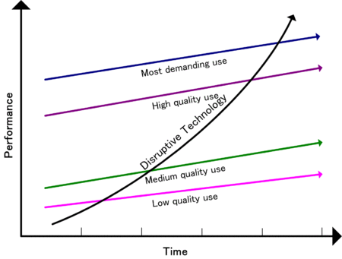
Disruptive Innovation Theory
Low-end
Quality increasing faster than need
Opportunity for low-cost entrant
New-market
Fits an emerging segment with an unmet need
Low-end disruption
http://en.wikipedia.org/wiki/Disruptive_technology

Slide 3
Responding to Disruptive Innovations
Your existing position
What’s going on in the environment
What to do
Options
Compete directly
Serve a different market
Create a new market

Slide 4
So how do companies innovate?
New products for high-margin customers
Cheap alternatives to existing products
New products for “nonconsumers”

Slide 5
Resources, Processes, Values
Resources
Assets
Processes
Way of working
Values
Criteria used to make decisions
People, cash, products
Hiring, budgeting, product development
Customer demands, ethics, cost structure
Determines whether a company embraces or ignores a disruptive innovation.
Source: Christensen, C., Anthony, S., and Roth, E. “Seeing What’s Next: Using the Theories of Innovation to Predict Industry Change.” Harvard Business School Press, 2006, p.6.

Slide 6
Understanding Signals of Change
Undershot Customers
Overshot Customers
Nonconsumers
Nonmarket Contexts
Source: Christensen, C., Anthony, S., and Roth, E. “Seeing What’s Next: Using the Theories of Innovation to Predict Industry Change.” Harvard Business School Press, 2006, p.2.

Slide 7
Systems Thinking Versus Process Thinking
Process Thinking
Considering the system as a collection of independent processes
Decompose and optimize
Systems Thinking
Considering the system as a collection of integrated processes
Synthesize and optimize
For what types of problems is each best suited?

Slide 8
A sample process: reporting expenses
Submit expense report
Manager reviews and approves
Division controller reviews and approves
Accounts Payable reviews and approves
Payment request sent to bank
Confirmation of payment sent to submitter
What is the scope of this process?
How many groups are involved?
How sensitive is the entire system to changes?

Slide 9
Systems thinking example
+
-
Potential adopters
Developers build apps
People buy iPhone
+
+
Explain how this applies to:
What should hardware manufacturers do?
What should OS developers do?
What should developers do?
Apple and RIM
Google
Samsung
Adapted from: http://en.wikipedia.org/wiki/Causal_loop_diagram

Slide 10
Connecting Systems Thinking and Disruption
Streaming services
What stakeholders are affected?
How does it change the “product?”
What processes are directly affected?

