Slide 1
MIS5001: Information Technology Management Enterprise Applications
Larry Brandolph Larry.Brandolph@temple.edu http://community.mis.temple.edu/mis5001sec401f13

Slide 2
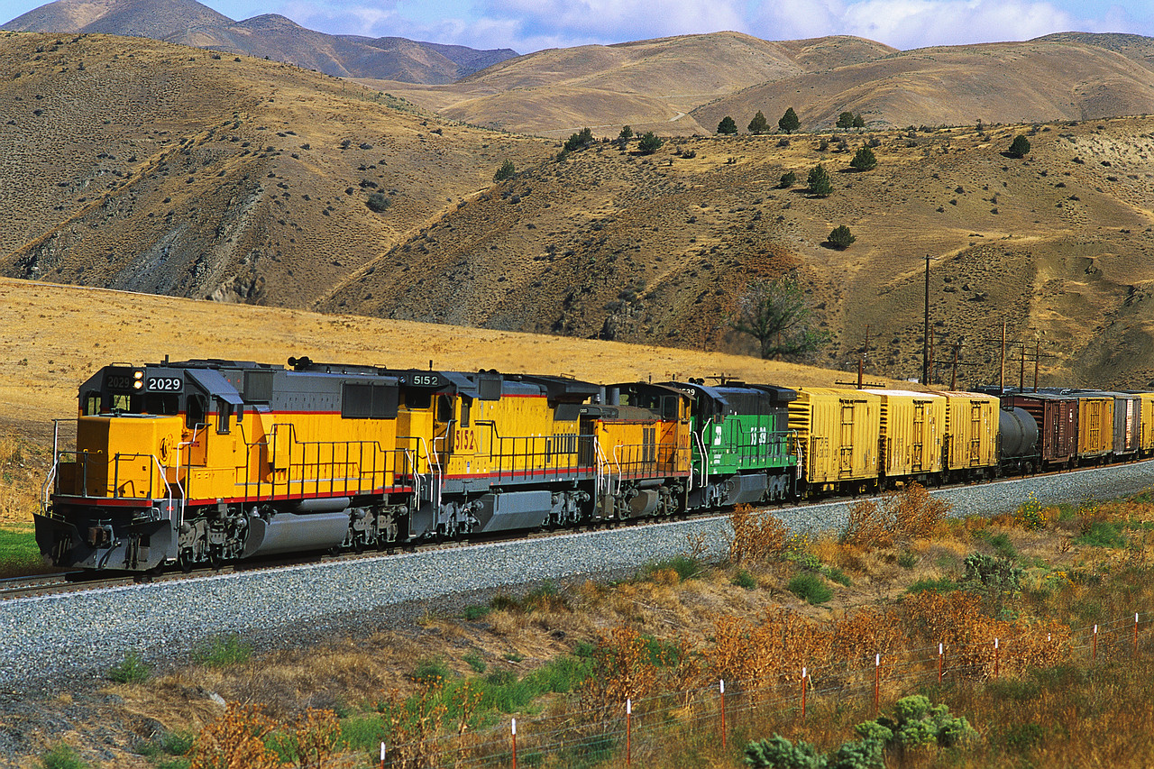
What can IT learn from the railroad business?

Slide 3
Enterprise Architecture
It’s more of an approach and a philosophy than a particular system…
ERP
Social Media
Knowledge Management
CRM
Business Intelligence
…but implies that systems should be able to share data across the enterprise.
DIGITAL BUSINESS MODELS
Web 2.0
Social Media
Analytics

Slide 4
Two Competing Models
Enterprise Systems Approach
Distributed Systems Approach
Enterprise System (ERP/CRM)
Accounting
Finance
Human Resources
Marketing
Manufacturing
Information Technology
Organization
Organization
Accounting
Finance
Human Resources
Marketing
Manufacturing
Information Technology
Both can be part of an Enterprise Architecture

Slide 5
Enterprise Applications
Enterprise Resource Planning (ERP)
Customer Relationship Management (CRM)
What are the key goals?
What are the benefits?
What are the problems?

Slide 6
Enterprise Systems and Innovation
Do enterprise applications encourage or discourage innovation?
Are they compatible with an “agile” organization?

Slide 7
Distributed Systems and Compliance
Do distributed systems encourage or discourage compliance?
What are the pitfalls in heavily regulated industries?

Slide 8
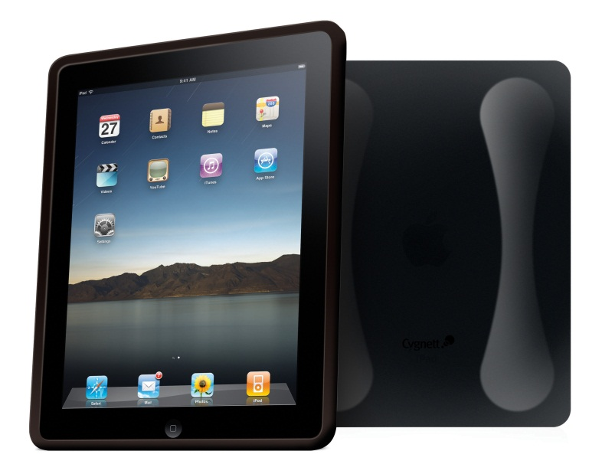
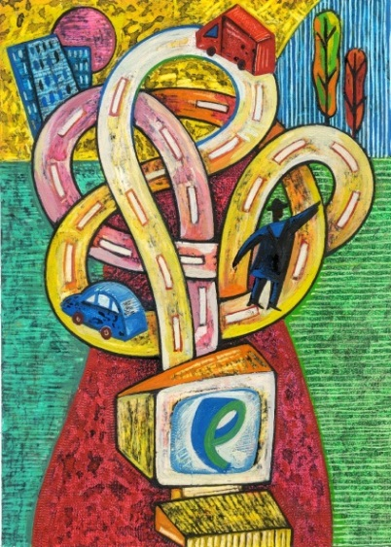
Enterprise Systems and the Modern Organization
Are enterprise systems consistent with changes in...
Mobile technology?
Social media?
A hyperconnected world?

Slide 9
The Future?
How do you think enterprise systems will evolve?

