Slide 1
MIS5001: Information Technology Management Network-Enabled Business Models
Larry Brandolph Larry.Brandolph@temple.edu http://community.mis.temple.edu/mis5001sec401f13

Slide 2
Evolution of Interactivity
Web 1.0
Web 2.0
Web 3.0
Non interactive
One-way flow
Interactive
User generated
The ‘semantic web’
Organizing content
?

Slide 3
We’re in the middle of Web 2.0
Facebook
Twitter
Linkedin
YouTube
Instagram
Squidoo
Pinterest
digg
Blogging*

Slide 4
What Web 2.0 Services Have in Common
User generated content
Decentralized control
Networks of users
“Free”
Based on sharing information
Facebook
Twitter
Linkedin
YouTube
Instagram
Squidoo
Pinterest
digg
Blogging*
“Social Media”

Slide 5
What Web 2.0 means
For individuals
New ways to communicate socially
New ways to communicate professionally
For organizations
New ways to communicate internally
New ways to communicate externally
Narrowcasting
Self-promotion and networking
Locate expertise and knowledge sharing
Public relations, product promotion

Slide 6
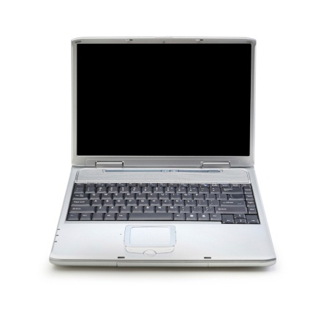
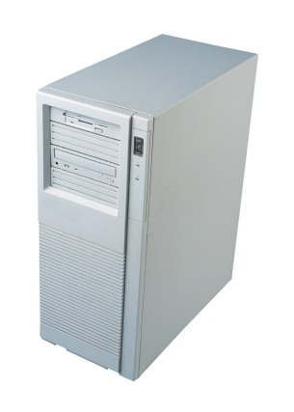
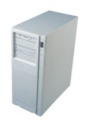
Quick Primer on n-tier Architecture
1-tier architecture
Your computer runs Microsoft Word locally
It is stored and is executed on your hard drive.
Your computer runs the client interface for the hospital records system locally but the application is run remotely on a server within the hospital
n-tier architecture
Your computer runs Internet Explorer locally but Gmail is running remotely on a collection of Google’s servers

Slide 7
The Cloud
What is it?
What makes an application “in the cloud”?
Why is it new?
Why is it not new?
What business models are enabled by the cloud?
How is Web 2.0 enabled by the cloud?

Slide 8
Comparing Two Internet-Enabled Models
Using the Internet as a conduit for connecting businesses
The Cloud
“E-Business”
Using the Internet to access hosted services
B2B
Electronic Data Interchange
Amazon.com
Netflix
Dropbox

Slide 9
Attending to Signals
Are cloud-based services “low-end” or “new market”?
How could it disrupt IT-related industries?
How could it disrupt non-IT industries?

