Slide 1
MIS5001: Information Technology Management Business Models around Digital Content
Larry Brandolph Larry.Brandolph@temple.edu http://community.mis.temple.edu/mis5001sec401f13

Slide 2
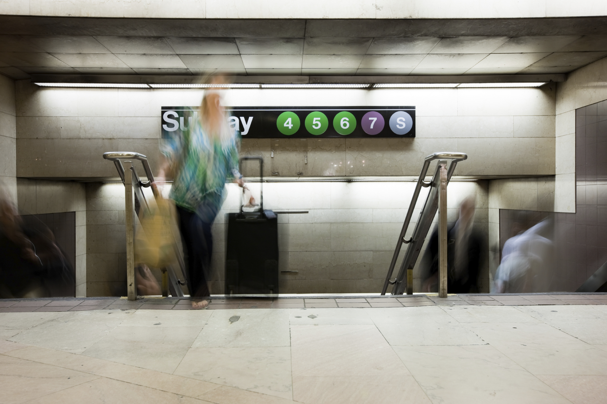
What is “Freeconomics”?

Slide 3
Picking up the tab…
The product
The service
What do you charge for?
What do you give away?
Why?
And how does technology facilitate this shift?

Slide 4
A Few “Freeconomic” Models
Freemium
Advertising
Cross-subsidies
Zero marginal cost
Labor exchange
Gift economy
And again, consider how technology facilitates each of these…

Slide 5
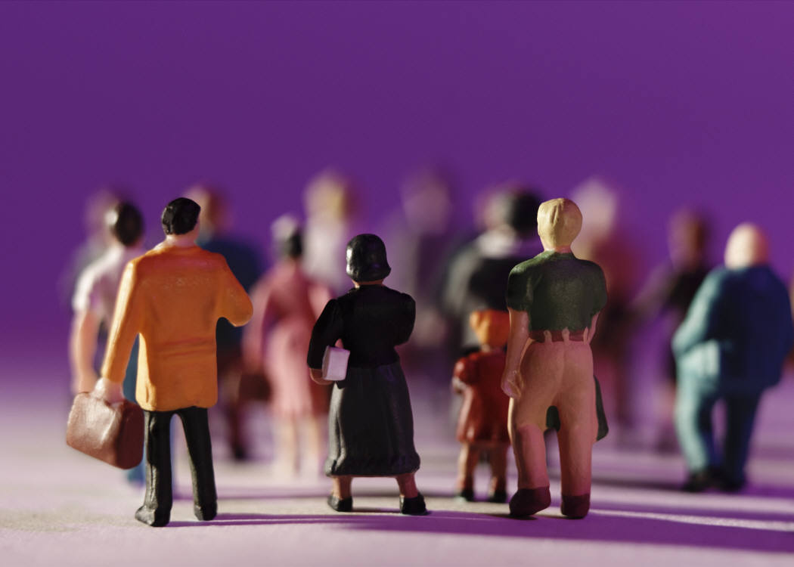
How does technology facilitate crowdfunding?

Slide 6
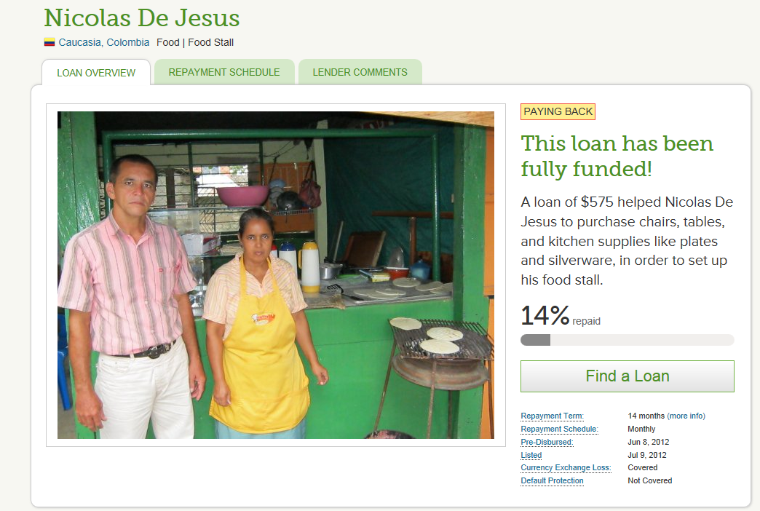

Slide 7
How could these shifts affect healthcare?

