Slide 1
MIS5001: Information Technology Management Evaluating Emerging Technology Trends
Larry Brandolph Larry.Brandolph@temple.edu http://community.mis.temple.edu/mis5001sec401f13
Notes:
Kodak
Evaluated Kodak’s response to Sony’s introduction of the Mavica 1981.
Human inclination to rely on familiar assumptions and exhibit a reluctance and/or inability to revise those assumptions, even when the evidence supporting them no longer exists or when other evidence would question their accuracy.

Slide 2
Why look at emerging technologies?
Defense of business
Significant potential return
They can be disruptive
To your competition
To you

Slide 3
Key Concepts
Firm position
Incumbent
New entrant
Technology
Evolutionary
Discontinuous
Response
Aggressive Stance
Passive Stance

Slide 4
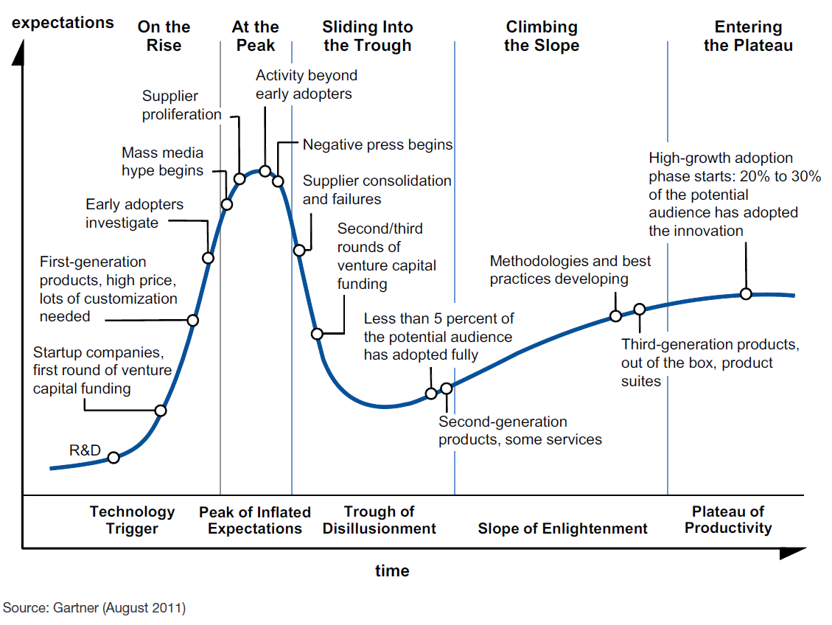
The Gartner Hype Cycle
Source: Hype Cycle for Emerging Technologies, 2012, Gartner Gateway

Slide 5
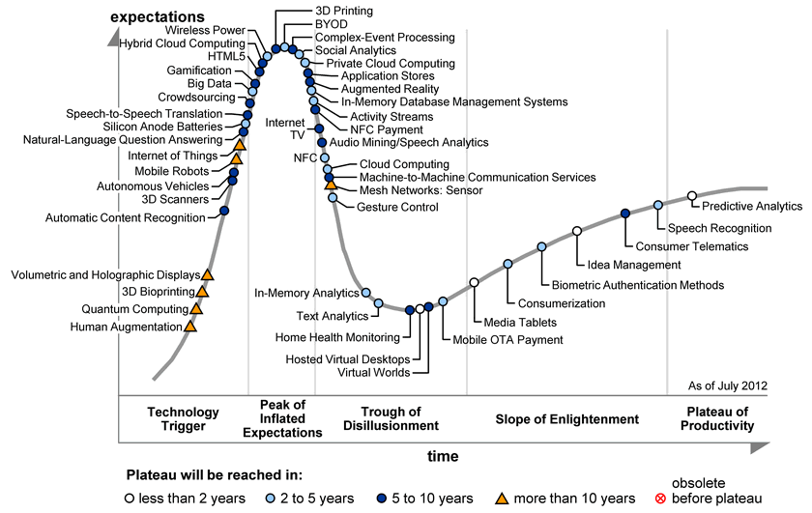
Hype Cycle for 2012
Source: Hype Cycle for Emerging Technologies, 2012, Gartner Gateway

Slide 6
The Challenge: Turning Emerging Tech into Business Models
The Customer Value Proposition (CVP)
Profit Formula
Key Resources
Key Processes
Johnson, M., Christensen, C., and Kagermann, H. (2008). Reinventing Your Business Model. Harvard Business Review.
Notes:
A Successful company is one that has found a way to create value for customers – that is a way to help customers get an important job done. “job” – A fundamental problem in a given situation that needs a solution.
Profit Formula is a blueprint that defines how the company creates value. It consists of the following:
Revenue Model: Price and Volume
Cost Structure: Direct/indirect, economies of scale
Resource Velocity: How fast do we need it?
Key Resources: People, technology, products, facilities, equipment, channels, and brands. Items that create the value.
Key Processes: Operational and Managerial processes that allow companies to delivery and repeat, but creates value. Training, development, manufacturing, budget, sales, planning, sales and service.

Slide 7
Mistakes Incumbents Make
Affected by an organization’s
Delayed Participation
Sticking with the Familiar
Reluctance to Fully Commit
Lack of Persistence
Resources
Processes
Values
Source: Day, G. and Schoemaker, P. (2000). Avoiding the Pitfalls of Emerging Technologies. California Management Review. (42)2. pp. 8-33.
Notes:
Delaying Participation – Wait, watch and see attitude
Sticking with the Familiar – doubt that the technology will overcome the hurdles
Technology is using attempting to push and change the standard
Reluctance to Fully Commit – Industry can’t make the decision to implement disruptive technology. Lots of Phases and Parts
Lack of Persistence – Can you go the distance. Large companies typically have little patients.

Slide 8
Things You Can Do
Attend to signals from the periphery
Invest in a learning capability
Maintain flexibility through an options perspective
Maintain organizational separation
Would these actions be more effective when the innovation is…
Low-end?
New-market?
Source: Day, G. and Schoemaker, P. (2000). Avoiding the Pitfalls of Emerging Technologies. California Management Review. (42)2. pp. 8-33.

