Slide 1
MIS5001: Information Technology Management Knowledge Management and Business Intelligence
Larry Brandolph Larry.Brandolph@temple.edu http://community.mis.temple.edu/mis5001sec401f13

Slide 2
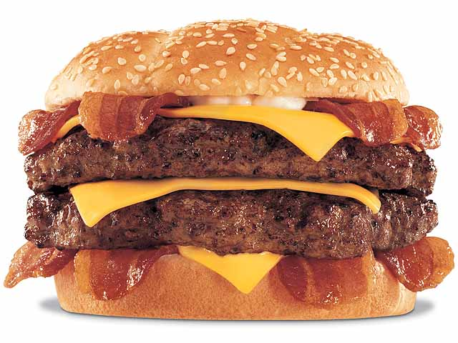
How do you know if a new product will sell?

Slide 3
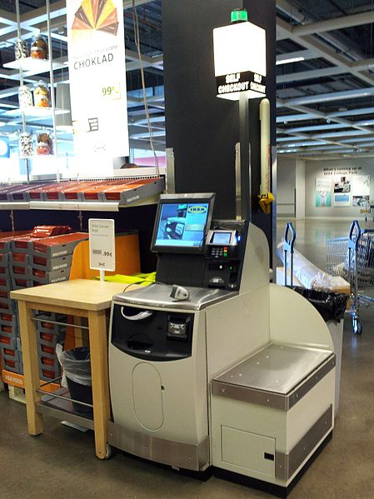
Analytics
The discovery and communication of meaningful patterns in data (Wikipedia)
“Extract insights from your enterprise data and all the big data that is continuously flowing in from a variety of new sources” (IBM)

Slide 4
Moneygram International
Looked at key traits in money transfer transactions to detect fraud
Consumer complaints dropped 72% in one year
http://public.dhe.ibm.com/common/ssi/ecm/en/imc14649usen/IMC14649USEN.PDF

Slide 5
Centerstone Research Institute
Used existing data to enable real-time decision-making
Track how physicians spend their time throughout the day
30% increase in revenue 25% increase in compliance 37% shorter wait to schedule service
http://www.ibm.com/smarterplanet/us/en/ leadership/centerstone

Slide 6
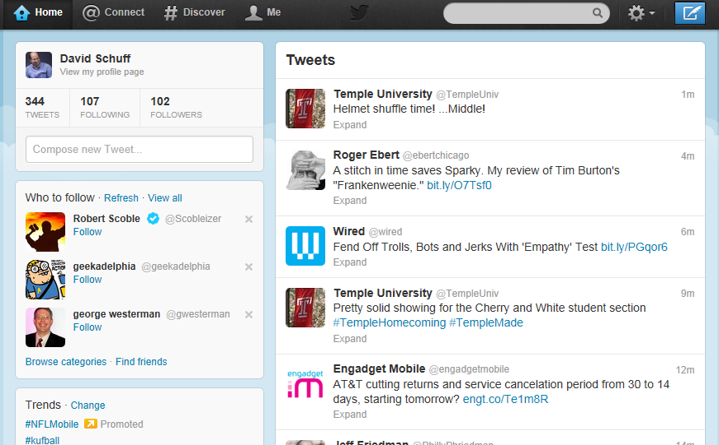
Types of Data
Structured
Unstructured
How would you classify health record data?

Slide 7
Data
Information
Knowledge
Data is collected
Information is produced
Knowledge is discovered and managed
How do you “manage” knowledge?

Slide 8
Communities of Practice
What do they deal in?
Data, information, or knowledge
Structured or unstructured

