Slide 1

MIS5001:
Information Technology Management
Ethics and Continuity Management
Larry Brandolph
Larry.Brandolph@temple.edu
http://community.mis.temple.edu/mis5001sec401f13

Slide 2

Are We Security Savvy?
11%
4-digit PINs that are “1234”
20%
4-digit PINs that begin with “19”
http://blogs.computerworld.com/security/21027/quirky-trends-pins-include-420-and-69-password-hat-tips-007-pi-8675309

Slide 3
Big Impact
50%
Organizations that were victims of at least one cyberattack in 2011
$5.5m
Average cost of a data breach in 2011 (down from 2010!)
http://gocsi.com/survey
http://www.cio.com/article/702494/Cost_of_Data_Breaches_Declines

Slide 4

Cascading damages
Hacker attacks a corporate network
Network outage, data loss, information theft
Loss of productivity, revenue, quality of care
Tarnished reputation, loss of trust
Legal liability, loss of profitability
From Greisiger (2006) – NetDiligence Corporate Presentation

Slide 5
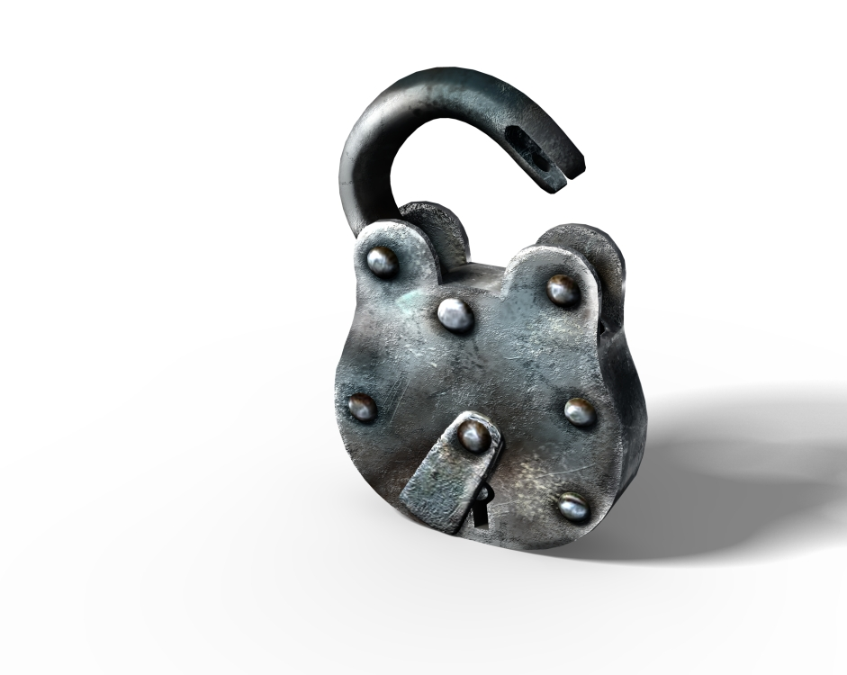
Spending on IT Security
$151 billion projected for 2012 (Financial Times, 2011)
5.6% of total enterprise IT spending
Emerging executive position:
The Chief Information
Security Officer
  To whom should the CISO report?

Slide 6

Regulating Information:
Financial Services
Financial Privacy Rule
Safeguards Rule
Pretexting Protection
Gramm–Leach–Bliley Act of 1999
Notes:
FPR – have to inform customers what information is collected and how it will be used; with right to opt-out
Safeguards Rule – written plan detailing how institution will protect private information
Pretexting Protection – written plan detailing how institutions will protect against unauthorized access, phishing, etc.

Slide 7
Regulating Information:
Healthcare
The Health Insurance Portability and Accountability Act of 1996 (HIPAA)
The Patient Safety and Quality Improvement Act of 2005 (PSIQA)
What is the purpose of each law?
What is its implication for the information technology function?
Source: http://www.hhs.gov/ocr/privacy
Notes:
Key tenets:
HIPAA – secure records with individually identifiable health information; ensure that portability does not compromise security
PSIQA - voluntary reporting system to enhance the data available to assess and resolve patient safety and health care quality issues

Slide 8
How do you protect against a breach?
Inventory systems
Assessing where vulnerabilities exist
Determine tolerance for a breach
Account for corporate culture
What is the role of the CISO?
Is this consistent with the “lessons learned” from CareGroup?

