Slide 1

MIS5101:
Business Intelligence
Relational Data Modeling
Sunil Wattal

Slide 2

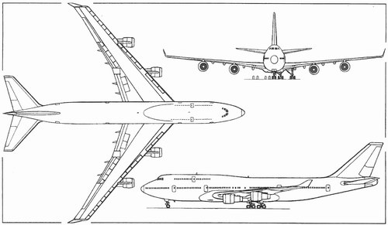
What is a model?
Representation of something in the real world

Slide 3
Modeling a database
A representation of the structure of the data
Describes the data contained in the database
Explains how the data interrelates

Slide 4
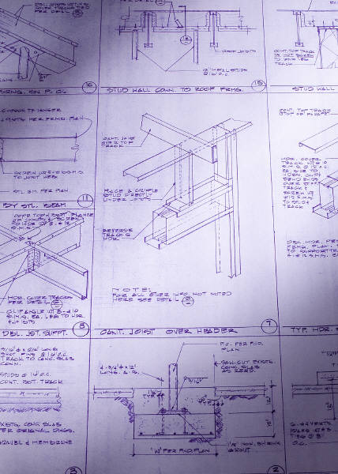
Why bother modeling?
Creates a blueprint before you start building the database
Gets the story straight: easy for non-technical people to understand
Minimize having to go back and make changes in the implementation stage

Slide 5
Systems analysis and design in the context of database development
Systems Analysis is the process of modeling the problem
  Requirements-oriented
  What should we do?
Systems Design is the process of modeling a solution
  Functionality-oriented
  How should we do it?
This is where we define and understand the business scenario.
This is where we implement that scenario as a database.

Slide 6
Start with a problem statement
“We want a database to track orders.”
That’s too vague to create a useful system
We gather requirements to learn more
Gather documentation
  About the business process
  About existing systems
Conduct interviews
  Employees directly involved in the process
  Other stakeholders (i.e., customers)
  Management

Slide 7
Start with a problem statement
Refine the problem statement
  Getting iterative feedback from the client
End up with a scenario like this:
  The system must track customer orders
  Multiple products can go into an order
  A customer is described by their name, address, and a unique Customer ID number
  An order is described by the date in which it was placed, what was bought, and how much it costs
The specification “what was bought” is a little vague, and that will cause us a problem a little later.
But let’s leave it for now…

Slide 8
The Entity Relationship Diagram (ERD)
The primary way of modeling a relational database
Three main diagrammatic elements
Entity
A uniquely identifiable thing (i.e., person, order)
Relationship
Describes how two entities relate to one another
(i.e., makes)
Attribute
A characteristic of an entity or relationship (i.e., first name, order number)

Slide 9
A very simple example
Last name
First name
Customer
ID
Order
number
Order Date
City
Customer
makes
Order
Product
name
Price
State
Zip

Slide 10
The primary key
Entities need to be uniquely identifiable
  So you can tell them apart
Use a primary key
  An attribute (or a set of attributes) that uniquely identifies an entity
How about these as primary keys for Customer:
First name and/or last name?
Social security number?
Customer
ID
Uniquely identifies a customer
Order
number
Uniquely identifies an order

Slide 11
Last component: Cardinality
Defines the rules of the association between entities
Customer
makes
Order
at least – one
at most - one
at least – one
at most - many
This is a one-to-many relationship:
One customer can have many orders
One order can only belong to one customer

Slide 12
Crows Feet Notation
Customer
makes
Order
There are other ways of denoting cardinality, but this one is pretty standard.
So called because this…
…looks something like this
There are also variations of the crows feet notion!

Slide 13
Cardinality is defined by business rules
What would the cardinality be in these situations?
Order
?
contains
?
Product
Course
?
has
?
Section
Employee
?
has
?
Office

Slide 14
But we have a problem with our ERD
This assumes every order contains only one product.
So if I want two products, I have to make two orders!
The problem: Product is defined as an attribute, not an entity.
(Because we didn’t define our requirements clearly enough?)

Slide 15
Here’s a solution
Last name
First name
Customer
ID
Order
number
Order Date
City
Customer
makes
Order
State
Zip
contains
Quantity
Now…
A customer can make multiple orders
An order can contain multiple products
A product can be part of multiple orders
Product
Product
name
Price
Product
ID

Slide 16
Implementing the ERD
As a database schema
  A map of the tables and fields in the database
  This is what is implemented in the database management system
  Part of the “design” process
A schema actually looks a lot like the ERD
  Entities become tables
  Attributes become fields
  Relationships can become additional tables

Slide 17
The Rules
1. Create a table for every entity
2. Create table fields for every entity’s attributes
3. Implement relationships between the tables
1:many relationships
Primary key field of “1” table put into “many” table as foreign key field
many:many relationships
Create new table
1:1 relationships
Primary key field of one table put into other table as foreign key field
1:many relationships with original tables

Slide 18
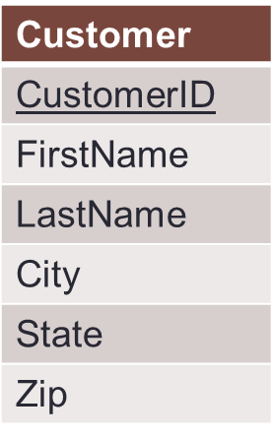
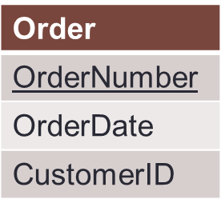
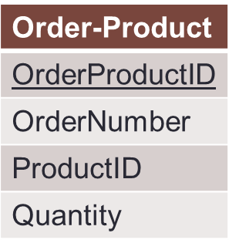
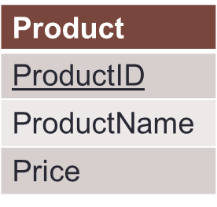
Our Order Database schema
Original 1:n relationship
Original n:n relationship
Order-Product is a decomposed many-to-many relationship
Order-Product has a 1:n relationship with Order and Product
Now an order can have multiple products, and a product can be associated with multiple orders

Slide 19
The Customer and Order Tables:
The 1:n Relationship
Customer Table
CustomerID | FirstName | LastName | City | State | Zip
1001 | Greg | House | Princeton | NJ | 09120
1002 | Lisa | Cuddy | Plainsboro | NJ | 09123
1003 | James | Wilson | Pittsgrove | NJ | 09121
1004 | Eric | Foreman | Warminster | PA | 19111
Order Table
Customer ID is a foreign key in the Order table. We can associate multiple orders with a single customer!
In the Order table, Order Number is unique;
Customer ID is not!
Order Number | OrderDate | Customer ID
101 | 3-2-2011 | 1001
102 | 3-3-2011 | 1002
103 | 3-4-2011 | 1001
104 | 3-6-2011 | 1004

Slide 20
The Customer and Order Tables:
Normalization
Customer Table
CustomerID | FirstName | LastName | City | State | Zip
1001 | Greg | House | Princeton | NJ | 09120
1002 | Lisa | Cuddy | Plainsboro | NJ | 09123
1003 | James | Wilson | Pittsgrove | NJ | 09121
1004 | Eric | Foreman | Warminster | PA | 19111
No repeating orders or customers.
Every order is unique.
This is an example of normalization..
Every customer is unique.
Order Table
Order Number | OrderDate | Customer ID
101 | 3-2-2011 | 1001
102 | 3-3-2011 | 1002
103 | 3-4-2011 | 1001
104 | 3-6-2011 | 1004

Slide 21
Normalization
Organizing data to minimize redundancy (repeated data)
This is good for two reasons
  The database takes up less space
  Fewer inconsistencies in your data
If you want to make a change to a record, you only have to make it in one place
  The relationships take care of the rest

Slide 22
To figure out who ordered what
Match the Customer IDs of the two tables, starting with the table with the foreign key (Order):
We now know which order belonged to which customer
  This is called a join
Order Table
Customer Table
Order Number | OrderDate | Customer ID | Customer ID | FirstName | LastName | City | State | Zip
101 | 3-2-2011 | 1001 | 1001 | Greg | House | Princeton | NJ | 09120
102 | 3-3-2011 | 1002 | 1002 | Lisa | Cuddy | Plainsboro | NJ | 09123
103 | 3-4-2011 | 1001 | 1001 | Greg | House | Princeton | NJ | 09120
104 | 3-6-2011 | 1004 | 1004 | Eric | Foreman | Warminster | PA | 19111

Slide 23
Now the many:many relationship
Order Table
Order-Product Table
Order Number | OrderDate | Customer ID
101 | 3-2-2011 | 1001
102 | 3-3-2011 | 1002
103 | 3-4-2011 | 1001
104 | 3-6-2011 | 1004
Order ProductID | Order number | Product ID | Quantity
1 | 101 | 2251 | 2
2 | 101 | 2282 | 3
3 | 101 | 2505 | 1
4 | 102 | 2251 | 5
5 | 102 | 2282 | 2
6 | 103 | 2505 | 3
7 | 104 | 2505 | 8
Product Table
ProductID | ProductName | Price
2251 | Cheerios | 3.99
2282 | Bananas | 1.29
2505 | Eggo Waffles | 2.99
This table relates Order and Product to each other!

Slide 24
To figure out what each order contains
Match the Product IDs and Order IDs of the tables, starting with the table with the foreign keys (Order-Product):
Order-Product Table
Order Table
Product Table
Order ProductID | Order Number | Product ID | Quantity | Order Number | Order Date | Customer ID | Product ID | Product Name | Price
1 | 101 | 2251 | 2 | 101 | 3-2-2011 | 1001 | 2251 | Cheerios | 3.99
2 | 101 | 2282 | 3 | 101 | 3-2-2011 | 1001 | 2282 | Bananas | 1.29
3 | 101 | 2505 | 1 | 101 | 3-2-2011 | 1001 | 2505 | Eggo Waffles | 2.99
4 | 102 | 2251 | 5 | 102 | 3-3-2011 | 1002 | 2251 | Cheerios | 3.99
5 | 102 | 2282 | 2 | 102 | 3-3-2011 | 1002 | 2282 | Bananas | 1.29
6 | 103 | 2505 | 3 | 103 | 3-4-2011 | 1001 | 2505 | Eggo Waffles | 2.99
7 | 104 | 2505 | 8 | 104 | 3-6-2011 | 1004 | 2505 | Eggo Waffles | 2.99
So which customers ordered Eggo Waffles (by their Customer IDs)?

Slide 25
Why redundant data is a big deal
The redundant data seems harmless, but:
What if the price of “Eggo Waffles” changes?
And what if Greg House changes his address?
And if there are 1,000,000 records?

Slide 26
Another rule for normalizing
Create new entities when there are collections of related attributes, especially when they would repeat
For example, consider a modified Product entity
Vendor Name
Vendor Phone
Vendor Address
Don’t do this…
Vendor
Vendor ID
…do this →
Then you won’t have to repeat vendor information for each product.
Vendor Name
Vendor Phone
Vendor Address
sells
Product
ID
Product
Product
name
Product
Product
name
Price
Product
ID
Price

Slide 27
A scenario: The auto repair shop
A car is described by a VIN, make, and model.
A mechanic is described by a name and SSN.
A repair is described by a repair id and a price.
A transaction occurs on a particular date and has a transaction ID.
An invoice has an invoice number and a billing name, city, state, and zip code.
Each transaction is associated with a repair, a car, and a mechanic.
Many transactions can make up an invoice.
A transaction can only belong to one invoice.
Cars, repairs, and mechanics can all be part of multiple transactions.

Slide 28
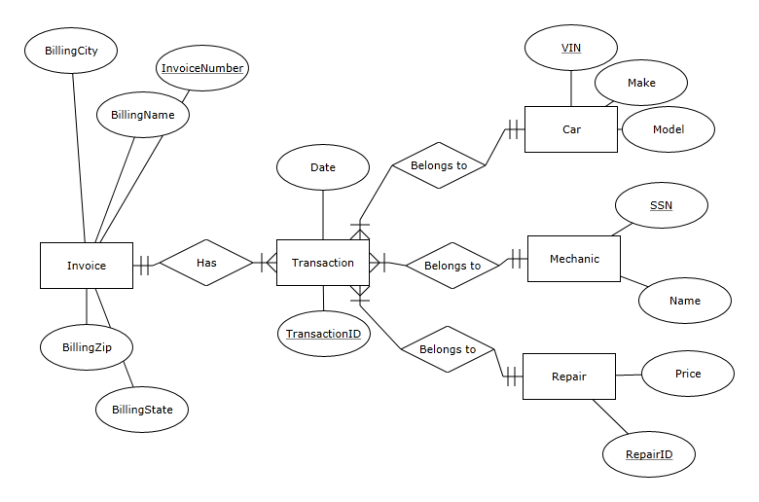
Solution

