Slide 1
MIS5101: Business Intelligence Outcomes Measurement and Data Quality
Sunil Wattal

Slide 2
Data Quality
The degree to which the data reflects the actual environment.
Do we have the right data?
Is the collection process reliable?
Is the data accurate?

Slide 3
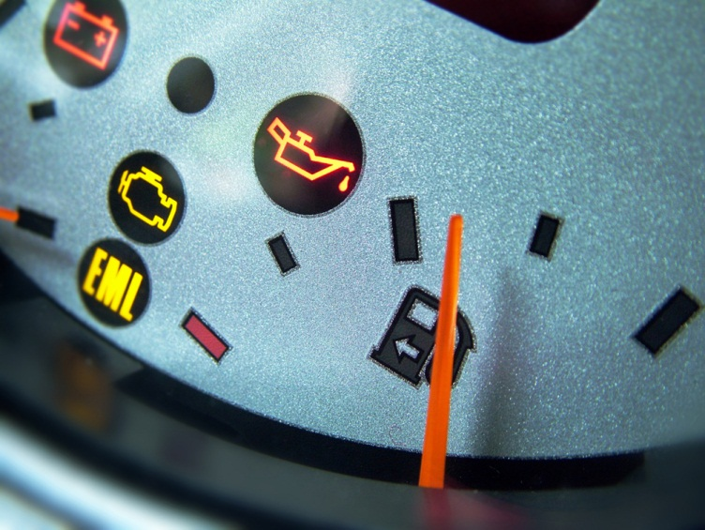
Finding the right data
Consistent with goals of the analysis
Measures what it claims to measure
Include analysts during data selection
Key
Performance
Indicator
?
Adapted from http://www2.ed.gov/about/offices/list/os/technology/plan/2004/ site/docs_and_pdf/Data_Quality_Audits_from_ESP_Solutions_Group.pdf

Slide 4
KPI Criteria: SMART
Specific purpose for the business
Measurable
Achievable by the organization
Relevant to success
Time-phased
What do these have in common?

Slide 5
Ensuring accuracy
Know where the data comes from
Manual verification through sampling
Use of knowledge experts
Verify calculations for derived measures
How do these impact the balance with access?
Adapted from http://www2.ed.gov/about/offices/list/os/technology/plan/2004/ site/docs_and_pdf/Data_Quality_Audits_from_ESP_Solutions_Group.pdf

Slide 6
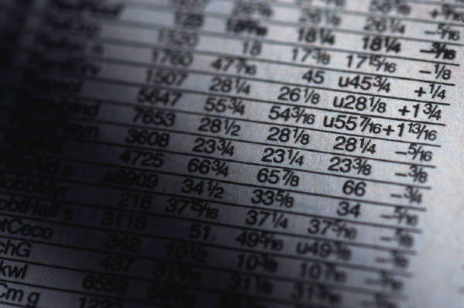
Reliability of the collection process
Build fault tolerance into the process
Check logs (if you can)
Periodically run reports and verify results
Keep up with (and communicate) changes
What can you do when you find an error after collection has begun?
Adapted from http://www2.ed.gov/about/offices/list/os/technology/plan/2004/ site/docs_and_pdf/Data_Quality_Audits_from_ESP_Solutions_Group.pdf

Slide 7
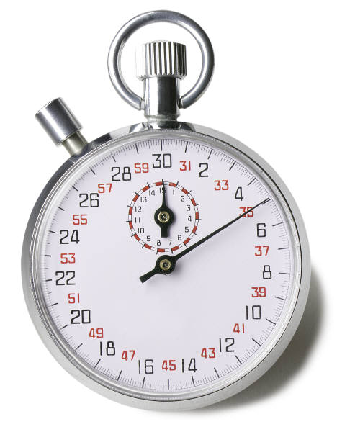
Evaluating System Usability
What are some good KPIs? Why are they good?
Why doesn’t everyone rigorously measure usability?
What are the benefits of compound metrics?
Are goal-based comparisons better than expert-based comparisons?

