Slide 1
MIS5101: Business Intelligence Data-Driven Management
Sunil Wattal

Slide 2
What is scientific management?
How are the topics we’ve discussed so far in this course consistent with scientific management?

Slide 3
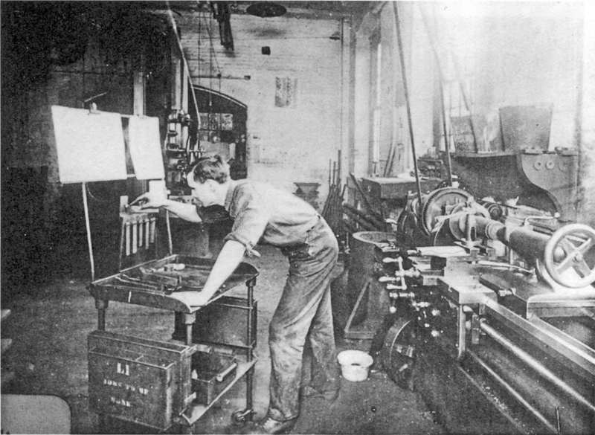
Does the proliferation of information technology make “scientific management” more or less relevant?
Source: Wikipedia (http://en.wikipedia.org/wiki/File:Musterarbeitsplatz.png)

Slide 4
Efficacy
Effectiveness
Efficiency
Intervention
Evidence-Based Decision-Making
Role of KPIs
Domains?
Marley, J. 2000. Efficacy, Effectiveness, Efficiency. Australian Prescriber. Vol. 23, No. 6, pp. 114-115.

Slide 5
Why might employees object?
In management consulting?
In healthcare?
So what should you do as a manager?

